Slide 1



Supportive Housing Assessment and Acuity Index Upload into HMIS

Slide 2
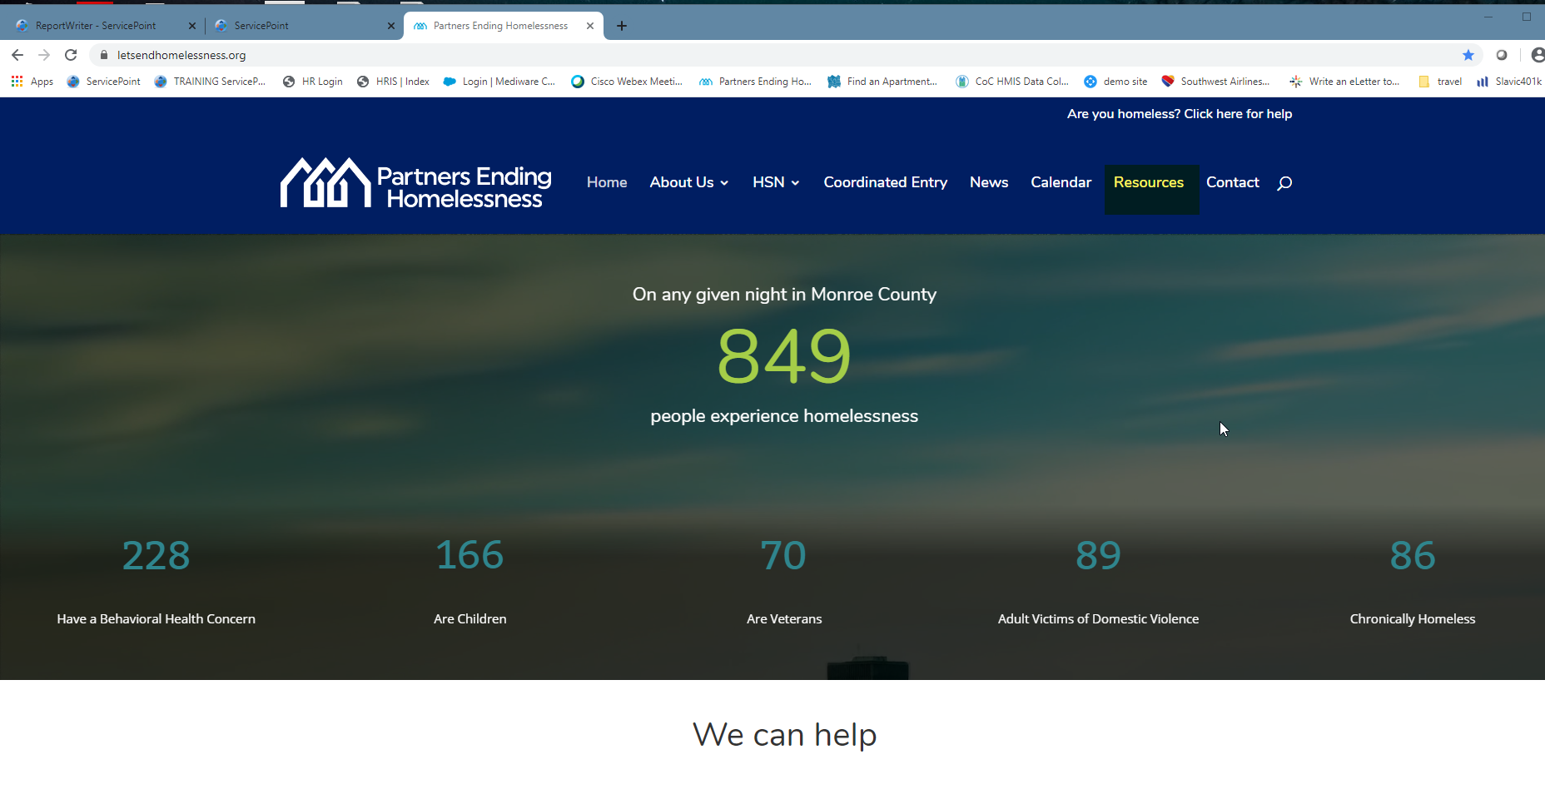
Go to our web site, then the resources tab

Slide 3
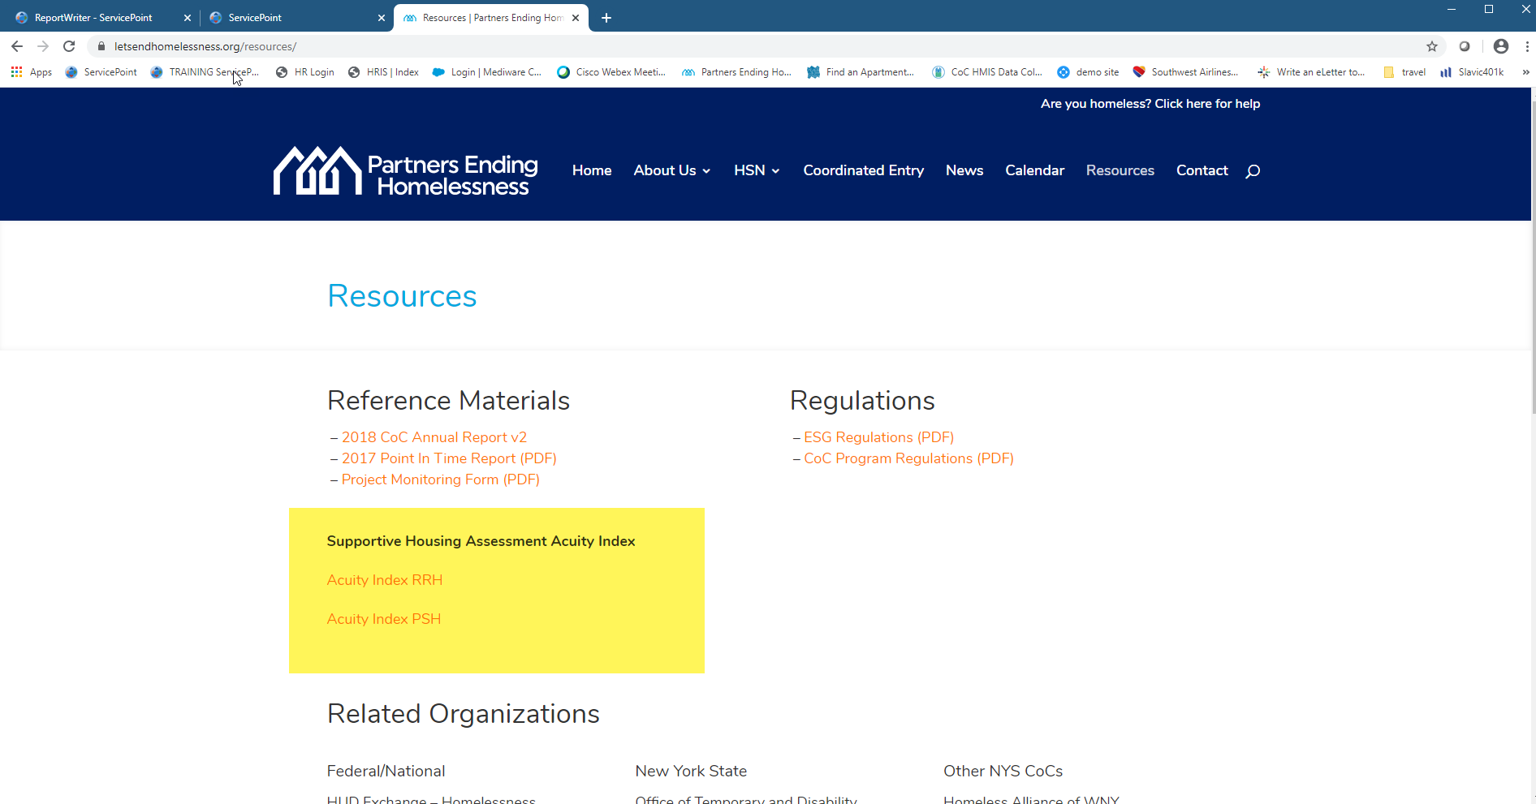
Go to Acuity Index

Slide 4
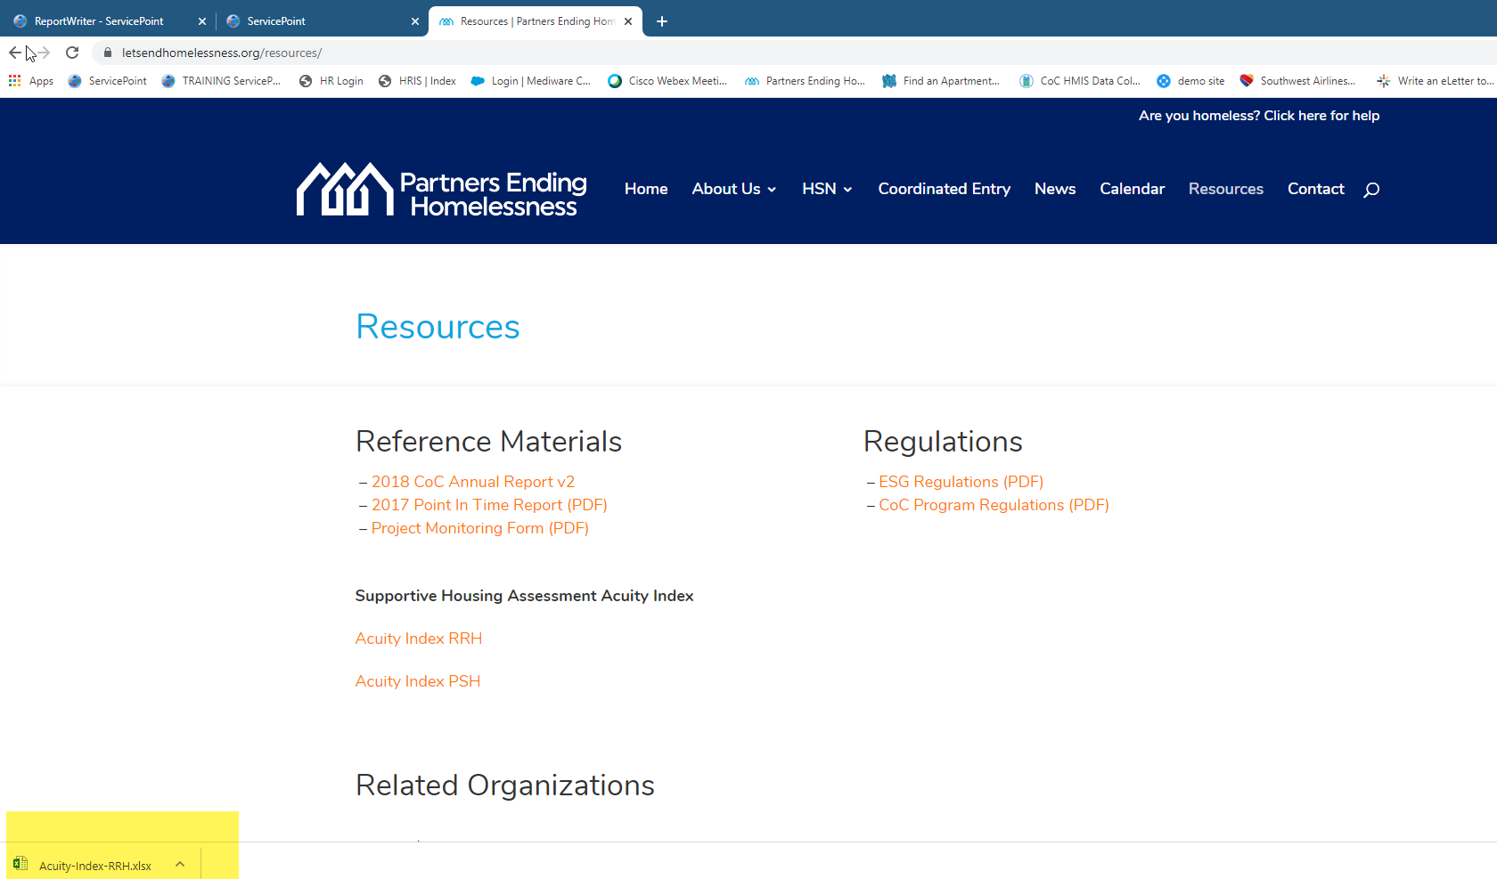
This will open the excel sheet

Slide 5
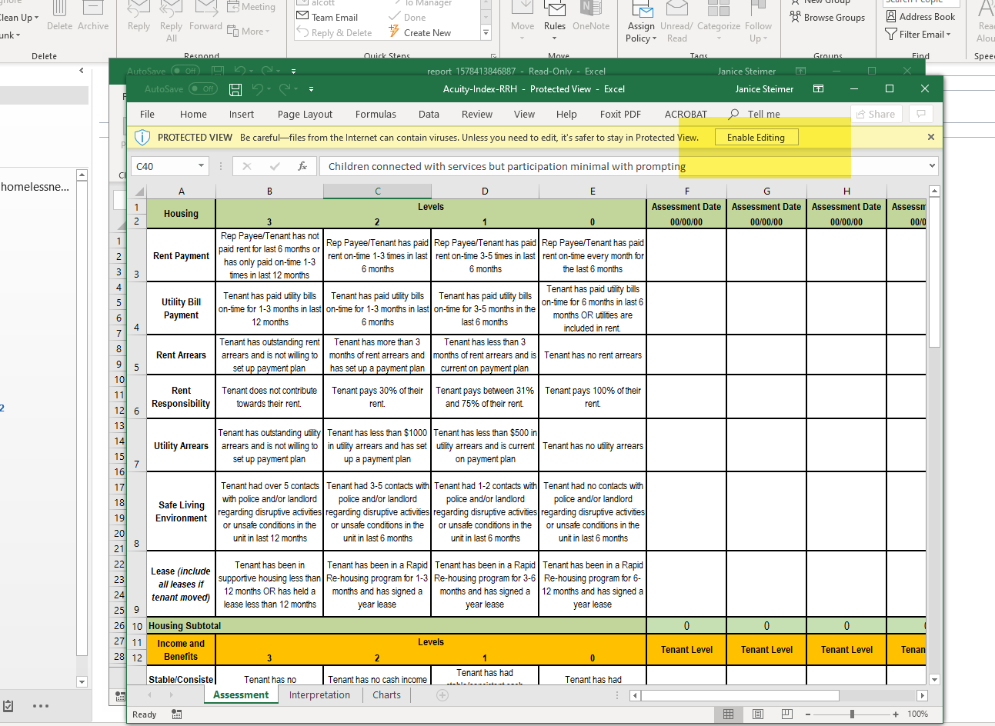
Enable editing

Slide 6
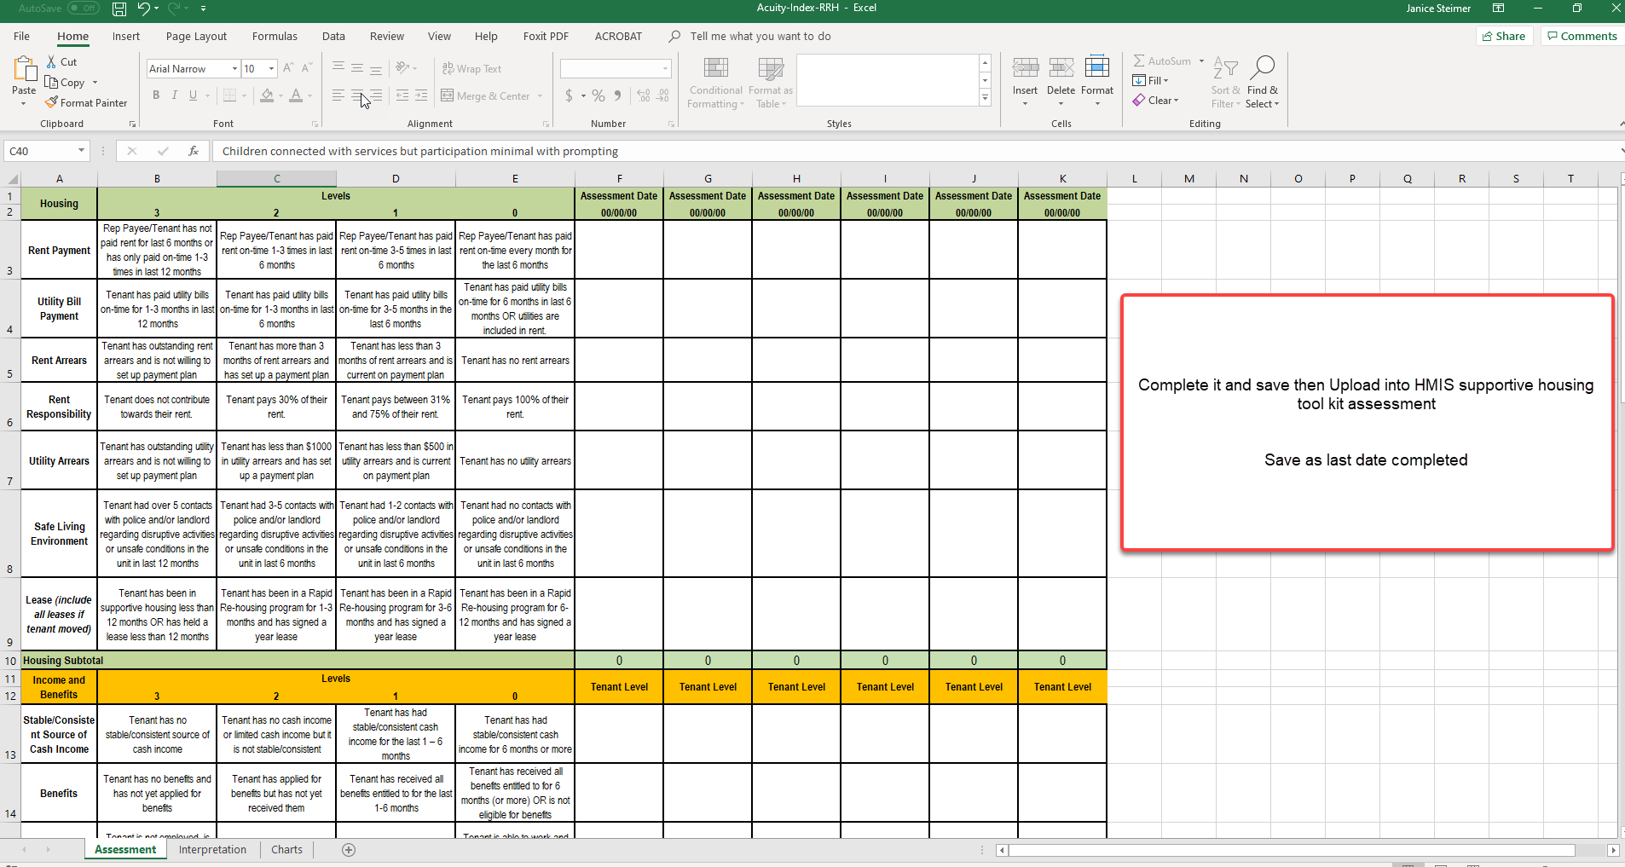
Use the next column open and enter the date completing for “save as” each time for the date you are currently working on. This will give you a running history

Slide 7
After saving your Acuity Index
go to the ClientPoint in HMIS
and continue as described next pages to attach the Acuity Index and complete the
Supportive Assessment

Slide 8
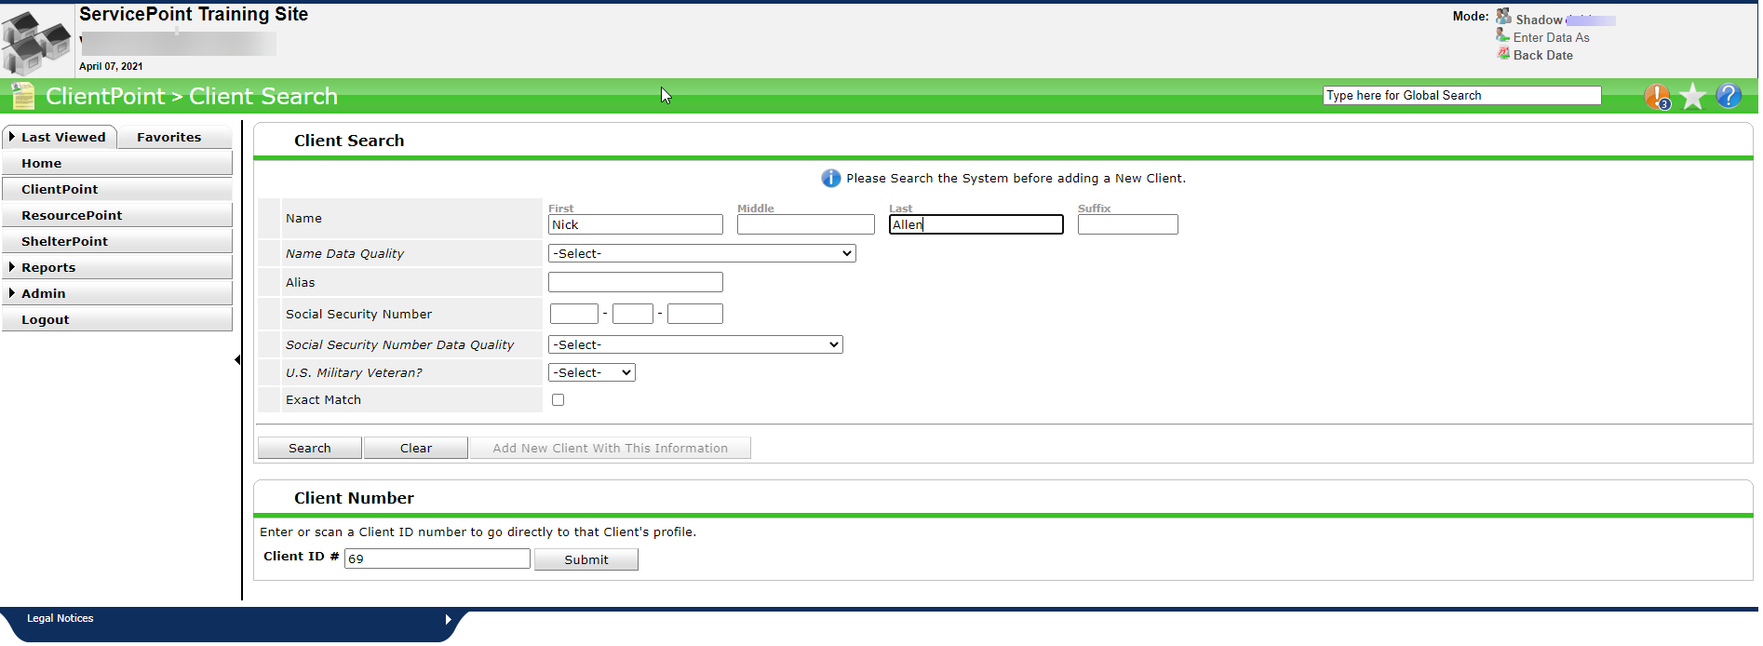
As with any Assessment the first step is to open the Client record.
Do this with the Client ID # or search the name.

Slide 9
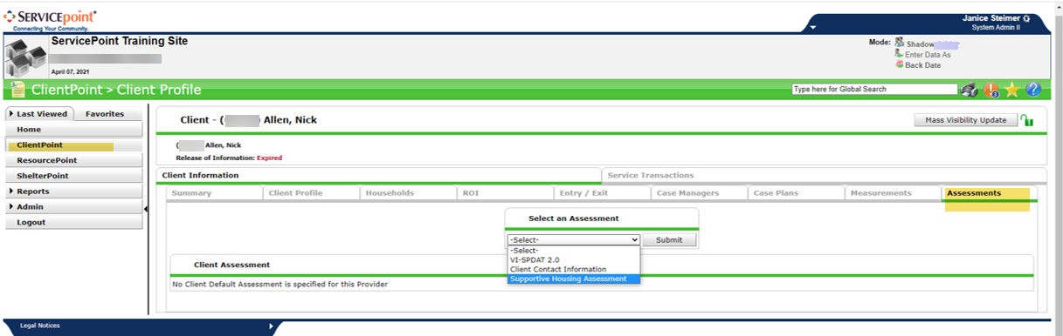
From here click on the Assessments Tab
At the select Assessment choose “Supportive Housing Assessment”

Slide 10
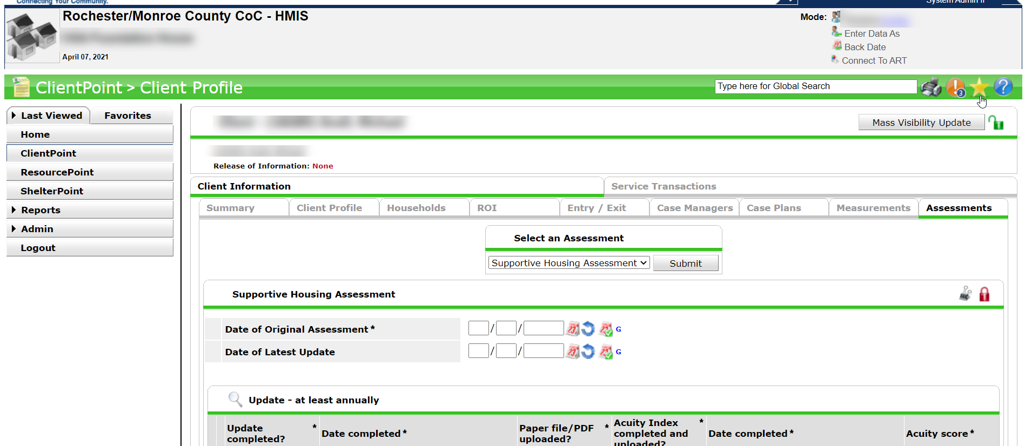
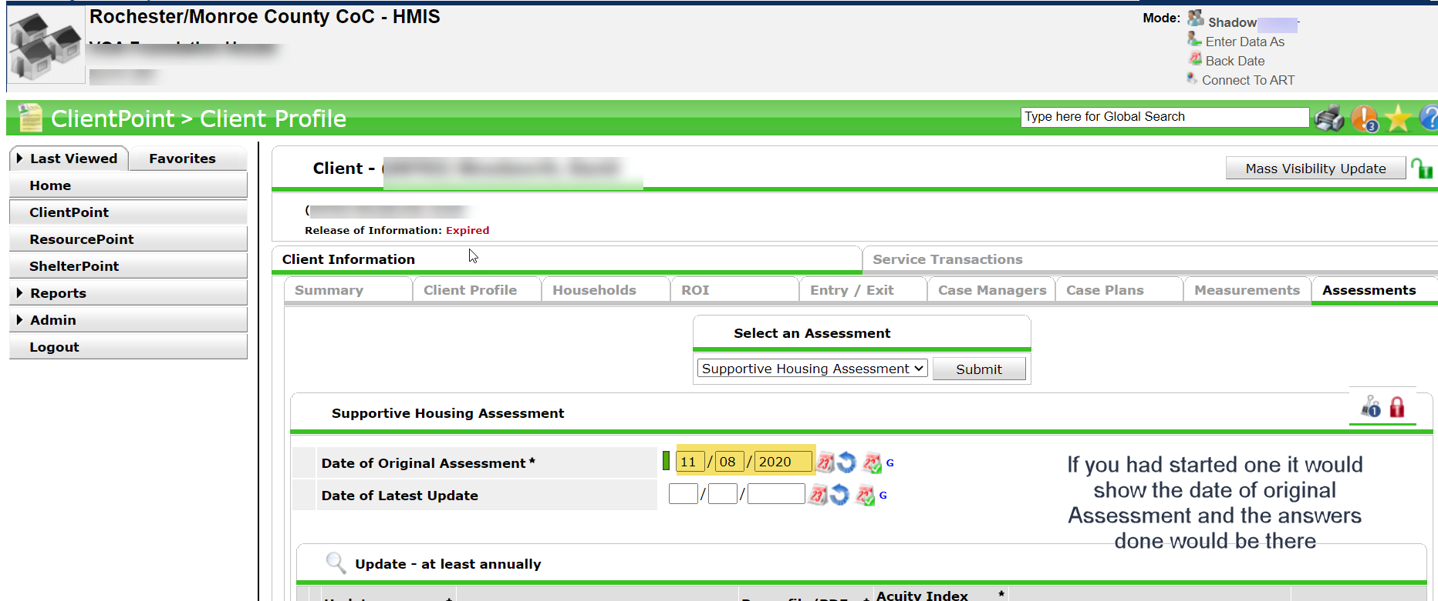

This will open-up the assessment.
Upload your Acuity-Index file to the Binder Clip.
You do a new one at least once a year and attach it to the assessment.
The Binder clip will show how many Acuity files are uploaded by the number showing

Slide 11
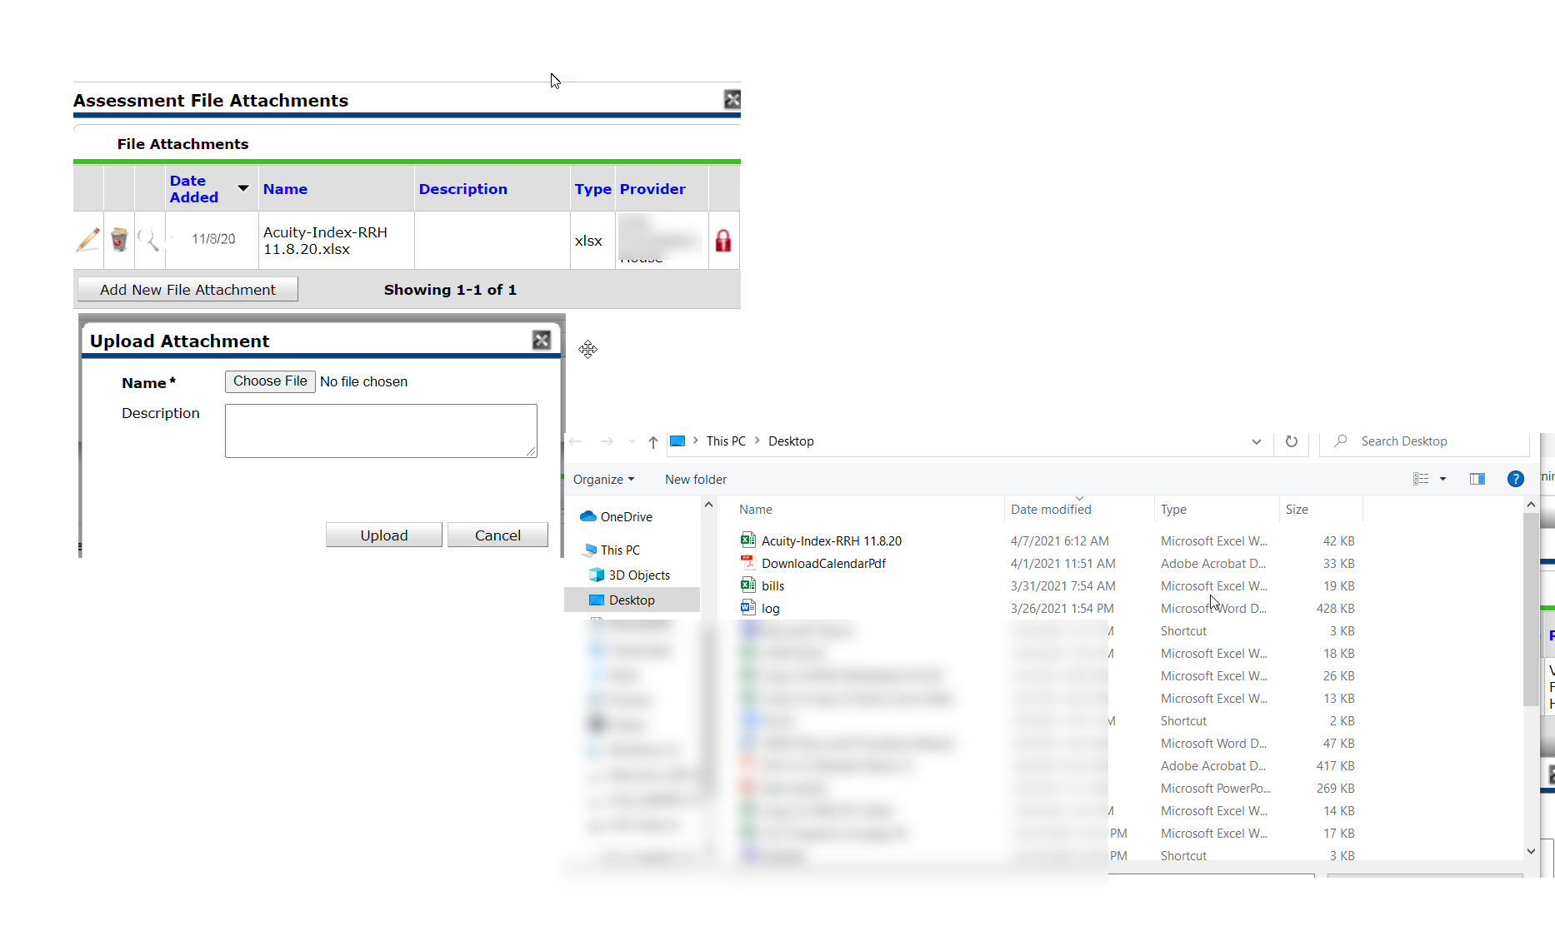
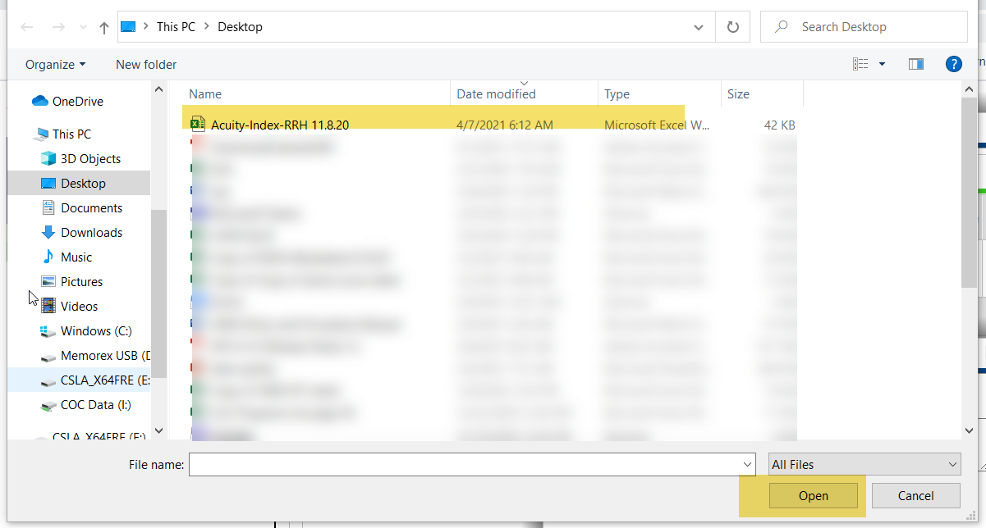
When you Click on the Binder Clip it will open a pop up.
You will see any previous uploads and will click on “Add New File Attachment” to add a new one.
When you do a pop up will open for you to choose a file.
Then your computer will open your folders, choose where you saves the Acuity file and open then upload

Slide 12
New
In Progress
Once you upload your Acuity
If this is your first time in the assessment it will be blank. Enter today’s date for Original Assessment .
IF THIS IS NOT THE FIRST TIME LEAVE THE ORGINAL DATE IN THERE AND JUST FILL IN THE LASTEST UPDATE
Once you upload your new Acuity
Leave the original date
Enter today’s date under updating.

Slide 13
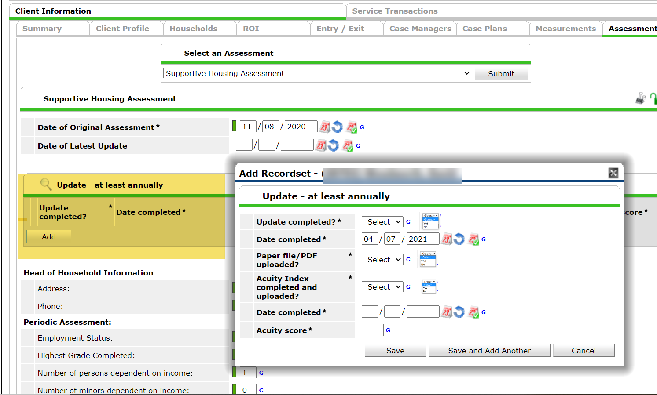
You then MUST do this step!
Hit the Add button and then the pop up will open.
Answer all the questions and save
Do this every time you update the assessment This is the date stamp for HMIS seeing it was done at least once a year as required..

Slide 14
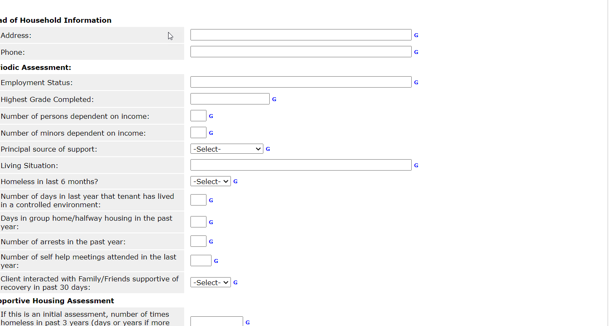
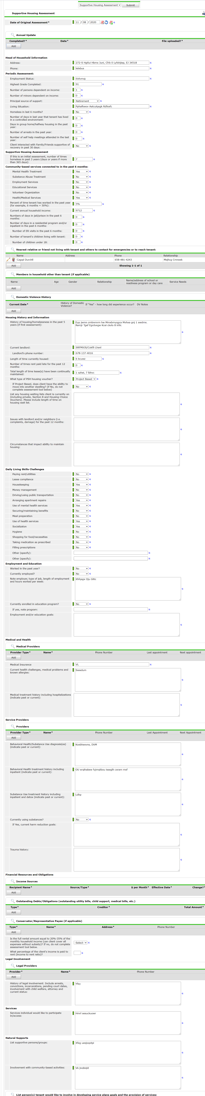
New
In Progress
Once you upload your Acuity and do the Annual update you are ready to fill out the assessment.
If this is your first time in the assessment it will be blank.
Just begin answering
REMEMBER TO SAVE AT THE END
. Once you upload your Acuity and do the Annual update you are ready to fill out the assessment
You will see the answers from the last time that it was opened.
Just update your answers
REMEMBER TO SAVE AT THE END

Slide 15
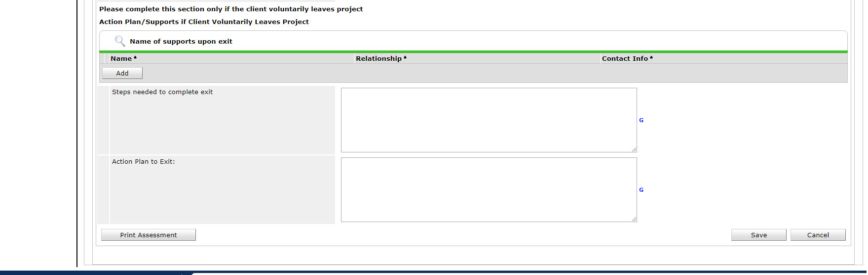

When you are done working on the Assessment it is very important that you go all the way to the bottom of the assessment and click on the save button to lock in your current answers
Once you hit save nothing will happen ,just return to the summary Tab or go to the ClientPoint .

Slide 16
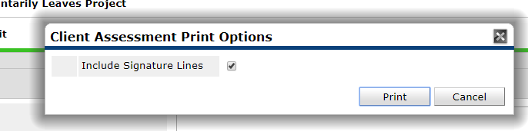
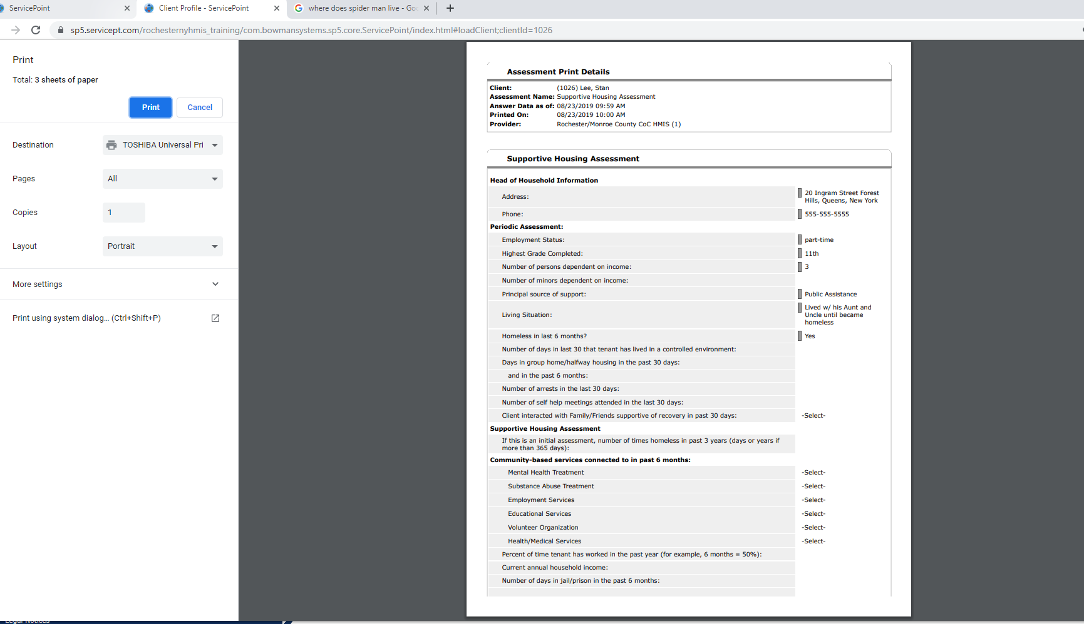
If you would like to print out the Assessment click on the Print Assessment tab.
You will get a pop-up asking if you want the Signature Lines then hit print
This will open your printer’s utility pop-up to print.

Slide 17
FAQ
You do not need to complete the whole Assessment at one time, you may go in and out whenever you need or want to.
You only need to fill in what is applicable but if you enter a sub-assessment that has an *asterisk, then you must complete the information for that section.
When you hit the save button you will not be directed to another screen, you must return to the ClientPoint tab or Summary Tab etc.
The Assessment will not save a version and start a new version like the VI-SPDAT this is just an open on-going assessment that when information changes you type over each and every time.
You must do the Acuity once a year and upload it to the binder clip in the Supportive Housing Assessment. Not the Client Profile
Put in the date of latest update date in the assessment and do the Update “ADD” button
You must update the Supportive Housing Assessment once a year and do the “Add button” for the update in the assessment to show the updated dates

