Slide 1
Homelessness in Monroe County Annual Report October 2017 – September 2018

Slide 2
Introduction
This report provides an overview of homelessness in Monroe County for the time period: 10/1/2107 – 09/30/2018. The time period selected is the federal fiscal year and is the same time period that HUD requires CoCs to submit annual reports. The report includes data from organizations that participate in the Homeless Management Information System (HMIS).
Permanent Supportive Housing and Rapid ReHousing programs are also included in this report – they are the largest component of the CoC funded projects. However, permanent housing program participants are not included in the homeless numbers that follow.

Slide 3
Unduplicated Number of Homeless
The number of programs participating in HMIS has increased over the years. There are only three emergency shelters, and two transitional housing programs who do not enter data into HMIS. Willow Domestic Violence Center is not allowed to participate in HMIS by statute.
Therefore, the unduplicated number of homeless using just HMIS does represent somewhat of an undercount of homeless persons. Assuming that the shelter beds in non-HMIS participating programs have similar utilization rates and taking into account that is fairly common for homeless persons to be in more than one program in a year, the CoC is able to estimate a total unduplicated count of 6,191 persons.

Slide 4
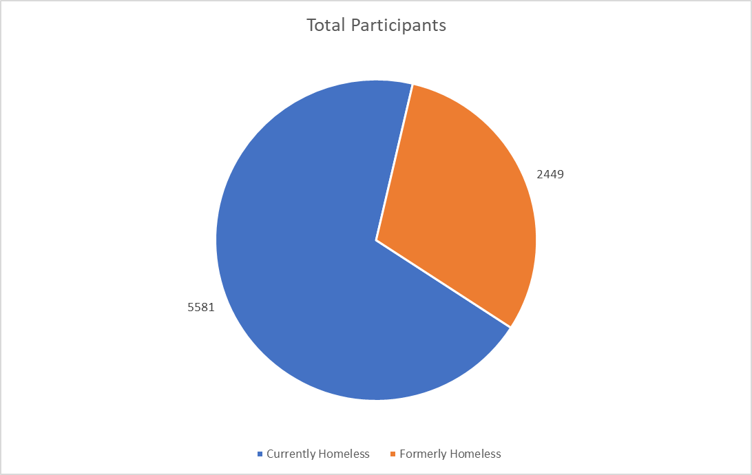
HMIS - Unduplicated Number of Homeless
5,581 unduplicated persons experienced homelessness for at least one night
2,449 persons received continuing services after moving into permanent housing
Persons who went to supported housing are represented in both slices of the graph.

Slide 5
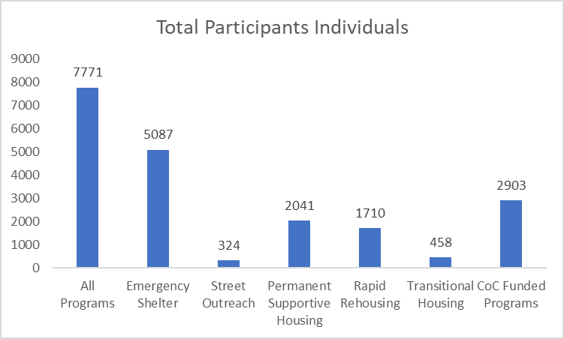
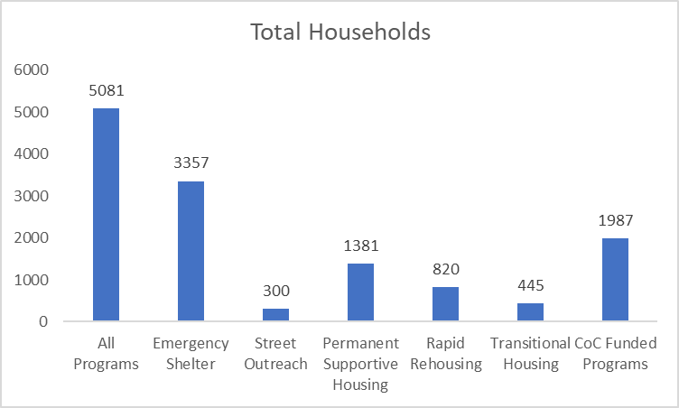
Persons Served by Program Type
Homeless services programs served 7,771 persons in 5,081 Households.
CoC Funded Programs served 2,903 persons in 1,987 Households.

Slide 6
System Flow
The following Sankey Diagram shows how participants journey through the system.
Numbers of persons are de-duplicated within program type.
If participant utilized more than one type they are counted in each type

Slide 7
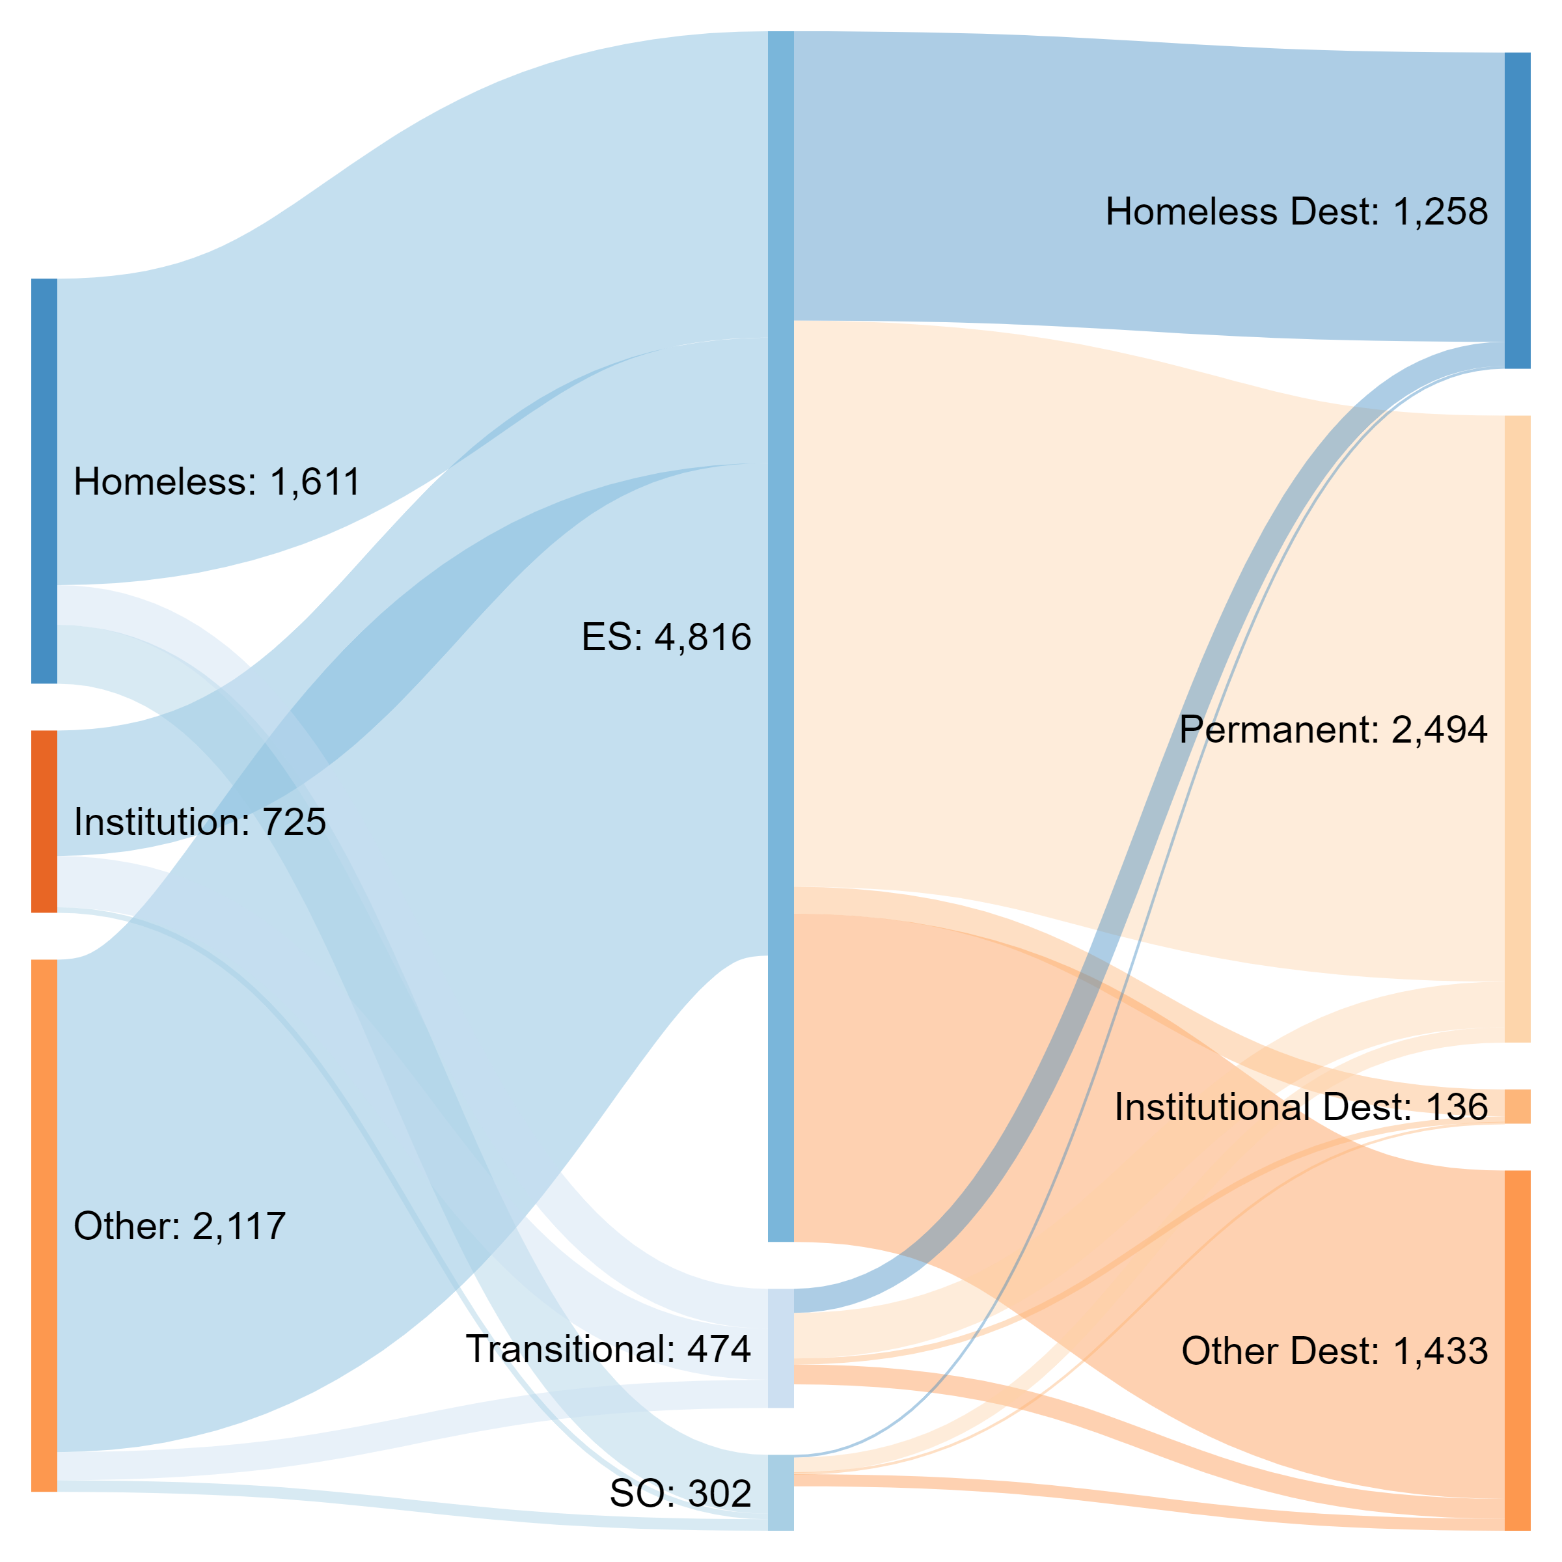
Previous Living Situation
Entry Into Homeless Services
Exit Destination
Notes:
Data is de-duplicated within service type

Slide 8
Households Served on an Average Night
Average night utilization was calculated by taking the average utilization across four point-in-time dates
On an average night, 1,711 Households are receiving services
267 Households are in Emergency Shelters
On an average night, 1,347 Households are receiving services from CoC funded programs
1,144 of these Households are being served in Permanent Supportive Housing Programs
312 of these Households are being served by Rapid Rehousing Programs
112 of these Households are being served by Transitional Housing

Slide 9
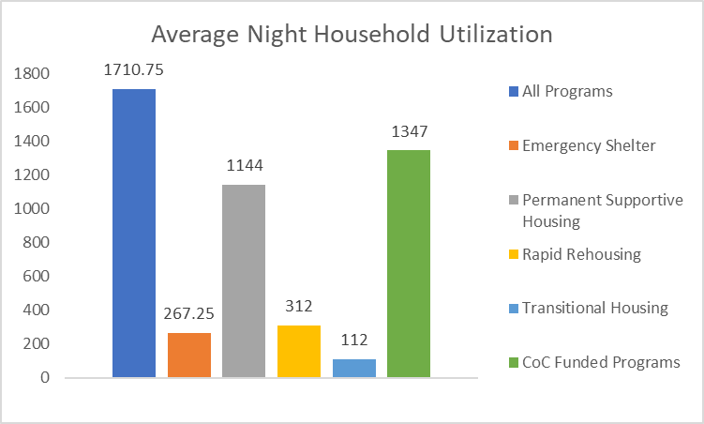
Households Served on an Average Night

Slide 10
Length of Stay in Programs
The average length of stay at Emergency Shelters was 25.4 days
The average length of stay in Transitional Housing is 107.9 days (approximately 3.5 months)
The average length of stay in Rapid Rehousing is 221.7 days (approximately 7.2 months)
The average length of stay in Permanent Supportive Housing is 1,600.2 days (approximately 4.4 years)
Across all programs, the average length of stay was 466.2 days

Slide 11
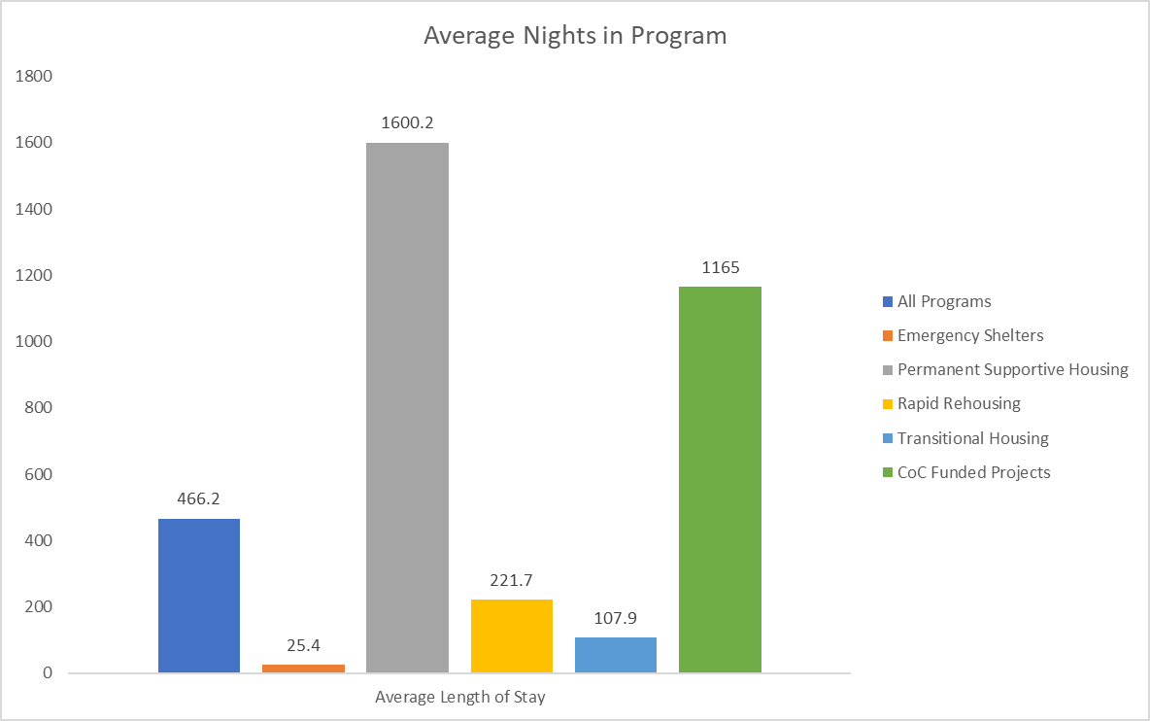
Length of Stay in Programs

Slide 12
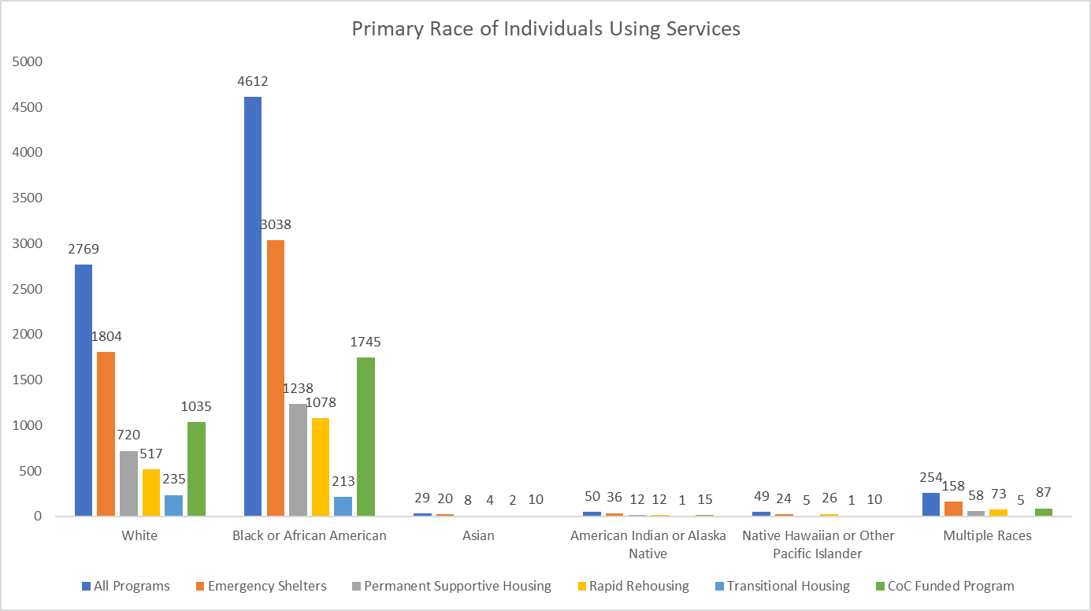
Participant Demographics: Race

Slide 13
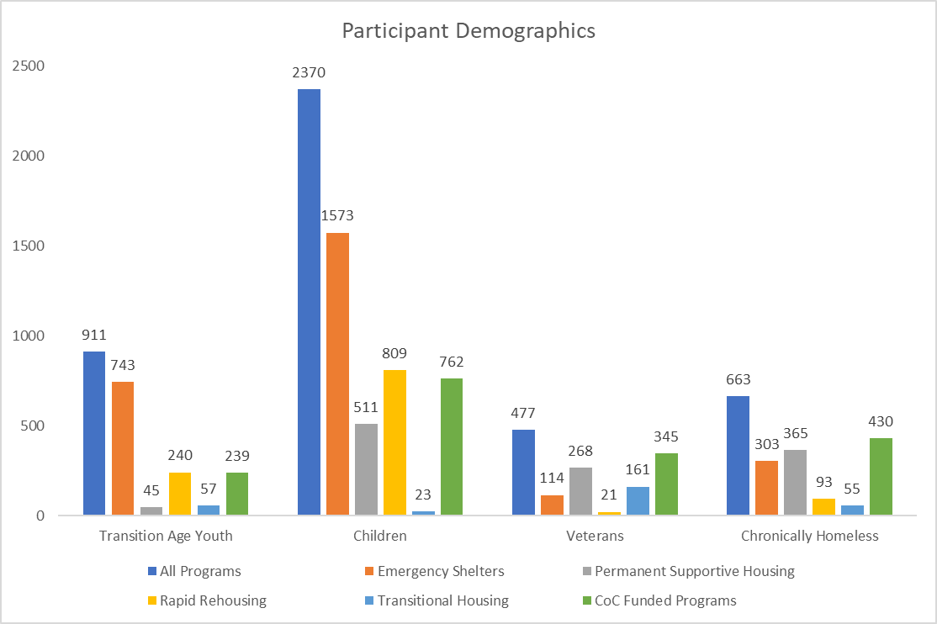
Participant Demographics: Sub-Population

Slide 14
Disability
Participation in Permanent Supportive Housing requires a HUD-defined disability which significantly impacts an individual’s ability to obtain and maintain housing
Only one member of the household is required to have a disability
Most homeless persons do not have a disability (4,618 persons)
The next most common number of disabilities is 3 or more (1,161 persons)
28.5% of Permanent Supportive Housing participants live with 3 or more disabilities

Slide 15
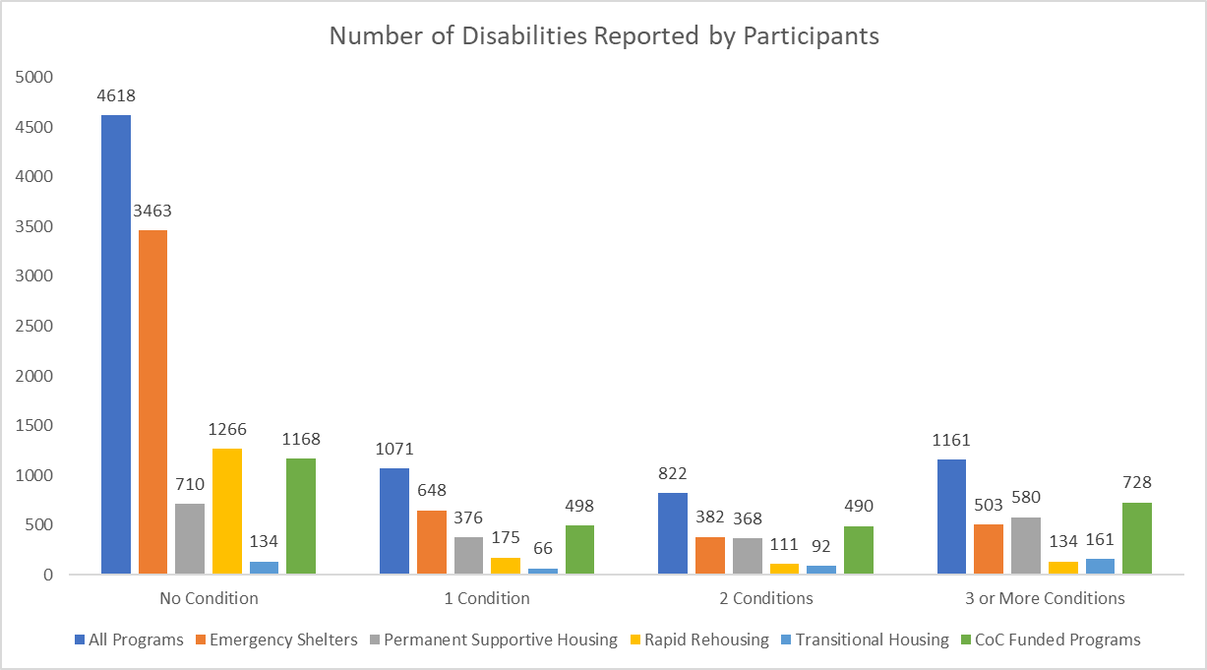
Program Participants - Disabilities

Slide 16
Exit Destination of Program Participants
5,016 persons exited HMIS-participating programs
48.6% Exited to Permanent Housing Destinations
533 persons exited Permanent Supportive Housing
80% Exited to Permanent Housing Destinations
791 persons exited Rapid Rehousing
58.7% Exited to Permanent Housing Destinations
332 persons Exited Transitional Housing
49% Exited to Permanent Housing Destinations

Slide 17
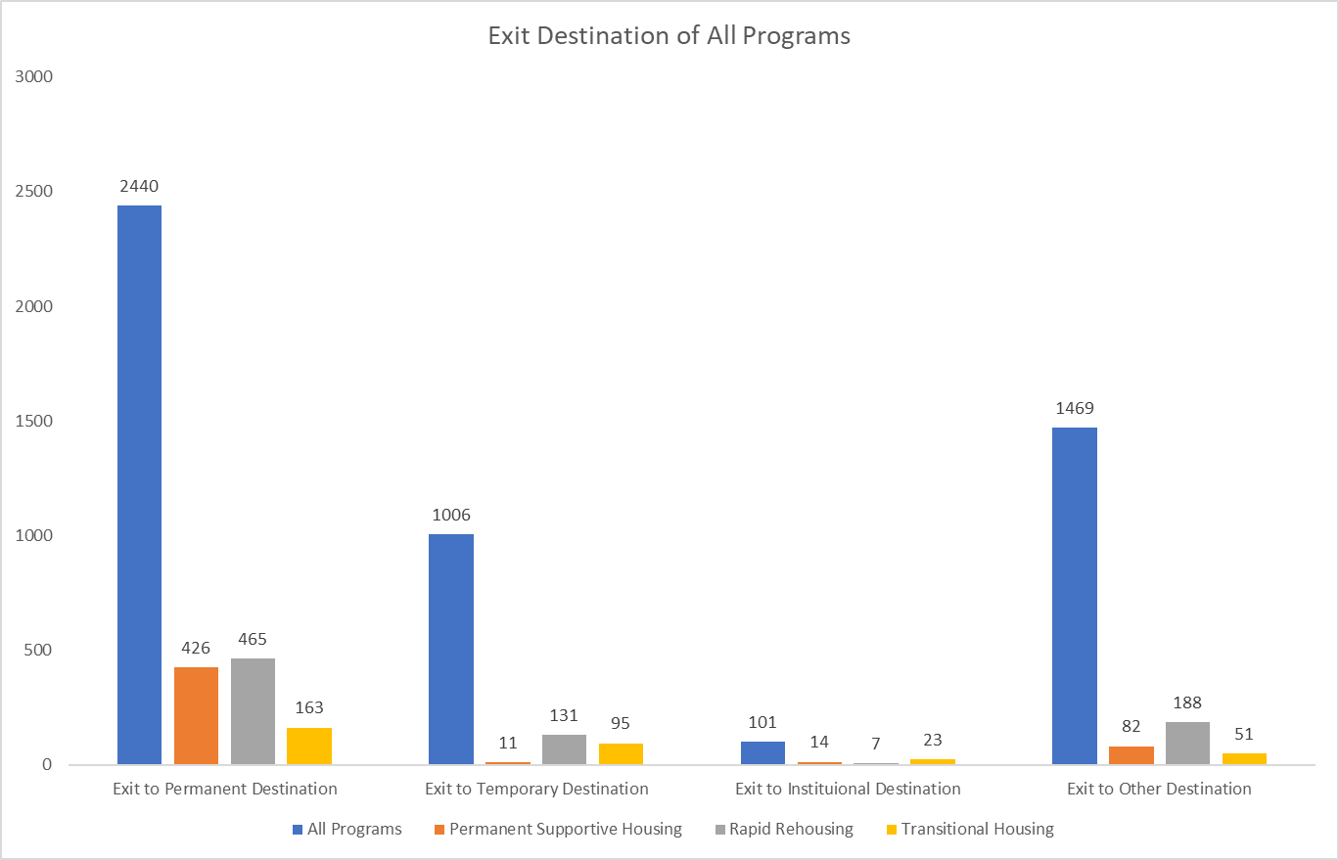
Destination of Program Participants

Slide 18
Emergency Housing (EH) Programs

Slide 19
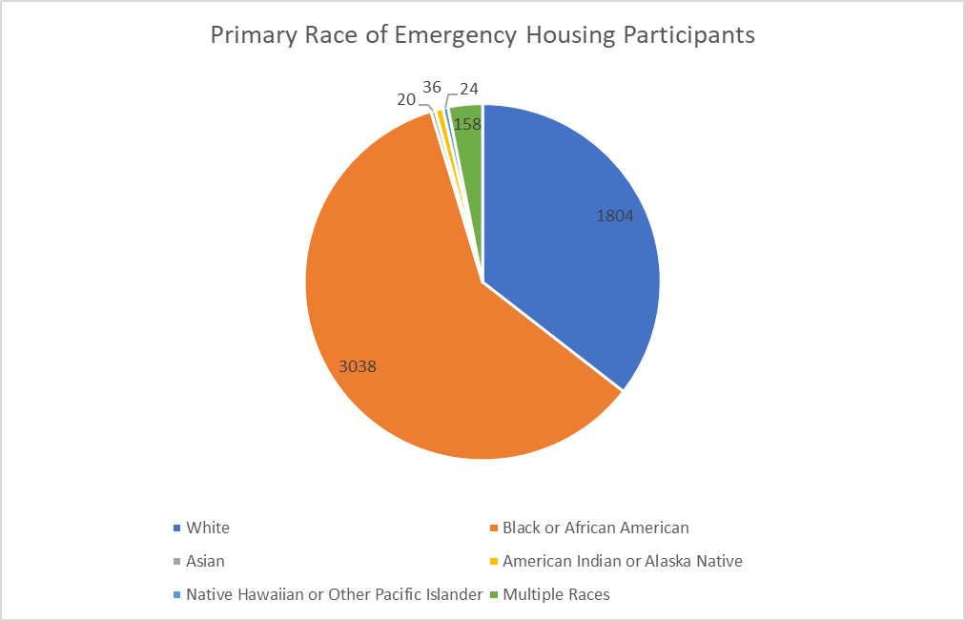
Primary Race of EH Participants

Slide 20
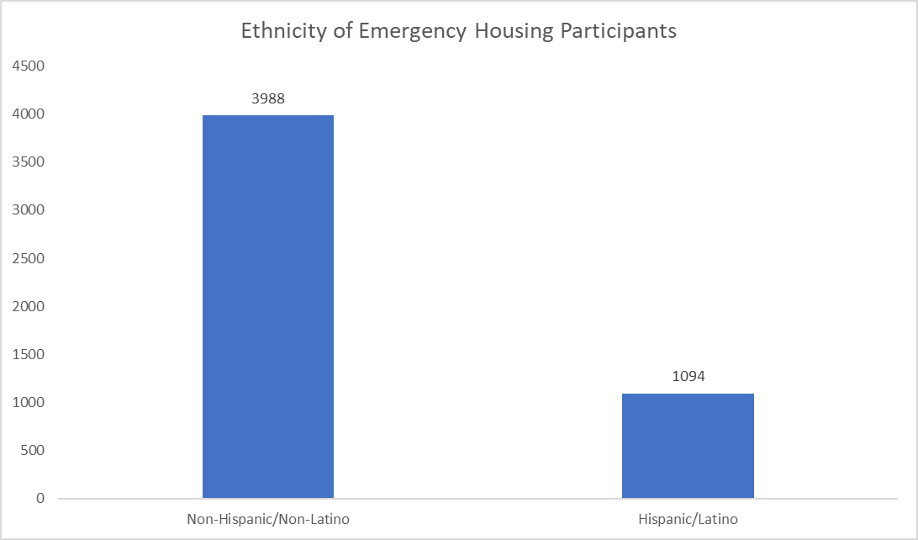
Ethnicity of Emergency Housing Participants

Slide 21
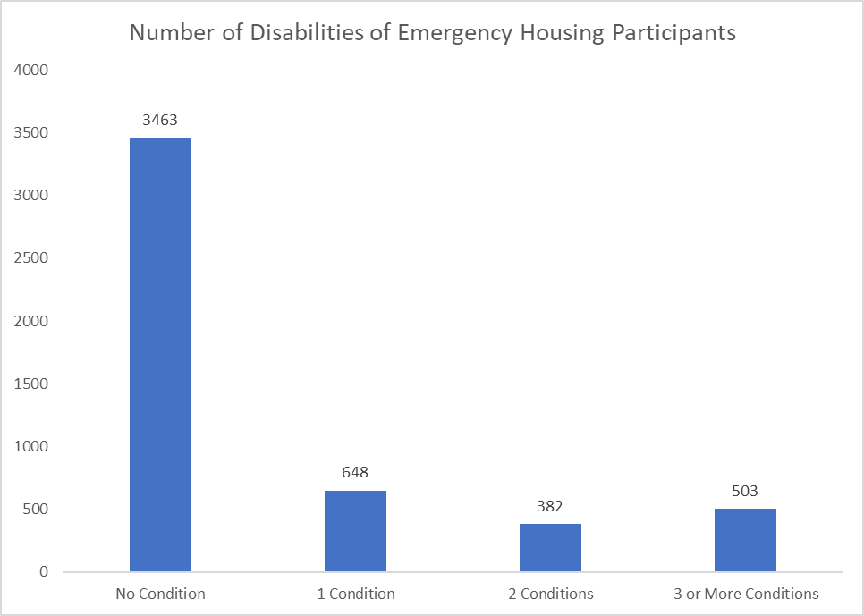
Number of Disabilities of EH Participants

Slide 22
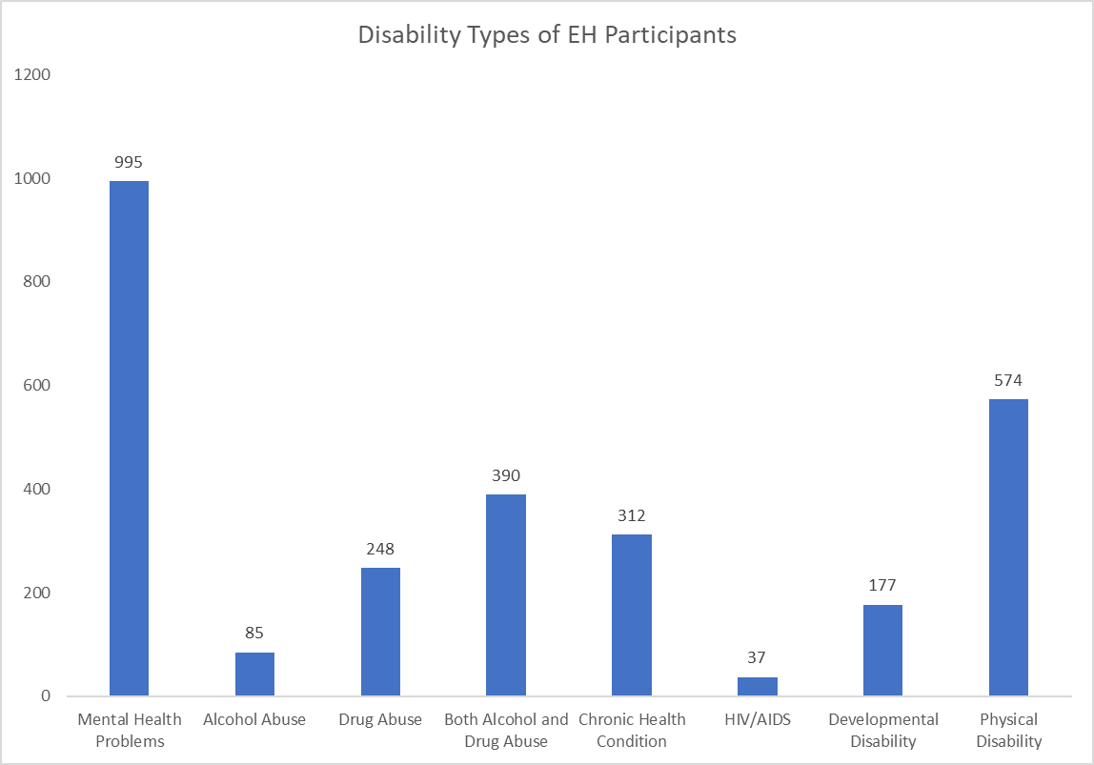
Disability Types of EH Participants

Slide 23
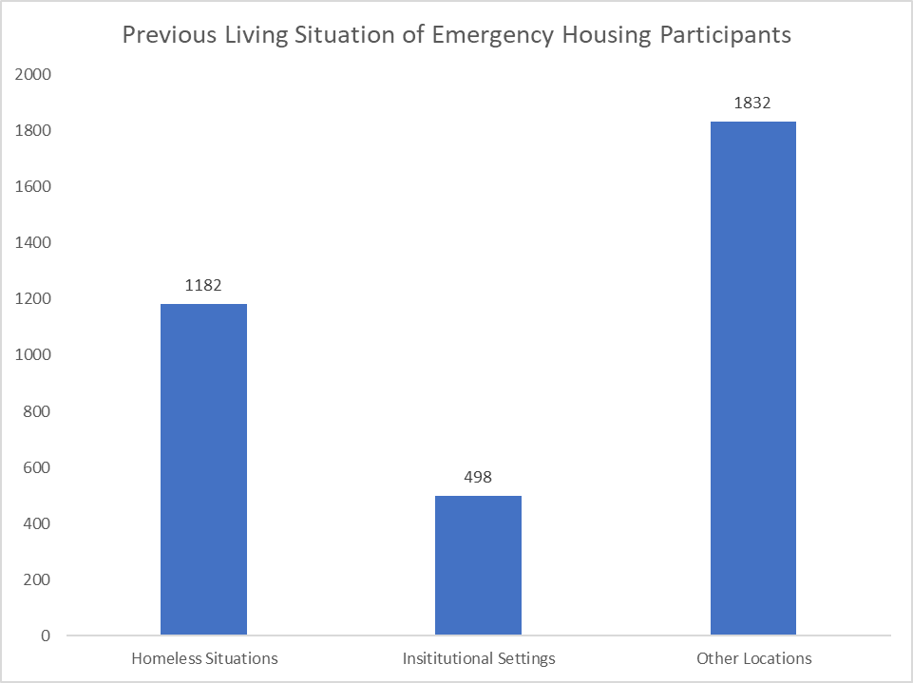
Previous Living Situation of EH Participants

Slide 24
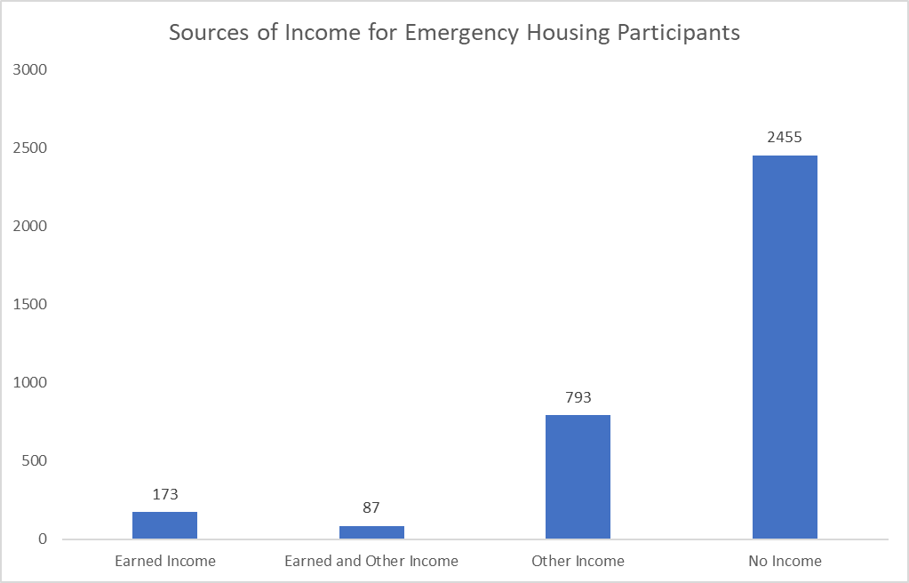
Sources of Income for EH Participants

Slide 25
Exit Destination of EH Participants
4,467 Participants exited Emergency Housing Programs
23% Exited to Temporary Destinations
2% Exited to Institutional Destinations
29% Exited to Other Destinations
47% Exited to Permanent Destinations

Slide 26
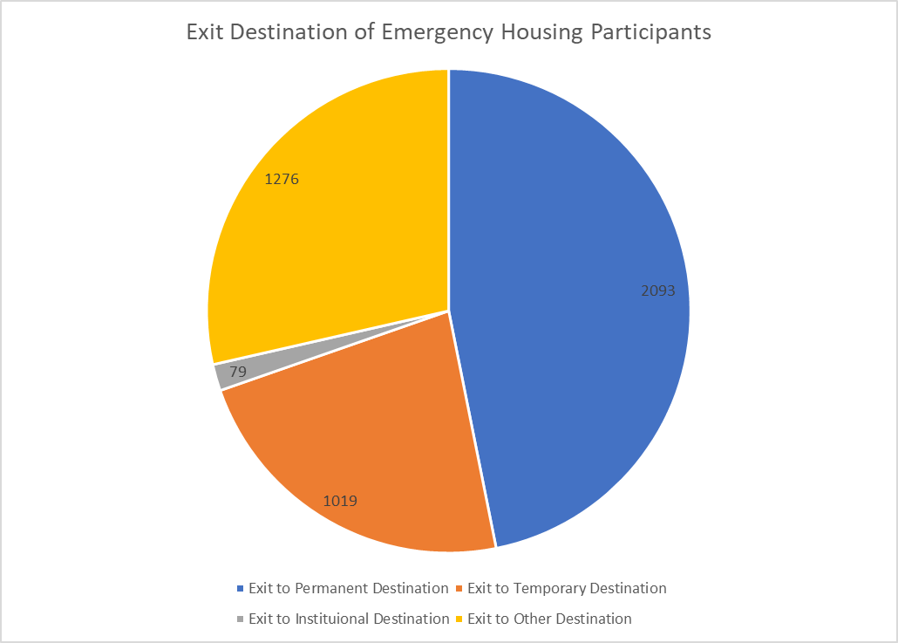
Exit Destination of EH Participants

Slide 27
Transitional Housing (TH) Programs

Slide 28
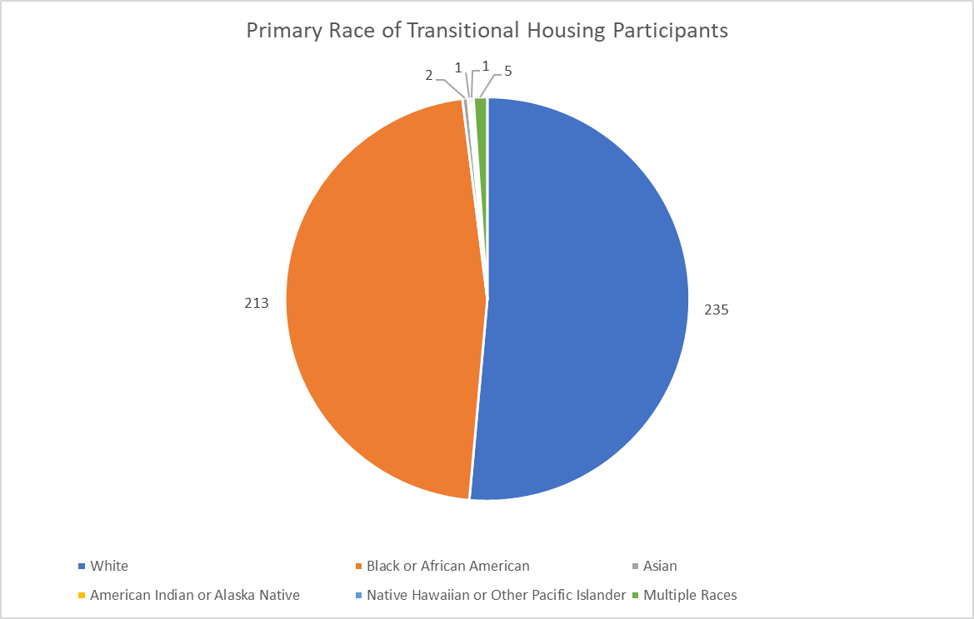
Primary Race of TH Participants

Slide 29
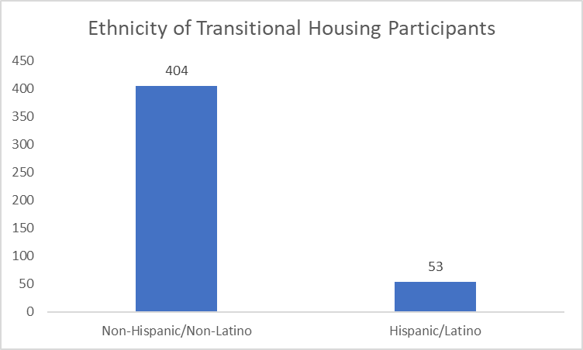
Ethnicity of TH Participants

Slide 30
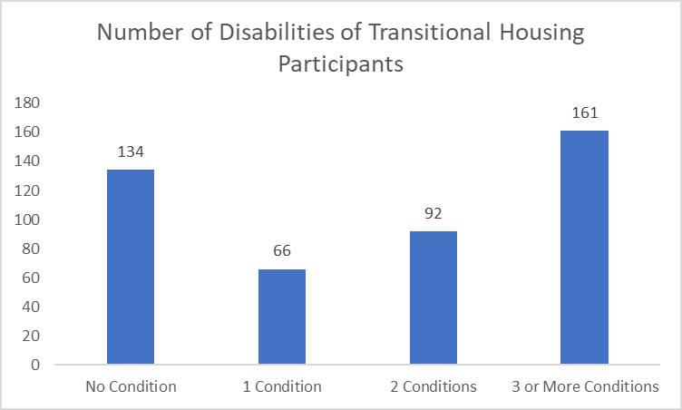
Number of Disabilities of TH Participants

Slide 31
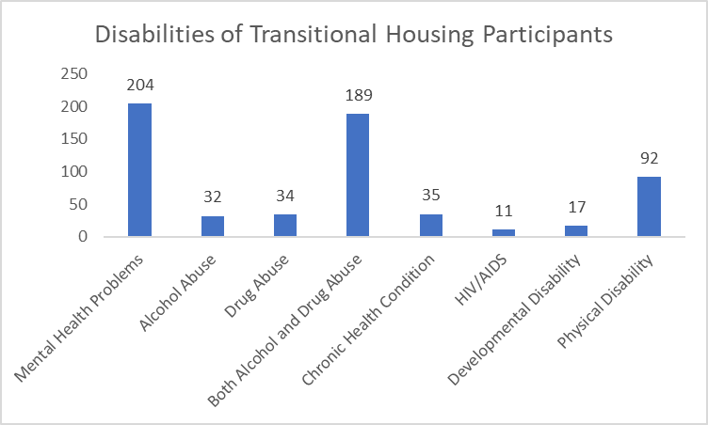
Disability Types of TH Participants

Slide 32
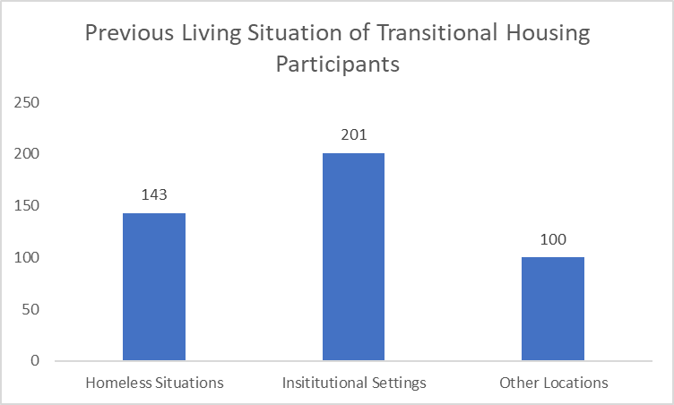
Previous Living Situation of TH Participants

Slide 33
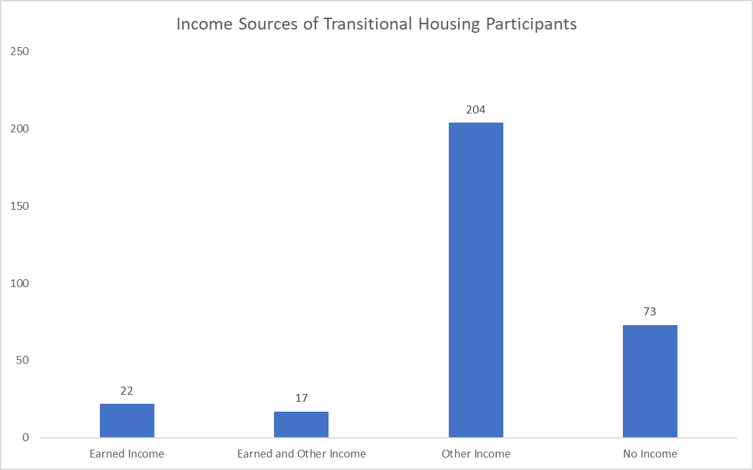
Sources of Income for TH Participants

Slide 34
Exit Destination of TH Participants
332 Participants exited Transitional Housing Programs
28.6% Exited to Temporary Destinations
7% Exited to Institutional Destinations
15% Exited to Other Destinations
49% Exited to Permanent Destinations

Slide 35
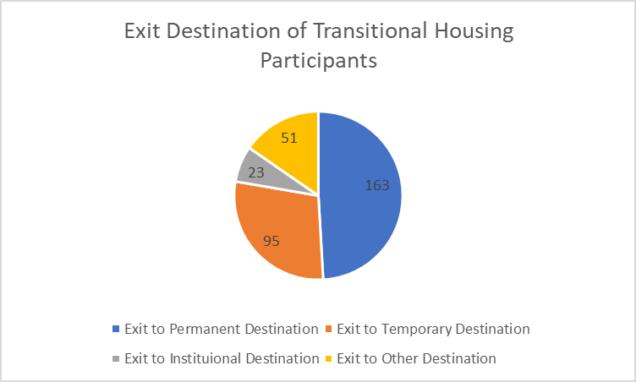
Exit Destination of TH Participants

Slide 36
Rapid ReHousing Programs (RRH)

Slide 37
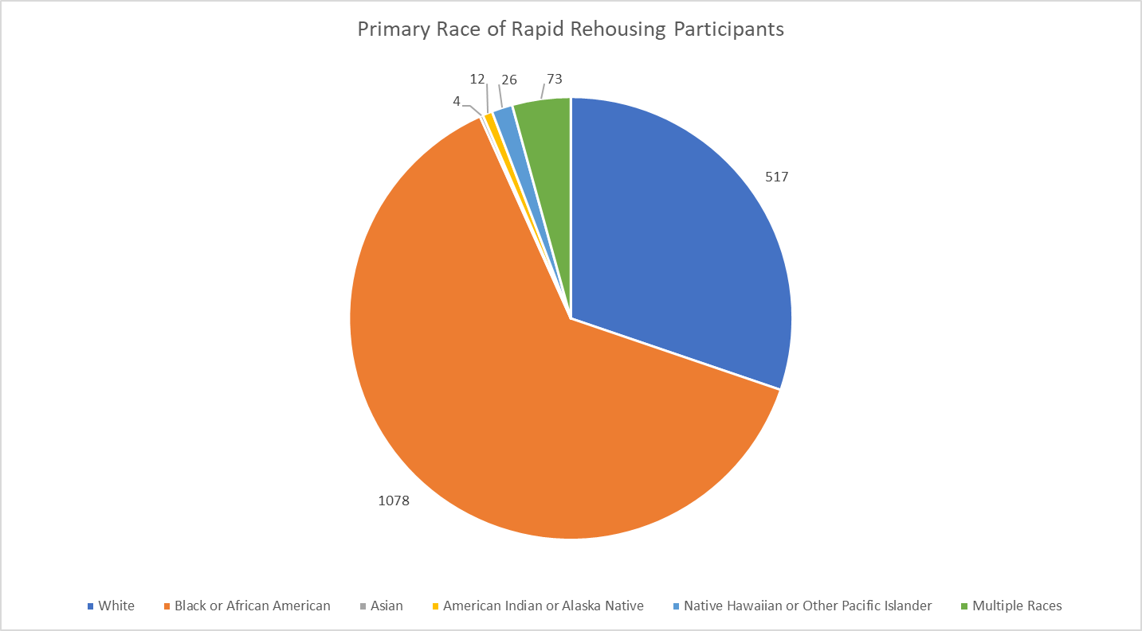
Primary Race of RRH Participants

Slide 38
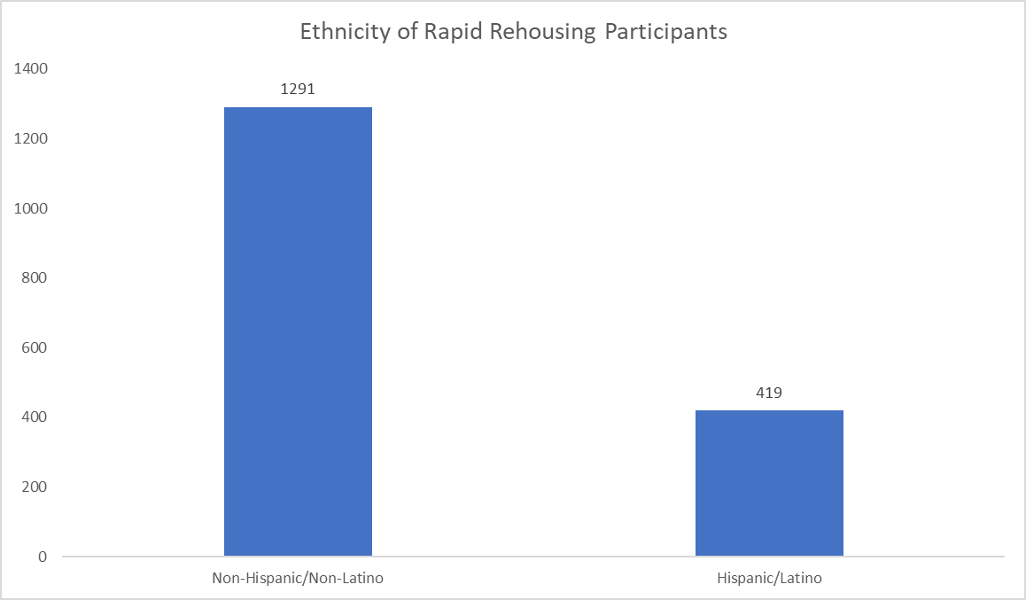
Ethnicity of RRH Participants

Slide 39
Number of Disabilities of RRH Participants
1,686 persons participated in Rapid Rehousing Programs in FY 2017-2018
The majority of participants (75%) did not have a HUD-defined disability
10.4% of participants had 1 disability
6.6% of participants had 2 disabilities
7.9% had 3 or more disabilities

Slide 40
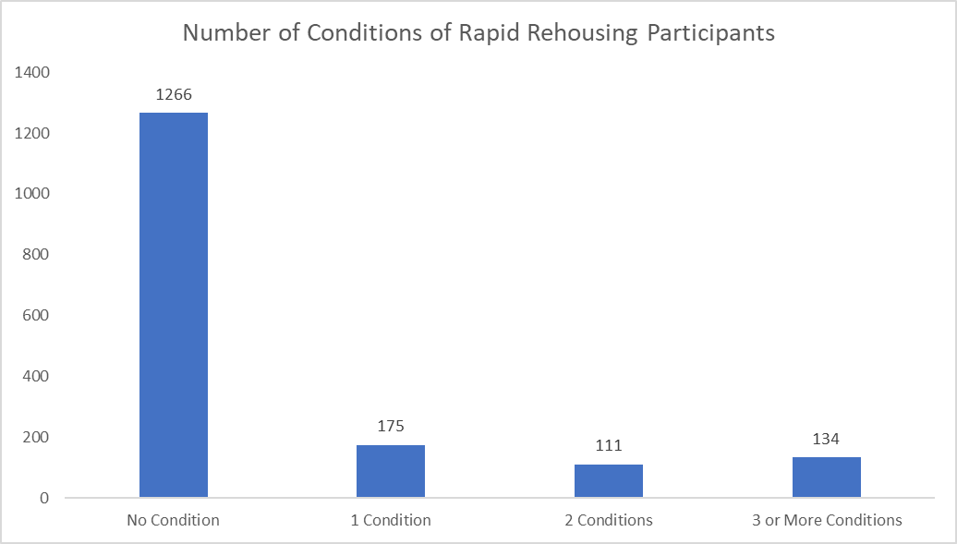
Number of Disabilities of RRH Participants

Slide 41
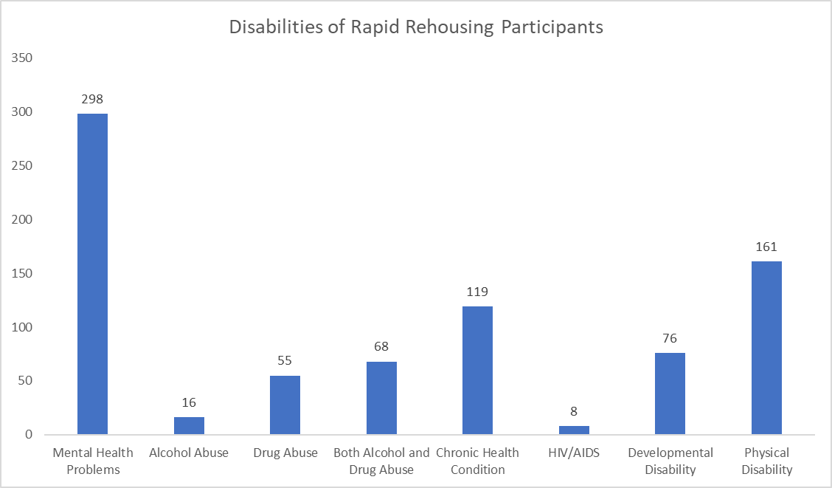
Disability Types of RRH Participants

Slide 42
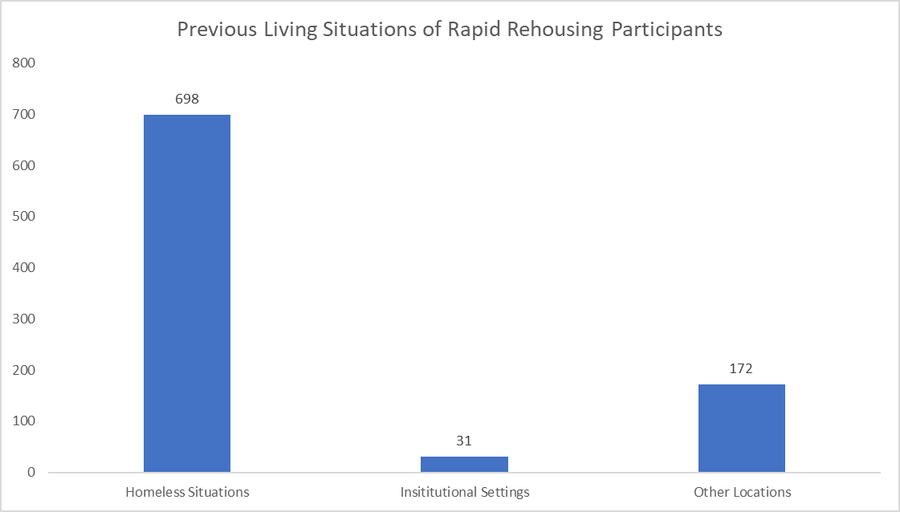
Previous Living Situation of RRH Participants

Slide 43
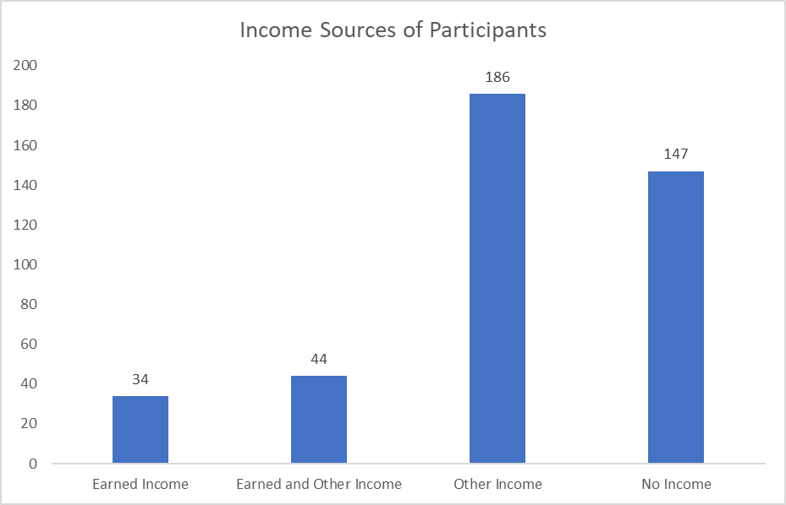
Sources of Income for RRH Participants

Slide 44
Exit Destinations of RRH Participants
791 persons exited RRH Programs
16.6% Exited to Temporary Destinations
1% Exited to Institutional Destinations
23.8% Exited to Other Destinations
58.7% Exited to Permanent Housing Destinations

Slide 45
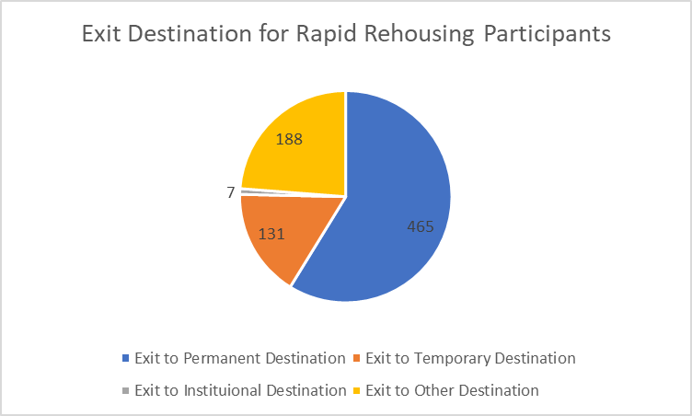
Exit Destination of RRH Participants

Slide 46
Permanent Supportive Housing (PSH) Programs

Slide 47
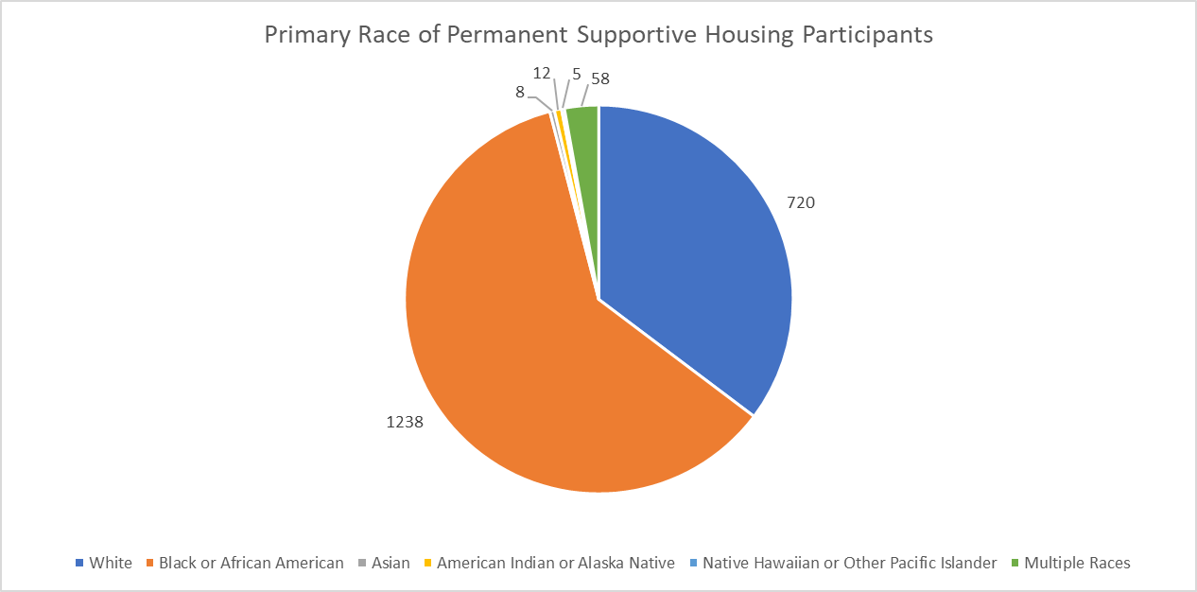
Primary Race of PSH Participants

Slide 48
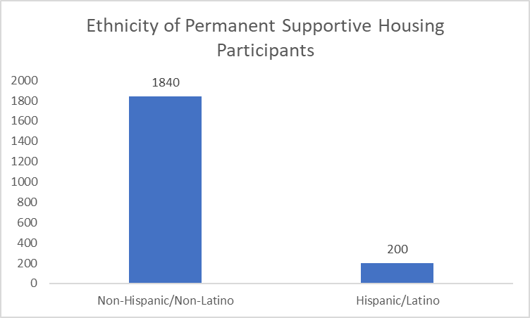
Ethnicity of PSH Participants

Slide 49
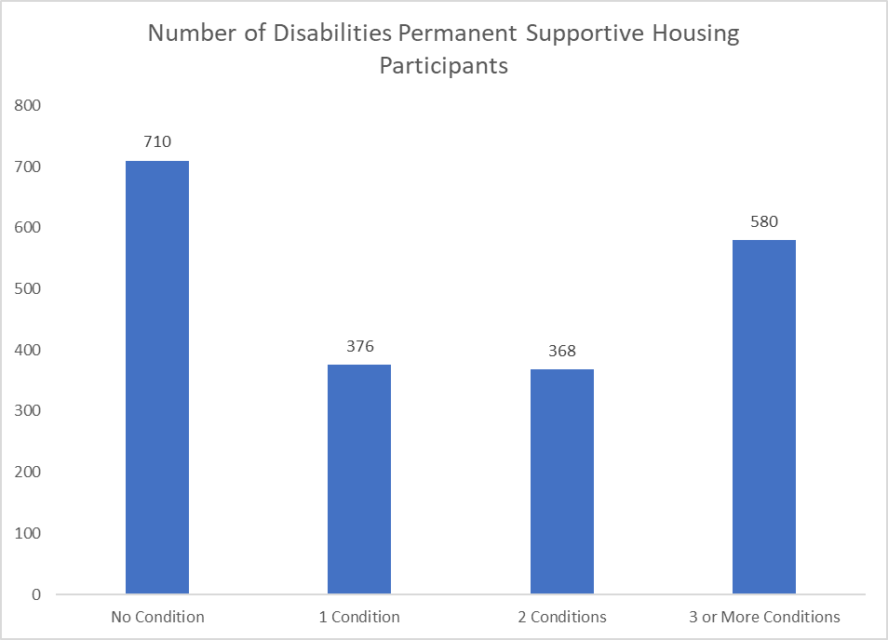
Number of Disabilities of PSH Participants (Note: The 710 participants with “No Condition” are predominantly children)

Slide 50
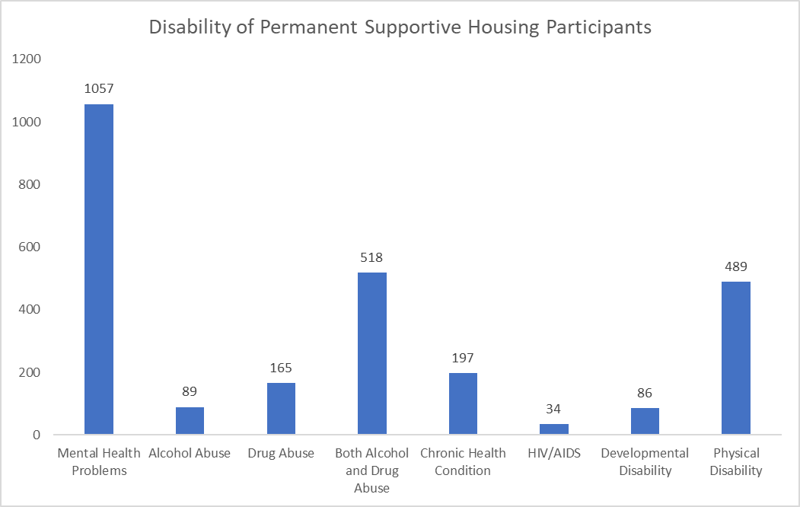
Disability Types of PSH Participants

Slide 51
Previous Living Situation of PSH Participants
68.4% of Permanent Supportive Housing Participants entered from a shelter or a place not meant for habitation
6.1% of Permanent Supportive Housing Participants entered from Institutional Settings
25.4% of Permanent Supportive Housing Participants entered from Other Locations

Slide 52
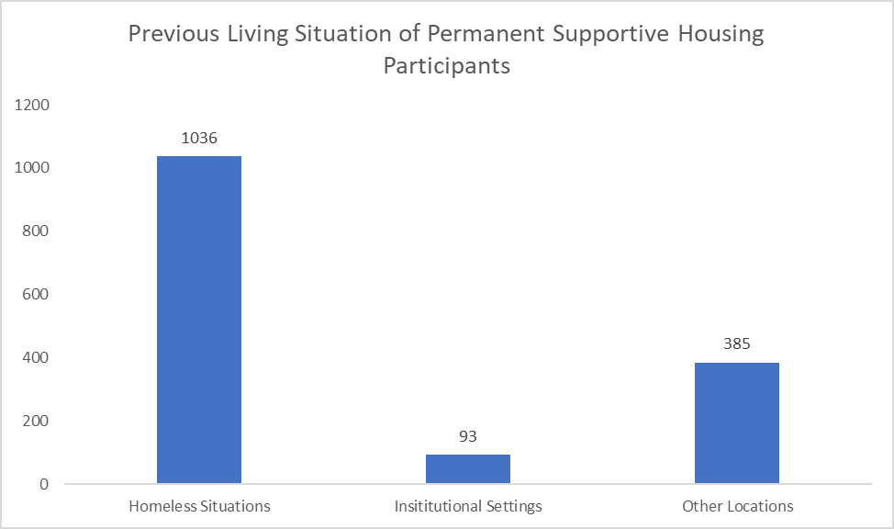
Previous Living Situation of PSH Participants

Slide 53
Income Sources of PSH Participants
81.2% of Households in PSH have some form of income
The most common form of income is non-employment income only, which 57.6% of households have
12.7% of households have both employment and non-employment sources of income
5.1% of households have only employment income

Slide 54
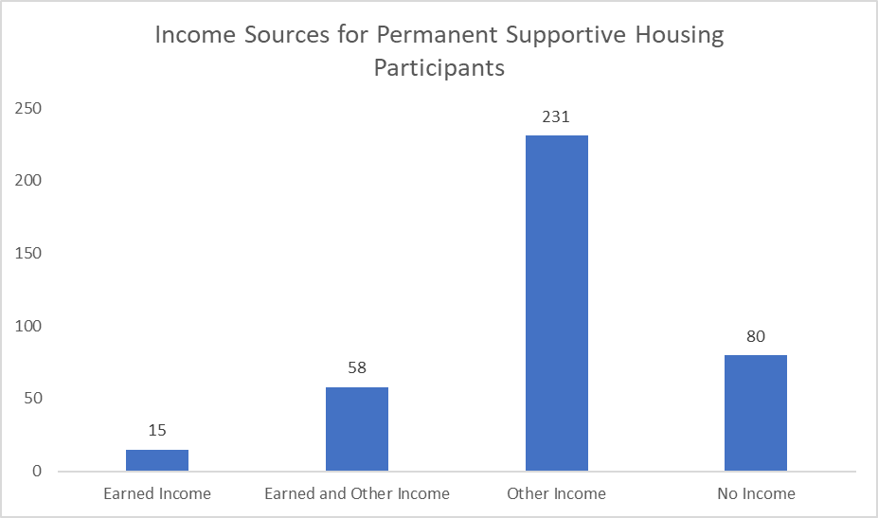
Income Sources of PSH Participants

Slide 55
Exit Destination of PSH Participants
533 persons exited Permanent Supportive Housing in FY 2017-2018
2% Exited to Temporary Destinations
2.6% Exited to Institutional Settings
15% Exited to Other Destinations
80% Exited to Permanent Destinations

Slide 56
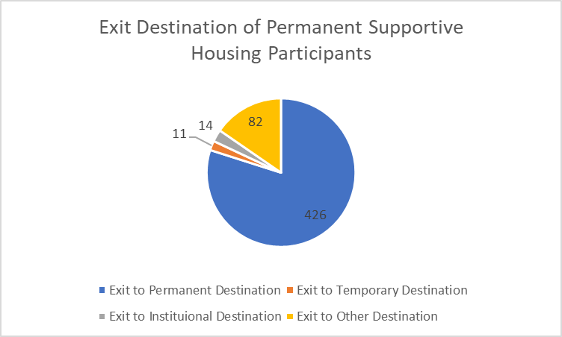
Exit Destination of PSH Participants

