Slide 1
Meet me Where I’m At
Utilizing Outreach Tactics to Engage Unsheltered Homeless
Notes:
Introductions

Slide 2
Agenda
Introductions
SWAN WAS HERE
Homelessness Is Hard
Outreach Workers
Benefits of a Peer
Approaches to the Homeless
Critical Time Intervention Model
Outreach Tactics
Notes:
Review of Agenda

Slide 3
Swan WAS Here
By Annika Leon
Notes:
Video

Slide 4
Step In the Right Direction
What was Jim experiencing aside from homelessness?
How did Maggie work with him?
How can we approach someone like Jim?
What did you notice about Jim that stood out?
Notes:
Nick Facilitates

Slide 5
Homelessness is Hard
We can make it easier
Homeless is a traumatic experience.
Just like repeated abuse, poverty, pain, being homeless is a constant stressor on our bodies.
Being unsure of where you will sleep and if it’s safe
Unable to have a decent meal
Being fearful of others
Experiencing mental and emotional issues due to loss, lack of family support, financial resource, and social support.
Notes:
NICK
Homelessness is a traumatic experience. Individuals and families experiencing homelessness are under constant stress, unsure of whether they will be able to sleep in a safe environment or obtain a decent meal. They often lack family support, financial resources, life skills, and social supports to change their circumstances. In addition to the experience of being homeless, an overwhelming percentage of homeless individuals, families, and children have been exposed to additional forms of trauma, including: neglect, psychological abuse, physical abuse, and sexual abuse during childhood; community violence; combat-relatedtrauma; domestic violence; accidents; and disasters. Trauma is widespread and affects people of every gender, age, race, sexual orientation, and background within homeless service settings.
Those working in homeless services have the opportunity to reach many trauma survivors who are otherwise overlooked. Providers in these settings can assist in the healing process by using the trauma informed approach,helping an individual or family develop supportive connections in the community and begin to heal from current and past traumas. Despite this fact, few programs serving homeless individuals and families directly address the specialized needs of trauma survivors. Homeless services have a long history of serving trauma survivors, without being aware of or addressing the impact of traumatic stress. Overwhelmed by the daily needs of their clients, providers in these settings often have few resources to address issues of long-term recovery.

Slide 6
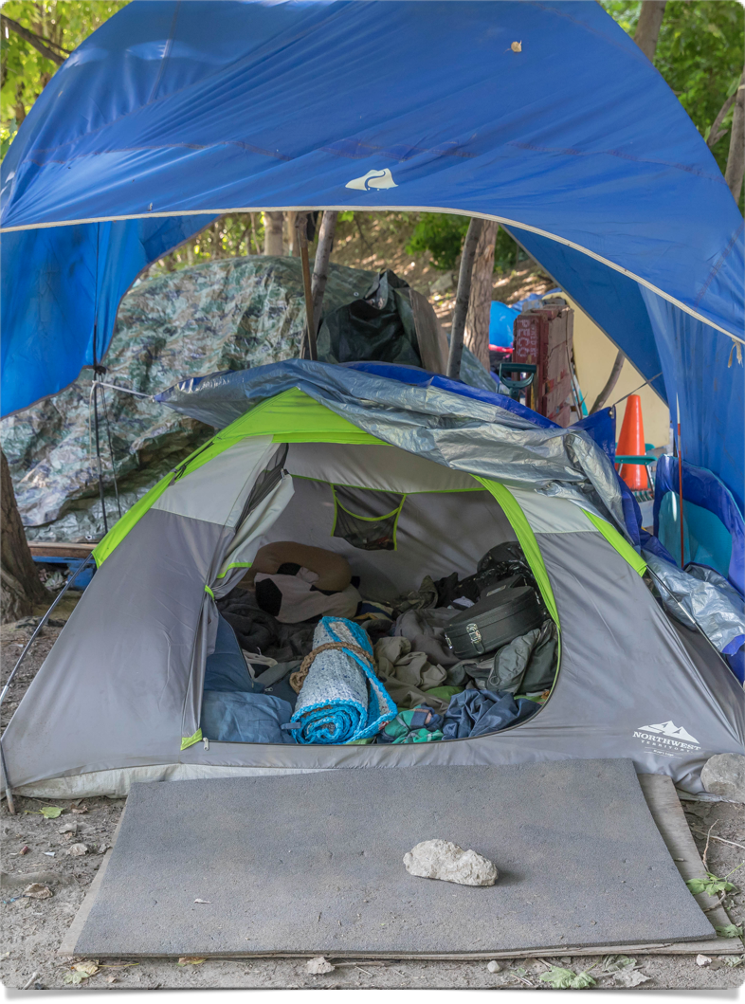
Homelessness is Hard
We can make it easier
Additionally homeless experience;
Neglect
Psychological abuse
Physical abuse
Sexual abuse
Homeless Children experience;
Community violence
Domestic violence
Accidents or Disasters
Notes:
Nick
In addition to the experience of being homeless, an overwhelming percentage of homeless individuals, families, and children have been exposed to additional forms of trauma, including: neglect, psychological abuse, physical abuse, and sexual abuse during childhood; community violence; combat-relatedtrauma; domestic violence; accidents; and disasters. Trauma is widespread and affects people of every gender, age, race, sexual orientation, and background within homeless service settings.
Those working in homeless services have the opportunity to reach many trauma survivors who are otherwise overlooked. Providers in these settings can assist in the healing process by using the trauma informed approach,helping an individual or family develop supportive connections in the community and begin to heal from current and past traumas. Despite this fact, few programs serving homeless individuals and families directly address the specialized needs of trauma survivors. Homeless services have a long history of serving trauma survivors, without being aware of or addressing the impact of traumatic stress. Overwhelmed by the daily needs of their clients, providers in these settings often have few resources to address issues of long-term recovery.

Slide 7
Outreach Workers
Have the opportunity to assist trauma survivors
Trauma Informed Approach must be used
History shows that although we work with a high number of homeless experiencing trauma
We are not trained in addressing the specialized needs of traumatic stress victims
Overwhelmed by needs of clients, providers have few resources to assist in long term recovery.
Notes:
Nick
Those working in homeless services have the opportunity to reach many trauma survivors who are otherwise overlooked. Providers in these settings can assist in the healing process by using the trauma informed approach,helping an individual or family develop supportive connections in the community and begin to heal from current and past traumas. Despite this fact, few programs serving homeless individuals and families directly address the specialized needs of trauma survivors. Homeless services have a long history of serving trauma survivors, without being aware of or addressing the impact of traumatic stress. Overwhelmed by the daily needs of their clients, providers in these settings often have few resources to address issues of long-term recovery.
Segue into Denise’s story

Slide 8
Peer Housing Advocate
As a Peer Housing Advocate;
Shed light on processes that work and don’t work
Partner as a person who “get’s you”
Not only experienced mental health or medical issues but homelessness too.
Spend additional time with client
Notes:
Introduce Denise

Slide 9
Peer Housing Advocate
Trauma Informed Approach and Peer Advocacy can;
Safety - Comfortable space; mentally and physically
Transparency and Trustworthiness - provide full and accurate info.
Choice - Approach that honors the individual’s dignity despite risk
Collaboration - Health happens with shared decision making
Empowerment - Recognition of individual’s strength and release of power in the “professional’s perspective”
Notes:
DENISE Tells Story
Safety creating a comfortable space where people feel culturally, emotionally, and physically safe as well as an awareness of an individual’s discomfort or unease.
Transparency and trustworthiness This includes providing full and accurate information about what’s happening and what is likely to happen next.
Choice this includes the recognition of the need for an approach that honors the individual's dignity
Collaboration and Mutuality This recognition that healing happens in relationships and partnership with shared decision making
EMPOWERMENT this includes the recognition of an individual's strength. The strengths are built on and validated.

Slide 10
Critical Time Intervention Team
Community Wide Intensive Outreach Team funded through SAMHSA in partnership with CCSI, OMH, Liberty Resources, PCHO, and MC Collaborative. 75 clients annually.
Criteria:
Most Vulnerable Individuals
Repeated difficulties navigating the system and connecting with housing and services
Behavioral Health Challenges
Limited family or social supports
Notes:
Lisa

Slide 11
Critical Time Intervention Team
Process: A nine month 3 phase program.
Phase 1: 3 months
Once enrolled we immediately connect the client based on their needs; i.e. housing finances, medical (determined by the client and through assessment)
Intensely work with the individuals during their transition into house.
Develop outside supports
Notes:
Lisa

Slide 12
Critical Time Intervention Team
Process: A nine month 3 phase program.
Phase 2: 3 months
Allow supports to begin to be a bigger part of their lives and host treatment team meeting to encourage relationship develop after their transition to housing.
Notes:
Lisa

Slide 13
Critical Time Intervention Team
Process: A nine month 3 phase program.
Phase 3: 3 months
Allow supports to begin to be a bigger part as we transition out of the client’s life. We are their for support but client should become more reliant on supports.
We celebrate in the last month.
Notes:
Lisa

Slide 14
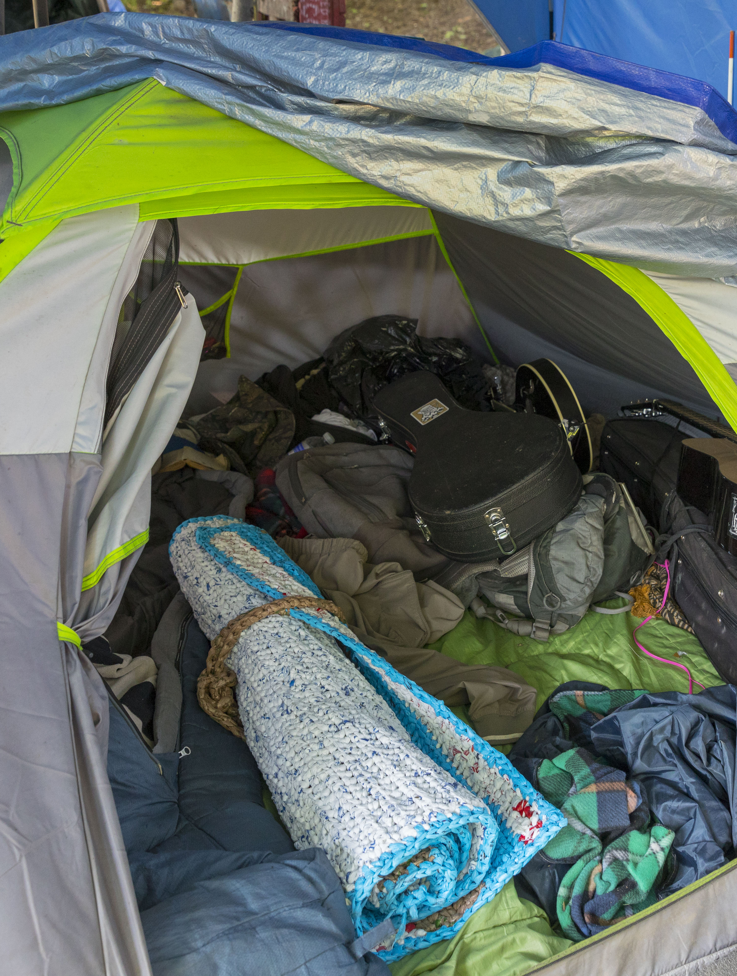
Outreach Tactics
Meet them where they’re at
Physical cues
Emotional response
Listen to their story
While listening, pick up on barriers, challenges, successes.
Set a couple small goals and deliver
Provide immediate response to meeting basic needs
Notes:
Nick

Slide 15
Basic Needs
Maslow’s Hierarchy of Need Outlines;
Food
Shelter
Clothing
Hygiene and Physical Care
Nothing more can truly be focused on without meeting these needs first.
Notes:
Denise

Slide 16
Basic Needs
Outreach Meet’s these needs by;
Is the person able to maintain their tent?
Do they want housing and what’s the process for this?
Be clear and direct.
Be informed about list’s and processes.
What do they need to survive today?
Are they aware of resources?
Do they need help engaging resources
Notes:
Denise

Slide 17
Basic Needs
Outreach Meet’s these needs by;
Do they need help engaging resources?
Do we need to bring food?
Should they access shelter versus being outside and what kind of shelter is suitable for their needs?
Providing hygiene kits, bedding supplies, hats, gloves, hand warmers
Engaging with other supports
Notes:
Nick

