Slide 1



Supportive Housing Assessment and
Acuity Index Upload into HMIS

Slide 2
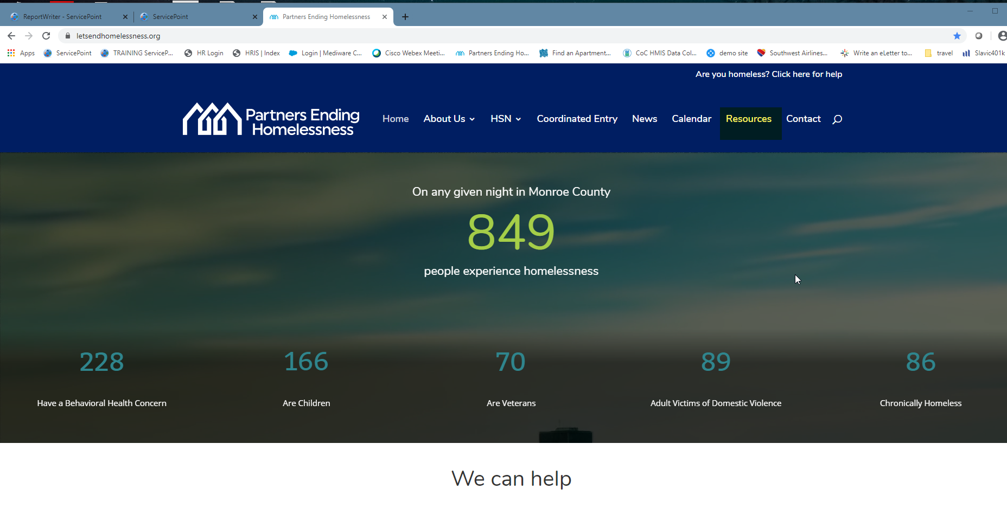
Go to our web site, then the resources tab

Slide 3
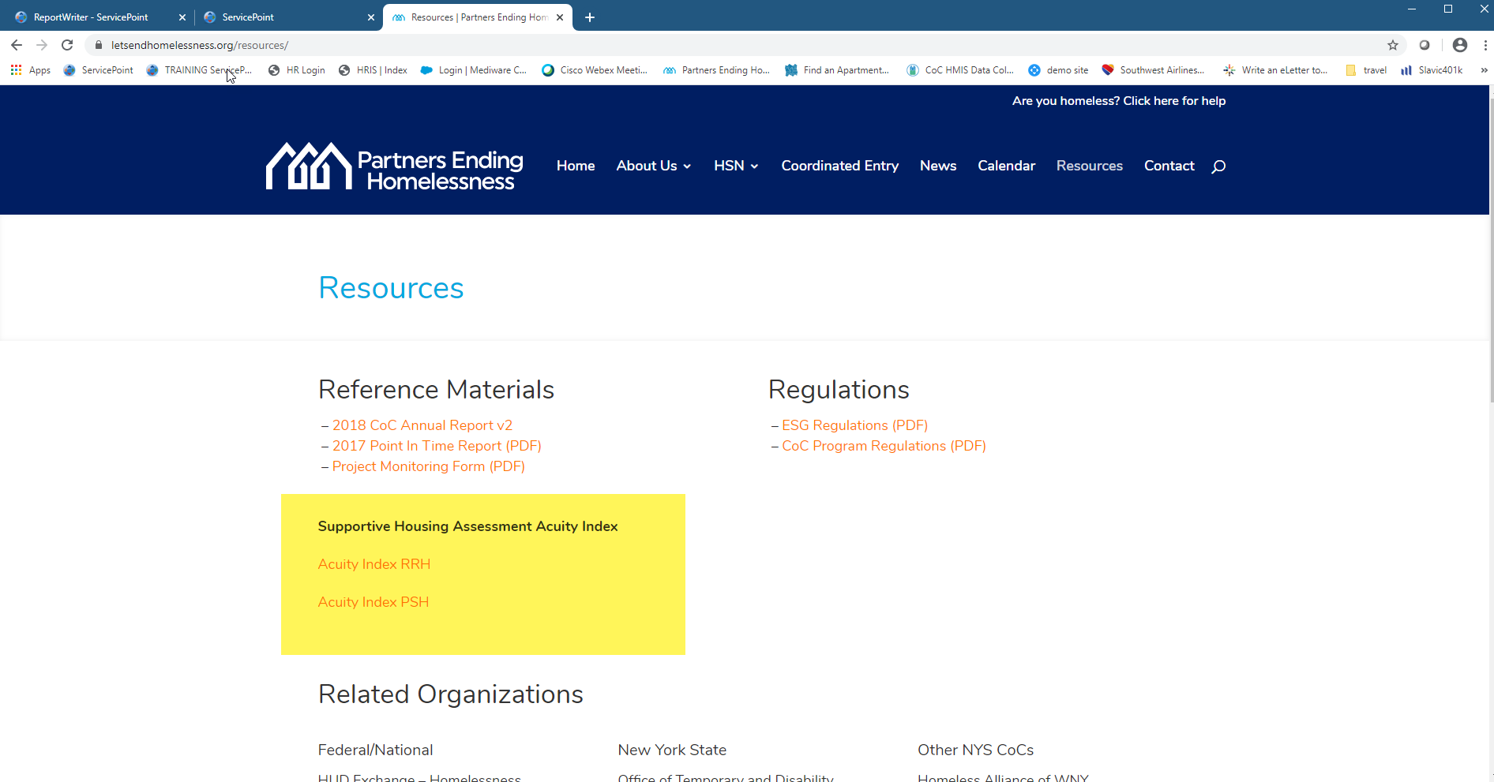
Go to Acuity Index

Slide 4
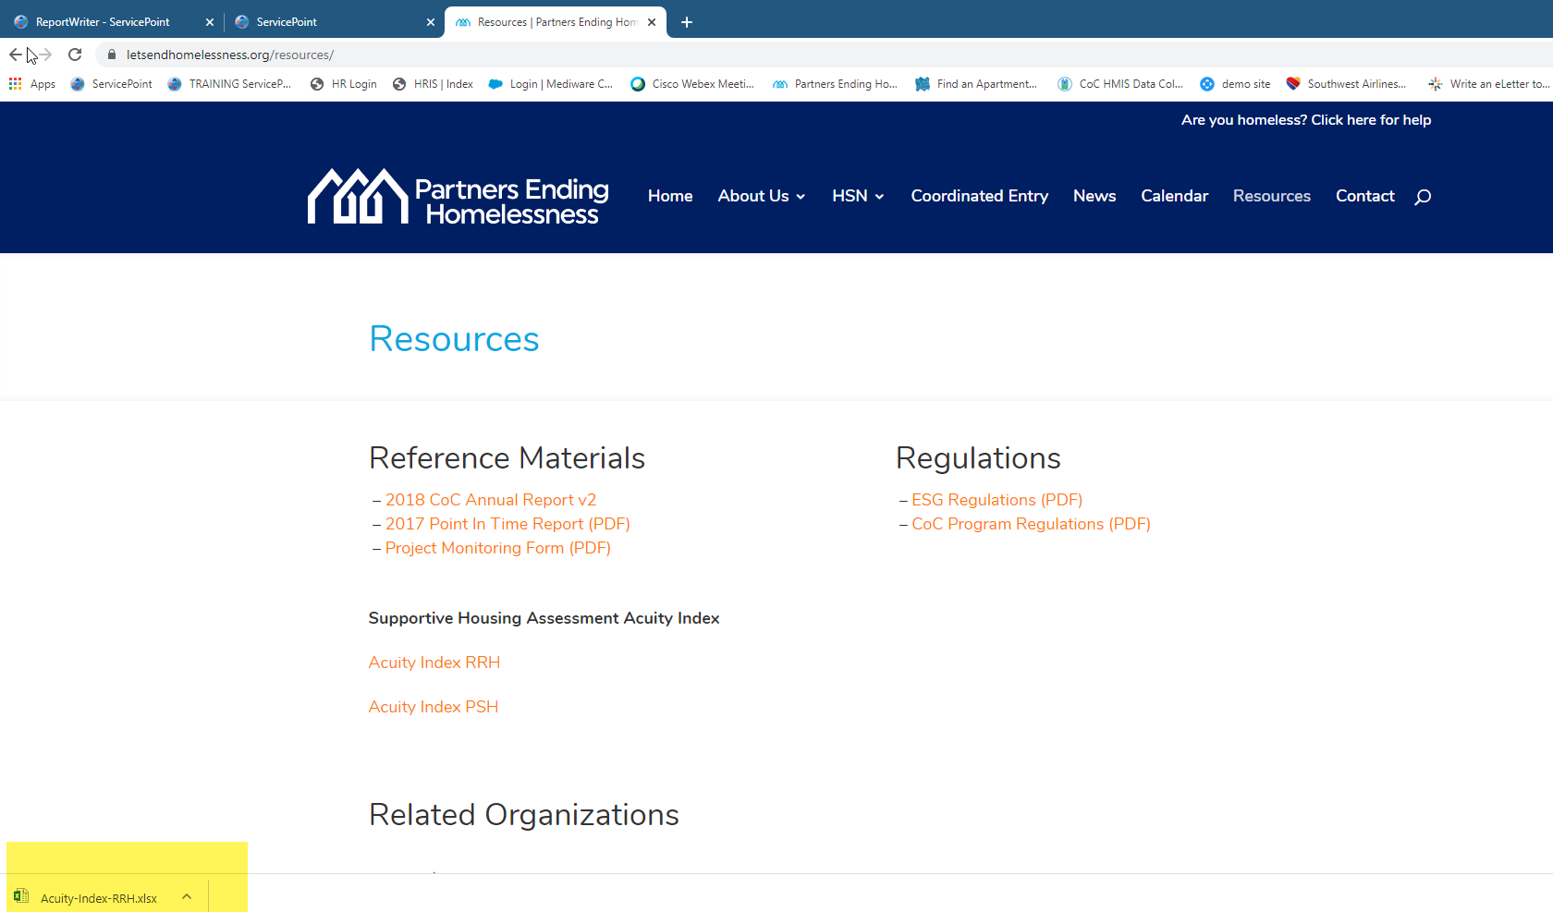
This will open the excel sheet

Slide 5
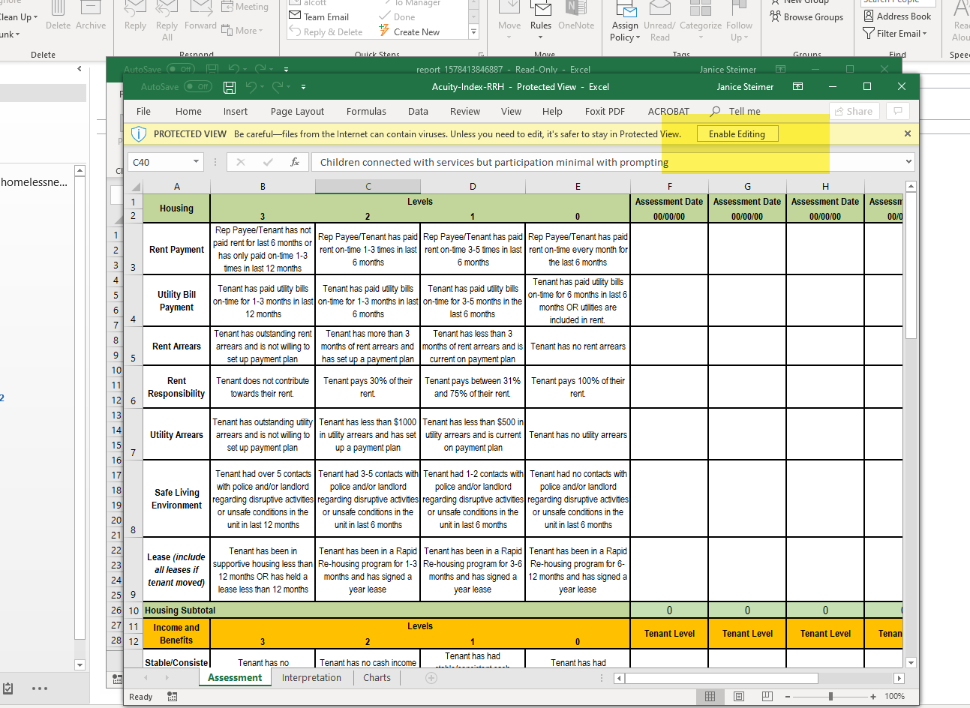
Enable editing

Slide 6
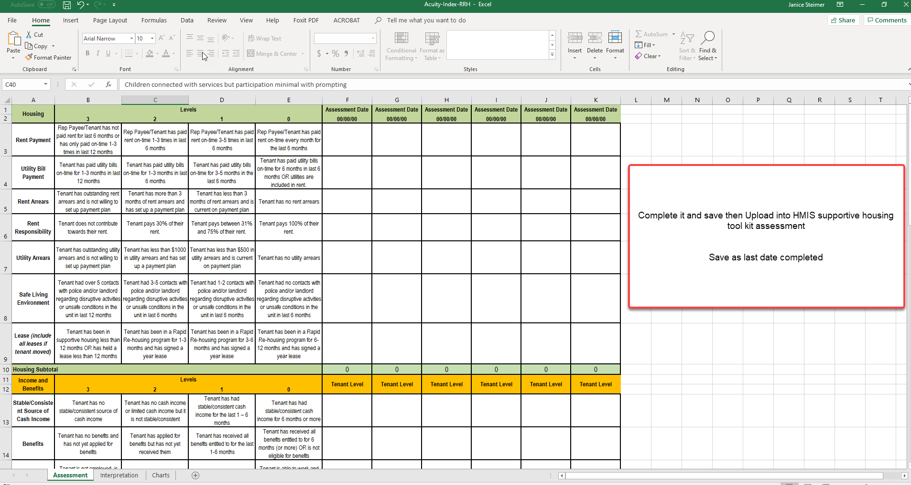

Slide 7
After saving your Acuity Index
go to the Clientpoint in HMIS
and continue as described next pages to attach the Acuity Index and complete the
Supportive Assessment

Slide 8
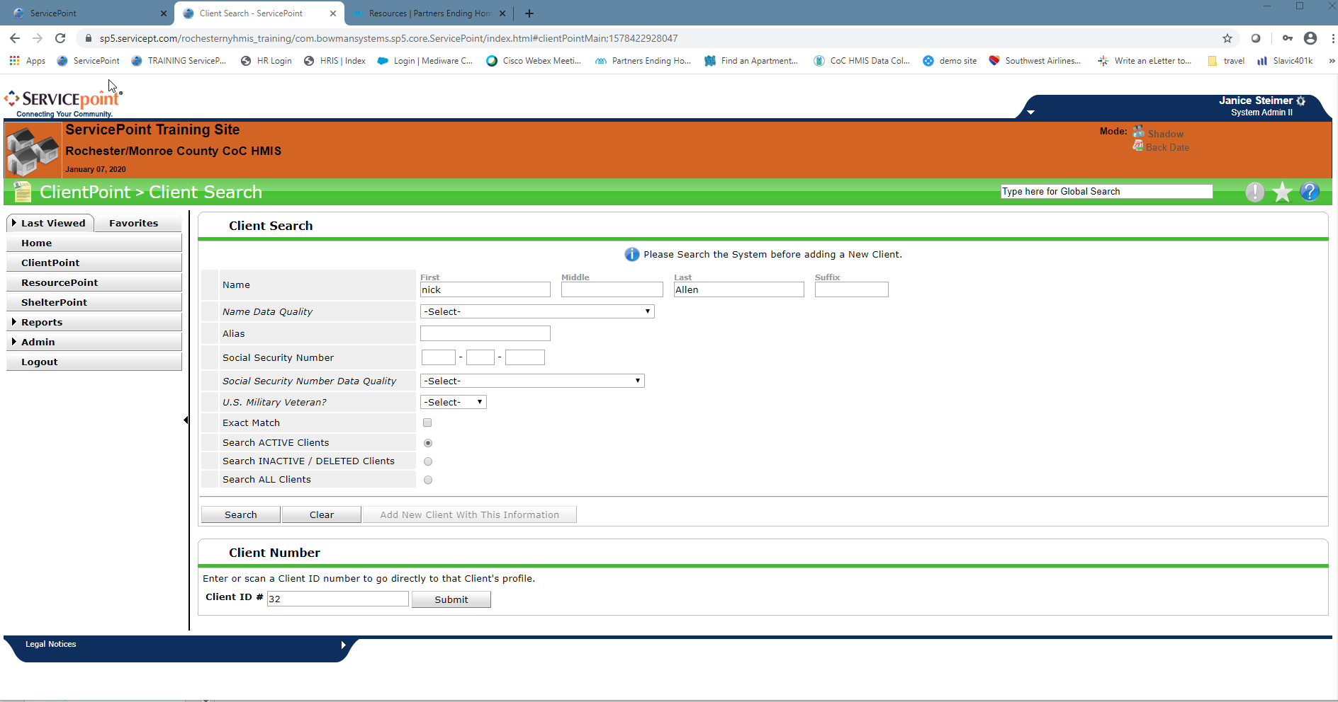
As with any Assessment the first step is to open the Client record.
  Do this with the Client ID # or search the name.

Slide 9
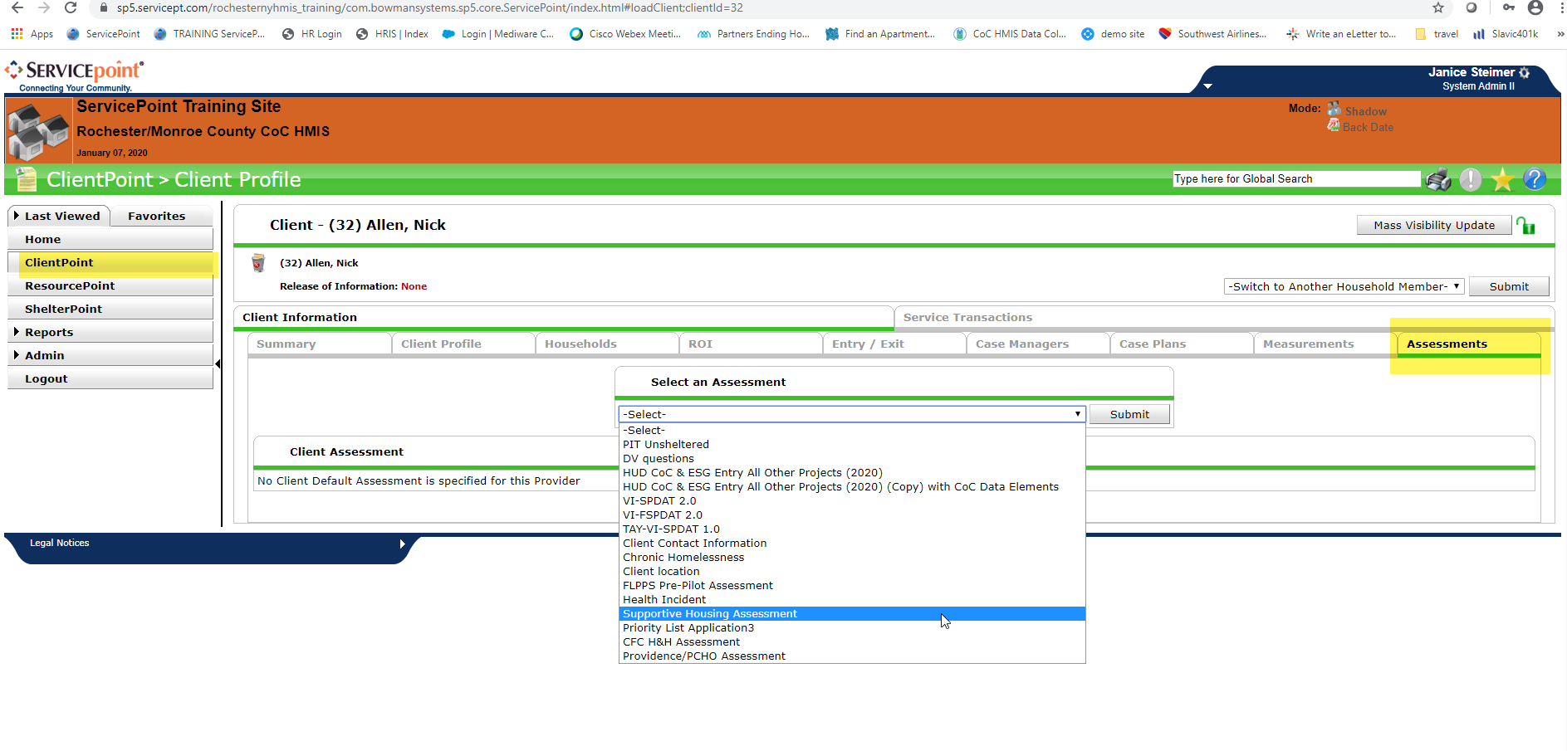
From here click on the Assessments Tab
At the select Assessment choose “Supportive Housing Assessment”

Slide 10
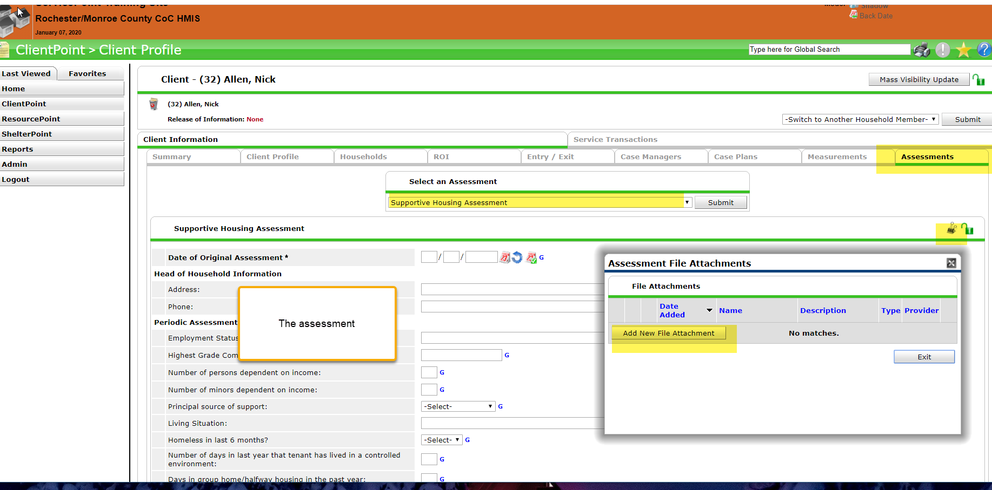
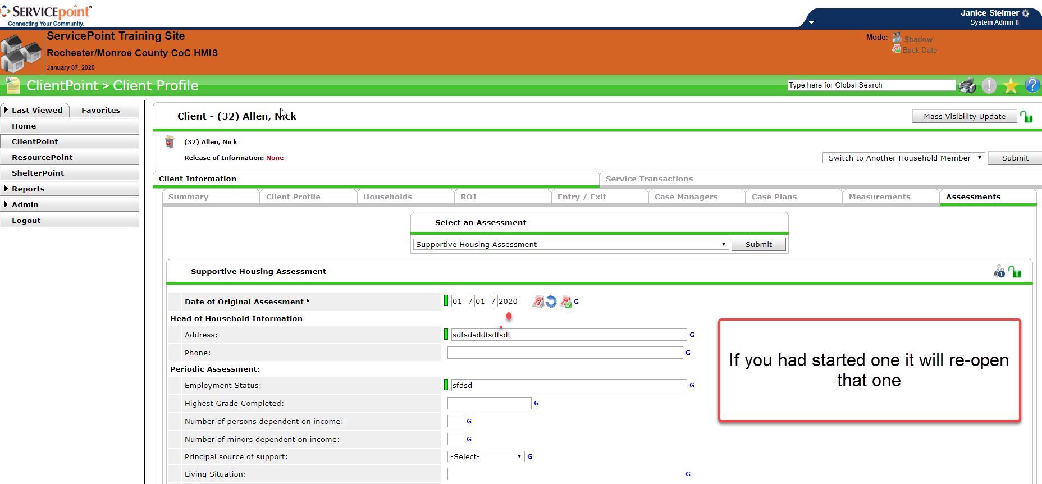
This will open up the assessment.
  If this is your first time in the assessment it will be blank, if you have been working on the assessment then it will contain the answers from the last time that it was opened and saved.
  If any of the answers have changed since the last time then you would just type over the last inputted information.

Slide 11
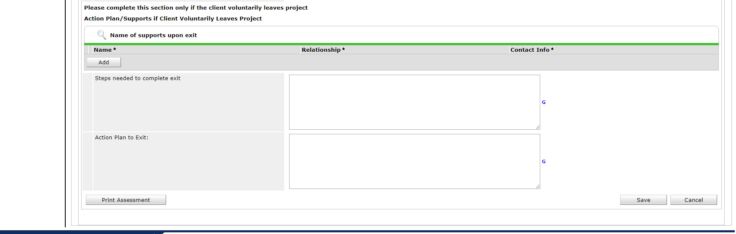
When you are done working on the Assessment it is very important that you go all the way to the bottom of the assessment and click on the save button to lock in your current answers
Once you hit save just return to the summary Tab or go to the ClientPoint .

Slide 12
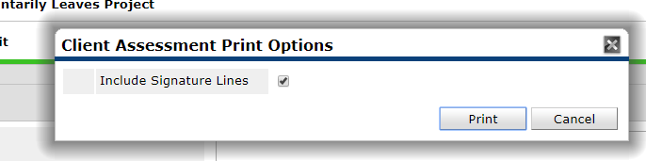
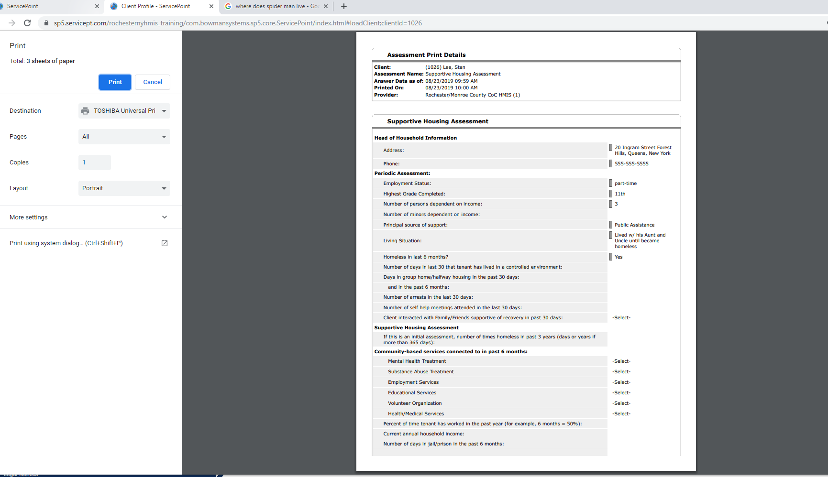
If you would like to print out the Assessment click on the Print Assessment tab.
You will get a pop-up asking if you want the Signature Lines then hit print
This will open your printer’s utility pop-up to print.

Slide 13
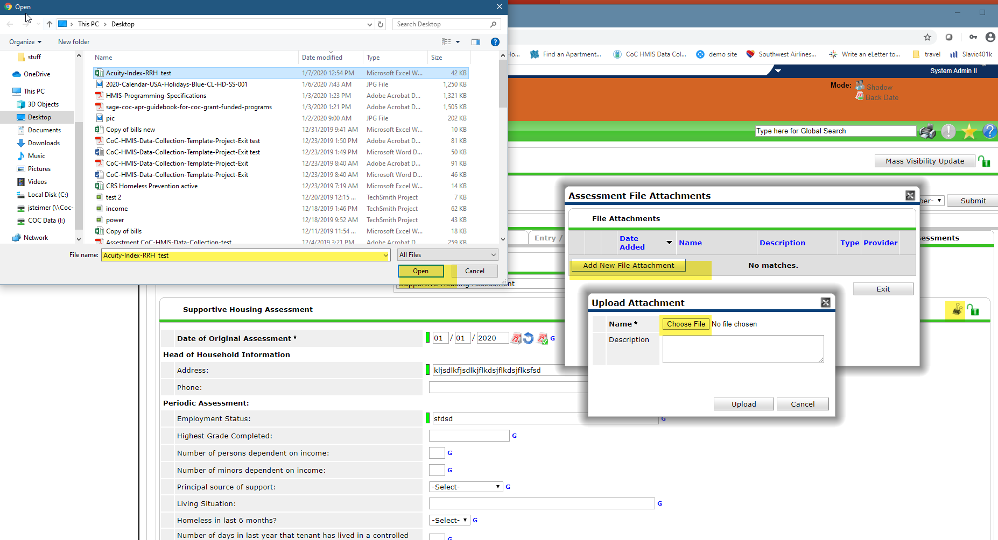
To attach the Acuity Index upload into the Client profile, when in the assessment you can click on the binder clip in the right hand corner
the “Assessment File Attachments” pop up will open
Then upload Attachment
Then your PC pop-up to choose where you saved the file click on it and open

Slide 14
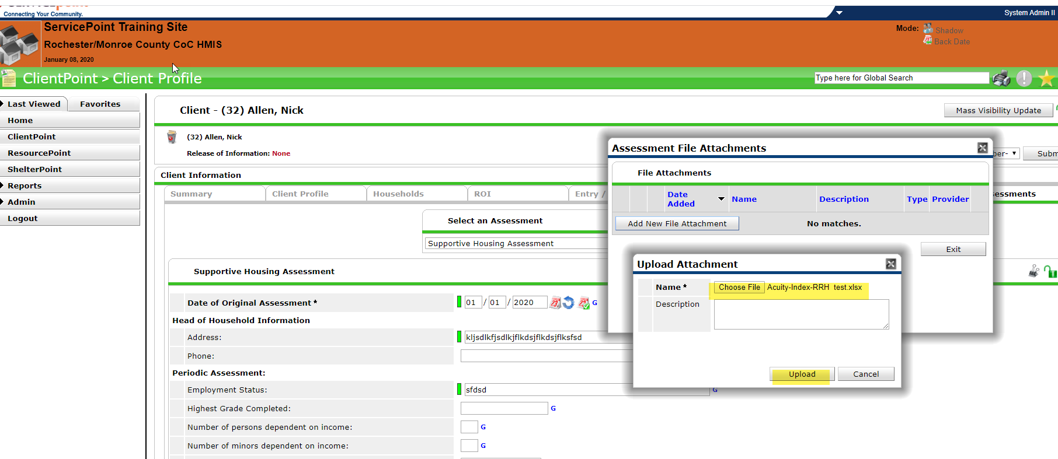
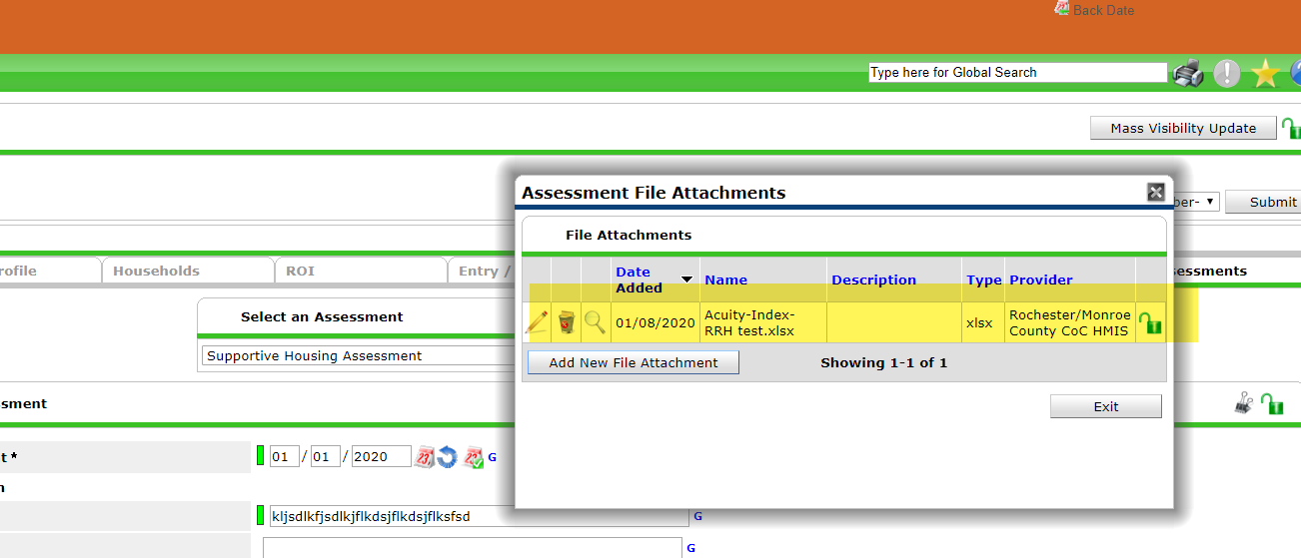
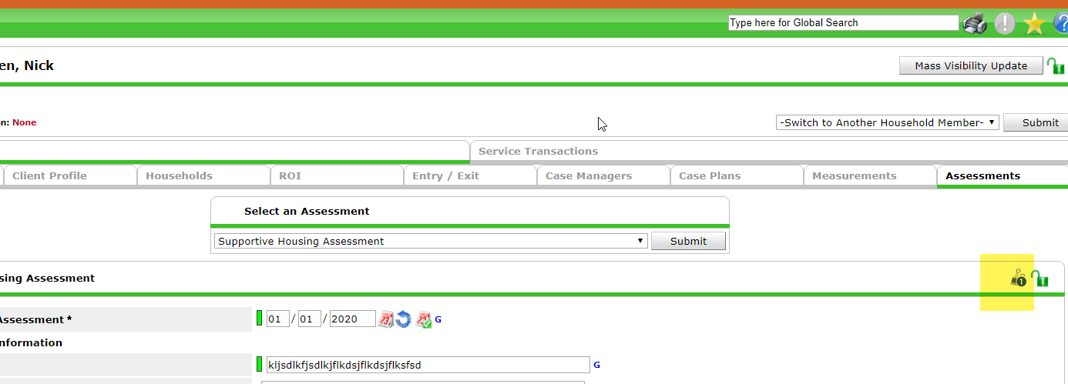
Once you click open the file will show in the “Upload Attachment”- Click Upload
You will now see the “Assessment File Attachments” and you will see the file and date you uploaded it. Hit exit
Now you will see a number on the binder clip alerting you that there is an attachment uploaded.

Slide 15
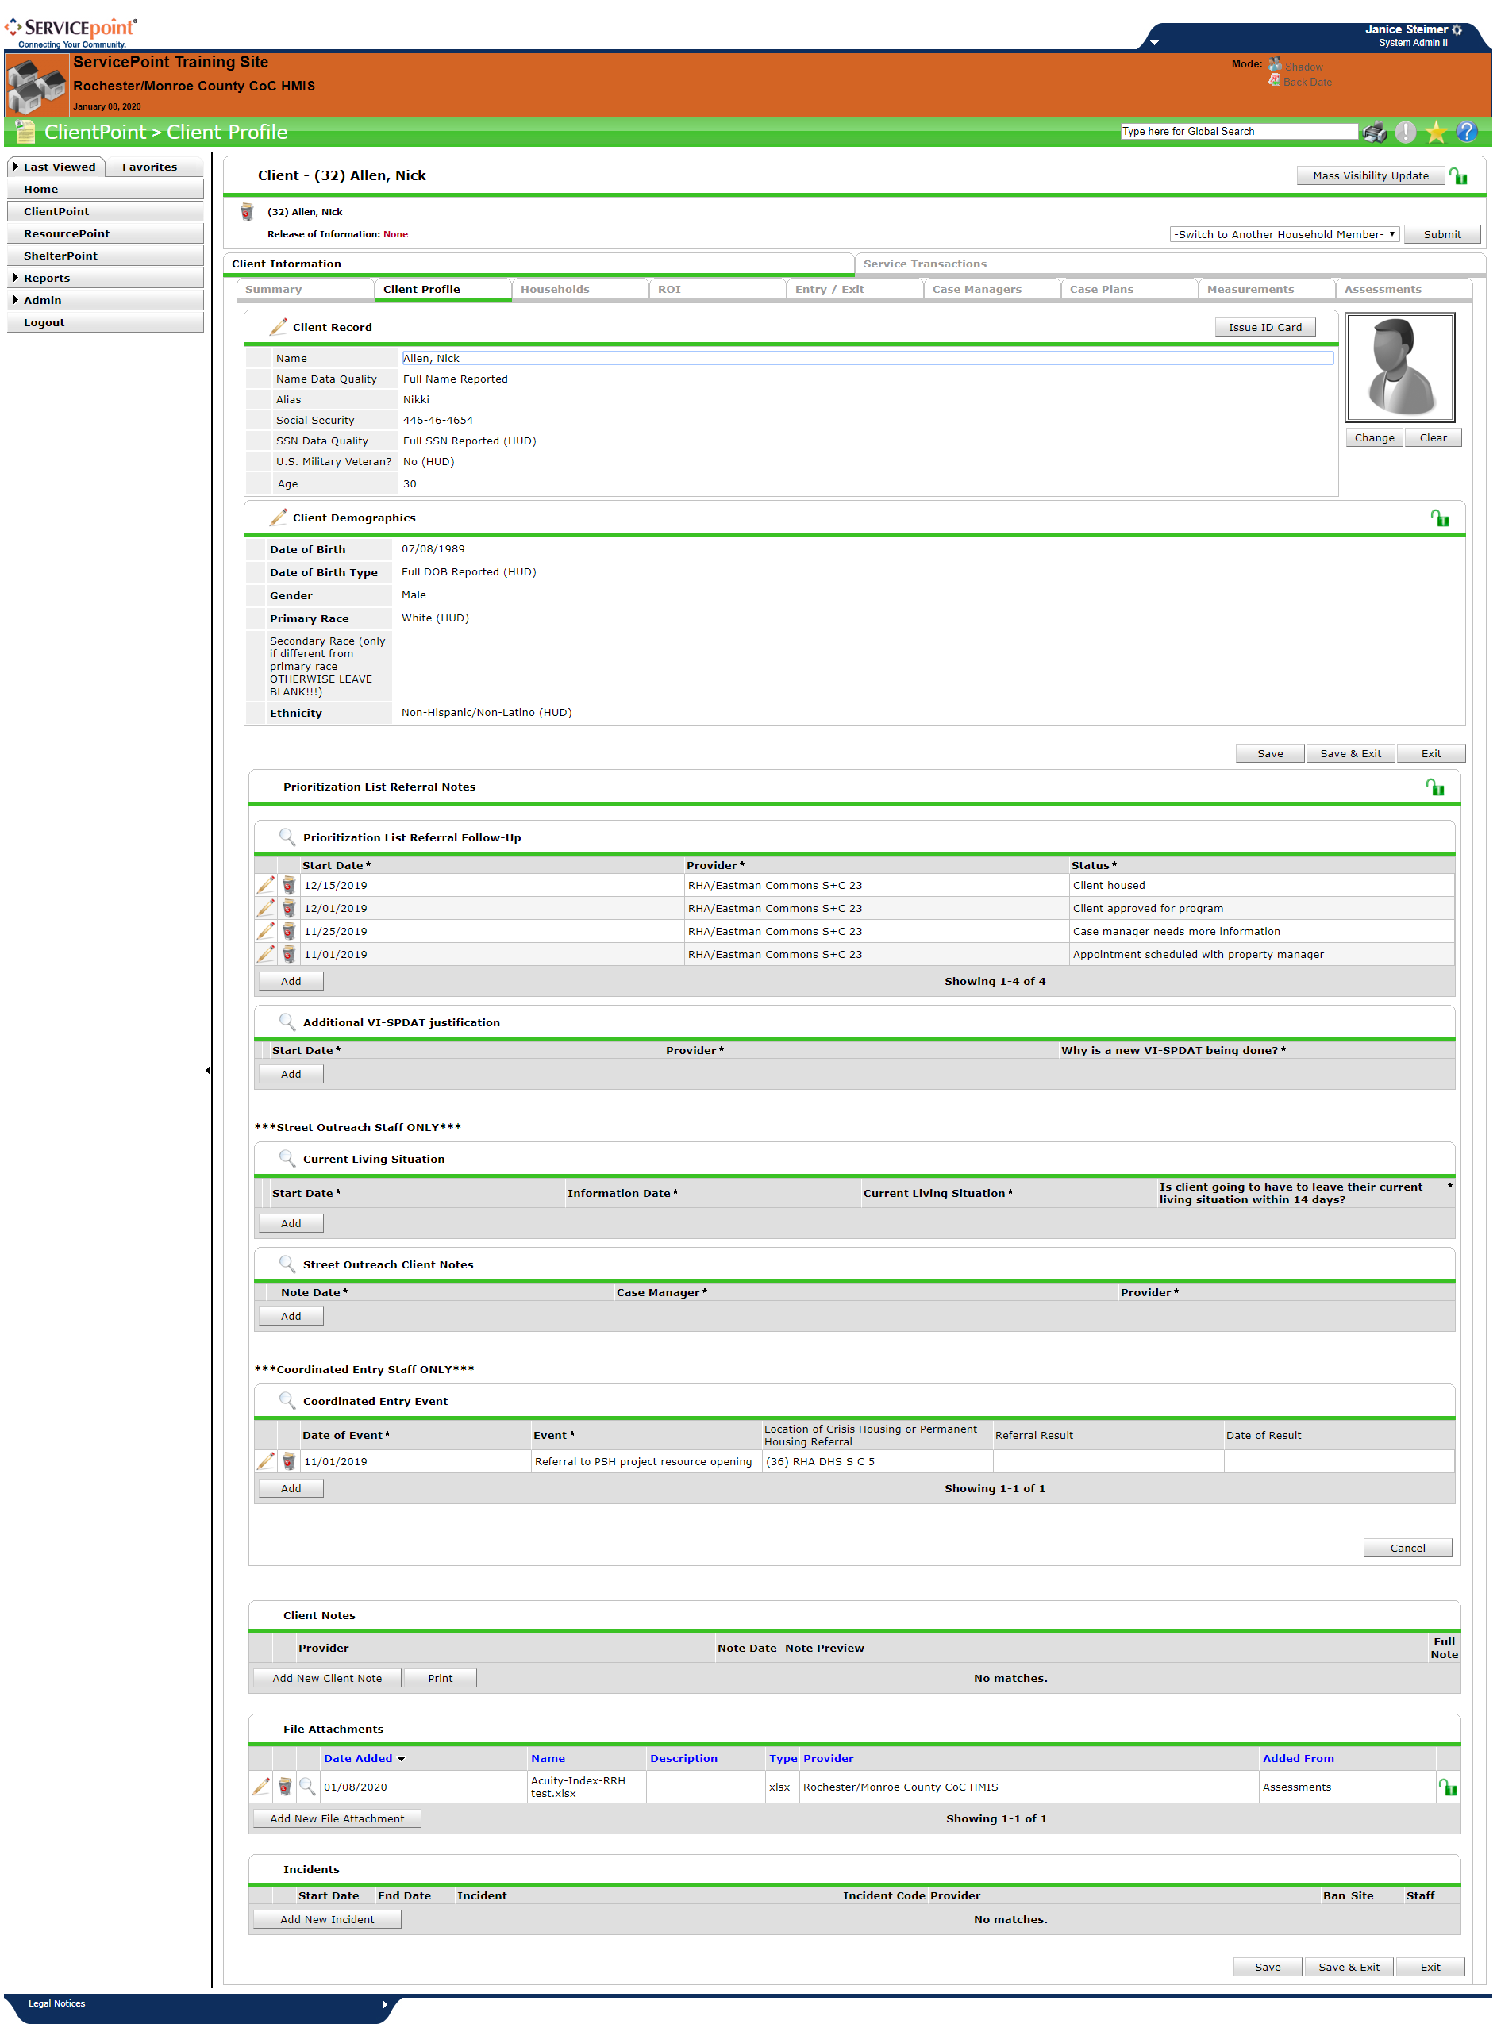
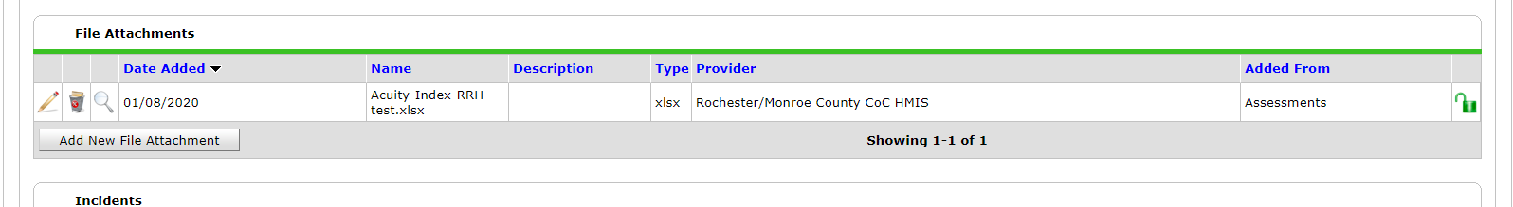
You can also see the Uploaded Attachment under the Client Profile if you scroll down to the “ File Attachments”
If you were not updating the Assessment at the time of uploading the Acuity you could upload directly from this area also using the “Add New File Attachment”

Slide 16
FAQ
You do not need to complete the whole Assessment at one time, you may go in and out whenever you need or want to.
You only need to fill in what is applicable but if you enter a sub-assessment that has an *asterisk, then you must complete the information for that section.
When you hit the save button you will not be directed to another screen, you must return to the ClientPoint tab or Summary Tab etc.
The Assessment will not save a version and start a new version like the VI-SPDAT this is just an open on going assessment that when information changes you type over each and every time.

