Slide 1
Partners Ending Homelessness FY19 HUD NOFA Debriefing & Local NOFA Training for Renewal Project Applications

Slide 2
Partners Ending Homelessness Staff
Connie Sanderson
Csanderson@letsendhomelessness.org
585-319-5091 ext. 103
Charles Bollinger III
cbollinger@letsendhomelessness.org
585-319-5091 ext. 101
letsendhomelessness.org
Notes:
Everyone

Slide 3
Collaborative Application Scoring Debriefing
letsendhomelessness.org
Notes:
Charles

Slide 4
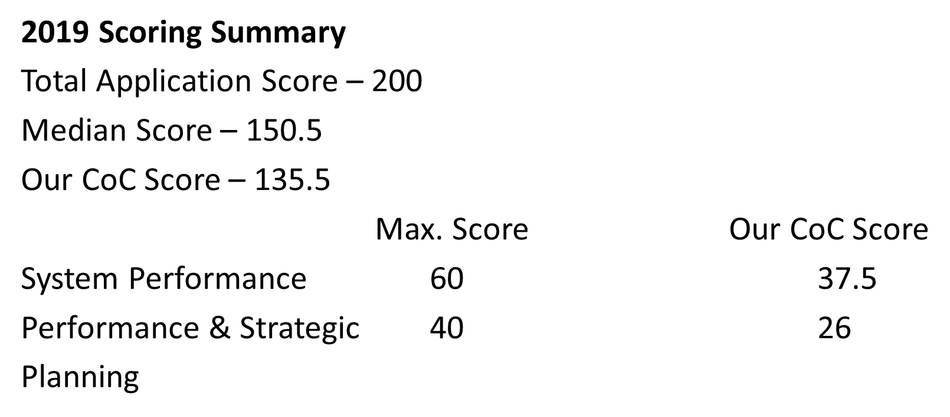
Collaborative Application Scoring Debriefing
letsendhomelessness.org
Notes:
Charles

Slide 5
Collaborative Application Scoring Debriefing
Max. Score Our CoC Score
Length of Time Homeless 14 8
Successful Permanent Housing
Placement and Retention 11 9.5
Returns to Homelessness 8 2
Job Income and Growth 15 7
First Time Homeless 3 2
letsendhomelessness.org
Notes:
Charles

Slide 6
Collaborative Application Scoring Debriefing
letsendhomelessness.org
Notes:
Charles

Slide 7
Introduction
Partners Ending Homelessness is the local
Continuum of Care (CoC), representing the City of Rochester, County of Monroe, and Towns of Greece and Irondequoit (NY-500), will submit a CoC Program Consolidated Application for funding to the U.S. Department of Housing and Urban Development (HUD) in the upcoming FY 2020 Continuum of Care Homeless Assistance Program Competition. This presentation describes the local application submission and review process.
letsendhomelessness.org
Notes:
Charles

Slide 8
Renewal Application Introduction
The PEH will be scoring and ranking all renewal projects for Permanent Supportive Housing, Rapid Re-housing, Transitional Housing, and TH-RRH projects.
CoC Planning Grant, Coordinated Entry, and HMIS renewals are non-competitive and will not be scored.
letsendhomelessness.org
Notes:
Tree
Shayna
Jenn
Suzanne

Slide 9
Application Review
The Local Application Review this year will be ranked on system performance from HMIS data. This will be based on scores as outlined in the local application. After the scoring is completed programs will receive their score but not their overall ranking. After HUD SNAPS office release their NOFA , all projects will be emailed their score, rank and tier.
letsendhomelessness.org
Notes:
Charles

Slide 10
Reallocation
HUD in the past NOFA has encouraged CoCs to use the reallocation process. Projects can reallocate their own project(s)at this time. If projects choose to reallocate their project, they must inform the PEH staff ( Charles Bollinger III) by COB 8/31/20 in an official email.
In the FY 2020 CoC Program Competition, HUD allows CoCs to use the reallocation process to create the following new types of projects:
Permanent supportive housing project that will primarily serve chronically homeless individuals and families, including unaccompanied youth
Rapid rehousing projects for homeless individuals and families, including unaccompanied youth, coming directly from the streets or emergency shelter, or person fleeing domestic violence situations.
Joint component project, which will combine TH and TH-RRH into single project to serve individuals and families experiencing homelessness
Dedicated HMIS projects and Coordinated Entry
CoC’s may choose to eliminate or reduce one or more renewal projects to create new project(s). When a CoC chooses to reallocate project(s) the Annual Renewal Demand for the CoC does not change.
letsendhomelessness.org
Notes:
Shayna

Slide 11
Reallocation
At this time PEH does not anticipate any project reallocation from unspent HUD funds or project capacity.
However, PEH reserves the right the reallocate projects in full or partial funding after HUD releases their NOFA for under preforming projects.
letsendhomelessness.org

Slide 12
Application Materials
Can be found on the www.letsendhomelessness.org website
The application can be downloaded from the PEH website.
letsendhomelessness.org

Slide 13
Rubric Questions - Renewals
Scoring for renewal projects is heavily weighted on program performance and efficiency The CoC will run an APR from 7/1/2019 to 6/30/2020 to review for the scoring applicable questions for your project’s application
All Projects APR will be pulled on 8/11/2020 (12 business days from this meeting)
letsendhomelessness.org

Slide 17
Renewals- Budgets
Budgets
Projects would not be a need to send in their budget at this time.
We are expecting all budgets to remain the same as FY19 Budgets.
If any project wants to make changes or amendments to their budgets, PEH must be made aware in an email before COB 8/31/2020
If projects are consolidating, they would need to do the budgets as required for consolidation. Projects also need to make PEH aware by email before COB 8/31/20.
letsendhomelessness.org

Slide 18
Scoring Discrepancy
All requests for second review of application for scoring discrepancies must be made in an official email to Charles Bollinger within 5 working days of receiving your score.
PEH will review the discrepancy and give an official response to the request within 2 working days
letsendhomelessness.org

Slide 19
Timeline for Local NOFA
July 24, 2020 Release of Local NOFA information
July 24 – August 11, 2020 HMIS Data clean up for all programs
August 11, Pulling of all HMIS Data for all programs
Scores and copy of HMIS APR will be sent to programs no later than August 31
TBA new applications NOFA released
TBA final score, rank and tier
letsendhomelessness.org

Slide 20
Questions
letsendhomelessness.org

