Slide 1

Established 1971- Present

Slide 2
Who We Are
The Housing Council in the Monroe County Area Inc., was founded in 1971 to expand safe and affordable housing opportunities for low and moderate-income persons residing in Monroe County, NY.
The affiliation with PathStone Corporation took place March 7, 2013. The Housing Council at PathStone is a HUD approved Housing Counseling Agency.

Slide 3
Programs & Services
Housing Hotline 5 days a week
Rental Registry update twice a week
Landlord Training
Tenant Education
First Time Homebuyer Services
Pre and Post Purchase Education
Foreclosure Prevention
Reverse Mortgage Counseling (HECM)
Fair Housing
Department of Human Services Inspections

Slide 4
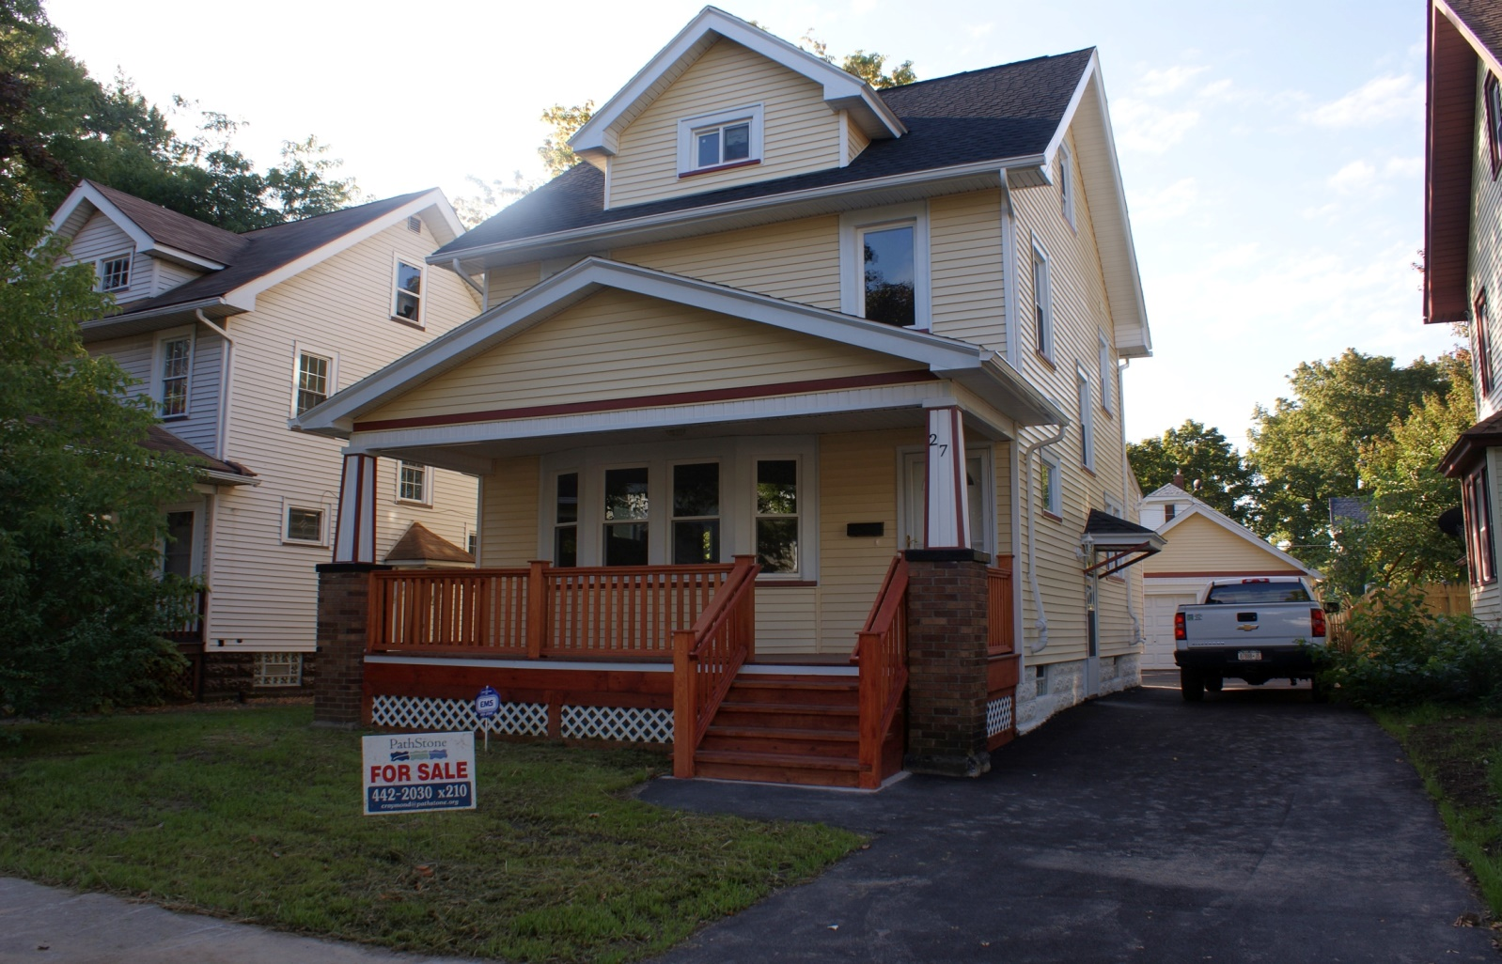

First Time Homebuyers

Slide 5
We Want To Empower
YOU!
Our Housing Counselors want to arm you with all the information you need to make the best decision for you and your family
We are here to connect you to the resources you are eligible for and coach you to your goals
You decide what’s best and when
Homeownership is not right for everyone
We want you to be successful when you know you are ready

Slide 6
What Do We Do?
We meet with people interested in purchasing their first home in a 1 on 1 counseling session
We discuss your goals, your wants vs needs and help you develop a plan
We review your current budget, credit report and affordability
Each client is given a personal action plan outlining what was discussed and the actions recommended for you to achieve your goals

Slide 7
What do we do?
We also offer group education
  Pre purchase:. on buying A-Z
  Post purchase: on important sustainability tools
Group Education is required for all grants and some loan programs

Slide 8
Grants
There are a variety of grant programs to assist first time buyers
The Housing Council at PathStone connects clients to the ones they are eligible for
Must complete counseling and education to be eligible
NOT EVERYONE IS GUARANTEED A GRANT

Slide 9
INDIVIDUAL COUNSELING
1-Hour one-on-one session determining mortgage, credit and grant eligibility
  BY APPOINTMENT ONLY
Documents from checklist need to be turned in prior to scheduling appointment
Application available for download on our website.

Slide 10
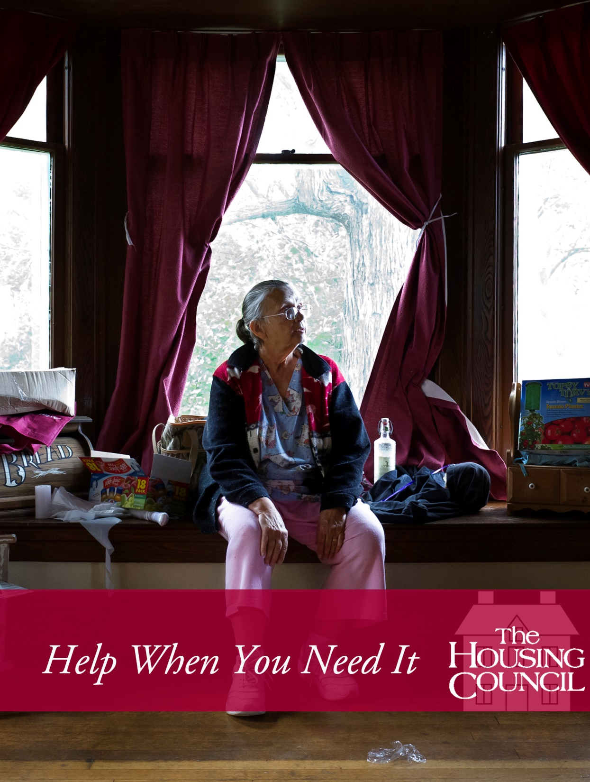

Foreclosure Prevention

Slide 11

What do we do?

Slide 12
Who do we serve?
The program serves homeowners of owner-occupied, one to four unit homes, in NYS who are at risk of losing their homes to foreclosure.
We provide services for homeowners facing Mortgage and Tax foreclosures.
Our service is FREE AND CONFIDENTIAL to anyone.
There are no income guidelines.

Slide 13

Do they meet the program requirements?
Live in area of office services
Owner occupied
Name on mortgage

Slide 14
Top 3 reasons clients seek our services
Loss of Income
Reduction of Income
Medical reasons

Slide 15
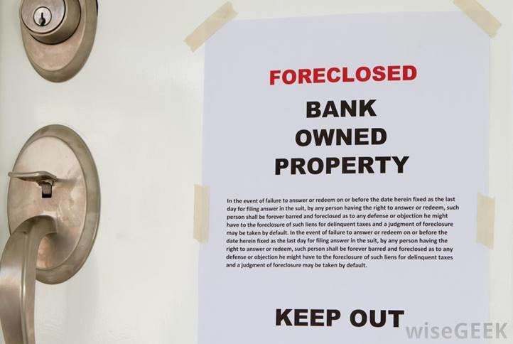
Our Clients …
FEAR of ending up on the street
STRESS of not knowing the process
OVERWHELMED

Slide 16
What We Do For
Our Clients
SUPPORT and EDUCATE through the foreclosure process
  Explain where you are in the the process and what to expect next.
  Homeowners who are in foreclosure are referred to local legal agencies.

Slide 17
What we do for our clients
Create a budget
A thorough analysis of each individual’s options is completed by the counselor and discussed with the client.
Create and execute action plan with client

Slide 18
What We Do For
Our Clients
Our counselors communicate with the lender and assist with all paperwork required to be sent in.
Coordinate with Legal Services for support through Settlement Conference to ADVOCATE
Homeowner works with counselor until they reach a resolution!

Slide 19

  Foreclosure Prevention Program
  Overall Success Rate
  95%

Slide 20
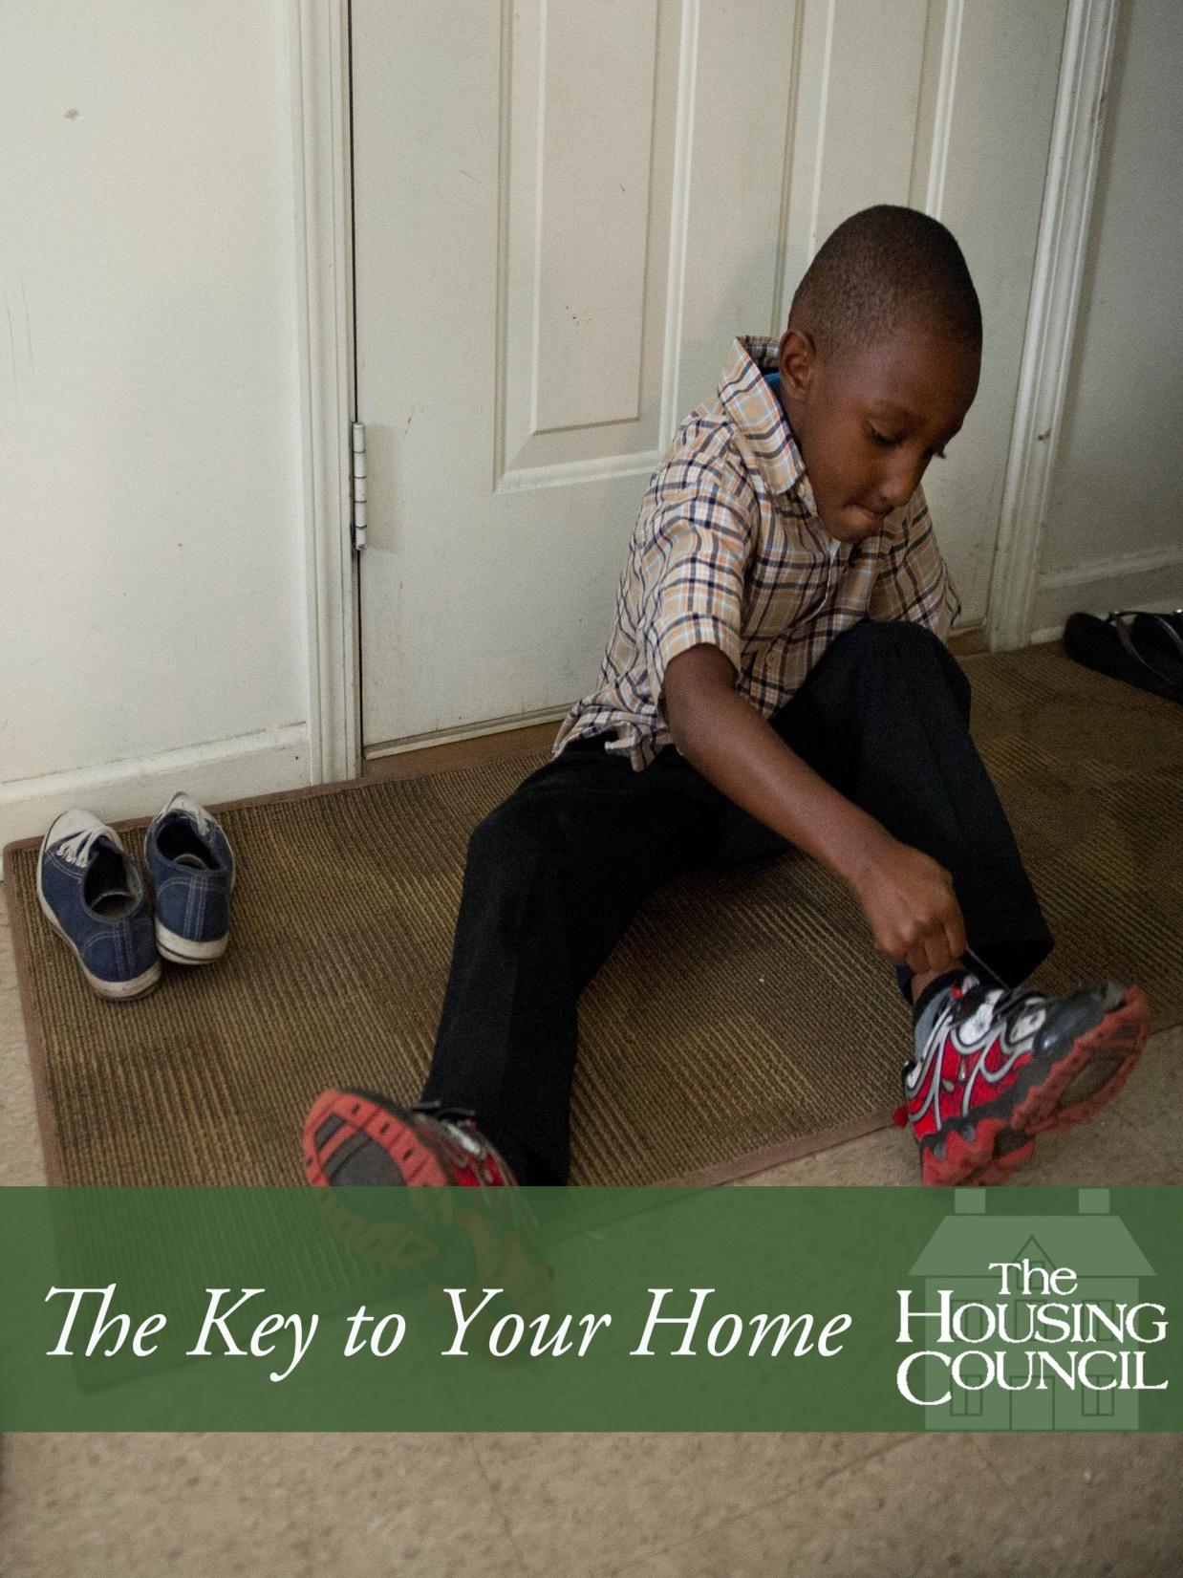
Landlord & Tenant Services

Slide 21
Landlord Services
Helps increase the business knowledge of local landlords through…
Workshops
Hotline- Bilingual counselors are available
Publications- all publications come in other languages
One-on-One counseling
Rental Registry

Slide 22
Tenant Services
Helps to increase the knowledge of tenants in regards to their rights and responsibilities:
Tenant Education Workshops
Housing Hotline- Bi-lingual counselors are available
Publications – publications are available in several other languages

Slide 23
Housing Hotline
Operates Monday through Friday from 9am to 12pm.
All counselors are trained to answer housing related questions for both tenants and landlords.
Refer clients to the best resources to fit their needs.
Crosses all program areas.

