Slide 1
Youth & Young Adult Homelessness
Monroe County- Rochester, NY

Slide 2
Overview of Existing Services
The Salvation Army – Genesis House
Emergency Shelter for youth ages 16 – 20
Case management, advocacy, educational, and aftercare supports
The Center for Youth Services
Emergency Shelter for up to 30 days for youth ages 12 -17
Transitional Living for up to 18 months for youth ages 16 – 21
Maternity Group Home for up to 18 months for moms ages 16 – 21
Rapid Rehousing for young adults ages 18 – 25 who are in shelters
Case management, advocacy, educational, and aftercare supports
24-hour Hotline #271-7670

Slide 3
Overview of Existing Services
YWCA
Emergency Housing for young adults ages 18 and up
Case management, advocacy, and other supports
McKinney-Vento Liaisons
Each school has a contact for students experiencing homelessness
RCSD – Greta Davis
https://nysteachs.org/lea-liaisons/
Support includes transportation
DSS
SNAP Benefits
Housing

Slide 4
Varying Definitions of Youth Homelessness
The McKinney-Vento Act defines unaccompanied youth as “a homeless child or youth not in the physical custody of a parent or guardian
HUD
Unaccompanied youth under 25 years of age, or families with children and youth, who do not meet any of the other categories but are homeless under other federal statutes, have not had a lease and have moved 2 or more times in the past 60 days and are likely to remain unstable because of special needs or barriers.
https://files.hudexchange.info/resources/documents/HUDs-Homeless-Definition-as-it-Relates-to-Children-and-Youth.pdf

Slide 5
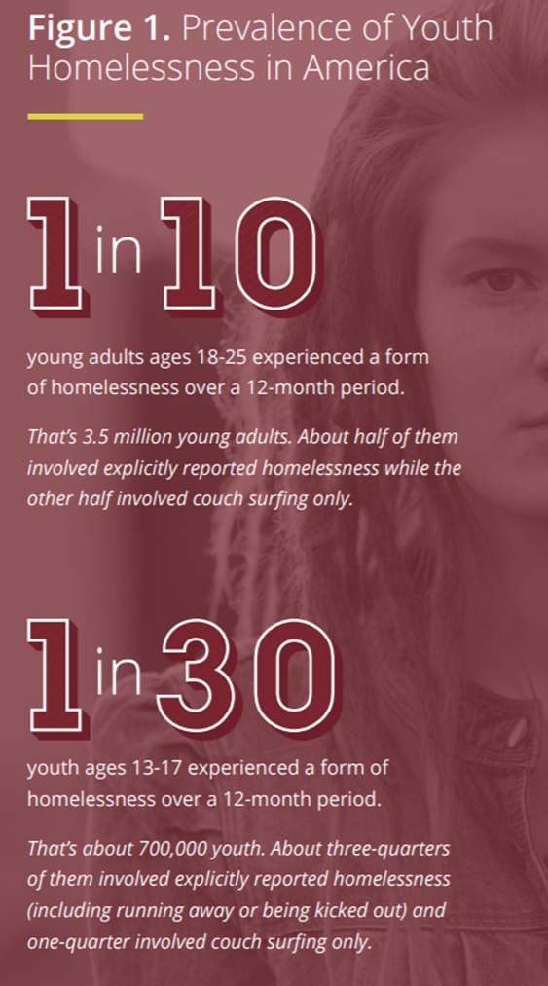
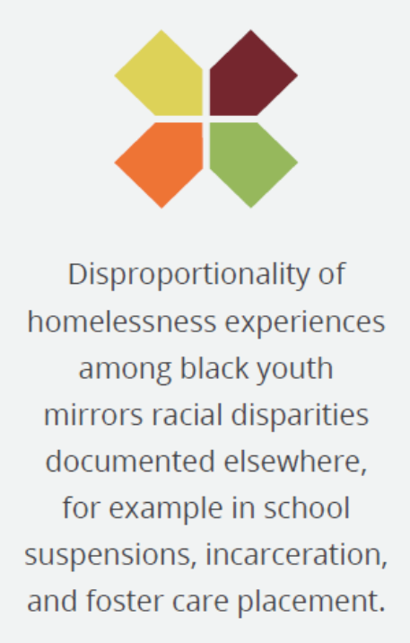
Trends
https://voicesofyouthcount.org/wp-content/uploads/2017/11/VoYC-National-Estimates-Brief-Chapin-Hall-2017.pdf

Slide 6
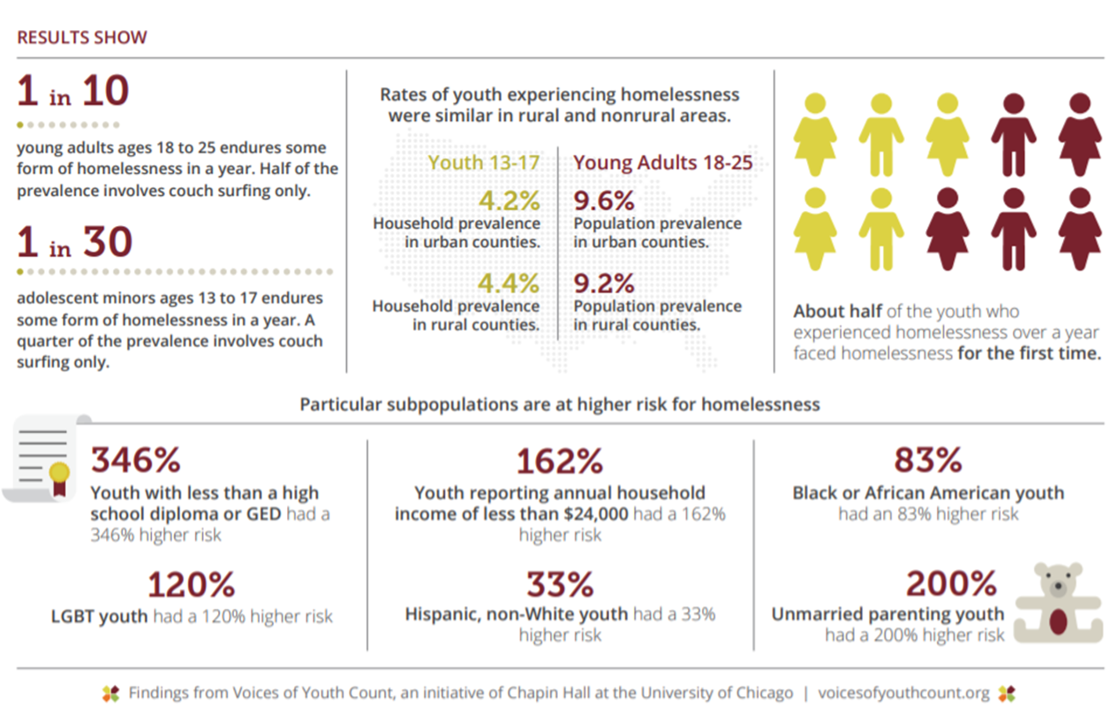

Slide 7
Trends
Seeing more intakes/referrals from detention and probation
Shrinking funding - state and federal levels of support have shrunk (NY State RHYA funding hasn’t recovered since the major cuts in 2008)
Mental health supports in the residential settings - seeing more referrals from psychiatric centers. Youth SPOA is nearly impossible for youth not connected with families.
In 2018, Monroe County DHS tracked 443 RHY (unduplicated) emergency housing placements for 16 – 21-year old RHY. 44% of those RHY were admitted to youth emergency shelters and 49% were admissions to adult homeless shelters, and 6% in hotels. It is important to note that the County’s DHS does not track RHY under the age of 16. The Center served an additional 162 RHY in our emergency shelter (not placed by Monroe County DHS) that year resulting in a final number of 605 RHY ages 12 – 21 accessing emergency shelter.
A 2019 Rochester Monroe County HMIS report identified 911 young people ages 18 – 24 who accessed homeless shelters, including adult shelters.
Based on our experience, and regional data, we believe that there are at least 1,000 RHY annually in our community. With less than 55 emergency shelter and transitional living beds dedicated to youth and young adults in our area, we know many RHY remain in unsafe situations.

Slide 8
Needs & Challenges
Treatment for alcohol and substance abuse, as will as mental health treatment, is difficult for unaccompanied youth and young adults to access.
Caught between/within systems: Child Welfare, MH, Probation, Schools, etc. Staff have to advocate and help the youth navigate these larger systems.
So few options, young people don't have a lot of choice or opportunities fail and have a safety net. Young people high demand commodity for adult predators. Not only strangers - can be their own families. Youth with disabilities - take SSI money.
COVID – concern about where youth with COVID can be isolated if under 18 and therefore not able to be housed in a hotel.
Finding decent, ethical landlords that will rent to young adults without a rental history.
Foster care is not a realistic option for older youth - not many FC homes available for teenagers.

Slide 9
Opportunities to Collaborate
Adult shelters serving 18 - 25 year olds
MH clinicians come into housing programs
Family mentors (peer advocates) for parents/guardians with youth in our shelters (MH/Chem advocacy)

Slide 10
Changes/Impact During COVID
Services from agencies that served families in the home have stopped
Youth who are COVID positive will be unable to access a shelter (can not place a minor in a hotel)
Youth turning positive in programming would result in ending of intakes and there aren't other options for youth under 18
Reducing bed numbers for social distancing
Decreased access to shelter for youth - schools were a large access point but also anxiety/fear of accessing a shelter because of possible COVID exposure therefore staying in more unsafe situations.
Young adults pushing against stricter safety policies and procedures due to feeling invulnerable

Slide 11
Questions? Comments?

