Slide 1
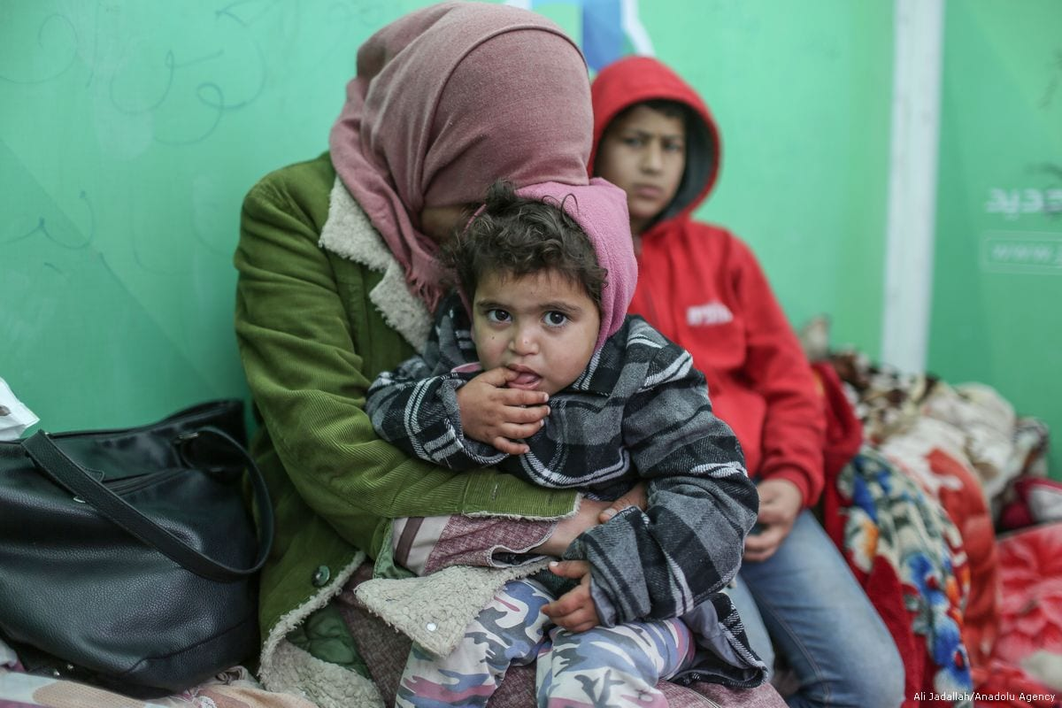
Families In Transition-FIT Program
Greta M. Davis, MSEd, LCSW- R, CASAC II
McKinney Vento Homeless Assistance Act: Education & Homeless Youth
Wednesday, March 17, 2021

Slide 2
Objectives:
Overview of Families In Transition, FIT Program: McKinney Vento Act, Education & Housing Instability
Current trends in service delivery:
Needs and challenges currently in serving students experiencing housing instability:
Opportunities to collaborate with others in the community:

Slide 3
Examples of Young People Experiencing Homelessness:
Anastasia sleeps on her friends couch and borrows her friends clothes to wear to school. Her dad kicked her and her mom out of the house after a fight that turned physical. She’s unsure where her mom is staying, but her mom assures Anastasia that she is fine.
Diego lives with his parents and his dog in a bedroom illegally subleased to them by other renters after his parents lost their suburban home due to a job layoff and illness. He hides his dog when the landlord comes around because pets are not allowed.
Fredrick lives with his two brothers, one sister, and mom in a motel room after a bad storm three moths ago made their old house unlivable. He attends high school in a different school district because the storm also destroyed his old school. Fredrick worries about what will happen to his family because his mom’s place of work has not reopened following the storm.
American Educator- Spring 2021

Slide 4
McKinney-Vento Act Definition of homelessness:
The term “homeless children and youth”—
A. means individuals who lack a fixed, regular, and adequate nighttime residence…; and
B. includes —
children and youths who are sharing the housing of other persons due to loss of housing, economic hardship, or a similar reason; are living in motels, hotels, trailer parks, or camping grounds due to the lack of alternative adequate accommodations; are living in emergency or transitional shelters; or are abandoned in hospitals;
children and youths who have a primary nighttime residence that is a public or private place not designed for or ordinarily used as a regular sleeping accommodation for human beings…;
children and youths who are living in cars, parks, public spaces, abandoned buildings, substandard housing, bus or train stations, or similar settings; and
migratory children…who qualify as homeless for the purposes of this subtitle because the children are living in circumstances described in clauses (i) through (iii).

Slide 5
Unaccompanied Youth:
Youth that are not in the physical care and custody of their parent.
The McKinney-Vento Act includes no program-specific age requirements to qualify as an unaccompanied homeless youth.
If a youth is eligible for K-12 (ages 3-21) public education in the state, he or she will be enrolled and served as an unaccompanied homeless youth.
Unaccompanied youth DO NOT need parent’s permission to enroll in school and should be enrolled immediately.

Slide 6
Every Student Succeed Act, ESSA
States that students have the following rights:
Homeless students have the right to continue attendance in their school of origin, and under the new definition, a school of origin includes preschool.
A student who moves into permanent housing is entitled to continued transportation for the remainder of the academic year.
There are increased privacy protections for address and housing information for students in temporary housing. Information about the living situation of a student who is homeless is part of the student’s record, subject to the protections of the Family Educational Rights and Privacy Act (FERPA).
Liaisons must notify unaccompanied youth of their eligibility for independent student status for the Free Application for Federal Student Aid (FAFSA).

Slide 7
Students Educational Rights
Immediate enrollment in school without the burden of providing proof of residency, immunizations, school records, or other documents typically needed for enrollment.
Transportation (no minimum mileage requirement-up to 50 miles one way)
Choice of School of Origin or School Where Temporarily Housed
Automatically Qualify For Food Services
Emergency Clothing & School Supplies
Participate Fully in Educational Support Services & Extra-Curricular Activities

Slide 8
Absences
The McKinney-Vento Act requires schools to identify and remove all barriers to enrollment and retention in school for children and youth in homeless situations. 42 U.S.C §§11432(g)(1)(I), (g)(7).
Zero tolerance rules for absenteeism can be such barriers, particularly when they result in class failures, exclusion from school, or court involvement. Frequently, students in homeless situations will miss school due to their living situations. Absences caused by homelessness must not be counted against students, as this would create a barrier to enrollment and retention in school.
Since the inability to earn any credit is a disincentive to remaining in school, the school must address that problem. The school must make any necessary adjustments to the student’s schedule to permit the student to make up local and state exams, obtain partial or prorated credit for his or her work and to participate in credit recovery opportunities.

Slide 9
Facts About Homeless Teens
The Department of Justice estimates that every year, over 1.7 million teens experience homelessness in the US.
According to estimates by the Urban Institute, nearly 1 in 5 youths under the age of 18 will run away at least once.
Approximately 40% of homeless teens identify as LGBTQ+.
Family rejection on the basis of sexual orientation and gender identity was the most frequently cited factor contributing to LGBT homelessness (46%).
Over 50% of young people in shelters and on the streets report that their parents told them to leave or knew they were leaving and didn't care.
About 80% of homeless youth (aged 12-21) use drugs or alcohol as a means to self-medicate to deal with the traumatic experiences and abuse they face.
In New York City, one in ten (114,085) youth experienced homelessness during the 2018-19 school year.
Young people of color, LGBTQ youth, student education, and pregnant/ parenting teens all disproportionately experience homelessness.

Slide 10
Characteristics Associated with Homeless Students
Physical
Hunger: saving food from school for home & preoccupation with food
Sleep Deprivation: restless, tired & moody
Poor Hygiene: disheveled & wearing the same clothes
Behavior: non-compliant, shutting down, aggression
Social
Impaired Social Skills: unable to initiate & maintain healthy peer friendships & socially immature
Intermittent Attention to Tasks: daydreaming & heightened distractibility
Lost Sense of Security: clingy toward parent, fear of going “home”, insecure/lack of confidence
Emotional
Stress: fatigued, preoccupied w/basic needs being met, traumatized, distracted, moody
Anxiety: fidgety, inability to focus, moody
Grief/Loss: anger, sadness, withdrawal, socially isolated
Lethargy: lack of motivation & loss of interest in everyday things
Academic
Lack of Academic Progress: decreased work quality; incomplete assignments/homework, intermittent attention on tasks, temperamental, lethargic, disinterest in school work,…

Slide 11
Rochester City School District’s Families In Transition, FIT Program
The McKinney-Vento-MV Act is the federal law that protects the educational rights of homeless students.
First enacted in 1987 because 50% of homeless students were not receiving a proper education.
McKinney-Vento Act was reauthorized in 2015, and is now part of the Every Student Succeeds Act, ESSA.
RCSD’s Families In Transition, FIT Program is the direct result of the McKinney-Vento Act and has been in place since 1997.
Trauma Sensitive Approach utilized to meet the needs of students and families recognizing the effects of toxic stress and trauma on the individual and their ability to perform at their optimal level.

Slide 12
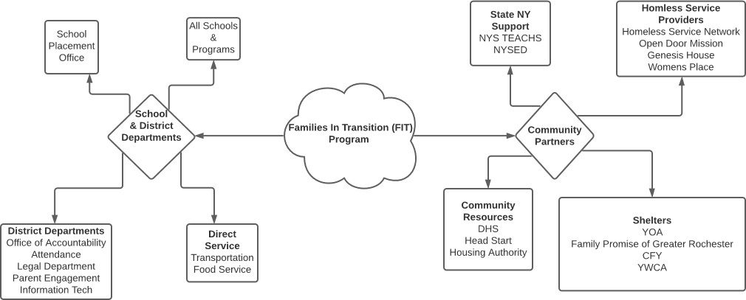
FIT Program Flowchart

Slide 13
Role of McKinney-Vento Liaison
Identification
Enrollment
Referral for Early Childhood
Referral for Health, Housing, and Other Needed Services
Parent Involvement
Posting Public Notice
Dispute Resolution
Transportation
Training for Colleagues
Meeting Needs of Unaccompanied Youth

Slide 14
Statistics- Last 5 Years
Year MV STAC Unaccompanied Youth
2016-2017 2723 135 190
2017-2018 3286 224 110
2018-2019 2880 160 77
*2019-2020 2295 162 53
*2020-2021 706 12 6
*Effects of the National Pandemic
STAC: System to Track and Account for Children

Slide 15
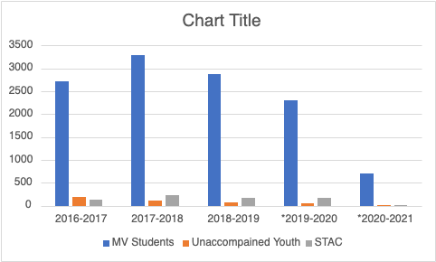

Slide 16
Leading Causes of Homelessness:
Substandard/Lack of Affordable Housing
Reduced Employment Opportunities
Loss of Employment
Domestic Violence
Physical/Mental Illness
Substance Abuse
Students Ejected From Home
Relocation

Slide 18
Elda Lopez Santana, Bilingual Home School Assistant
Current Needs and challenges faced by Students and Families Experiencing Housing Instability
https://drive.google.com/drive/folders/14UHHf3Iq7JMP5bB19OJXF9M2kNqRfONp?usp=sharing

Slide 19
Hannah Noble, Intern
Opportunities to Collaborate with Others in the Community
https://drive.google.com/drive/folders/1gfS0aCed8-avBE298LMxUhZPmOaHFrlz?usp=sharing

Slide 20
McKinney-Vento Resources
NYS TEACHS
Jennifer Pringle, J.D.
Project Director, NYS-TEACHS
New York State Technical and Education
Assistance Center for Homeless Students
www.nysteachs.org
151 West 30th Street, 5th Floor
New York, NY 10001
NYS-TEACHS Hotline (800) 388-2014
Direct (212) 822-9546
Fax (212) 807-6872
jpringle@advocatesforchildren.org
www.advocatesforchildren.org
NYSED
Melanie P. Faby, Program Associate
New York State Education Department
Office of Accountability -Title I
89 Washington Avenue, 320 EB
Albany, New York 12234
Phone: (518) 473-0295 FAX: (518) 486-1762
E-Mail: melanie.faby@nysed.gov

Slide 21
Staff Contact Information:
Gladys Williams, Secretary
Gladys.Williams@rcsdk12.org
585-324-9982
Elda Lopez Santana, Bilingual Home School Assistant
Elda.Vazquez@rcsdk12.org
585-324-9981
Greta M. Davis, MSEd, LCSW-R, CASAC II
McKinney-Vento Liaison
Greta.davis@rcsdk12.org
585-324-9983
30 Hart St., Room 122, Rochester NY 14605

