Slide 1

What is Affordable Housing?
Leslie R. Harvey
Outreach Administrator

Slide 2


Slide 3


The Housing Council in the Monroe County Area Inc., was founded in 1971 to expand safe and affordable housing opportunities for low and moderate-income persons residing in Monroe County, NY.
The affiliation with PathStone Corporation took place March 7, 2013. The Housing Council at PathStone is a HUD approved Housing Counseling Agency.

Slide 4


Programs & Services
Housing Hotline
Rental Registry update twice a week
Landlord Training
Tenant Education
First Time Homebuyer Services
Pre and Post Purchase Education
Foreclosure Prevention
Reverse Mortgage Counseling (HECM)
Fair Housing
Department of Human Services Inspections

Slide 5

50 Years Later
1971 – Lead poisoning issues
Good /safe neighborhoods
Redlining by realtors
2021 – High rents
Low housing stock
Accessibility for POC

Slide 6
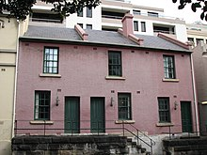
Types of Housing Options
Private Landlords
The Landlord is the property owner
Must maintain Warranty of Habitability
Should have a Certificate of Occupancy

Slide 7
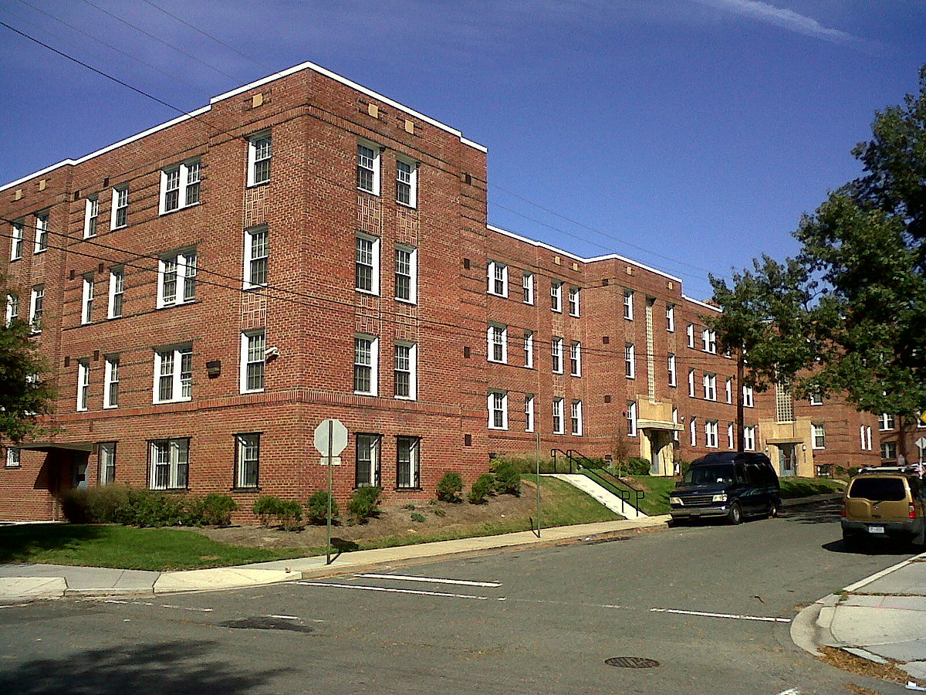
Types of Housing Options
Affordable Housing
Income Based
Affordability Index
National standard – 30% of income
Income standard includes rent/utilities
No sacrifice for basic needs

Slide 8

Disqualifications for Affordable Housing
Conviction for Methamphetamine production in the home
Lifetime sex offenders
Felony convictions are reviewed on a case-by-case basis

Slide 9
Types of Housing Options
Affordable Housing
Income Based
Affordability Index
National standard – 30% of income
Income standard includes rent/utilities
No sacrifice for basic needs

Slide 10

Types of Affordable Housing
Section 8
Helps low-income afford housing
Provides housing in private and managed rental units
Is transferable
Pays anything above 30% adjusted monthly income
Project Based Voucher
Rental subsidy attached to the unit only
Is non-transferable
Tenant pays 30% of income
Public Housing
Property is funded by a government entity
Comes in all types and sizes
Is available for families, elderly, persons w/disabilities, etc.

Slide 11


Who is Eligible for Affordable Housing​
Families/Individuals earning below 50% AMI
Elderly 62+ years old
Persons with disabilities as defined by HUD
Seniors 55+

Slide 12

Why the need for Affordable Housing​
Studies proves more likely to succeed
More safe
Healthier
Sutainable communities
Create jobs
Promotes Diversity

Slide 13
Fair Market Rent
A person would need to make at least $17.41/hr to afford a 2 bed in Monroe County.

Slide 14

Standard application process for Affordable Housing Units​
Complete an application
Gather qualifying documents
Proof of all household income
In-person interview
Tour of available units
Lease signing > Move-In date > Pay security deposit

Slide 15

Documents Needed
Recent paystubs
Bank statements
Two forms of photo ID
Copy of Social Security card
Prior year tax returns
Birth certificates for all occupants

Slide 16
What to bring to the interview
1. Name, address, and phone number of employer.
Also, name and phone number of the human resource person/office to verify your income.
2. Most recent income tax return and all W2’s
3. Proof of the following income and benefits:
  DSS Budget sheet, caseworker name, team number, phone and fax number
  Current Social Security, Disability and or SSP Award Letter, or most recent printout
  Child Support Court Order or payment history printout
  Alimony Court Order
  Unemployment verification
  Military/Veteran pay stubs
  Workers Compensation Verification
  Pension Benefits Letter
  Periodic Withdrawal from Trust Funds
4. Name of bank and account numbers for all bank accounts
5. Most recent statement from 401k, Stocks and Bonds, Gifts, and Lottery winnings
6. Birth certificates for all household members and proof of custody for all minors
7. Social Security cards for all household members
8. Photo ID’s for all adults

Slide 17

Common Reasons for Application Denial
Incomplete form
Falsified information
Not eligible
Criminal record
Background check

Slide 18

Fair Housing Laws
Federal, State, and some Local government have enacted Fair Housing laws that prohibit the use of certain characteristics that are, considered to be, irrelevant, not business related and/or consistent with business necessity as criteria to determine qualifiction in the sale, rental, or financing in housing unless exemption rule apply.

Slide 19

Who Must Follow The Law?
Landlords
Property Managers
Real Estate companies
Municipalities
Banks or other lending institutions
Homeowner insurance companies

Slide 20
What Housing Is Covered?
- Rental
- Sale
- Leasing
Discrimination based on race is illegal in all instances
Advertising in any discriminatory manner is also illegal in all instances
Exceptions/Limitations
- Owner Occupied
- Religious Organization
- Private Clubs
- Housing for Older People

Slide 21

Who is Protected?
Fair Housing Law
Federal Protected Classes:
Race
Color
National Origin
Religion
Sex [Gender] - Includes Sexual Harrasement
Familial Status
Disability (actual or perceived)

Slide 22



A Collaboration between

Slide 23

Our Goal
Diversity
Equity
Inclusion

Slide 24

PathStone Corporation | Rochester Regional Health

Slide 25
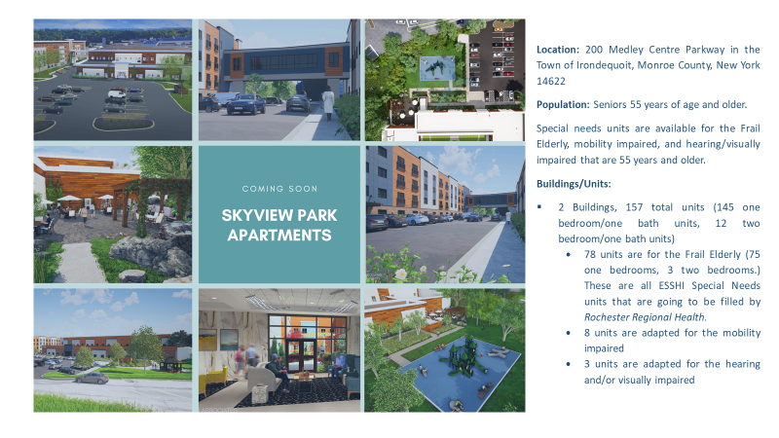

Slide 26
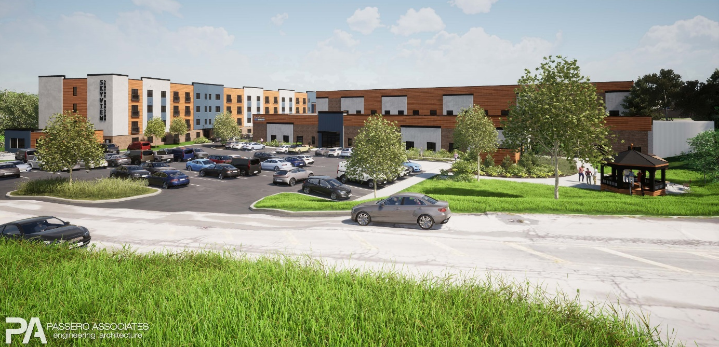
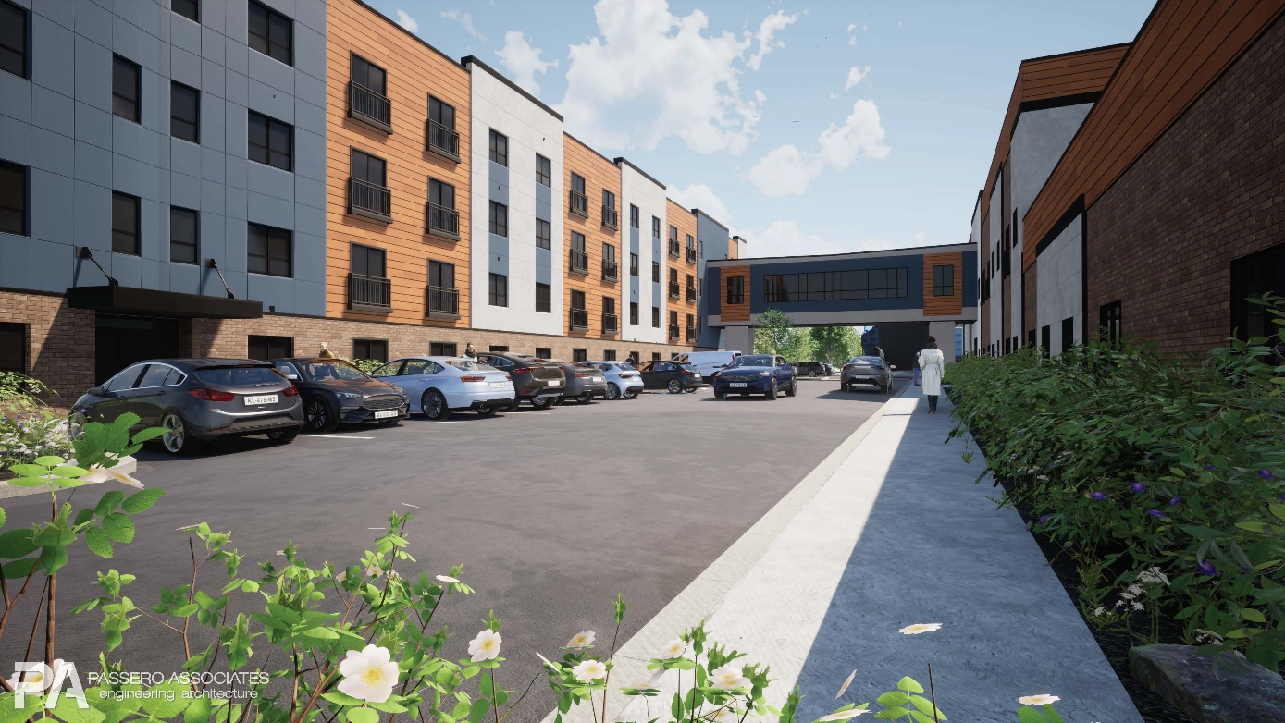
Amenities:
Non-Smoking Community
3 Beautiful Courtyards
Community Gardening Space
2 Outdoor Patios with Grilling Stations
Indoor Community Rooms and Gathering Areas
Storage Lockers
Fitness Center
Ample Parking
Elevators
Enclosed Skybridge Connecting Both Buildings
Security Systems
Washer and Dryer in Each Unit
In-unit Call System for Emergencies
Juliet Balconies
Air Conditioning
Roll-in Showers Available
Grab Bars
Quartz Counter Tops
Carpeting in Bedrooms
Large Closets
Utilities:
Heat and hot water are included. Resident pays electric.

Slide 27
Looking to Apply?
Applications Accepted Starting March 19th, 2021
Apply Online at Skyviewparkapartments.org
Request and Application by e-Mail at leasing@pathstone.org
Request an application via phone at (585) 546-6340 or TDD 1-800-545-1833
Printed application may be picked-up outside of our corporate office at 6 Prince Street, Rochester, NY 14607
Return Applications to leasing@pathstone.org
Or drop off/mail to 6 Prince Street, Rochester, NY 14607
(A drop slot is located in the main door of the office)
Due to COVID-19 our office is currently closed to the public for walk-ins.
The housing lottery for Skyview Park Apartments will be held on Tuesday, June 8th at 2pm EST via ZOOM.
The Application deadline to be included in the lottery is May 18th, 2021.

Slide 28


