Slide 1
Exploring Causes of Shelter Entry and Re-Entry
Leanne W. Charlesworth, Lindsay Fink
& Sarha Smith-Moyo
Notes:
Lindsay

Slide 2
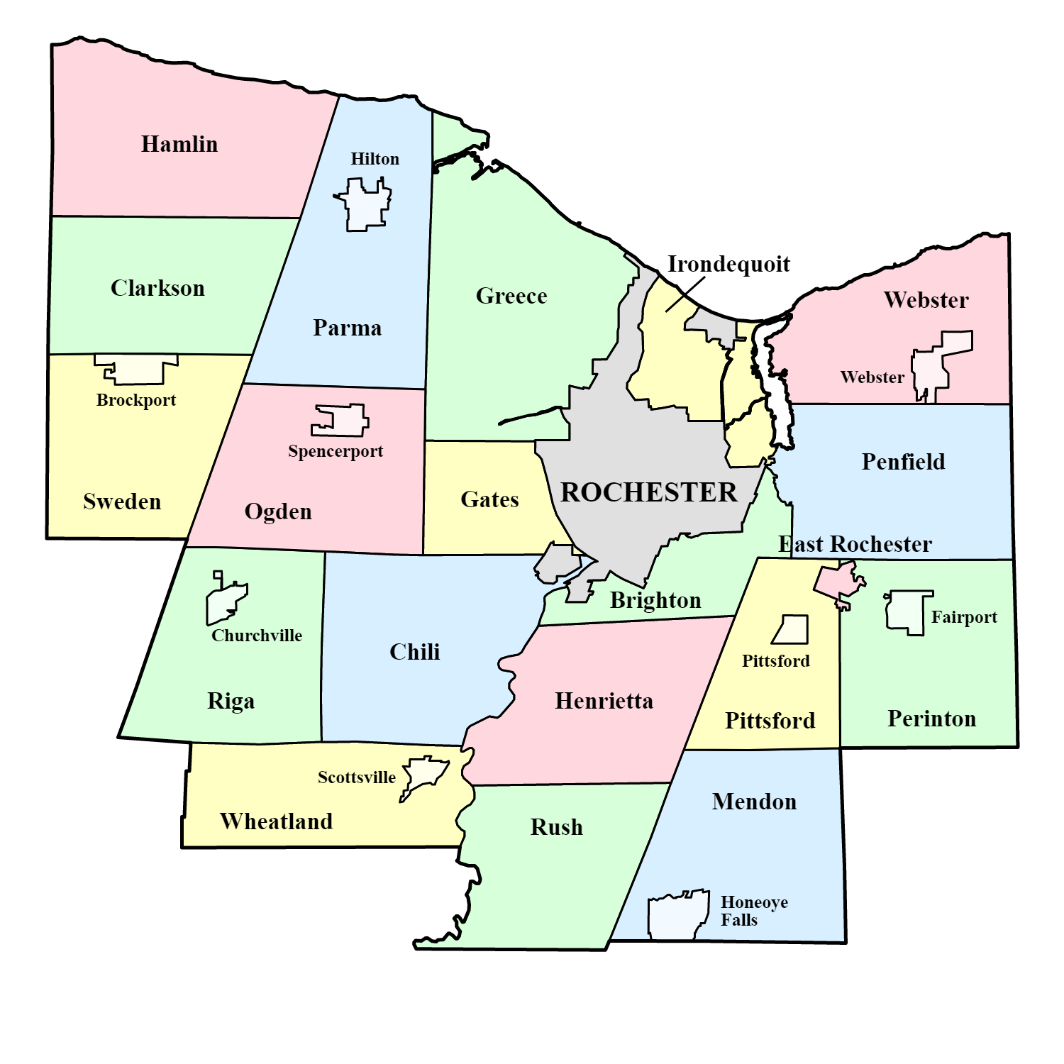
Overview
This study analyzed 2019 Homeless Management Information Systems (HMIS) data from emergency shelters in Monroe County in order to explore the basic characteristics of one segment of the homeless population, and the dynamics of homeless shelter use.
In 2019, eviction was the most common recorded reason for shelter entry
Primary reason for shelter entry differed according to gender, age and race/ethnicity
Return to shelters (or shelter re-entry) was common
Notes:
Lindsay

Slide 3
Brief Review of Causes of Homelessness in the U.S.
Different causal factors overlap and synergistically contribute to homelessness
Factors include (but are not limited to):
- Lack of income
- Substance use
- Mental health challenges
- Incarceration
- Family violence
Eviction is a significant cause of homelessness (Crane, 2005)
Demographic differences:
The ‘chronically homeless’ are more likely to be older than those moving quickly in and out of homelessness (Henwood, et al., 2015). Older adults appear to be more likely than younger adults to avoid services and treatment (Wilke & Vinton, 2005).
Males comprise the majority of the homeless population (Bird, et al., 2017). Women are more likely to enter homelessness due to domestic violence and men are more likely than women to enter after incarceration (Hardin & Wille, 2017
-
Notes:
Leanne

Slide 4
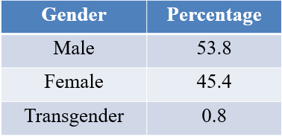
The Present Study: Demographics
3,137 individuals recorded as entering 16 different emergency shelters in Monroe County in 2019.
Age ranged from 12 to 82 with an average age of 36; 4.6% (n=145) fell between 12 and 17 years of age.
Race/Ethnicity:
60.5% (n=1,899) Black or African American
37.8% (n=1,187) White
< 2% (n=51) = Native Hawaiian or Pacific Islander,
Asian, or American Indian or Alaskan Native
Notes:
Lindsay

Slide 5
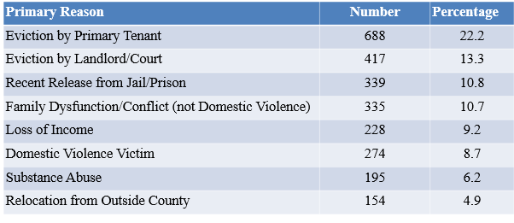
The Present Study: Primary Recorded Reason for Shelter Entry
Eviction by primary tenant and eviction by landlord/court were the primary reasons for shelter entry across all groups
Notes:
Leanne

Slide 6
The Present Study: Shelter Entry Differences
Gender
Men more likely to identify recent release from jail or prison as a cause than women (86.7% of men compared to women at 15.9%)
Women more likely to report domestic violence as a cause than men (86.1% of women compared to 12.8% of men)
Age
Generation Z (born between 1997 and 2019, n=539) top three reasons for shelter entry: eviction by primary tenant, family dysfunction, domestic violence
All other generations’ top three reasons for shelter entry: eviction by primary tenant, eviction by landlord or court, recent release from jail or prison
As age increased, medical, mental health, and substance abuse challenges grew more common as the reported primary reason for shelter entry
Race/Ethnicity
Non-Hispanic/Latino whites were more likely to enter, than other racial/ethnic groups, due to substance use, natural disaster and mortgage foreclosure
Black or African Americans were more likely to enter due to family dysfunction, recent release from jail or prison and criminal activity
Notes:
Lindsay

Slide 7
The Present Study: Shelter Re-Entry
29.8% (n=935) of sample members returned to either the same or a different shelter in 2019. These 935 individuals accounted for 1,160 of the total 4,619 (25%) shelter entrances in Monroe County in 2019
Most (68.2%, n=638) had two recorded shelter entries
17.7% (n=165) had three recorded entries, 7.7% (n=72) had four, approximately 6% had five or more.
Individuals differed significantly in the reason for shelter re-entry
Notes:
Lindsay

Slide 8
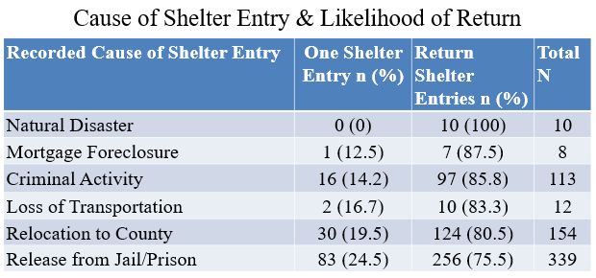
The Present Study: Shelter Re-Entry
Notes:
Leanne

Slide 9
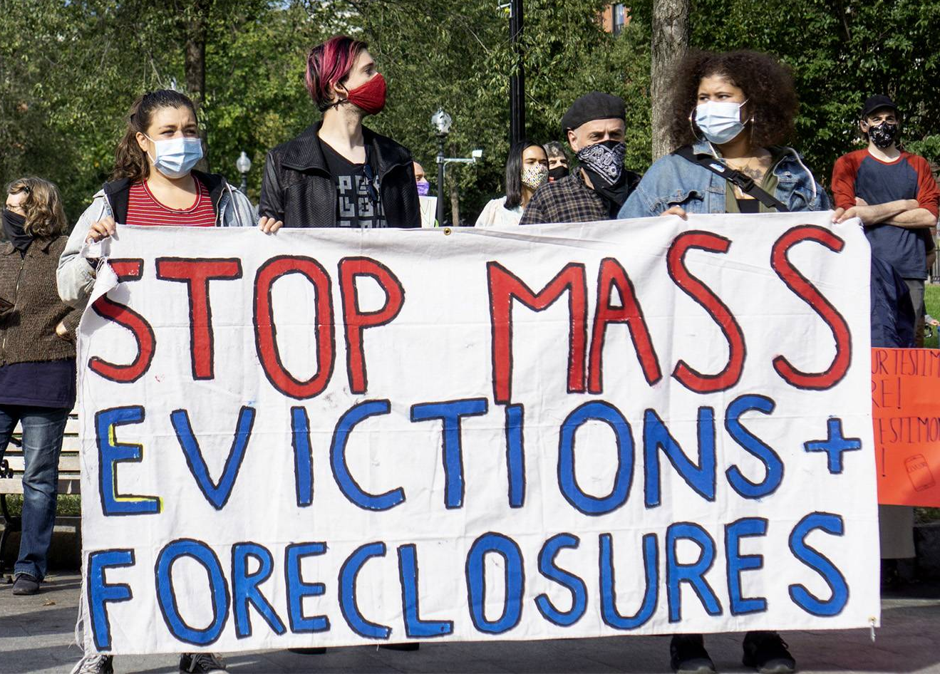
Recommendations
Eviction must continue to be addressed in homelessness prevention
efforts.
Demographic differences should be considered in tailoring policies and programs.
Complex inter-relationships among risk factors must be researched further and integrated into evidence-based prevention and intervention.
In shelters, reason for entry could be used as risk of re-entry assessment point.
Notes:
Leanne

Slide 10
References
Bird, M., Rhoades, H., Lahey, J., Cederbaum, J., & Wenzel, S. (2017). Life goals and gender differences among chronically homeless individuals entering permanent supportive housing. Journal of Social Distress and the Homeless, 26(1), 9–15. https://doi.org/10.1080/10530789.2016.1274570
Crane, M., et al. (2005). The Causes of Homelessness in Later Life: Findings From a 3-Nation Study. The Journals of Gerontology. Series B, Psychological Sciences and Social Sciences, 60(3), S152–S159. https://doi.org/10.1093/geronb/60.3.s152
Duchesne, A. T., & Rothwell, D. W. (2016). What leads to homeless shelter re-entry? An exploration of the psychosocial, health, contextual and demographic factors. Canadian Journal of Public Health, 107(1), e94–e99. https://doi.org/10.17269/cjph.107.5271
Hardin, J., & Wille, D. E. (2017). The homeless individual’s viewpoint: causes of homelessness and resources needed to leave the sheltered environment. Social Work and Social Sciences Review, 19(2), 33-45.
Henwood, B., Byrne, T., & Scriber, B. (2015). Examining mortality among formerly homeless adults enrolled in Housing First: An observational study. BMC Public Health, 15(1), 1209–. https://doi.org/10.1186/s12889-015-2552-1
National Alliance to End Homelessness. (2020, January 27). Chronically Homeless. https://endhomelessness.org/homelessness-in-america/who-experiences-homelessness/chronically-homeless/
National Alliance to End Homelessness (2021). State of Homelessness: 2020 Edition.https://endhomelessness.org/homelessness-in-america/homelessness-statistics/state-of-homelessness-2020/
Wilke, D., & Vinton, L. (2005). The nature and impact of domestic violence across age cohorts. Affilia, 20(3), 316–328. https://doi.org/10.1177/0886109905277751

Slide 11
Questions?

