Slide 1
101 OF CHANGES FOR INCOME& HUD VERIFICATIONS
HMIS 2.2.22

Slide 2
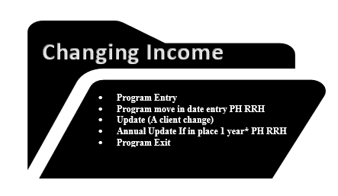
Non-cash and health insurance
Updating a disability can only be done at the entry so if it ever needs to be updated one must go into the pencil at the entry date.

Slide 3
1st thing to remember is YOU MAY NOT HAVE PUT THE HUD VERIFICATIONS IN BUT IF YOU CAN SEE IT, YOU MUST DEAL WITH IT. This means if you go into a HUD verification, and you see something that no longer applies then YOU MUST END IT!!
you must do this by preserving the previous history of that HUD verification and ending via the pencil and changing it through the HUD Verification Icon NOT TYPING OVER or changing information.
2nd YOU MUST END THE OLD before STARTING THE NEW. So, for every new income or HUD verification change there must be two steps, #1 END THE OLD AND #2 BEGIN THE NEW

Slide 4
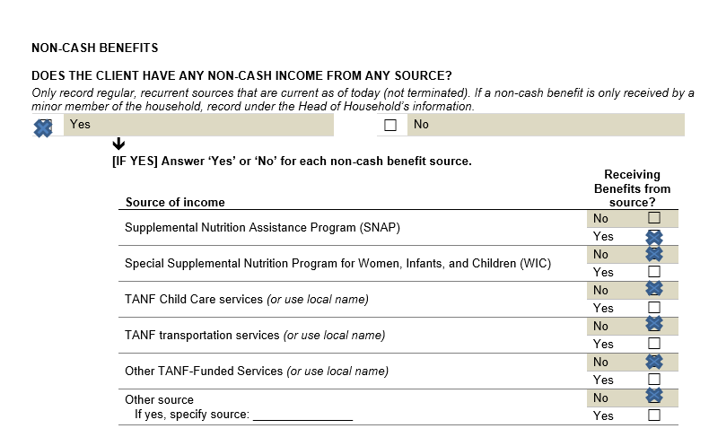
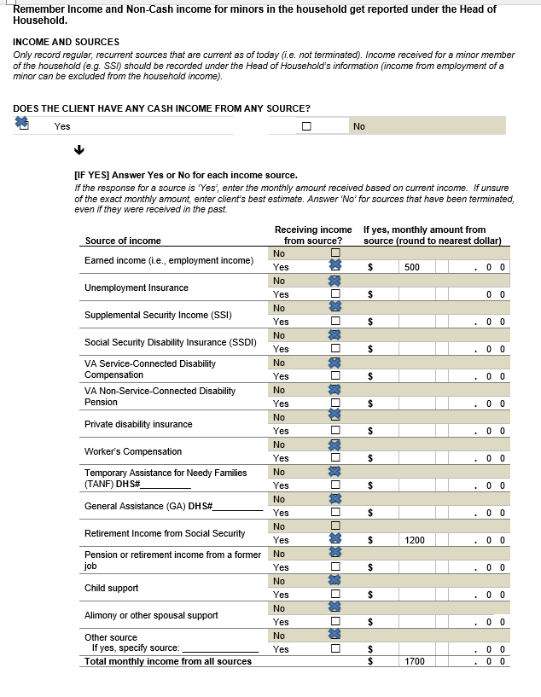
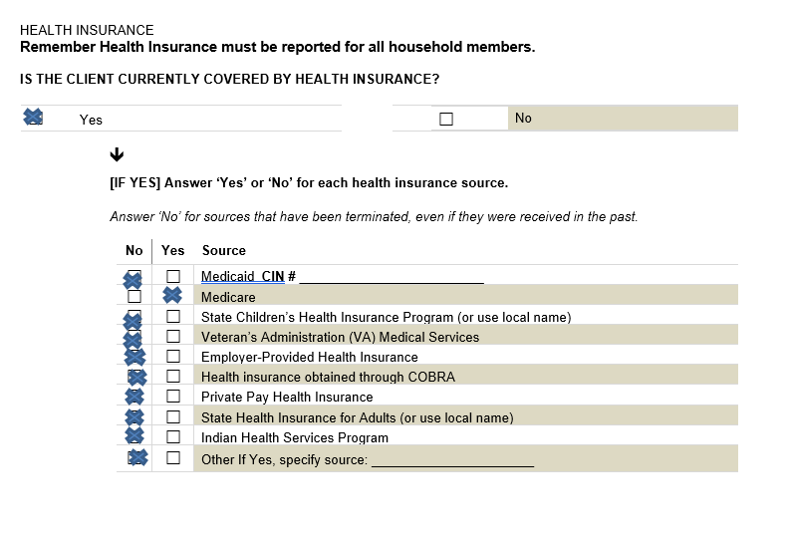
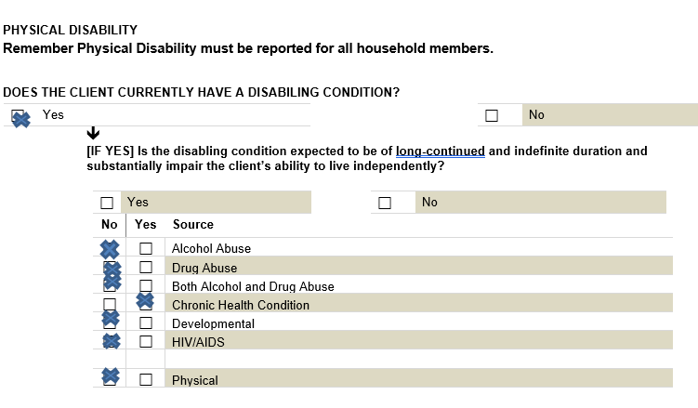
Remember the HUD verifications are exactly that, we are verifying four different types of HUD verifications:
cash income
non-cash income,
health insurance
physical disability
Each of these HUD verifications have a yes or no question and then the actual items for verifying, starting the date that you are doing your particular entry type for:
Entry
Move-in
Update(change/interim
Annual assessment
exit
you would obtain this information from the paper HUD intake/exit form that contains section that look like these shown
Once you have the current information you need to compare to what is already showing in the clients HMIS record and make any changes needed WITHOUT LOSING THE HISTORY of what is there currently

Slide 5
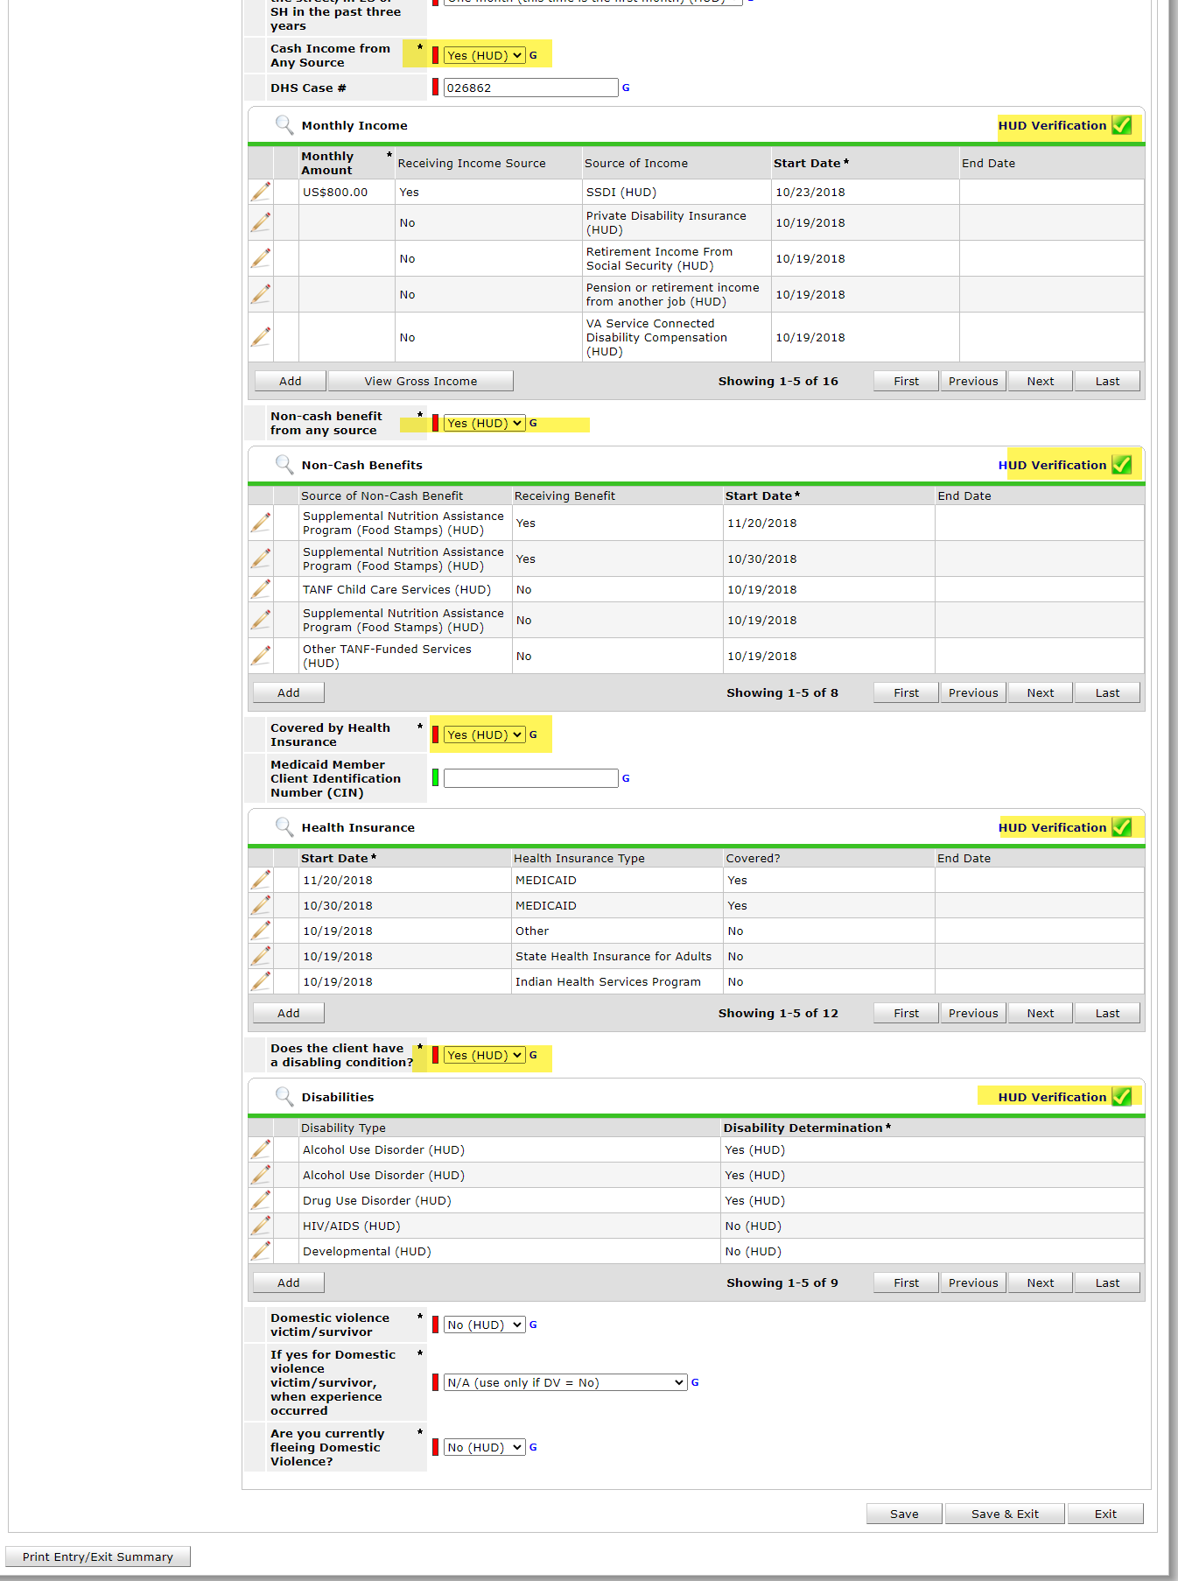
When you go into your entry, the assessment comes up ,you can see the four HUD verifications with the yes/no question:
cash income with the yes/no
Non-Cash with the yes/no
Covered by health insurance with the yes/no
Does the client have a disabling condition with the yes/no
when you complete your assessment All the HUD Verification MUST BE GREEN and not RED.
Right= Wrong=
Every HUD verification has an “ADD” button at the bottom of that section-you will never use this “ADD” button to add or change income. Pretend it does not exist. You will always use the magnifying glass and the actual HUD verification button to change or modify a HUD verification field .

Slide 6
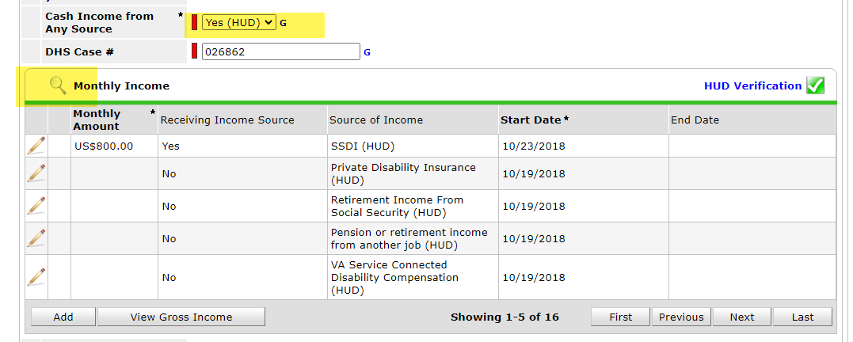
To start our HUD verifications, we would first start with cash income.
Based on the paper assessment that was filled out with the client, we can see that they told us they have Earned Income of $500 a month and Retirement Income from SSI of $1200 a month
So, we would answer the yes/no question with a “Yes” that they have cash income from any source.
Next click on the magnifying glass to open up the current list of cash income.

Slide 7
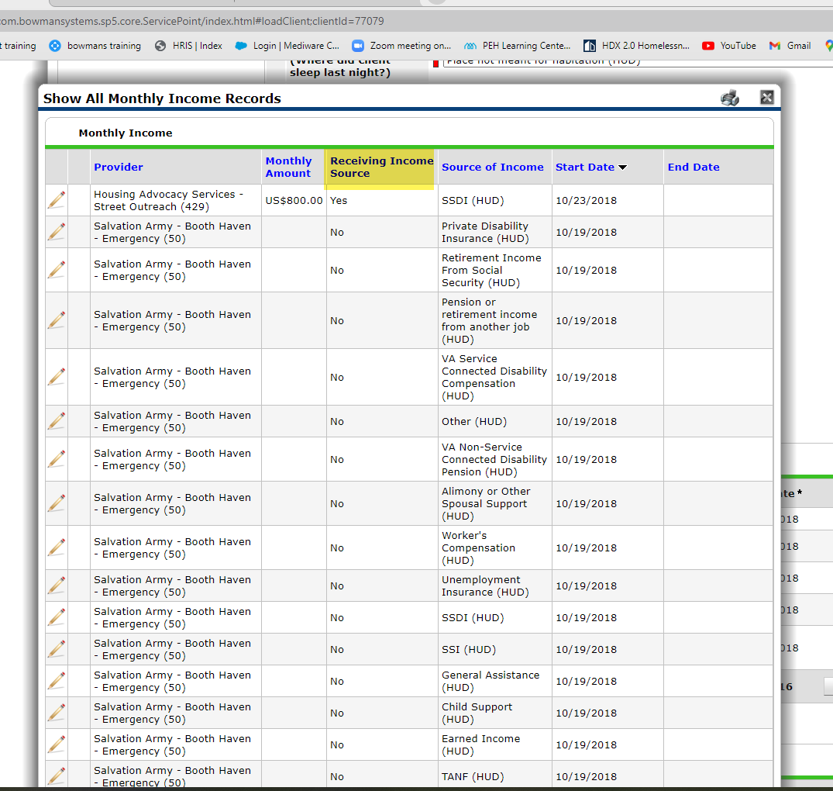
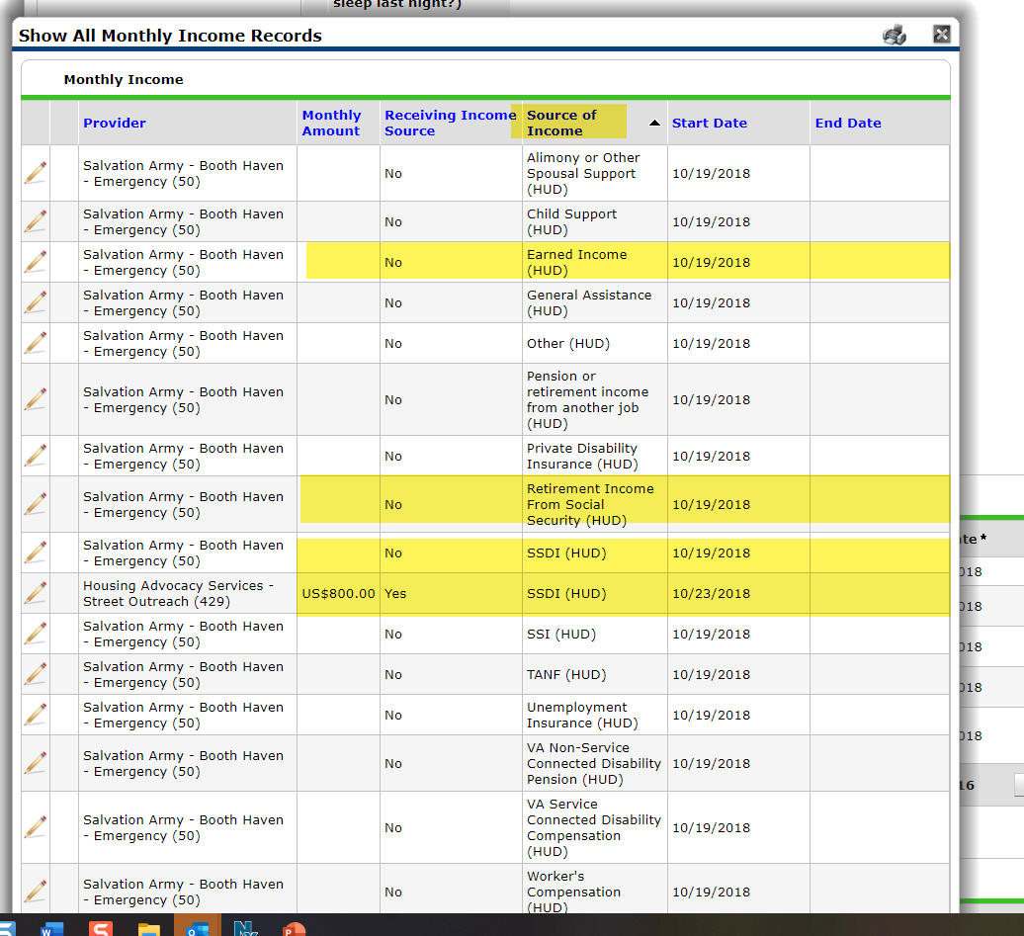
When you click on the magnifying glass it will open up all the monthly income records as shown
the first thing you want to do is click on where it says receiving income source and it'll move all the yes’s to the top.
This way you can see what is the current active income, they are reporting as receiving .(this is a yes with no end date)
Now we
need to see the
sources of
income that
are reported
(ender and open)
To do this click on
the Source of
Income column to
group the sources.
We can now see that some sources have multiple open income like the SSDI has both a yes and a no with no end dates, so they are both active. If you can see it then in order to change it, you need to deal with all that have no end dates.
So based on the reported income on the previous page we know they have earned income of $500 and Retirement income from SS of $1200 and NO SSDI
WE now need to report that income here without typing over or deleting the history already reported here as of the entry date.

Slide 8
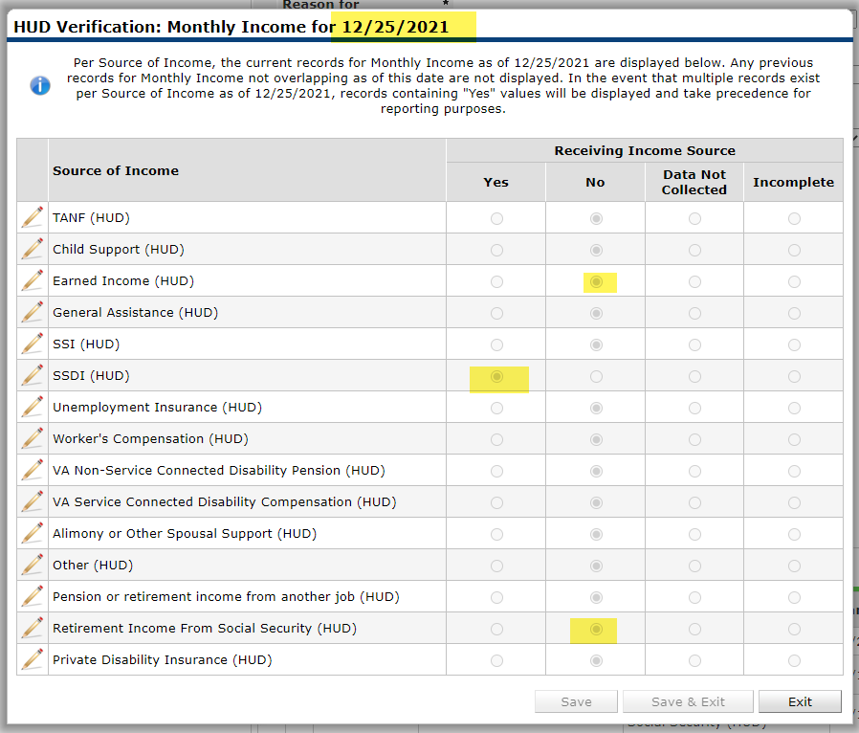
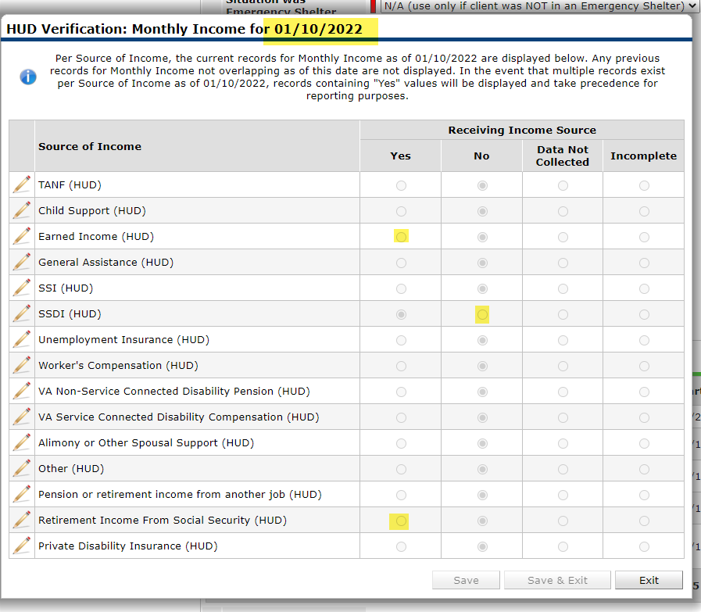
That being said what we need to happen is to get the dots for the monthly income that are in there from the 12/25/21 last update which shows:
Earned income as “NO”
SSDI as “YES”
Retirement Disability Income from Social Security as “NO”
changed
so that for 1/10/2022 it shows:
Earned Income as “YES”
SSDI as “NO”
Retirement Income from Social Security as “YES”
But we need that to happen without wiping out that 12/25/21 history . No typing over, no using the “ADD” button, no field exiting

Slide 9
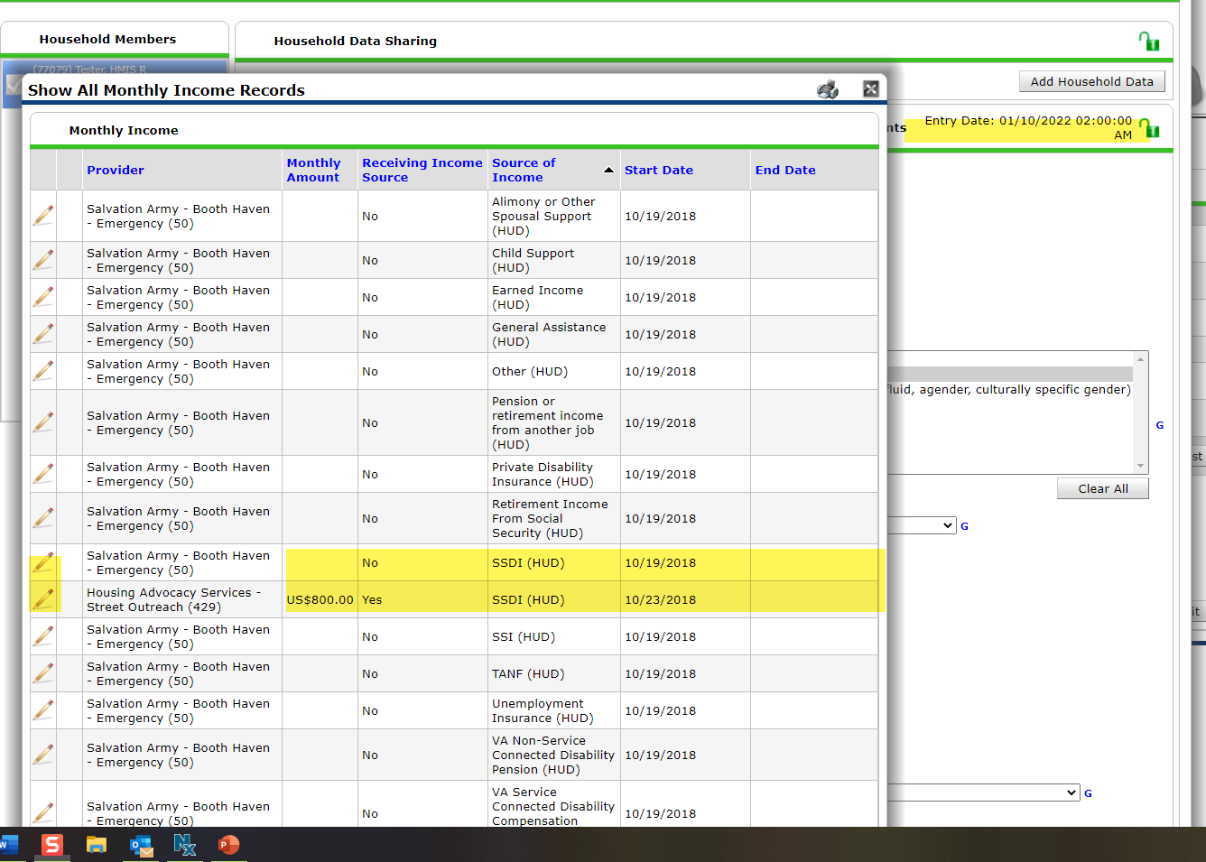
we do this Just using the pencil in front of the current income and ending it for the day before our new start date!
We use the day before because we need to start the new for the date of our entry and they can’t be the same date. Also, It does not matter when the change actually happened you only care about the day before you are doing the entry or the change for.
let's start with the SSDI….
In this case we have two that need ending, the reason for this most likely is the “YES” was added using the “ADD” button without ending the “NO” and going through the HUD verification tab. As we can see this create an extra burden for the next time there is a change so again never add a HUD verification items using the “ADD” button use the steps show next.
So lets click on the first pencil by the “No” for the SSDI

Slide 10
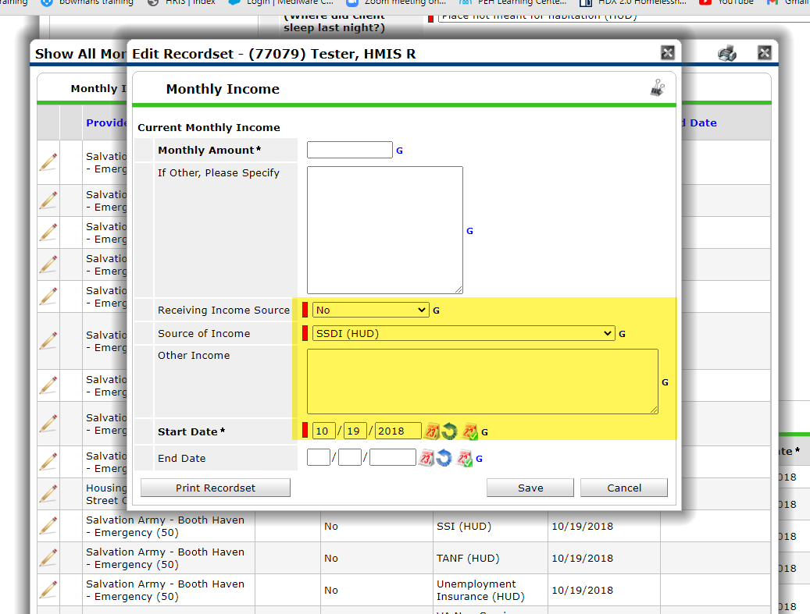
When you click on the pencil you will get this popup
the first thing to remember is you are never ever going to change anything in this popup
you will not change anything here
you will not change a source of income
you will not change a start date
you will leave all that information just as you see it when the popup opens

Slide 11
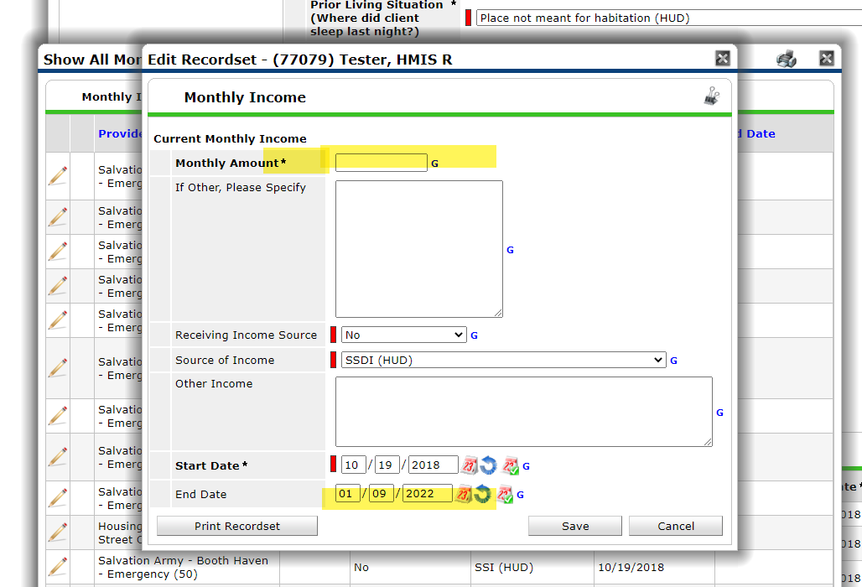
On this pop up the only areas you will possible touch is :
On a “NO” you need to enter the monthly Amount on “0” because a no=zero no monthly$
If you are just changing an amount for the income and the “Receiving Income, say “YES” YOU DO NOT TYPE OVER AND PUT THE NEW AMOUNT HERE ! LEAVE IT ALONE AT THE OLD AMOUNT. We will change in another screen
Next the End Date, which is always the day before whatever the entry date is you are working with for your change. IT IS NOT WHEN THE CHANGE ACTUALLY HAPPEN but the day before this change is going to START.
once you enter the needed

Slide 12
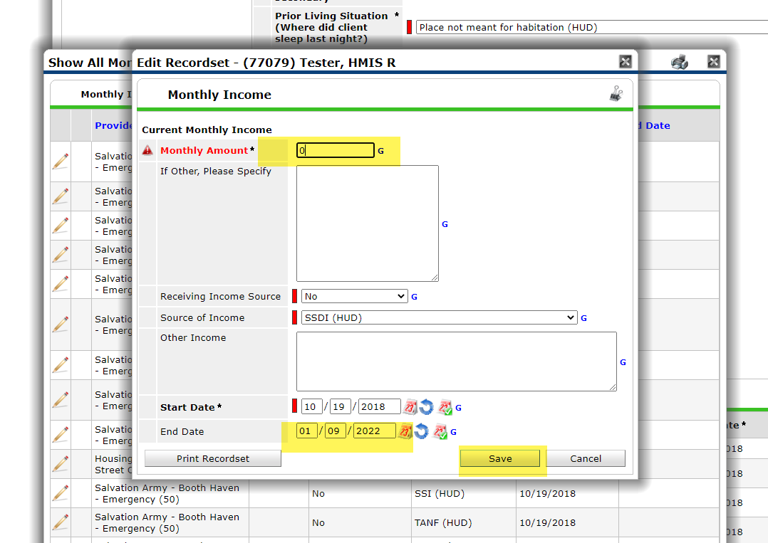
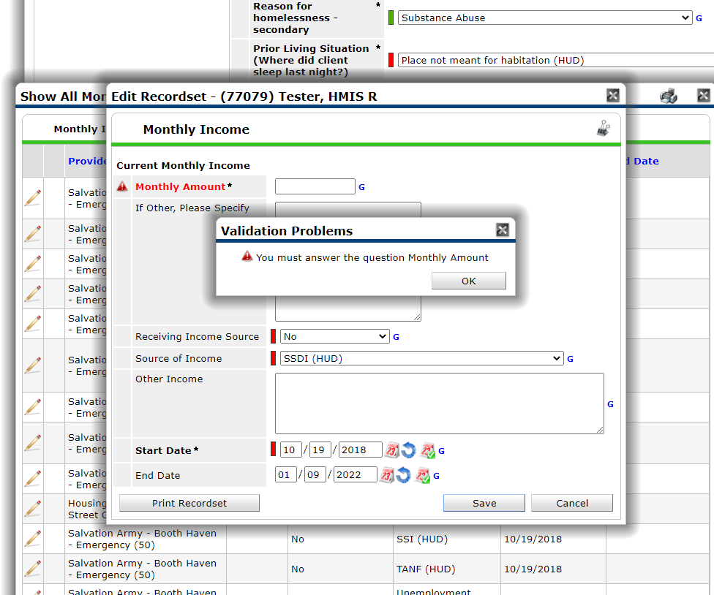
On our example we need the end the one “NO” for SSDI, so we need to put that zero up in the monthly income
if you forget to do the zero on the monthly income and you hit save you are going to get this popup that says you must answer the question for a monthly income you would hit OK and you would add your zero
Then add the End Date for the day before out entry date (which in this case is 1/10/2022)
then hit save

Slide 13
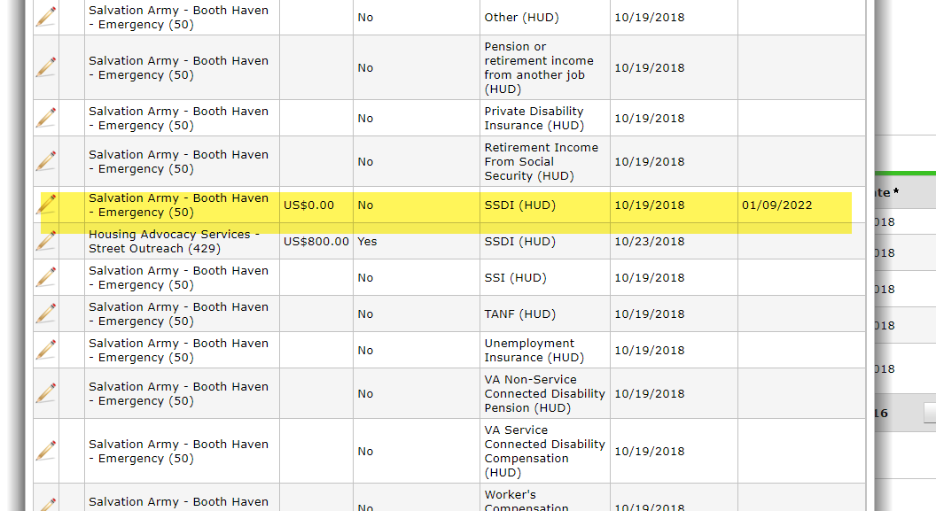
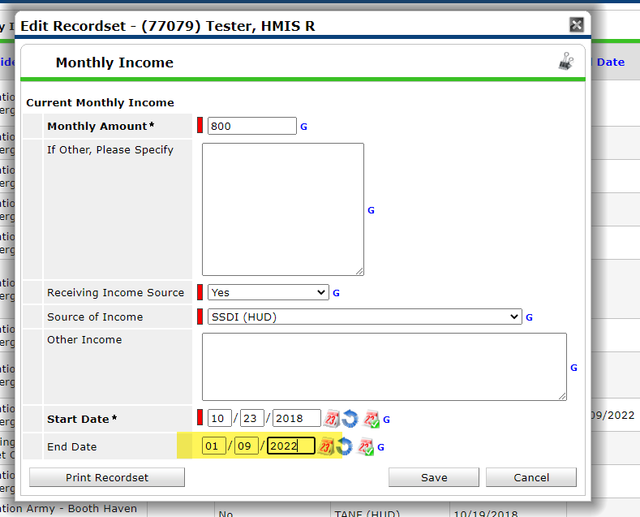
We come back to the cash income screen, and we can now see there is an end date next to the SSDI now
We now must end the “YES” for the SSDI of the $800 because they no longer have that income
We do this the same way as we did the no before, and we go into the pencil
We come back to the pop up
since this is a “YES” we do not change the monthly amount (leave it at the amount in there)
We do not change the receiving income source ( leave it at the status shown)
we do not change the start date(leave it at the date that is in there)
All we do is go down to the end date and end it for the day before
And hit save

Slide 14
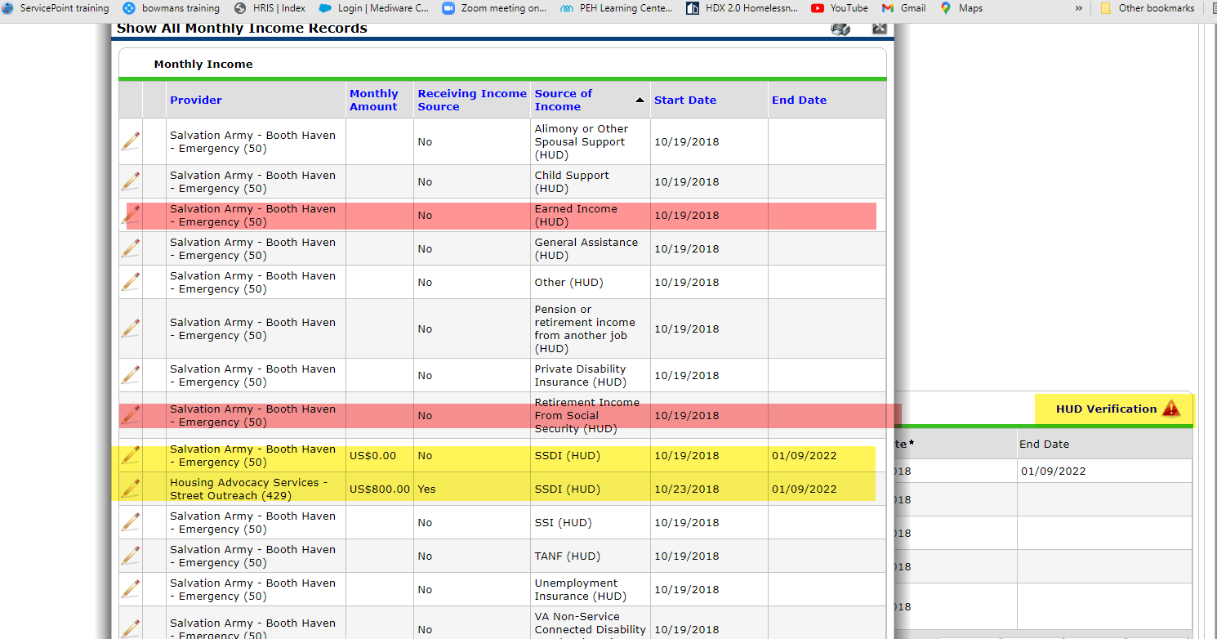
This time when you returned to the cash income screen you will see that the SDI with the yes is also now ended but also your HUD verification is now showing red
this is because we have now moved the dot for the SSDI to the incomplete from the yes/no columns inside the HUD Verification for the start date of 1/10/2022( this will allow you to now say that on 1/10/22 they are no longer receiving SSDI
but before you can do that you must do the same end dates through the pencil for the “Earned Income” and “retirement Income for SS”
this is to allow their HUD verification dots to also move within the HUD verification so you can change the status starting 1/10/2022

Slide 15
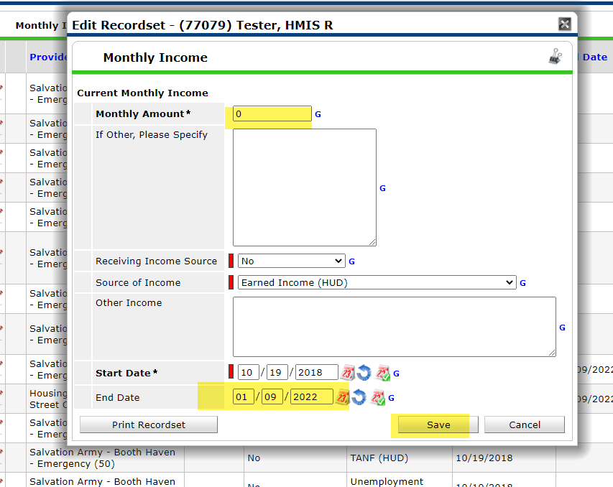
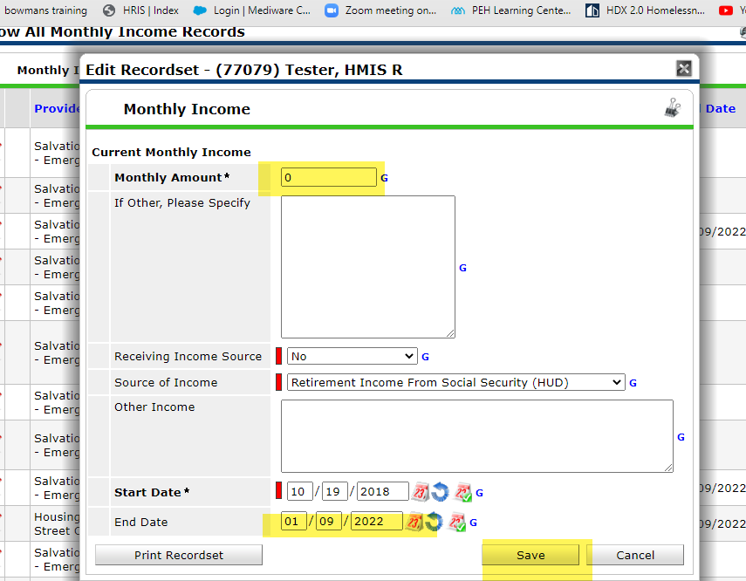
By going into each of those pencils for the Earned Income NO and Retirement Income Social Security NO you’re going to get the pop up just like shown previously.
Since these are both “NO” you would put the “0” under the Monthly Amount and then go down to the End Date and put the “day before date”
Then hit save
REMEMBER DO NO CHANGE ANYTHING ELSE

Slide 16
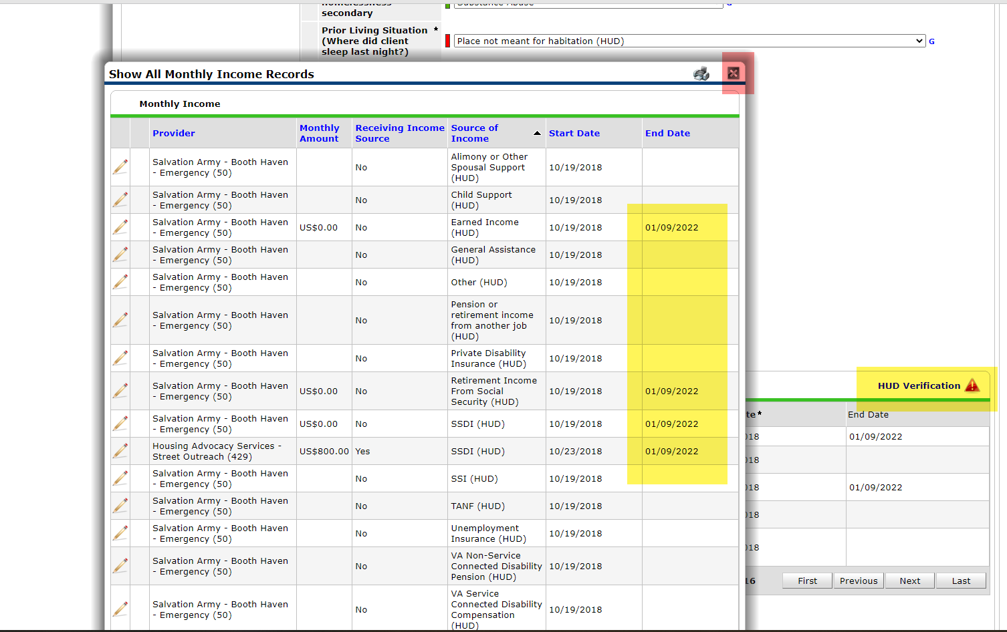
After finishing your last end date and hitting saved you will come back to show all monthly income records and you will see an end date on all the areas needed
the end date for the earned income NO because they now have earned income And we need to start it
retirement income for Social Security because they now have that income, and we need to start it
and the end date for the two SSDI’s because they no longer have that type of income, and we need to end
At this point we will click on the RED HUD VERIFICATION tab

Slide 17
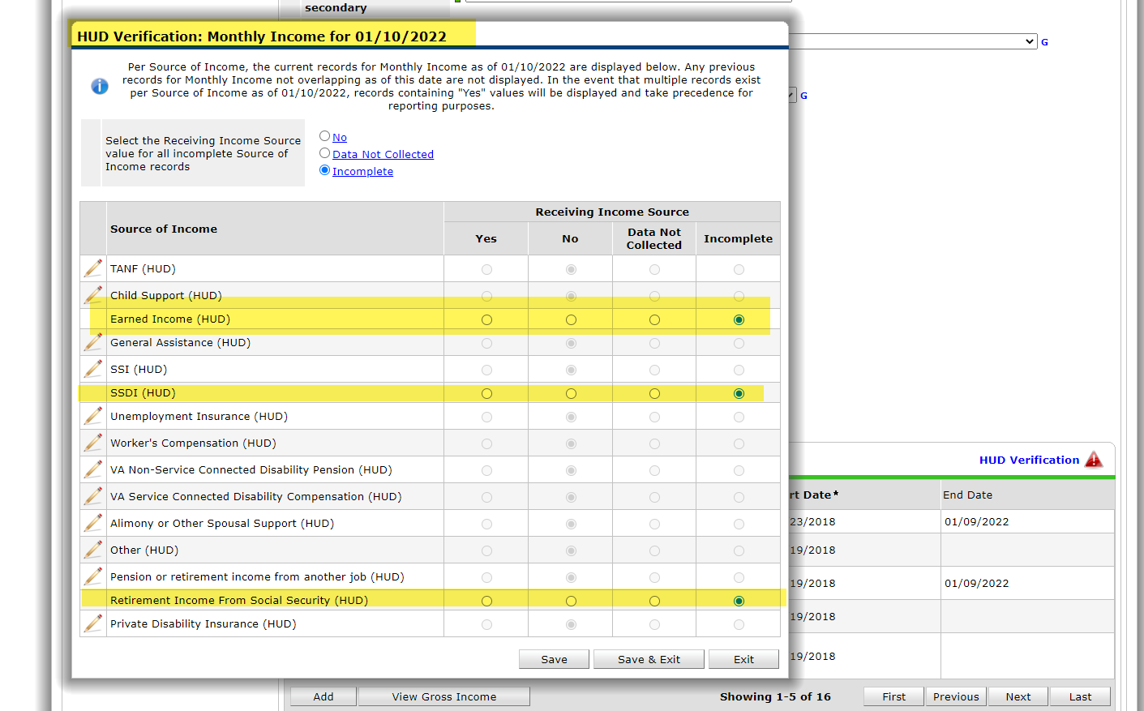
Once you click on the red hood verification at the popup you will now see it opens up for the date of 1/10/2022 and shows the 15 types of income
but three of them show incomplete in those three are
Earned Income
SSDI
Retirement Income for Social Security
these were the three types that we ended by going through the pencil, putting an end date
we will now move those incomplete dots to either yes or no for the start date of 1/10 22to verifying whether that income is yes or no

Slide 18
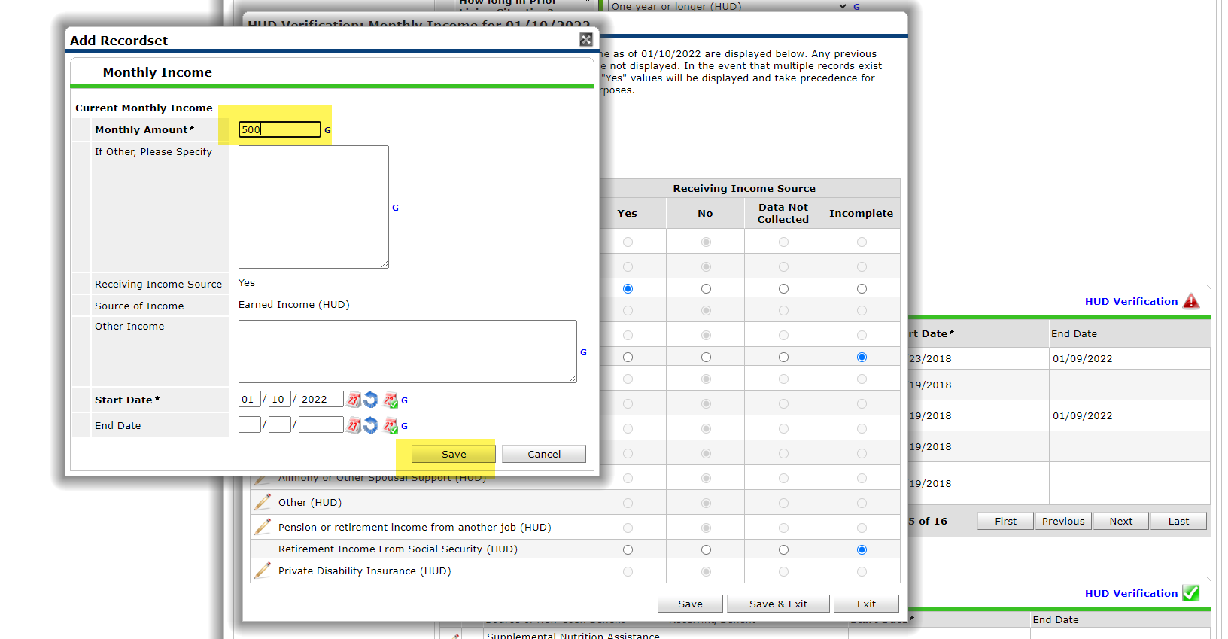
So, the first Incomplete is Earned Income. We move it to yes by clicking on the “YES” dot space.
when we do that the Add Recordset pops up
from here is where we now add the new Monthly Amount based on our intake form. It already has the YES filled in the Source is filled in and the Start date of out entry date we do not need to do any of that.
By going through the HUD Verification, we don’t type over or change anything we just fill in the new amount and it has it already for a “YES”
hit save and go to the next incomplete

Slide 19
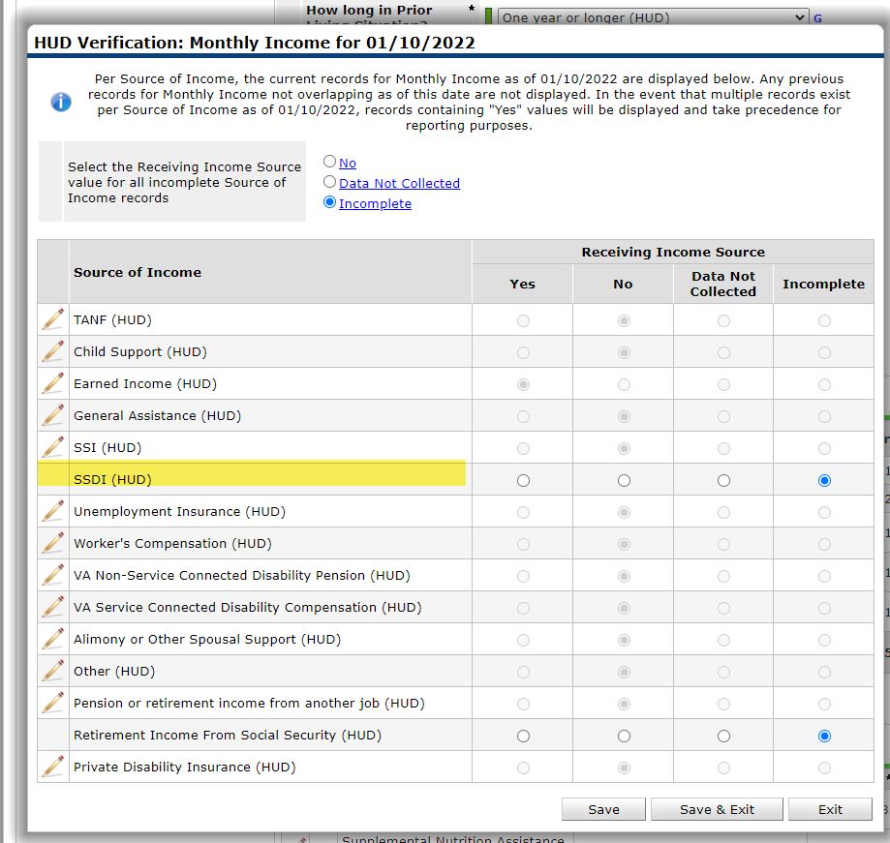
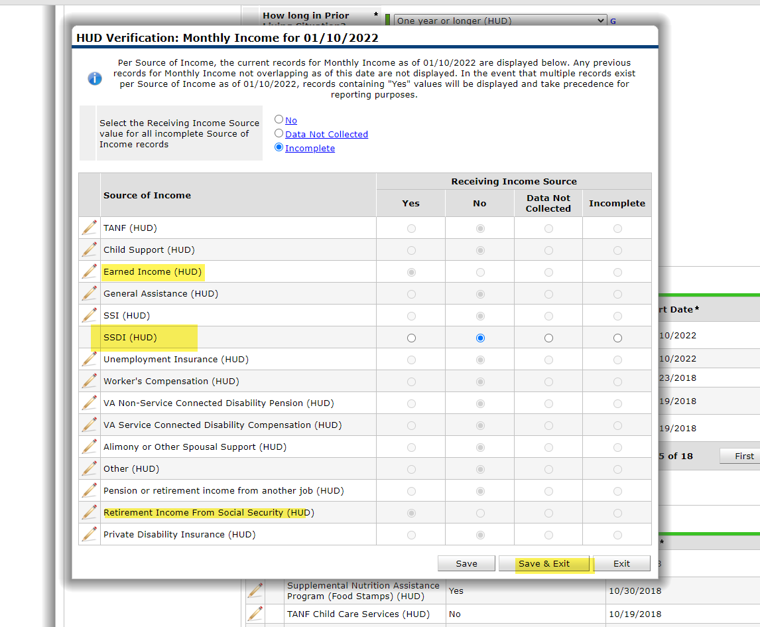
This SSDI is now a “NO” starting 1/10/22 so we click on the No spot, and it will highlight.
you will not get a pop for “NO’S” this is because it will automatically generate a No in the HUD Verification with the start date of our entry
Just go now to the next incomplete . If you had no more, you'd save &exit

Slide 20
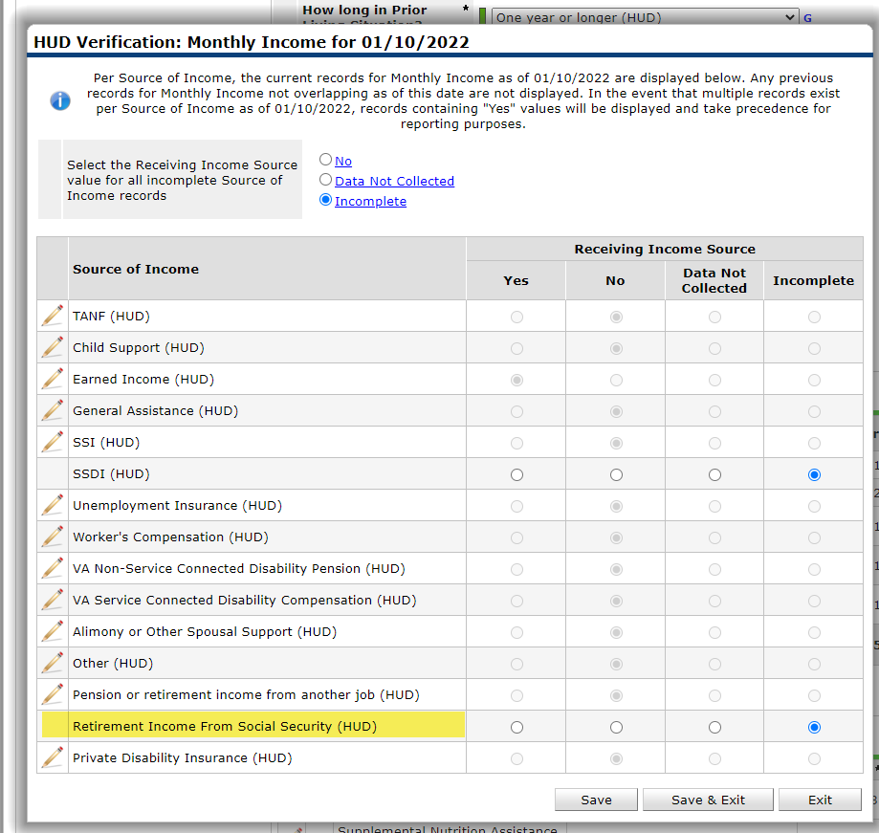
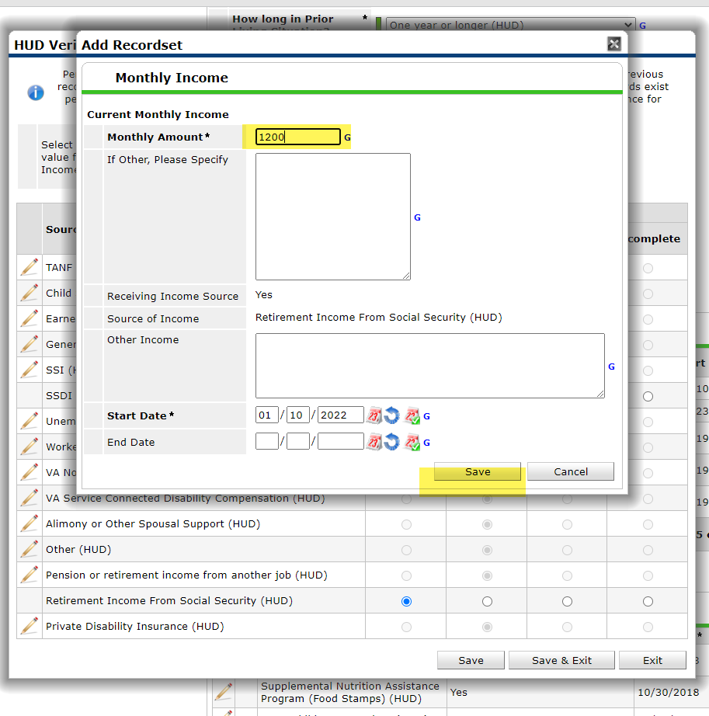
So, this Incomplete is just like the others. Since this income is a “YES” We move it to yes by clicking on the “YES” dot space.
when we do that the Add Recordset pops up
from here is where we now add the new Monthly Amount based on our intake form. It already has the YES filled in the Source is filled in and the Start date of out entry date we do not need to do any of that.
By going through the HUD Verification, we don’t type over or change anything we just fill in the new amount and it has it already for a “YES”
hit save
When you hit save you’ll see your answers for the fifteen types of Cash Income that needed to be verified for HUD for that entry date
now hit save and exit and we go to the next HUD Verification
NON-Cash

Slide 21
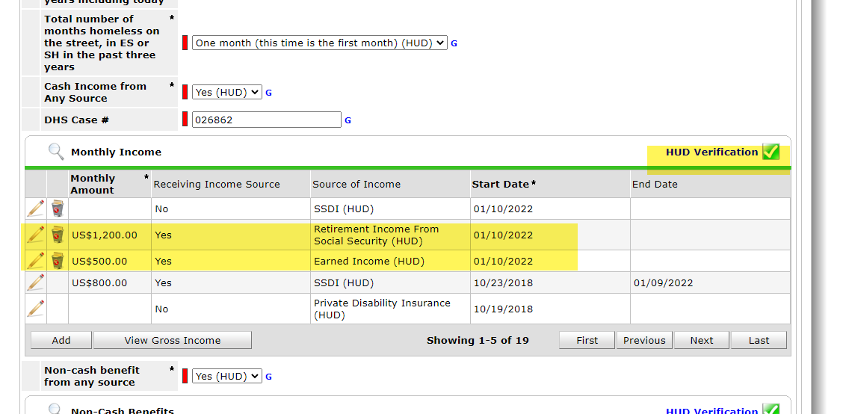
Once you click on Save and exit it will come back out to your assessment and you now can see that on verification has turned back to green which is what you wanted
sometimes you can also see your new income that you just added but the best way to see it is to go back into the magnifying glass

Slide 22
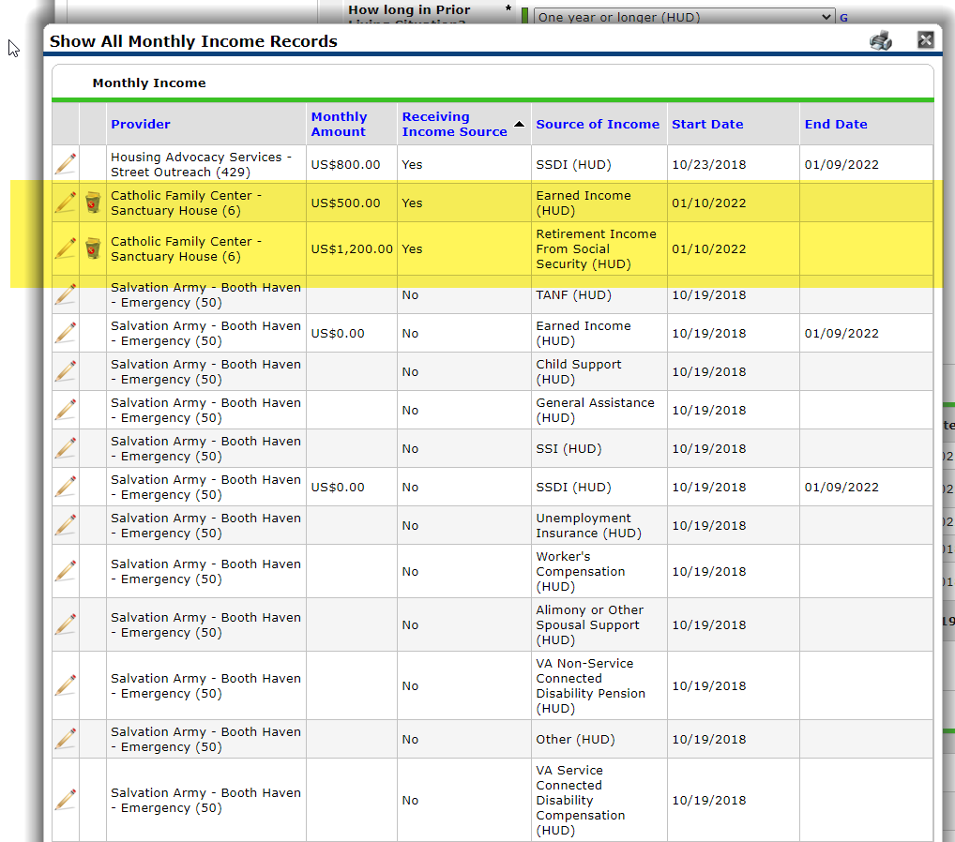
Again, first click on the receiving income column so the YESES go to the top
We can see here that the Rachel yeah original yes for the SSDI now has an end date, so that no longer active ,
we can see the two new YESES for the “Earned Income and the Retirement Income from Social Security, both with no end dates so that is our current active income
next click on the source of income header so that it groups by sources of income

Slide 23
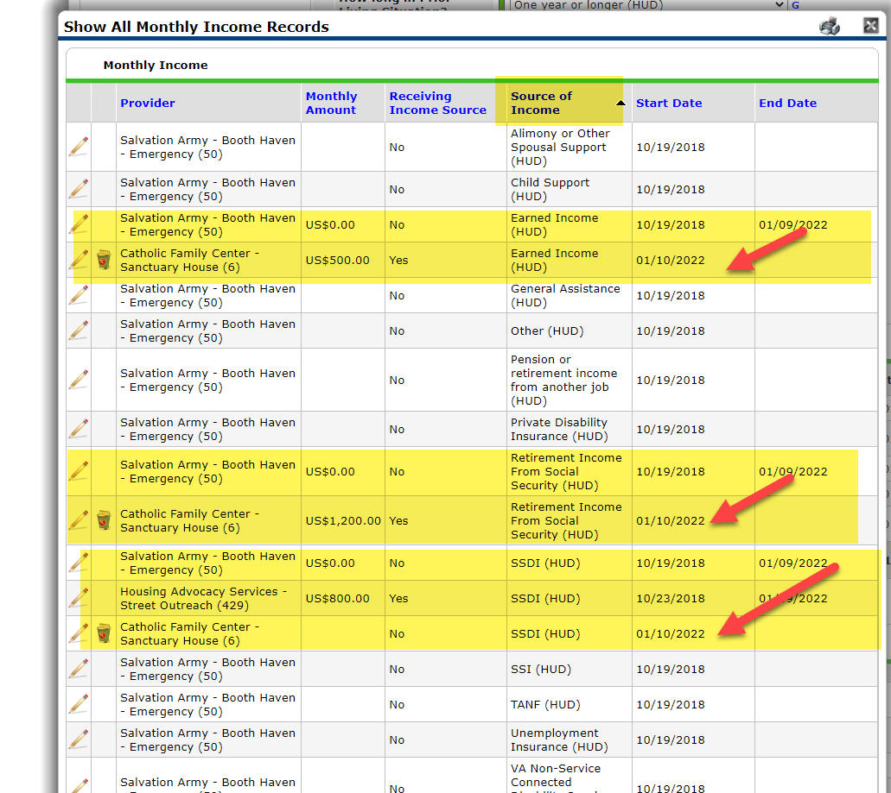
When we look at it from the source of income view it shows us the actual timelines that we created by using the end date and then restarting it through the actual HUD verification tab
by looking at the earned income we can see where we ended the no on one nine 2022 and then below it we can see the yes where we restarted it on 1/10/2022
the same is true for the retirement income from Social Security we ended it on one nine 2022 and then the yes starts on 1/10/2022
now for the SSDI we can see where we hit end those two entries that were hanging out, we had a no we needed the end, and we had a yes, we needed to end also. Once we ended both of those, we could then get the incomplete we needed so to put in our no that started for 1/10/2022
All this is done so that it we keep the history that HUD has on all these entries they are acting as timelines,(pictures) . This is why you never type over or change anything when you go into the pencils you need this information for HUD

Slide 24
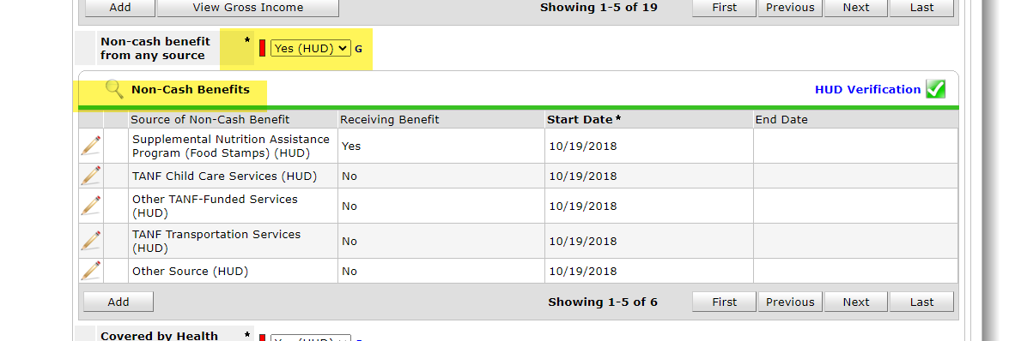
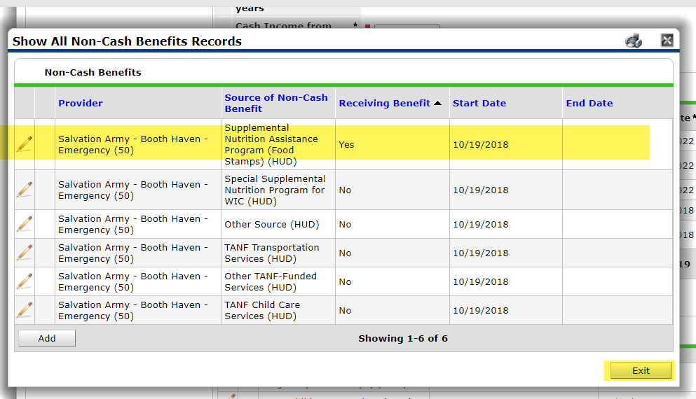
You then continue to verify the other HUD Verifications.
Next is NON-Cash, in this case the reported they have Snap. For HMIS non-cash is a yes/no question so if the had it before and say they now receive a higher amount in HMIS as long as it say “Yes” that is all that matters (not the amount)
First step answer the YES/NO in this case it is “Yes”
Then go into the magnifying glass
At the pop-up sort by the Receiving Benefits.
In this case we can see they are receiving SNAP , It is a “Yes” with no end date we can see it it does not matter the provider or start date it is still active . WE DO NOT NEED TO DO ANYTHING.
Just exit

Slide 25
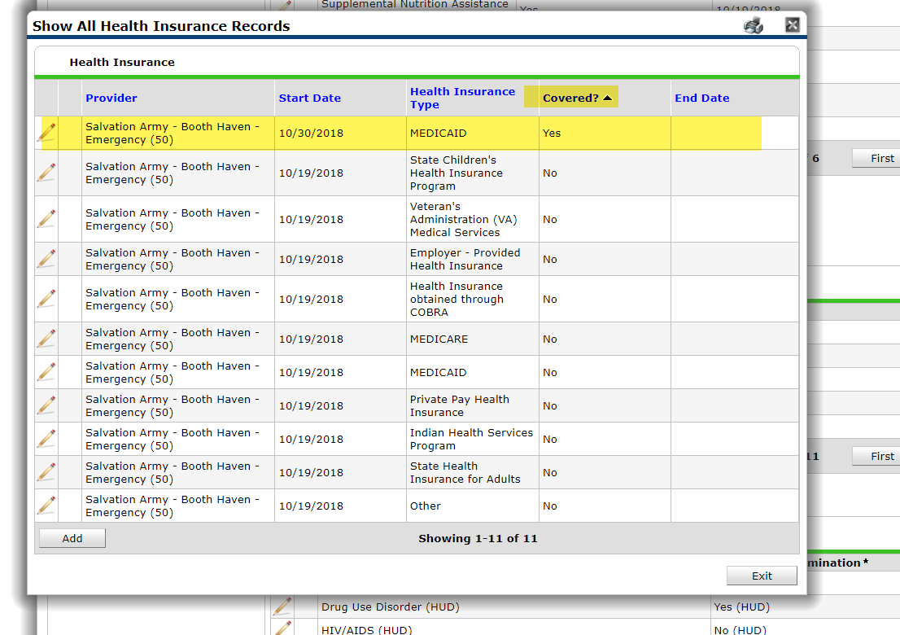
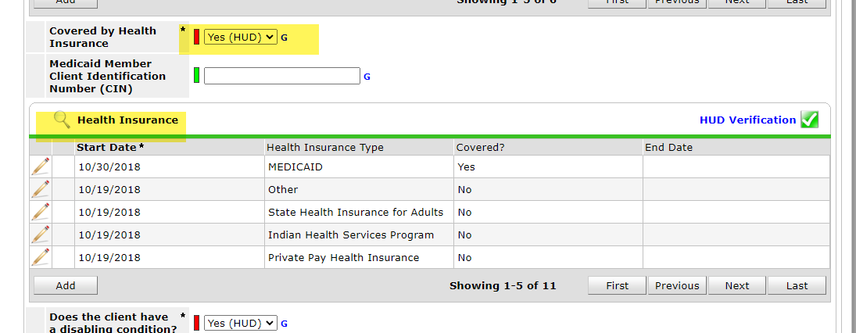
Next is health insurance again based on our scenario they have Medicare.
you go to the yes/no question it is still a “YES”
Then go into the magnifying glass
At the pop-up go to “covered” click so that the yeses go to the top, we see currently it is MEDICAID not MEDICARE

Slide 26
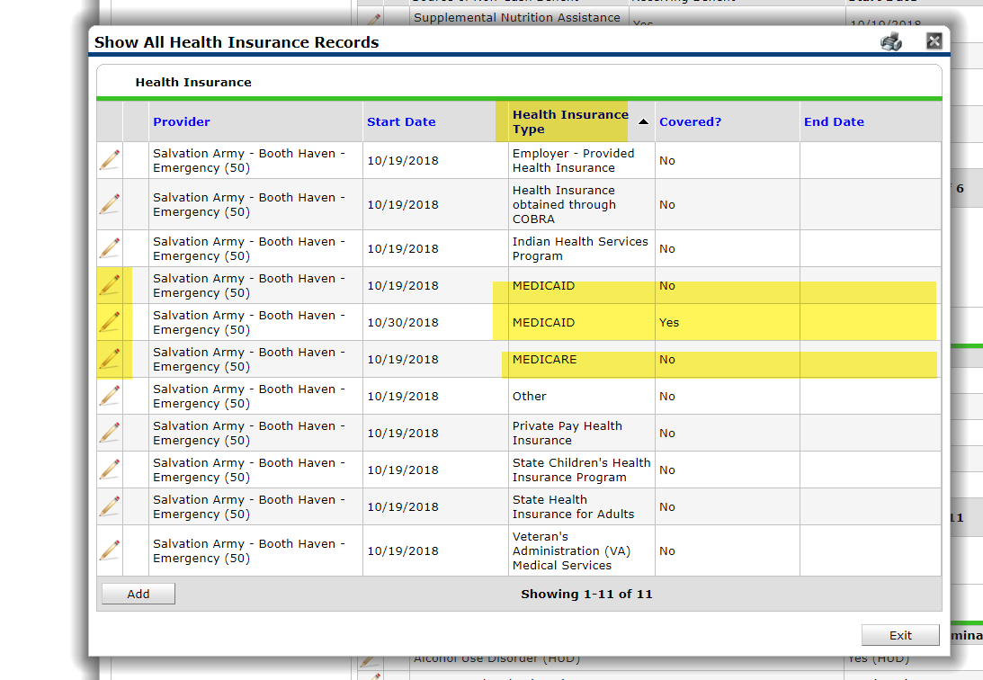
Next click on the header for Health Insurance Type so that we can group all our insurance types together
when we do this, we can see that we have two Medicaid's ones a yes ones and no neither one of them have an end date, so they are both active and we have one Medicare which is a no
this tells us we need to end all three of those incomes in order to get our red verification to start our new Medicare income for the 1/10/2022

Slide 27
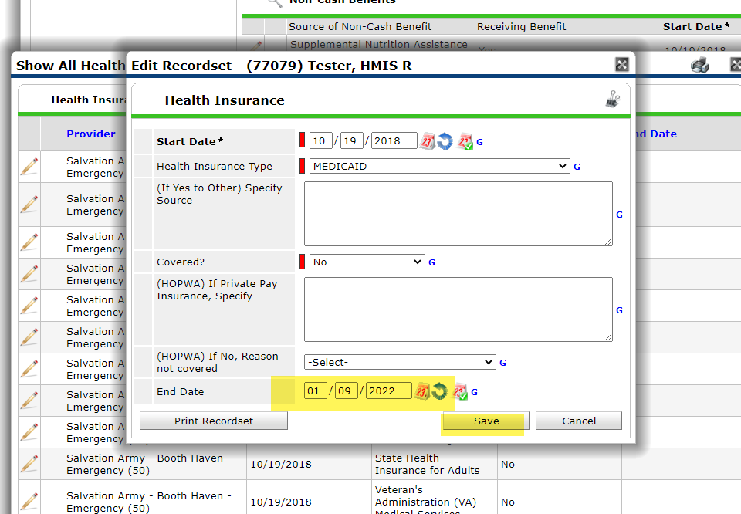
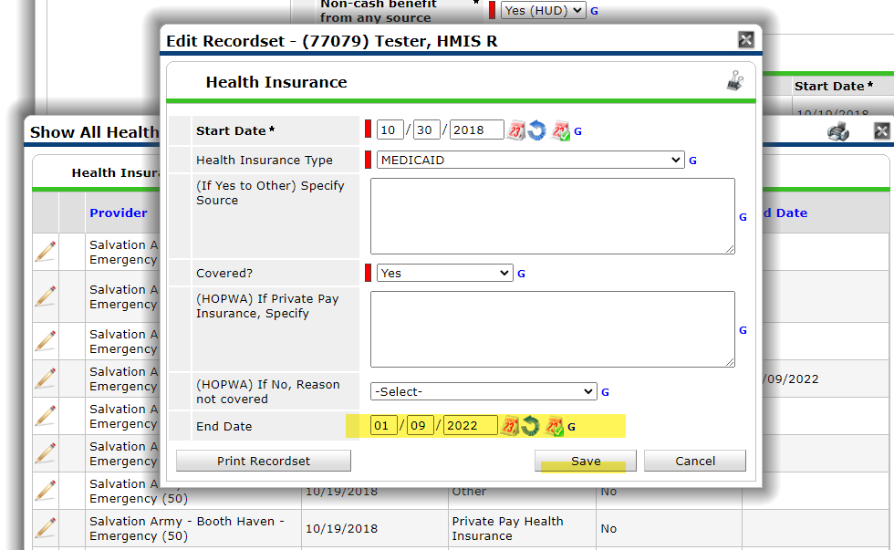
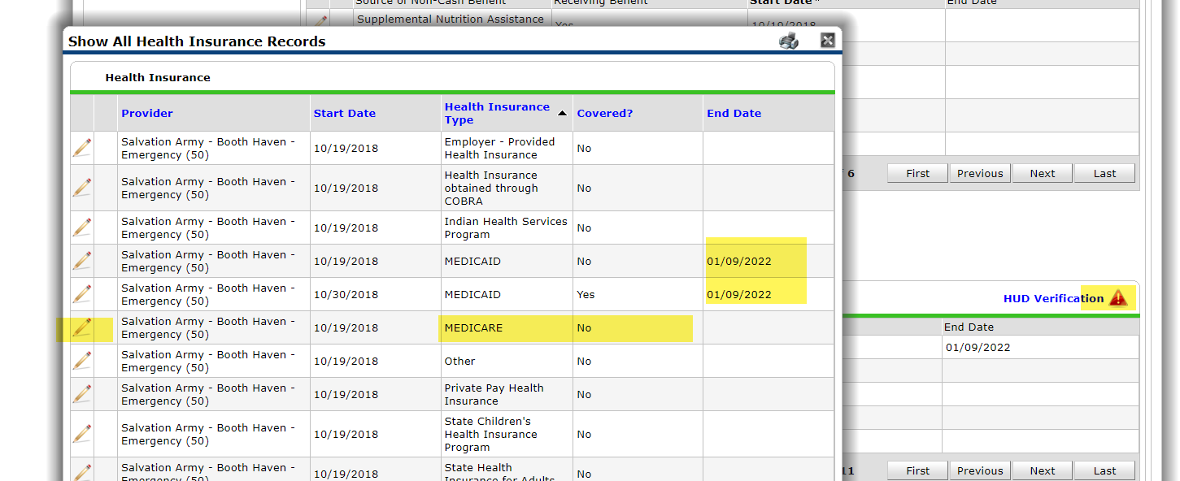
So here for the two Medicaid’s
first to “NO” we go into the pencil and just go down to the end date and end it for the day before of 1/9/2022 hit save
then for the ”YES” Medicaid into the pencil just go down to the know and end it for 1/9/2022 ,then hit save
After you hit save, you come back out to the screen with “All Health Insurance Records”
We can see the end date next to the two Medicaid’s
The HUD Verification has turned red because that verification dot have moved to the incomplete
now we must do the pencil for the Medicare

Slide 28
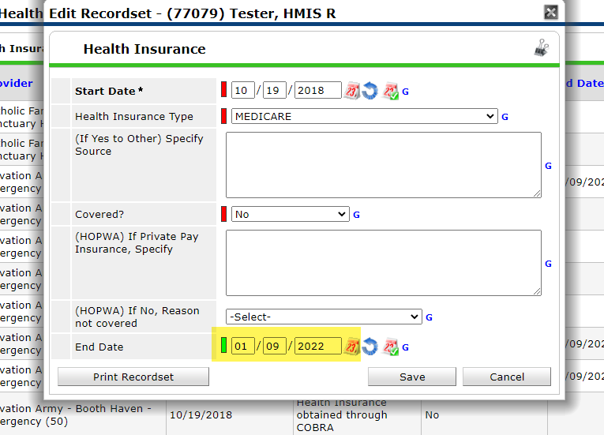
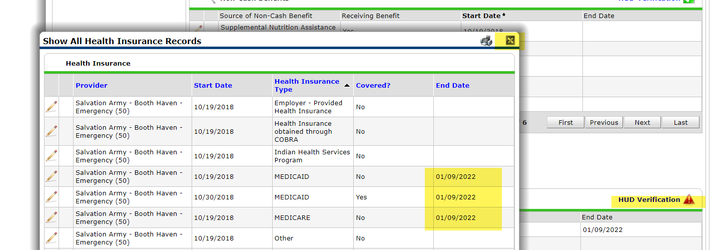
When we go into the pencil for the Medicare “NO” we just go down to the end date, again putting the one 1/9/2022 for the end date and hit save
After hitting save
we come back to All Health Insurance Records again
we see the end date next to all three of our health insurance records we ended, and our HUD Verification is still red
Click on the X or exit
Then click on the red HUD verification

Slide 29
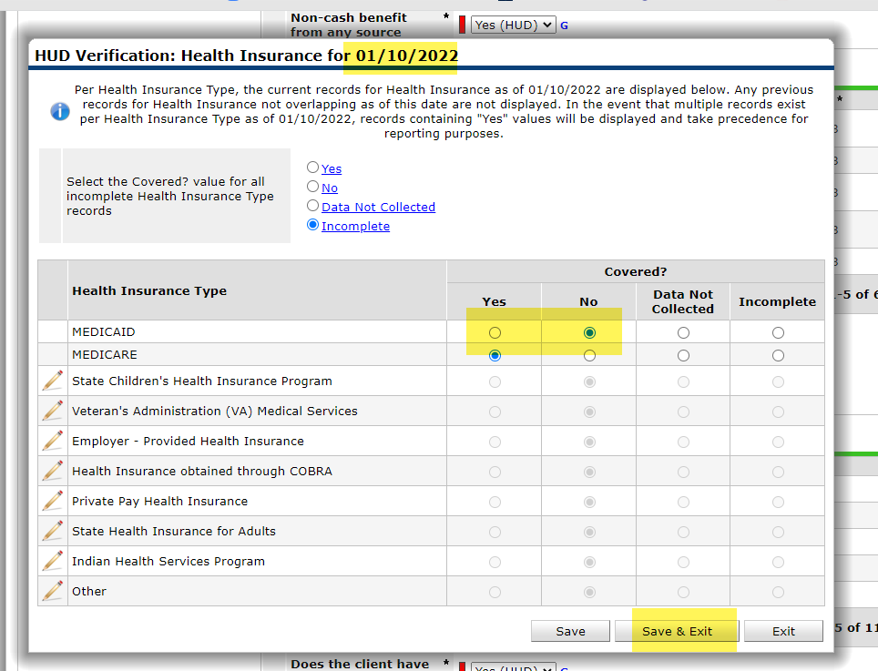
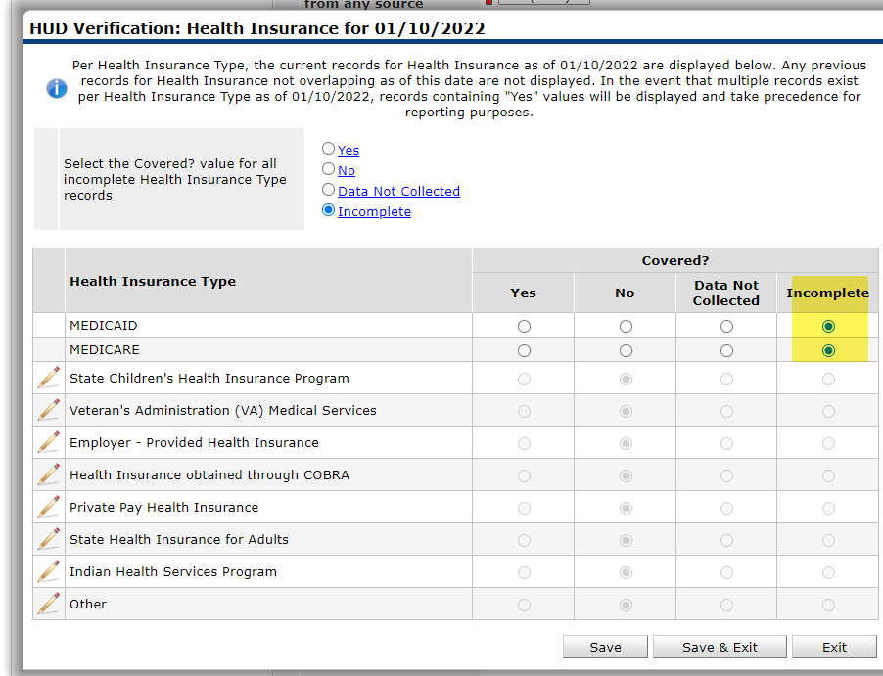
When we click on the red HUD verification Open up the pop up showing the health insurance types that need verifying for 1/10/2022
we can see on the Medicaid and Medicare the two verification dots are under incomplete this is because we ended them for 1/9/2022
We will now answer the yes/no questions for those two health insurance types
Based on our intake form, the Medicaid answer is now “NO”
The answer for Medicare is now “YES” once we moved those HUD verification dots, we then hit save and exit
The HUD Verification will now be green, and we can see that starting 1/10/2022 Medicare is now “YES” and Medicaid is now “NO”
The last HUD Verification is Disability you only do this on an entry …….

Slide 30
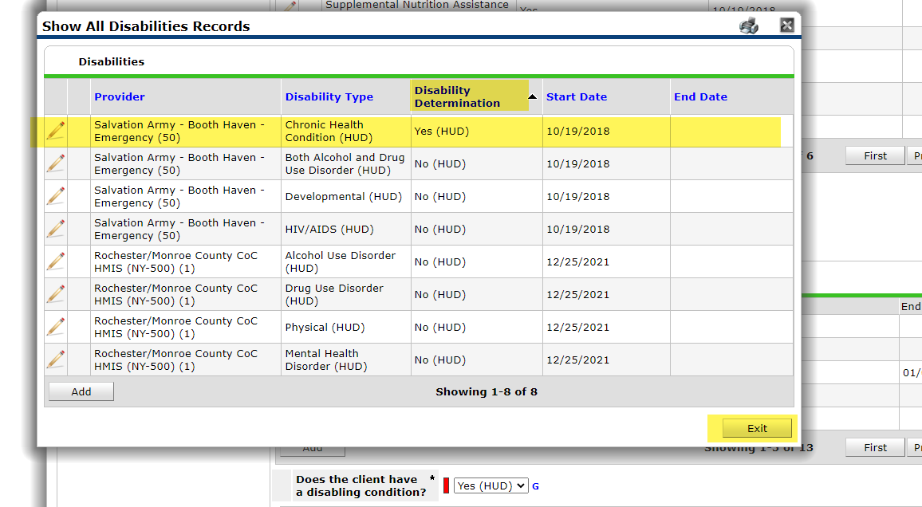
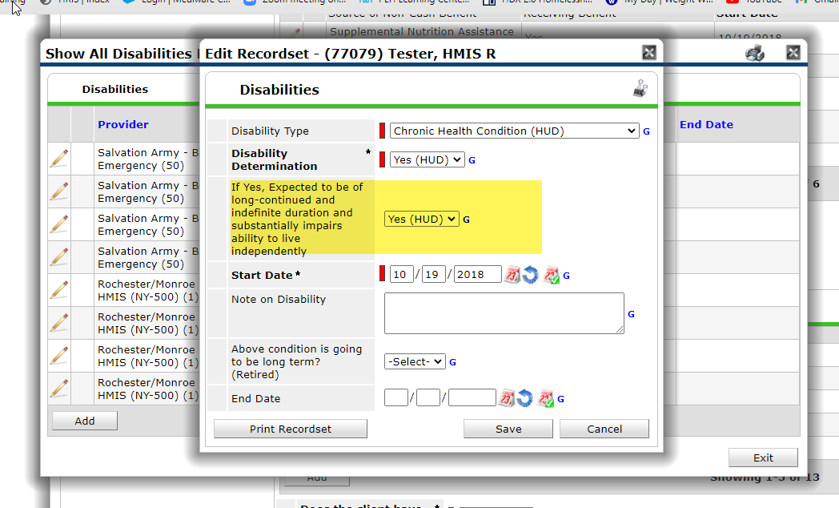
First step answer the YES/NO in this case it is “Yes”
Then go into the magnifying glass
At the pop-up sort by the Disability Determination.
In this case we can see they have a chronic Health Condition, It is a “Yes” with no end date we can see it, it does not matter the provider or start date it is still active . WE DO NOT NEED TO DO ANYTHING. It matches the intake form
Just exit
If you ever start disability type to a “YES” know that you will get a pop-up where it wants you to answer “Yes” that it is going to be long term and effect housing-then save

Slide 31
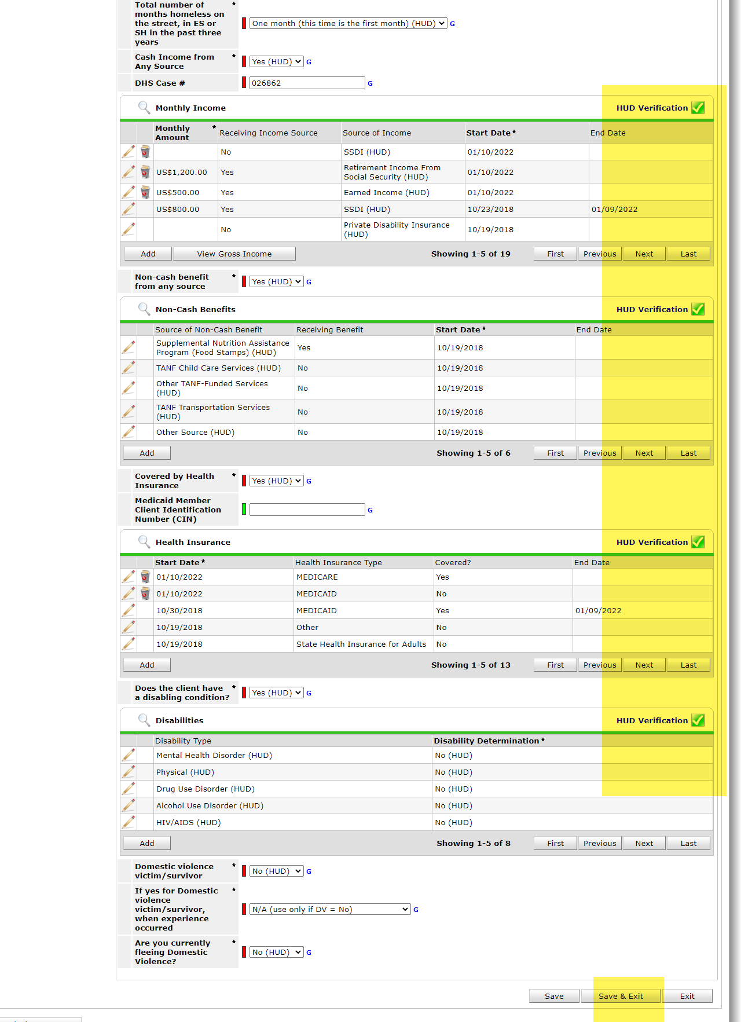
Once the HUD verifications are completed and show green for the type of assessment you are doing be it for(entry, move-in update, Hud Verification Update, Annual Assessment, Exit) then you would do the same for all family members.
Remember Cash income and Non-Cash income for a household member under age 18 gets reported under the head of house’s income.
Once all household members assessments questions are updated and HUD verifications are updated and green then save and exit.

Slide 32
Things to remember
If you can see it under the HUD verification and it's not ended, it is active, and you need to deal with it
The provider does not need to be your provider in order to be an active Hud verification. As long as the information is correct, and it is still active with no end date

