Slide 1
How to run reports ART in SAP Business Objects, APR, CAPER or Data Quality Report
-what to look for

Slide 2
Step one Making sure you are in the Program for which you want to run the report for this very important other wise your data will not be correct.

Slide 3
• Make sure you are “entering data as” the program you will be running the report for.
• Your default program is on the top left of the screen. If this is the program you want, you don’t need to do anything.
Otherwise, click on “Enter Data As” on the top right of the screen and choose the program for the report by clicking on the + .

Slide 4
Once you click on the It will open the program under the “Enter Data As”. Think pf this as opening the file drawer for the program you want to work with.
Then click on the Reports tab.

Slide 5
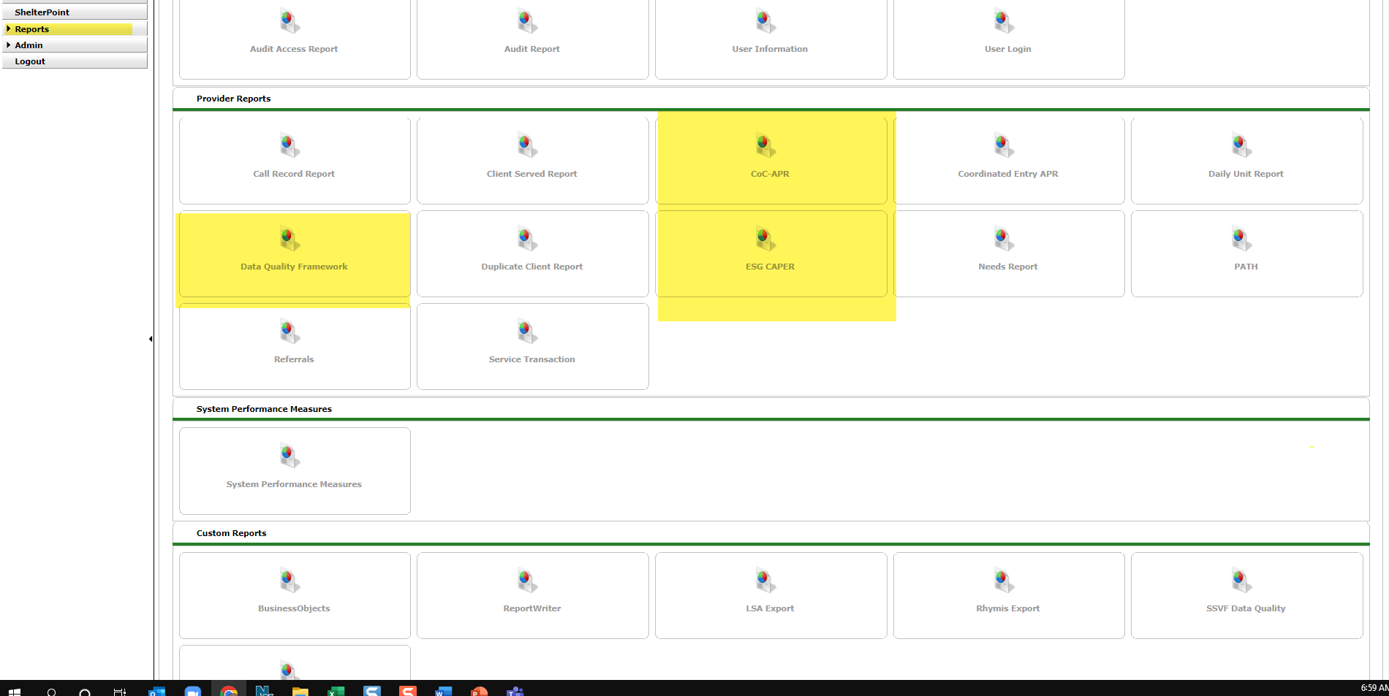
Once the Report tab is clicked the Dashboard will open. From here the APR, Caper and Data Quality Framework are accessed.
Remember the APR is for PHS and RRH, the CAPER for Emergency and TH and the Data Quality is for all types
Click on the report you want to run.

Slide 6
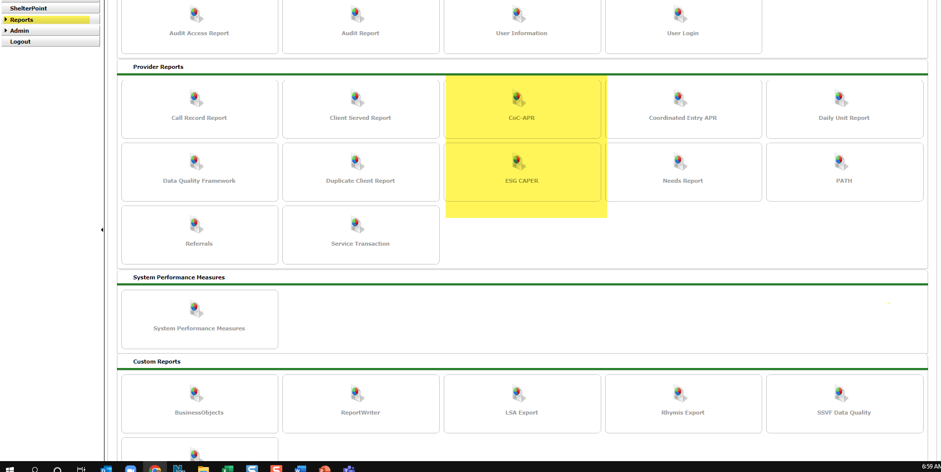
The following slides are for running the APR and CAPER.
They both run the same

Slide 7
Once the you click on either the APR or the CAPER make sure the Provider is the one for which you want your report for.
Enter the date range that you want the report to run for. It will show that which was true during that chosen timeframe(so if someone exited before the chosen range they would not be included in the report)
Put the Entry/Exit type
Then Build Report

Slide 8
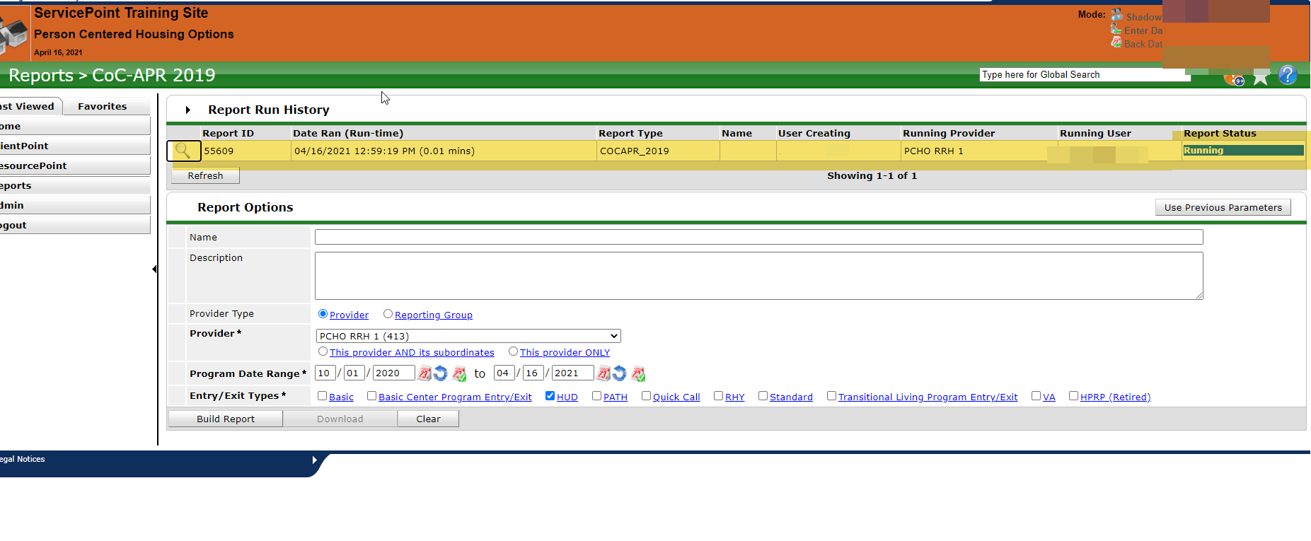
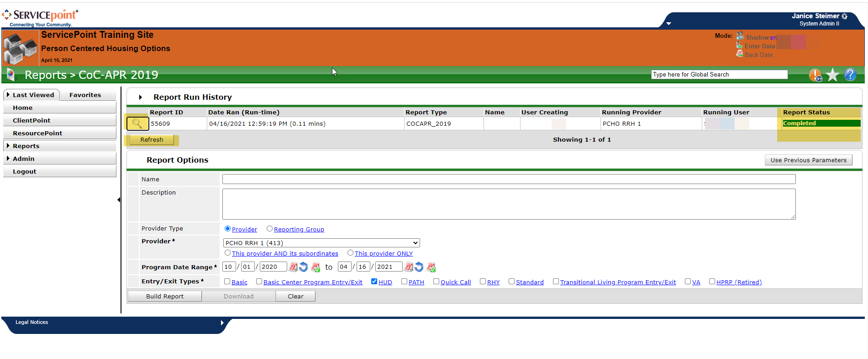
When you hit build report you will see on the banner above showing the report running.
Click refresh and keep clicking refresh until it changes to complete
Once shows complete
Click on the magnifying glass to load the report below in the APR/CAPER

Slide 9
This is what the whole report looks like when is load and you scroll down through the different sections.
This report delivers a wide range of information from clientele served demographics, income, timeliness, etc.
It will show error/missing information in HMIS entries
Information from this report is used when doing the Renewal Project Ranking for the HMIS portion and mentoring and HUD reporting so it is very important that when issues are found that are fixed.

Slide 10
CAPER/APR – Data Quality Checks
6a Personally Identifiable Information
Name
SSN
Date of Birth
Race
Ethnicity
Gender
6b Universal Data Elements
Veteran Status
Project Start Date
Relationship to HOH
Client Location
Disabling Condition

Slide 11
6c Income and Housing Data Quality
Destination (important, but was not
counted on renewal application)
Income and Sources at Start
Income and Sources at Annual Assessment
Income and Sources at Exit
6d Chronic Homelessness
Look a project type:
Missing time in institution
Missing time in housing
Approximate date started
Number of times
Number of months
6e Timeliness
Number of projects start records

Slide 12
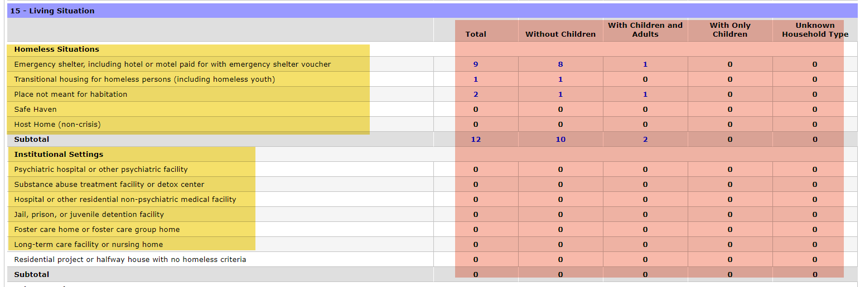
15 Living Situation
Homeless Situations:
Emergency Shelter
Transitional Housing
Place Not Meant for Habitation
Safe-Haven (Salvation Army program)
Institutional Settings (if client was there less than 90 days and was in a Homeless Situation beforehand):
Psychiatric Hospital
Substance abuse treatment center
Hospital
Jail, prison or juvenile detention center
Foster care
Long-term care facility or nursing home

Slide 13
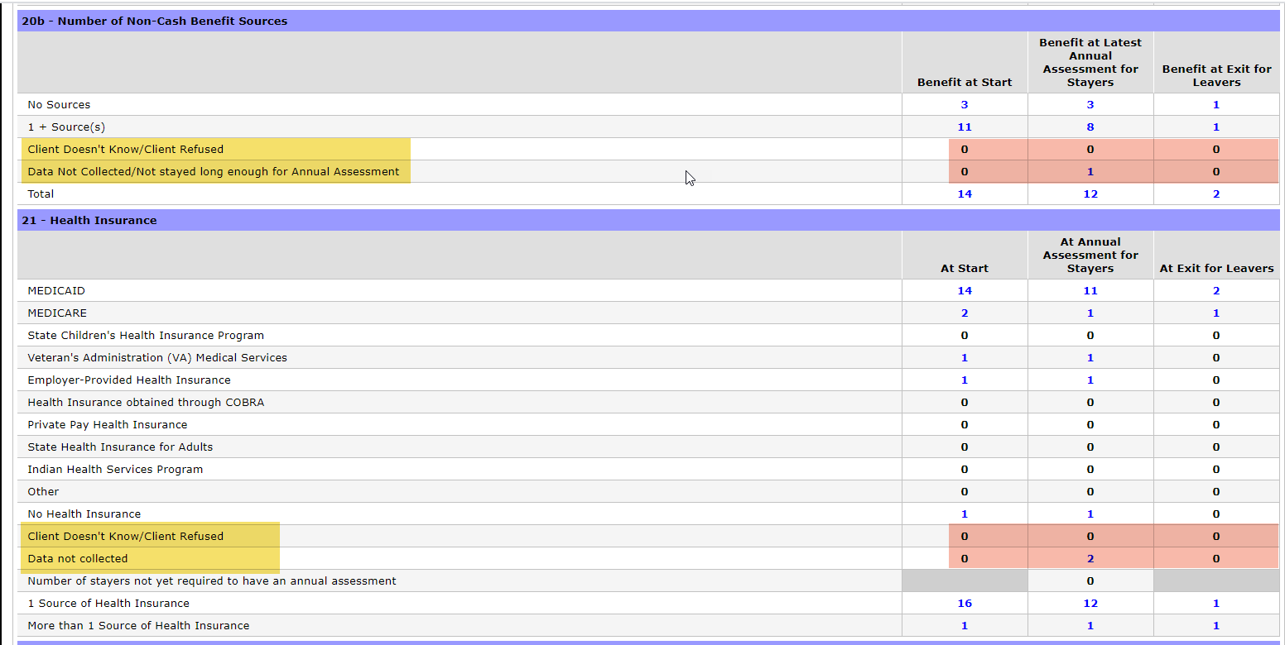
20b Number of Non-Cash Benefit Sources
Client Doesn’t Know/Client Refused & Data Not Collected should all equal 0
(No Sources gets counted elsewhere)
21 Health Insurance
Client Doesn’t Know/Client Refused & Data Not Collected should all equal 0
(No Health Insurance gets counted elsewhere)

Slide 14
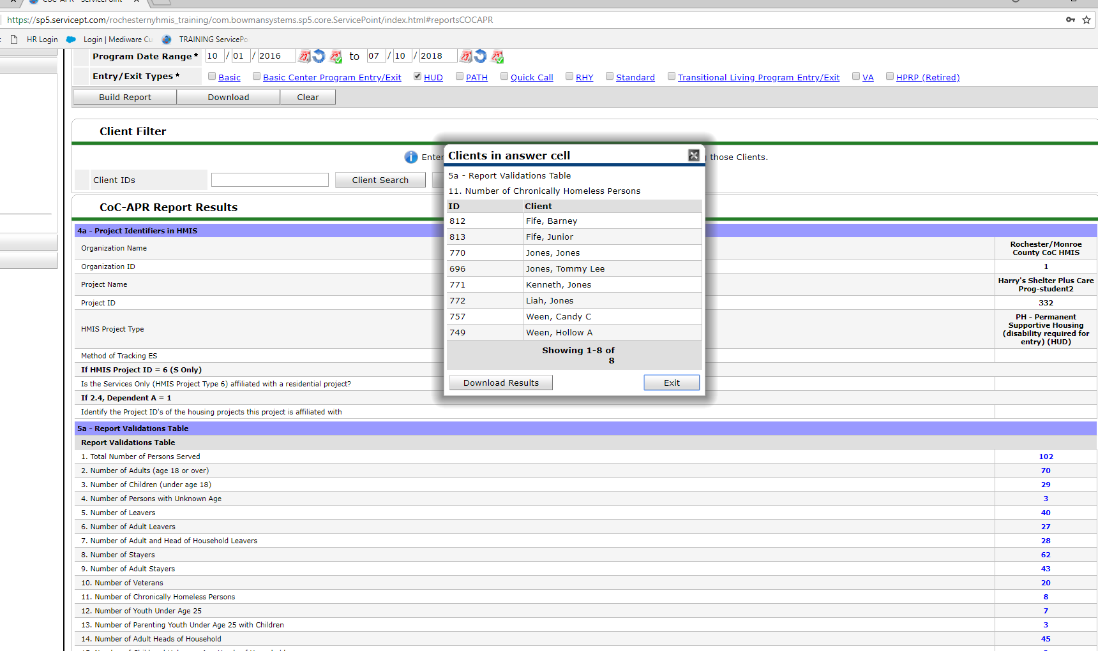
• When the report will appear on screen
• Click on blue numbers to see clients who are included in the count for that line of the
report.

Slide 15
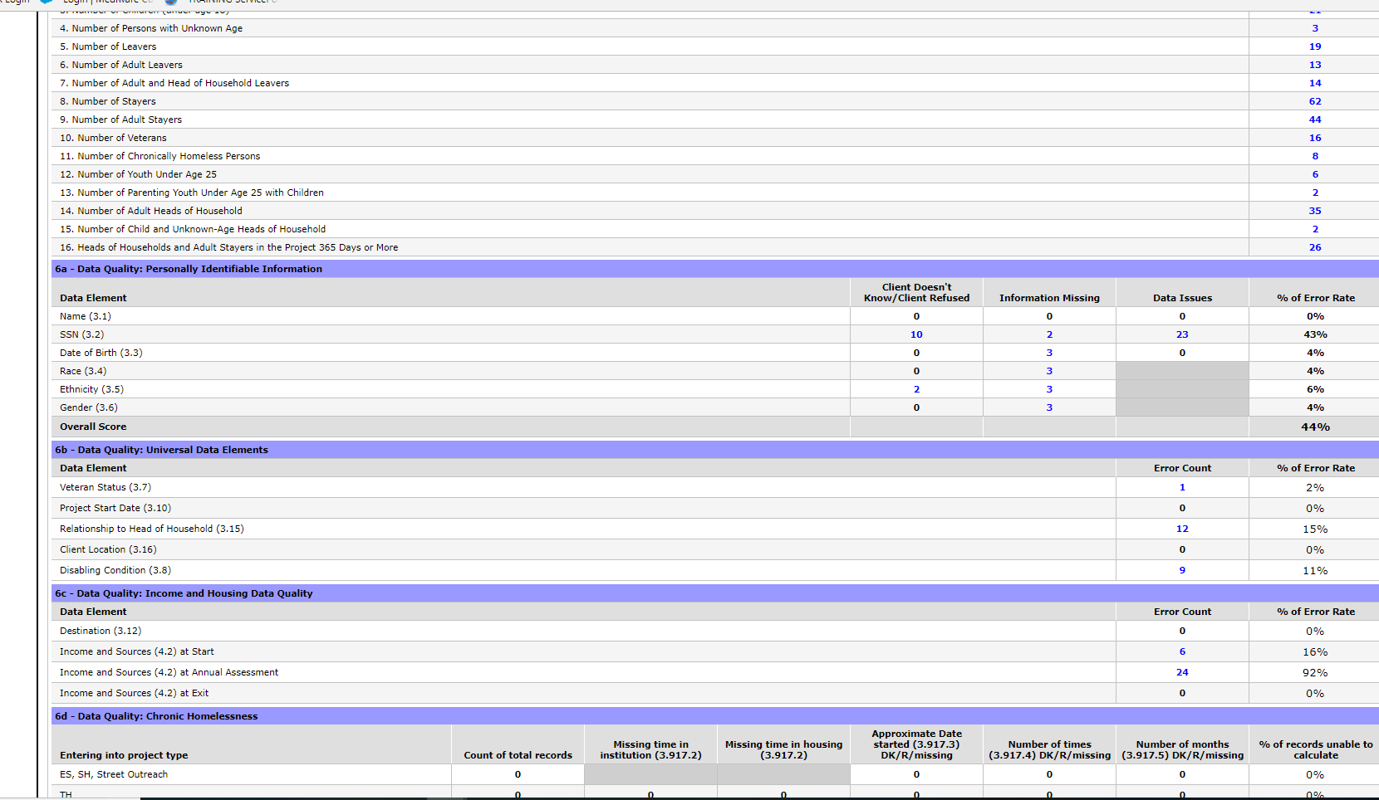
This area will tell you the stayer(active), the leavers(exited). Head of house, children, Adults etc.
Anything that says information missing or error count is something you should be looking at. By clicking on the blue number on the computer screen in any section it will open the pop-up screen to give the client ID # and names you can download this list or just write them down. In the errors or missing data this then allows you to go into ClientPoint and make the corrections needed.

Slide 16
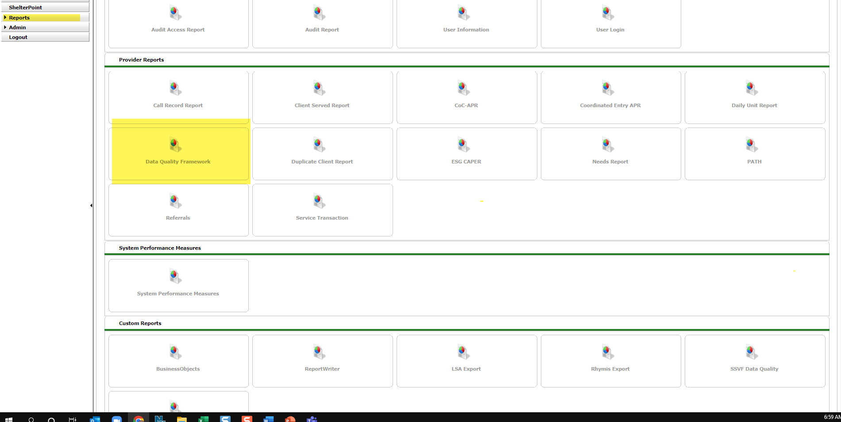
The following slides are for running the Data Quality Framework.

Slide 17
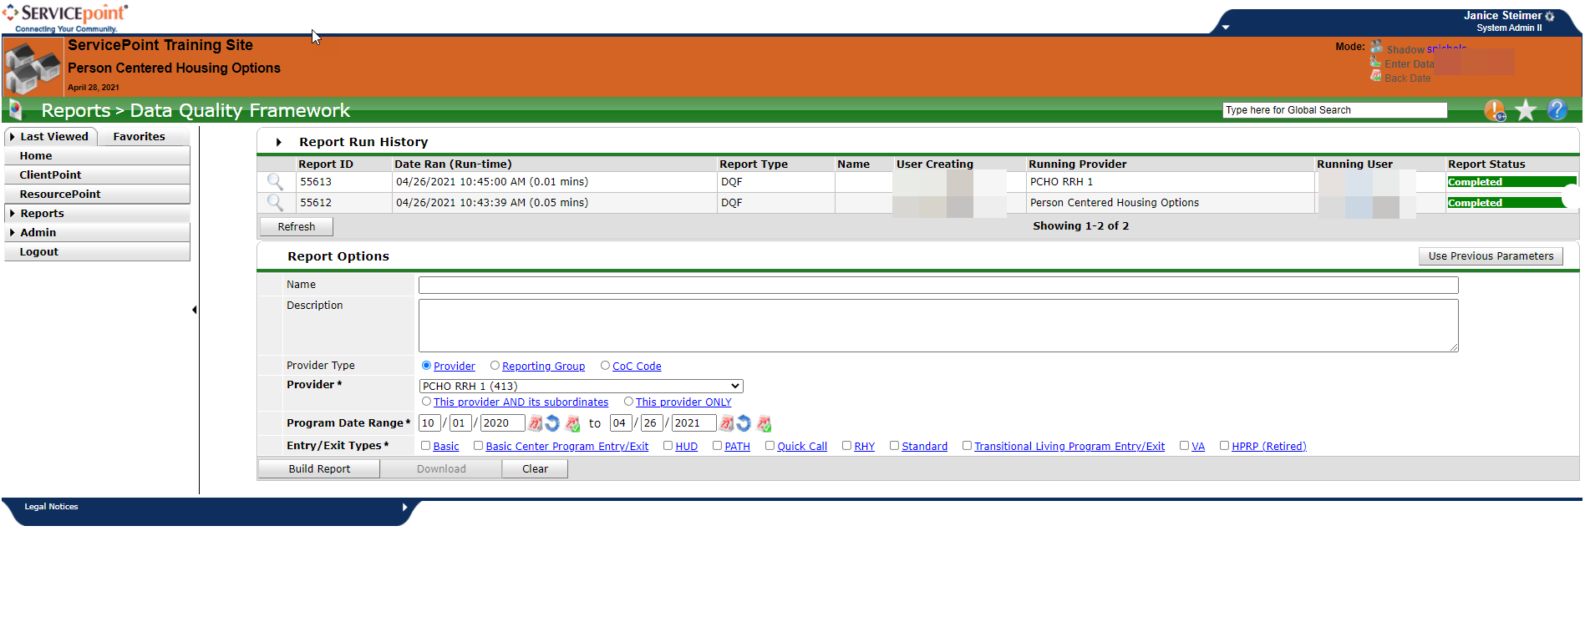

Slide 18
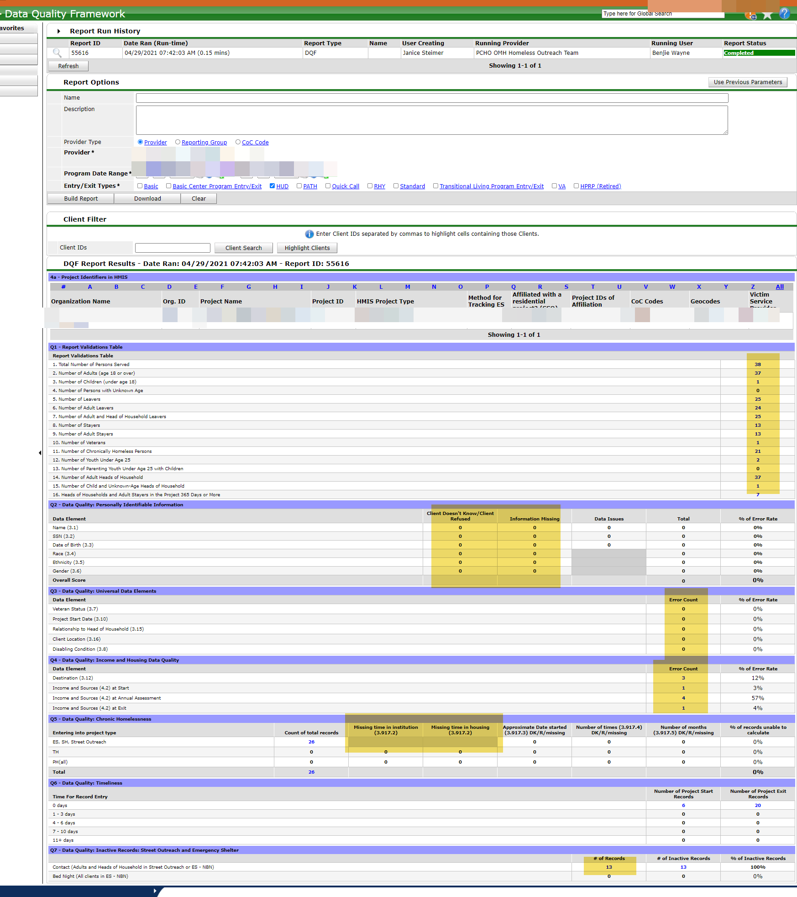
The Data Quality framework is a
Q1 Validation
In the DQ report, it is used to create totals of clients
Q2 Personally Identifiable Information (PII)
Critical for a system’s ability to un-duplicate & merge records.
Show Missing , unknow information or data issues in the PII.
Q3 Universal Data Elements
Veteran Status - Not Missing -Veterans are 18 or older
Project Entry Date - Looking to ensure that there are not overlapping project
stays for the client in the same project.
Relationship to Head of Household – Everyone has a relationship – A HoH is identified (“self”) – There is not more than one HoH per household
Client Location – Not missing – Valid CoC code
Disabling Condition – Not missing – Set to “Yes” if special need of long-term duration is identified
Q4 Income & Housing
Destination • 8,9, 99 or 30 – Left without an Exit Income
Errors are any record where information is not present because the client didn’t know the response, refused to provide a response, or the information was just plain missing…
…or where the response of client has income “yes” or “no” at a data collection stage is inconsistent with the income source information.
It’s been over a year and no exit, and an annual assessment has not been done with correct date.
Q5 Chronic Homelessness
A and B are the building blocks for determining Chronic Homelessness.
Missing data prevents the HMIS from accurately reporting chronic homelessness, and from knowing how long someone has been homeless
Q6 Timeliness
This section identifies how quickly project entries and project exits are entered into HMIS after they occur
It compares the system date and time to the effective date and time. *If and entry is deleted and re-entered it WILL used the newer system time showing a longer timeliness
Q7 Inactive Records in Street Outreach & Emergency Shelter
Data quality includes maintaining accuracy in the number of active records in a system.
Records often remain open and hamper the project and community’s ability to generate accurate performance measurement.
This section sets a 90-day limit on inactive records and reports how many records within the report range are inactive (i.e. should have been exited but were not) based on contact with the client for outreach or bed nights for shelter

Slide 19
This area will tell you the stayer(active), the leavers(exited). Head of house, children, Adults etc.
Any field that says information missing or error count is something you should be looking at.
By clicking on the blue number on the computer screen in any section it will open the pop-up screen to give the client ID # and names you can download this list or just write them down. In the errors or missing data this then allows you to go into ClientPoint and make the corrections needed.

Slide 21
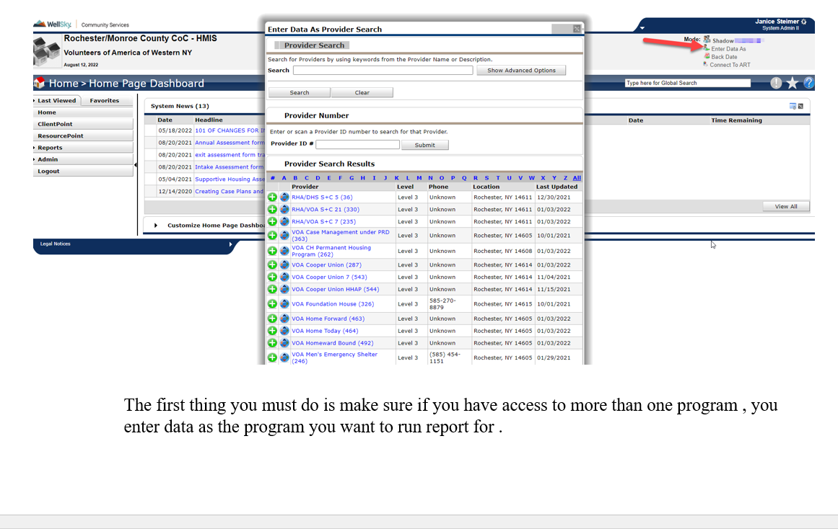

Slide 22
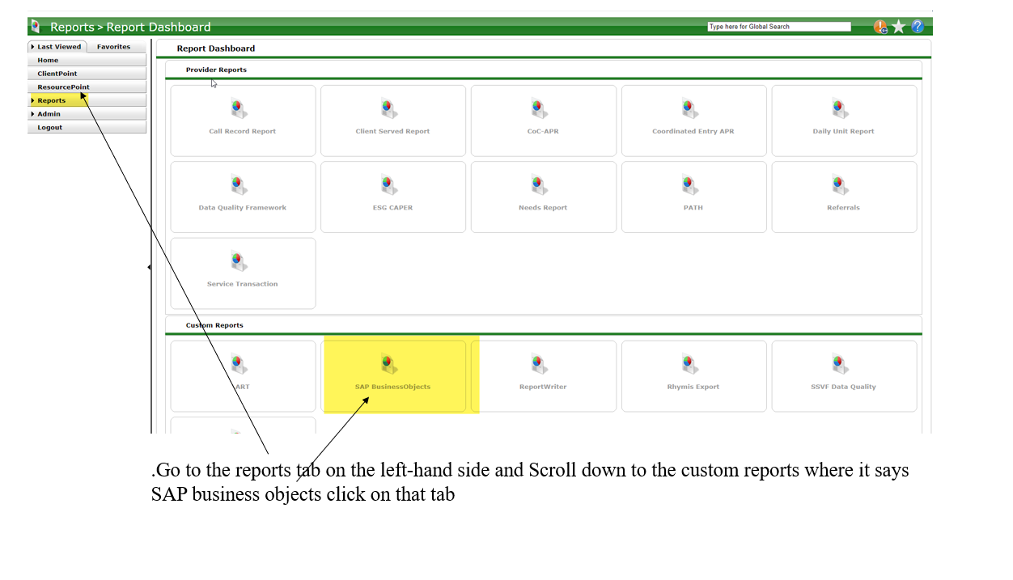

Slide 24
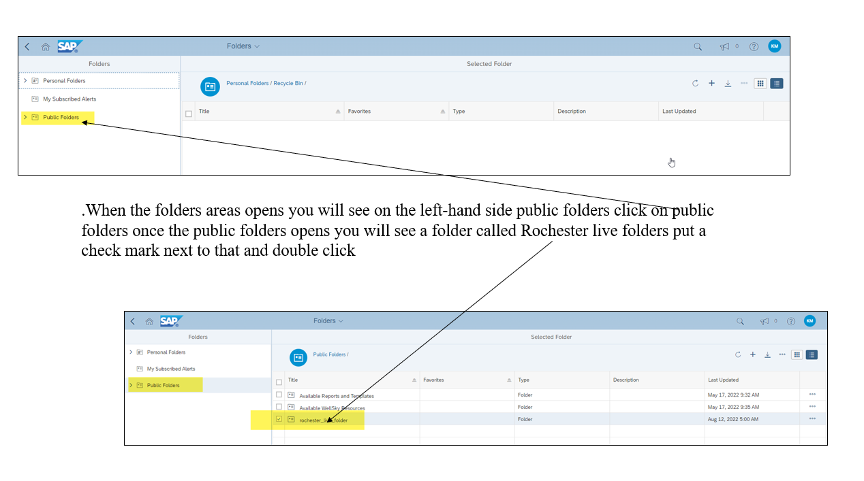

Slide 25
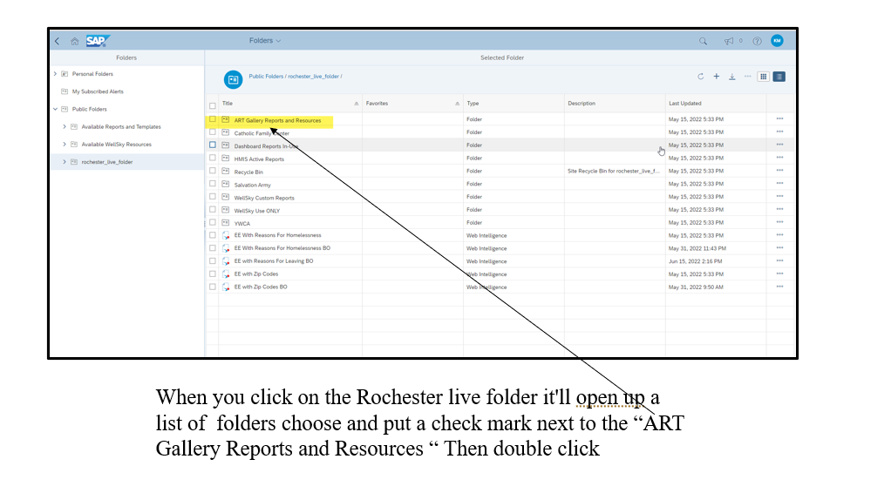

Slide 26
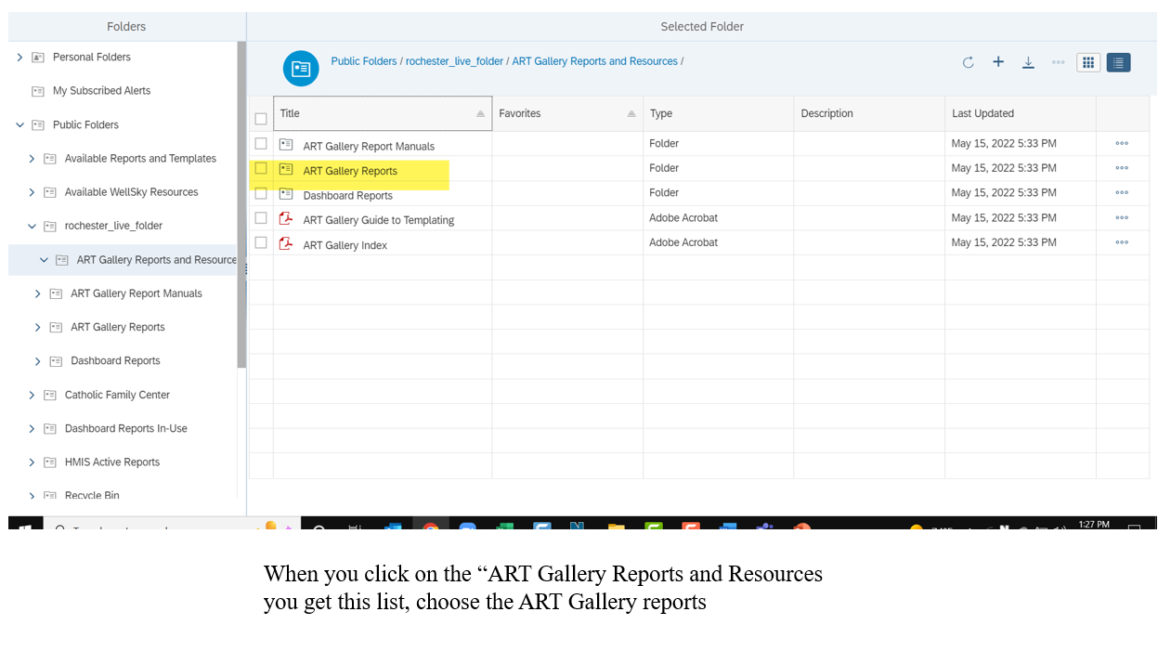

Slide 27
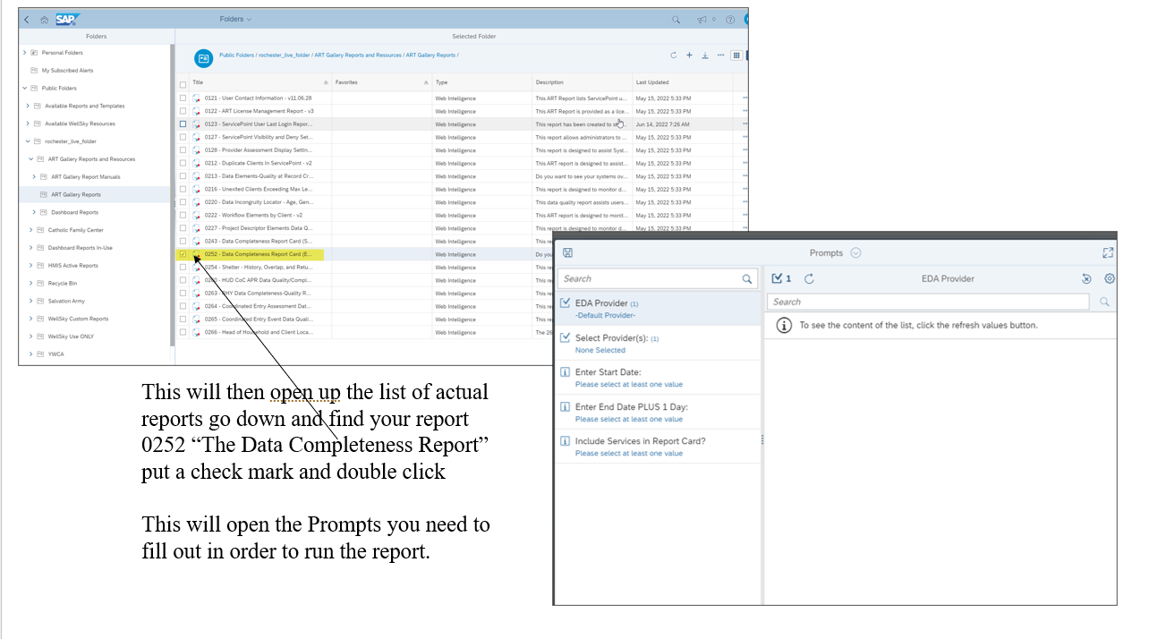

Slide 28
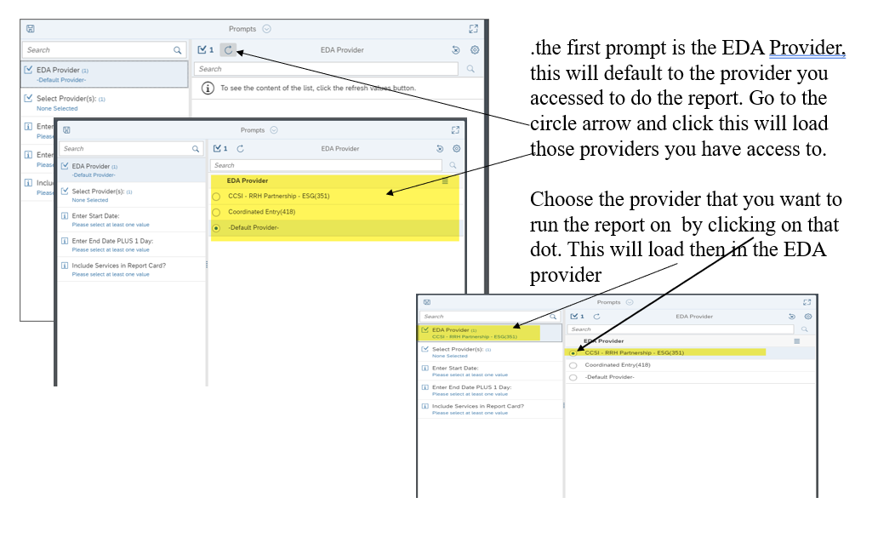

Slide 29
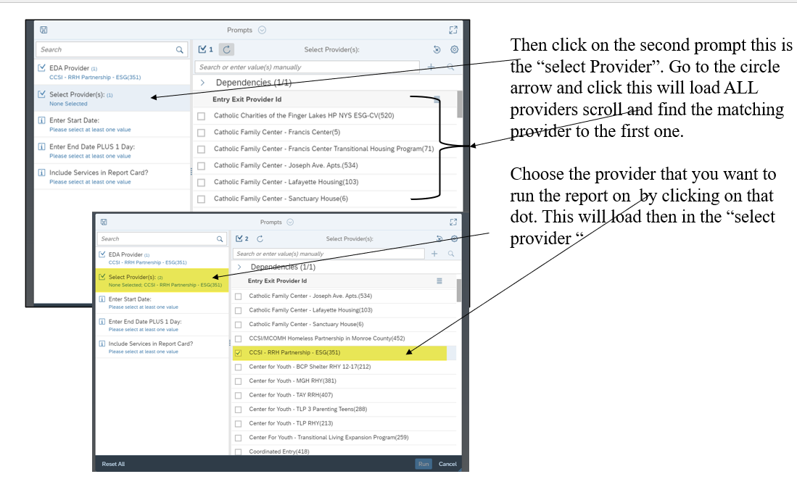

Slide 30
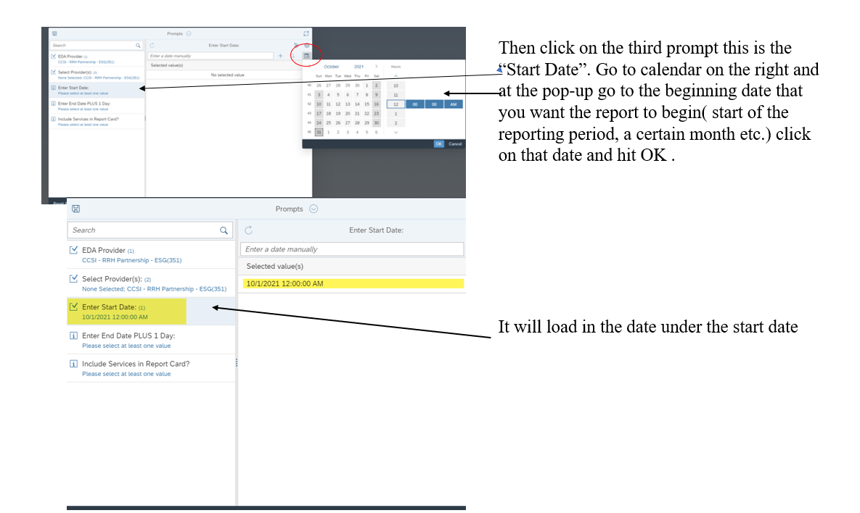

Slide 31
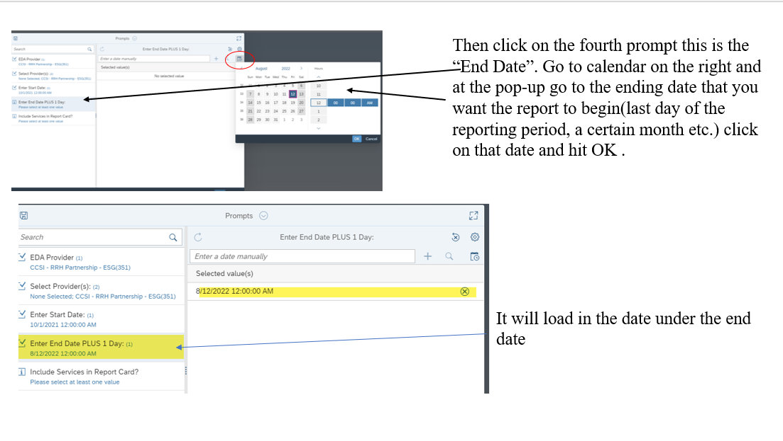

Slide 32
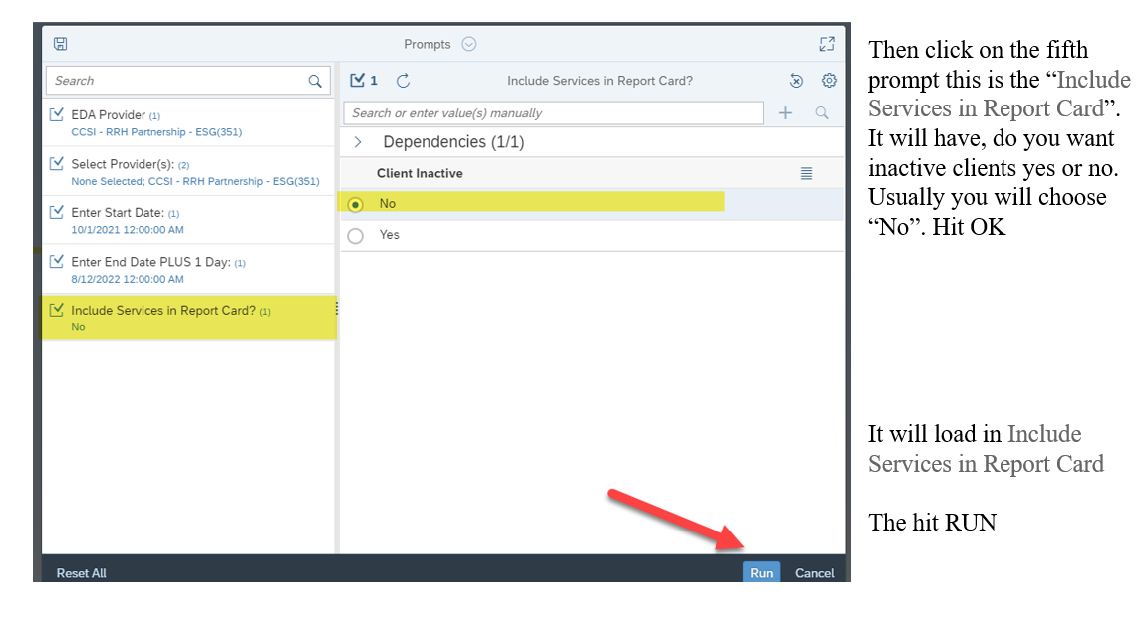

Slide 34
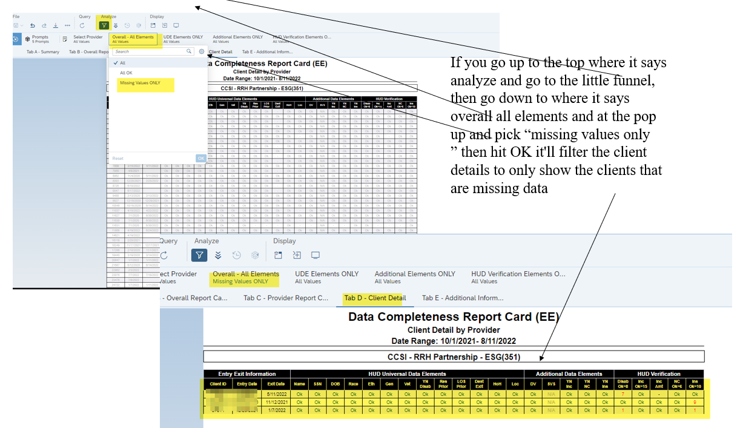

Slide 35
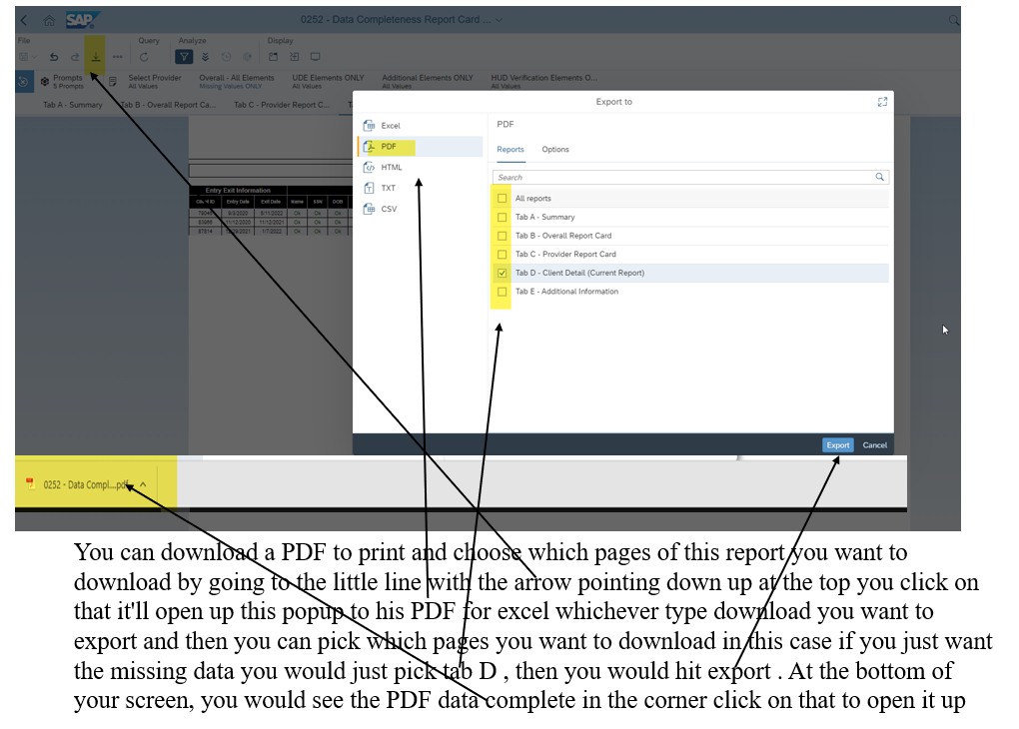

Slide 36
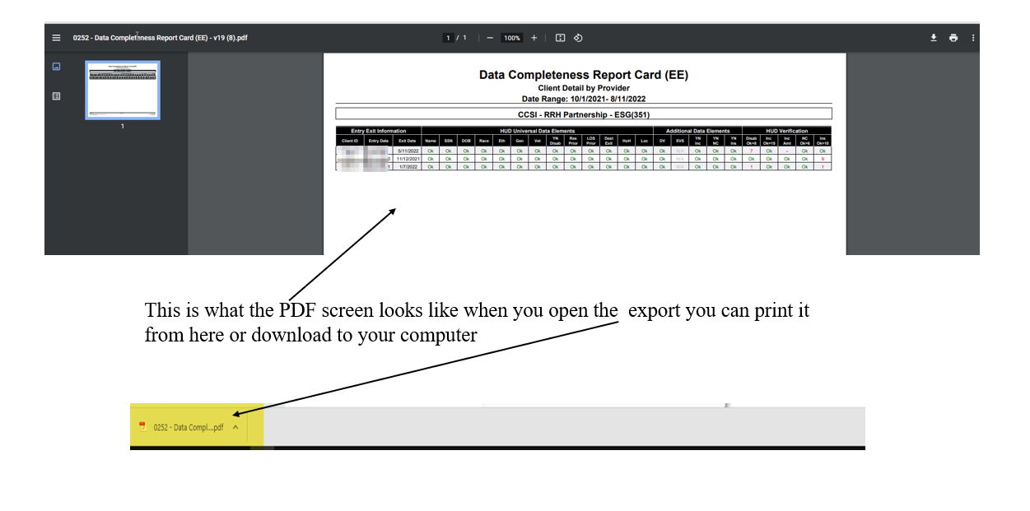

Slide 37
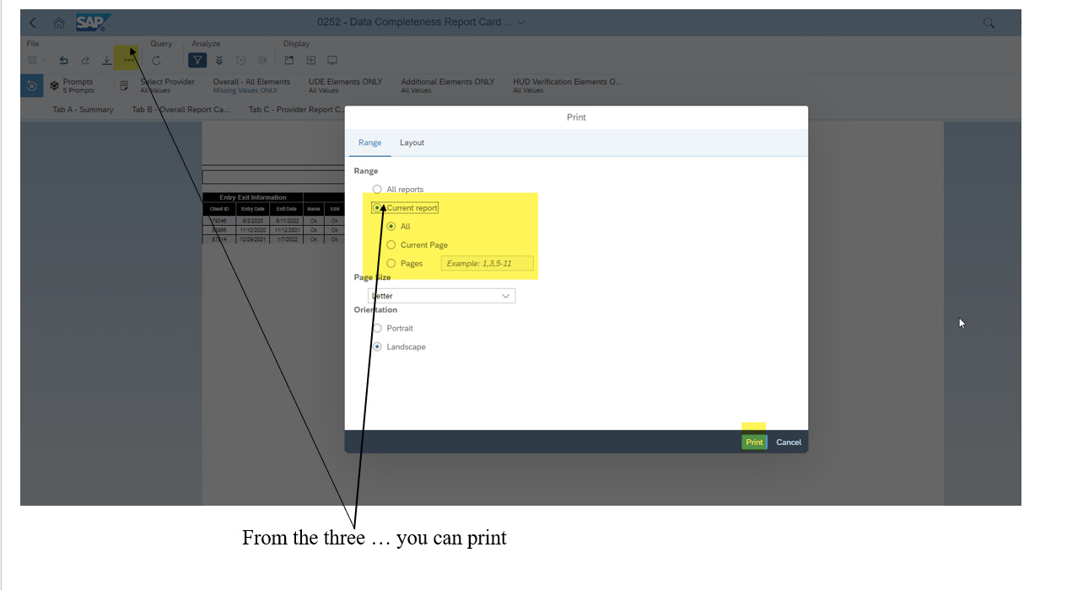

Slide 38
