Slide 1
2022 NOFO
System Performance Measures Debrief

Slide 2
What are the System Performance Measures (SPM)?
HUD’s way to measure how well a community’s homeless response system is functioning
Analyzed yearly when CoCs upload their Longitudinal Systems Analysis (LSA)
Implemented in 2017, and CoC’s earn points in the annual CoC Program Competition
Point totals are determined by the yearly NOFO and are earned by demonstrating successful program outcomes
There are 7 SPM (SPM #6 does not apply to our CoC)
Additional points are awarded within the System Performance section of the NOFO for results from the annual PIT count
Measures outcomes from CoC- and non CoC-funded projects (e.g., ESG funded shelters, other funding sources, Street Outreach, etc.)

Slide 3
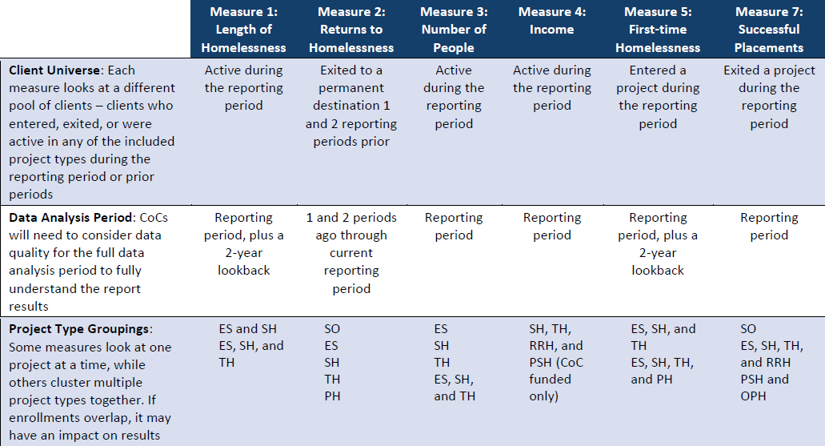

Slide 4
The 2021 NOFO indicated there would be an increased weight given to SPM in subsequent NOFOs:
SPM | Points Awarded 2021 | Points Awarded 2022
Reducing the Number of Homeless Individuals and Families | 1 | 10
Reduction in the Number of First Time Homeless | 3 | 3
Reducing Length of Time Homeless | 6 | 13
Increase the Rate Households Move to Permanent Housing | 5 | 13
Reducing Returns to Homelessness | 4 | 8
Increasing Income for Program Participants | 4 | 7
TOTAL: | 23 | 59

Slide 5
How were SPM outcomes measured in the 2022 NOFO?
Reducing the Number of Homeless Individuals and Families
Goal: Decrease of 5% in number of sheltered homeless between 2021 and 2022 PIT Count (2 of 10 pts)
CoC Outcome: 44% increase (488 persons to 706 persons)
Goal: Decrease of 5% of unsheltered homeless between 2021 and 2022 PIT Count (5 of 10 pts)
CoC Outcome: 27% increase (33 to 42)
Goal: Decrease of 5% of combined sheltered and unsheltered homeless between 2021 and 2022 PIT Count (3 of 10 pts)
CoC Outcome: 44% increase (521 to 748)

Slide 6
How were SPM outcomes measured in the 2022 NOFO?
Reduction in the Number of First Time Homeless
“First Time Homeless” is defined as individuals with no entry to ES, SH, TH, or any PH program within previous 24 months
Goal: Reduction in the number of first time homeless (1 of 3 pts)
CoC Outcome: Decrease of 701 persons (3184 to 2483)
The 2 remaining points were earned via narrative response

Slide 7
How were SPM outcomes measured in the 2022 NOFO?
Reducing the Length of Time Homeless
Goal: Reduce LOT homeless of persons in ES, SH, and TH by 5% between FY2020 and FY2021, OR demonstrate and average LOT homeless of 90 days or fewer (8 of 13 pts)
CoC Outcome: No change in LOT homeless; average LOT homeless was 62 days
The 5 remaining points were awarded via narrative response

Slide 8
How were SPM outcomes measured in the 2022 NOFO?
Successful Permanent Housing Placement or Retention
Goal: Between FY2020 and FY2021, increase by at least 2% the rates of exit from ES, SH, TH, RRH to Permanent Housing, OR demonstrate a rate of exit of 50% or higher (6 of 13 pts)
CoC Outcome: Decrease in exits to PH from 46% to 42% from FY2020 to FY 2021
Goal: Between FY2020 and FY2021, increase by at least 1% the rates of exit from PSH or other PH (excluding RRH), OR demonstrate the rate of retention or exits to PH was at least 96% (3 of 13 pts)
CoC Outcome: Increase of rate of exit/retention from 95% to 96%
The remaining 4 points were awarded via narrative response

Slide 9
How were SPM outcomes measured in the 2022 NOFO?
Returns to Homelessness
Between FY2020 and FY2021, demonstrate a reduction of at least 1% of the rate persons who exited SO, ES, TH, SH, or PH to a permanent housing destination experienced homelessness again within 6 months of exit, OR demonstrate a rate of return of 5% or less (3 of 8 pts)
CoC Outcome: No change between FY2020 and FY2021 (10% rate of return)
Between FY2020 and FY2021, demonstrate a reduction of at least 1% of the rate persons who exited SO, ES, TH, SH, or PH to a permanent housing destination experienced homelessness again within 12 months of exit, OR rate was 10% or less (3 of 8 pts)
CoC Outcome: Decrease from 8% to 7% of rate of returns after 12 months
The remaining 2 points awarded via narrative response

Slide 10
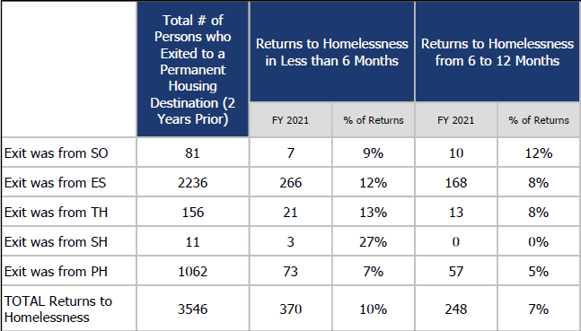
How were SPM outcomes measured in the 2022 NOFO?

Slide 11
How were SPM outcomes measured in the 2022 NOFO?
Jobs and Income Growth
This SPM has two distinct universes of clients measured:
CoC program system stayers
CoC program system leavers (this is the universe that was scored for the NOFO)

Slide 12
How were SPM outcomes measured in the 2022 NOFO?
Jobs and Income Growth
Goal: Between FY2020 and FY2021 demonstrate an increase in percentage of CoC Program Participants who had an increase in income from employment, OR that the rate of income from employment in the CoC was 20% or higher (2 of 7 pts)
CoC Outcome: Increase from 11% to 13%
Goal: Between FY2020 and FY2021 demonstrate an increase in percentage of CoC Program Participants who had increased non-employment cash income, OR that the rate of income from non-employment cash income was 50% or higher (2 of 7 pts)
CoC Outcome: Increase from 31% to 37%
Remaining 3 points earned via narrative response

Slide 13
Rapid Rehousing Beds
10 Points on 2022 NOFO
Demonstrate an increase of at least 20% in the number of Rapid Rehousing Beds in the CoC geographic area as reported in HDX, or
Clearly demonstrate the number of Rapid Rehousing Beds in the CoC’s geographic area sufficiently meets the need for this type of housing, which will be verified against information in the most recent PIT and HIC data reported in HDX

Slide 14
Rapid Rehousing Beds
Outcome:
2021: 598
2022: 536
It is likely we will not earn the 10 points here due to the decrease in RRH beds on the night of the PIT.
There is no narrative section to this question to allow us to write anything that demonstrates that the need for RRH beds are met
Based on current occupancy rates in RRH programs, the number is unlikely to increase for this year’s NOFO, which will be comparing 2022 and 2023

Slide 15
Non-Employment Income outcomes
Projects APR years
Overall CoC Average for this benchmark:
Participants who Gained or Increased Income from the Start to the Annual Assessment for Non-employment income: 31% (2021-2022)
2020-2021 35%
Participants who Gained or Increased Income from Start to Exit with Non-employment income: 41% (2021-2022)
2020-2021 26%
Overall PSH Average for this benchmark:
Participants who Gained or Increased Income from the Start to the Annual Assessment for Non-employment income: 39% (2021-2022)
2020-2021 40%
Participants who Gained or Increased Income from Start to Exit with Non-employment income: 48%(2021-2022)
2020-2021 25%

Slide 16
Non-Employment Income outcomes
Projects APR years
Continued
Overall RRH Average for this benchmark:
Participants who Gained or Increased Income from the Start to the Annual Assessment for Non-employment income: 14% (2021-2022)
2020-2021 33%
Participants who Gained or Increased Income from Start to Exit with Non-employment income: 30% (2021-2022)
2020-2021 33%
Overall TH Average for this benchmark:
Participants who Gained or Increased Income from the Start to the Annual Assessment for Non-employment income: 8% (2021-2022)
2020-2021 23%
Participants who Gained or Increased Income from Start to Exit with Non-employment income: 0% (2021-2022)
2020-2021 0%

Slide 17
Non-Employment Income outcomes
Participants who Gained or Increased Income from the Start to the Annual Assessment for Non-employment income:
Overall CoC Project decreased by 4% from 2020/21 to 2021/22
PSH Decrease by 1% from 2020/21 to 2021/22
RRH Decrease by 19% from 2020/21 to 2021/22
TH Decrease by 15% from 2020/21 to 2021/22
Participants who Gained or Increased Income from Start to Exit with Non-employment income:
Overall CoC Project increase by 15% from 2020/21 to 2021/22
PSH Project increase by 23% from 2020/21 to 2021/22
RRH Decrease by 3% from 2020/21 to 2021/22
TH stayed the same at 0% from 2020/21 to 2021/22

