Slide 1
FY2024 HUD CoC Funding NOFO Summary

Slide 2
Funding Available
Total Funding Available Nationally:
CoC Program Funding - $3,524,000,000
DV Bonus Project Funding - $52,000,000
YHDP – Non-competitive YHDP renewal and replacement grants (N/A)
Local Project Funding:
$14,984,653 – Annual Renewal Demand (ARD)
$1,798,158– CoC Bonus Projects (12% of ARD)
$1,927,404 – DV Bonus Funding
$106,774– Reallocated Funding
letsendhomelessness.org
Notes:
Tree
Shayna
Jenn
Suzanne

Slide 3
HUD Priorities
Ending Homelessness for all persons.
Use a Housing First approach
Reducing Unsheltered Homelessness
Improving System Performance
Partnering with Housing, Health, and Service Agencies
Building an Effective Workforce
Increasing Affordable Housing Supply
letsendhomelessness.org
Notes:
Tree
Shayna
Jenn
Suzanne

Slide 4
Major Changes
Tier 1 includes 90% of Annual Renewal Demand (ARD) = $13,486,188
Tier 2 is at 10% of Annual Renewal Demand (ARD) = $1,498,465
CoCs that create projects that coordinate with housing providers and healthcare organizations will receive up to 14 points as part of the Consolidated Application.
letsendhomelessness.org
Notes:
Tree
Shayna
Jenn
Suzanne

Slide 5
Major Changes
Two-year NOFO - Funding Years 2024 and 2025
Cost of Living Adjustments – HUD is authorized to make reasonable cost of living adjustments to renewal amounts to help afford increasing costs of operation due to inflation
CoC Maximum Award and FMR Adjustments – Rental Assistance, Leasing, and Operations costs will be adjusted prior to the award announcement. HUD will make adjustments for each fiscal year appropriation separately. FMR will be adjusted by applying the FMR in effect at the time of application submission to HUD.
letsendhomelessness.org
Notes:
Tree
Shayna
Jenn
Suzanne

Slide 6
CoC NOFO Scoring
Application Scoring – HUD will assess CoC Consolidated Applications on a 200-point scale
CoC Coordination and Engagement – 85 points
Project Capacity, Review, and Ranking – 28 points
Homeless Management Information System (HMIS) – 9 points
Point in Time Count – 5 points
System Performance – 60 points
Coordination with Housing and Healthcare – 14 points
CoC Merger Bonus Points – 25 points
letsendhomelessness.org
Notes:
Tree
Shayna
Jenn
Suzanne

Slide 7
Community Priorities
Largest Unmet Need Housing/Service Components
Permanent Supportive Housing
Emergency Shelter
Transitional Housing
Prevention/Diversion Services
Transitional Housing/Rapid Re-Housing
Rapid Re-Housing
Street Outreach
Other
letsendhomelessness.org
Notes:
Tree
Shayna
Jenn
Suzanne

Slide 8
Community Priorities
Prioritized Homeless Sub-Populations
Families
Chronically Homeless
Unsheltered Homeless
Transition Age Youth (18 -24 years old)
Fleeing Domestic Violence
Re-Entry
Veterans
Other
letsendhomelessness.org
Notes:
Tree
Shayna
Jenn
Suzanne

Slide 9
Community Priorities
Prioritized Special Needs
Mental Health
Chronic Health Conditions/Physical Disability
Substance Abuse
Developmental Disabilities
Employment Services
Aging (55+)
Other
letsendhomelessness.org
Notes:
Tree
Shayna
Jenn
Suzanne

Slide 10
Community Priorities
Barriers to Housing
Affordability
Availability
History of Prior Evictions/Poor Landlord References
Bad Credit
Units that meet HQS standards
Accessibility (Mobility)
History of Criminal Justice Involvement
Discrimination
Other
letsendhomelessness.org
Notes:
Tree
Shayna
Jenn
Suzanne

Slide 11
Community Priorities
Improving Housing Stability
Increase PSH/affordable housing resources
Increase support services
Increase cash assistance for housing-related costs, such as rental arrears, security deposits, etc.
letsendhomelessness.org
Notes:
Tree
Shayna
Jenn
Suzanne

Slide 12
FY2024 CoC Program Funding New Project Applicant Workshop

Slide 13
Introduction
Partners Ending Homelessness, the lead agency for the
Continuum of Care (CoC), representing the City of Rochester, County of Monroe, and Towns of Greece and Irondequoit (NY-500), will submit a CoC Program Consolidated Application for funding to the U.S. Department of Housing and Urban Development (HUD) in the upcoming FY 2024 Continuum of Care Homeless Assistance Program Competition. This presentation describes the New Project Application submission and review process.
letsendhomelessness.org
Notes:
Charles

Slide 14
Application Review
The Ranking and Review Committee will read and evaluate the new project applications. The process shall be transparent and impartial
The process includes an Appeal Process
New applications will be scored using the 2024 New Application Scoring Rubric
Project(s) approved for bonus and reallocated funds will be scored. The ranking and review committee will determine Tier 1 or Tier 2 placement.
letsendhomelessness.org

Slide 15
Eligible Applicants
Non-profits, states, local government,
and instrumentalities of local government
Individuals and for-profits are not permitted to apply for grants or be sub-recipients of grants.
letsendhomelessness.org

Slide 16
Eligible Projects Using Bonus or Reallocated Funds
Eligible Projects for Bonus Funding:
Housing Partnership PSH or RRH
Healthcare Partnership PSH or RRH
Permanent Supportive Housing (PSH)
Rapid Rehousing (RRH)
Joint Transitional Housing and Rapid Rehousing (TH-RRH)
Domestic Violence Bonus Project (DV-RRH and DV-TH/RRH)
PSH or RRH Expansion Grants
HMIS Expansion programs
Coordinated Entry Expansion programs
letsendhomelessness.org

Slide 17
Eligible Components: Permanent Supportive Housing
Provides long-term housing assistance to homeless individuals and families in which one adult or child has a documented long-term disability
PSH Programs must PRIORITIZE Chronically homeless individuals and families
letsendhomelessness.org

Slide 18
Eligible Components: Permanent Housing
b. Rapid Re-Housing (RRH)
Designed to help homeless individuals and families move as quickly as possible into permanent housing and achieve stability in that housing.
Provides short and/or medium-term assistance rental assistance and case management (up to 24 months)
The program participants KEEP the housing/unit when RRH assistance ends.
Client does not need to have a disability to enter project.
letsendhomelessness.org

Slide 19
Eligible Components: Eligible Components: Permanent Housing Transitional Housing (TH) to Rapid Rehousing (PH-RRH)
A Joint TH and PH-RRH Component project combines two existing program components–TH and PH-RRH–into a single project to serve individuals and families experiencing homelessness.
Can provide short- or medium-term tenant-based rental assistance for program participants in the rapid rehousing portion of the project. Supportive services must be provided for the entire project.
The program can serve participants for up to 24 months. A program participant may only need a temporary stay in the transitional housing unit or just rapid re-housing assistance. Still, the recipient or subrecipient must be able to make available the financial assistance and supportive services that traditionally comes with rapid re-housing assistance to that program participant if needed. Likewise, the rapid re-housing can be accessed without entering the TH program.
letsendhomelessness.org

Slide 20
Homeless Definitions
Category 1- Literally Homeless
An individual or family who lacks a fixed, regular, and adequate nighttime residence, meaning:
An individual or family with a primary nighttime residence that is a public or private place not designed for or ordinarily used as a regular sleeping accommodation for human beings;
An individual or family living in a supervised publicly or privately operated shelter designated to provide temporary living arrangements (including congregate shelters, transitional housing, and hotels and motels paid for by charitable organizations or by federal, state and local government programs); or
Is exiting an institution where (s)he has resided for 90 days or less and who resided in an emergency shelter or place not meant for human habitation immediately before entering that institution
letsendhomelessness.org

Slide 21
Homeless Definitions
Category 2 – Imminent Risk of Homelessness
Residence will be lost within 14 days of the date of application for homeless assistance
No subsequent residence has been identified
The individual or family lacks the resources or support networks needed to obtain permanent housing
letsendhomelessness.org

Slide 22
Homeless Definitions
Category 4 - Fleeing Domestic Violence
Individuals and families who are fleeing, or are attempting to flee, domestic violence, dating violence, sexual assault, stalking, or other dangerous or life-threatening conditions related to violence, who:
Have no identified subsequent residence; AND
Lack the resources and support networks needed to obtain other permanent housing.
letsendhomelessness.org

Slide 23
Housing Component Eligibility
PSH – Category 1, 4
TH/RRH – Category 1, 2 and 4
RRH – Category 1, 4
letsendhomelessness.org

Slide 24
Housing First
Housing First is a best practice model to quickly and successfully connect individuals and families experiencing homelessness to permanent housing without preconditions and barriers to entry, such as sobriety, treatment or service participation requirements. Supportive services are offered to maximize housing stability and prevent returns to homelessness as opposed to addressing predetermined treatment goals prior to permanent housing entry.
letsendhomelessness.org

Slide 25
Housing First
Housing First emerged as an alternative to the linear approach in which people experiencing homelessness were required to first participate in and graduate from short-term residential and treatment programs before obtaining permanent housing. In the linear approach, permanent housing was offered only after a person experiencing homelessness could demonstrate that they were “ready” for housing.
letsendhomelessness.org

Slide 26
Housing First
Few to no programmatic prerequisites to permanent housing entry
Low barrier admission policies
Rapid and streamlined entry into housing
Supportive services are voluntary but can and should be used to persistently engage tenants to ensure housing stability
letsendhomelessness.org

Slide 27
Housing First
Tenants have full rights, responsibilities, and legal protections
Practices and policies to prevent lease violations and evictions must be in place
Policies and procedures are in place to try and prevent eviction or multiple moves due to lease violations, but participants must abide with standard tenant requirements
letsendhomelessness.org

Slide 28
Rent
It is the expectation that PH programs engage with their participants to achieve housing stability which includes paying a portion of the rent
Rent will be the highest of:
30 percent of the family’s monthly adjusted income;
10 percent of the family’s monthly gross income; or
The portion of the family’s welfare assistance, if any, that is designated for paying rent
Income must be calculated according to 24 CFR 5.609 and 24 CFR 5.611(a)
letsendhomelessness.org

Slide 29
Chronically Homeless vs DedicatedPLUS PSH
All new PSH projects must either be (1) 100 percent dedicated to chronic homelessness or (2) DedicatedPLUS.
Chronically Homeless
Beds dedicated to chronically homeless individuals and families are those explicitly dedicated to their use within a CoC.
Another chronically homeless participant must fill the bed unless no chronically homeless persons are located within the CoC's geographic area. This concept only applies to permanent supportive housing (PSH) projects.
If a project comprises 100 percent dedicated beds, it is called for chronically homeless individuals and families.
letsendhomelessness.org

Slide 30
Chronically Homeless vs DedicatedPLUS PSH
Dedicated PLUS
The DedicatedPLUS concept provides more flexibility to communities, particularly for those already dedicated 100 percent of the PSH resources to chronic homelessness, to expand their eligibility to serve persons with long histories of homelessness and severe service needs who would not meet the definition of chronic homelessness at project entry.
https://www.hudexchange.info/faqs/reporting-systems/e-snaps-homeless-assistance-application-and-grants-management-system/nofasnotices/fy-2017-nofa/can-you-explain-the-difference-between-beds-dedicated-to-chronically/
letsendhomelessness.org

Slide 31
DedicatedPLUS PSH
A DedicatedPLUS project is a permanent supportive housing (PH-PSH) project where the entire project will serve individuals and families meeting the following criteria at project entry.
Experiencing chronic homelessness as defined in 24 CFR 578.3;
Residing in a TH project that will be eliminated and meets the definition of CH in effect at the time of move-in to TH
Residing in a place not meant for human habitation, emergency shelter, or safe haven; but the individuals or families experiencing chronic homelessness as defined at 24 CFR 578.3 had been admitted and enrolled in a permanent housing project within the last year and were unable to maintain a housing placement;
Residing in transitional housing funded by a Joint transitional housing (TH) and rapid re-housing (PH-RRH)
Residing and has resided in a place not meant for human habitation, a safe haven, or emergency shelter for at least 12 months in the last three years but has not done so on four separate occasions; or
letsendhomelessness.org

Slide 32
DedicatedPLUS PSH
DedicatedPLUS Continued
Receiving assistance through a Department of Veterans Affairs (VA)-funded homeless
assistance program and met one of the above criteria at initial intake to the VA’s
homeless assistance system.
A renewal project where 100 percent of the beds were dedicated to individuals and
families experiencing chronic homelessness, as described in section I.B.2.b.(2), under the
grant that is being renewed may either be reallocated as a DedicatedPLUS project or may
continue as a renewal dedicating 100 percent of its beds to individuals and families
experiencing chronic homelessness. If the project is reallocated as a DedicatedPLUS
project, the project must adhere to all fair housing requirements at 24 CFR 578.93.
letsendhomelessness.org

Slide 33
New Project Funding
Reallocation funding is available for FY2024 in the amount of $106,774
CoC Bonus funding available is $1,798,158, calculated at 12% of ARD
DV Bonus funding available is $1,927,404
Project(s) approved for bonus funds will be scored. The ranking and review committee will determine whether they are placed in Tier 1 or Tier
letsendhomelessness.org

Slide 34
Reallocation Funding
The Reallocated funding is $106,774:
PSH project
Supportive services dollars available
10% admin available
9 Households (9 units)
Veterans-specific units
*Reallocated and Bonus funds can be used to create a new PSH project.
letsendhomelessness.org

Slide 35
Reallocation Funding
The Project awarded the Reallocated funding will be expected to do the following:
Work with the previous organization to transition the current clients to the new project before June 2025.
Case manage existing clients in the project
Keep utilization rate at or above 100% of occupancy (9 units)
Timely record-keeping in HMIS
Case note documentation in HMIS
letsendhomelessness.org

Slide 36
Reallocation Funding
The Project awarded the Reallocated funding will be expected to do the following (Continued):
Obtain or achieve the following performance outcomes.
92% of clients retain or exit to permanent housing
20% of clients have employment
40% of clients have non-employment income
85% of clients have non-cash benefits
90% of clients have health insurance
letsendhomelessness.org

Slide 37
Healthcare Partnerships
5 points will be available for projects that partner with a health care resource to create new permanent housing units, PSH or RRH
Direct contributions from public or private health insurers or health care services provided by a public or private health care organization
Projects must comply with the HUD program and fair housing requirements
letsendhomelessness.org

Slide 38
Healthcare Partnerships
Requires written formal agreements
In-kind services must be valued at local rates consistent with payments made for those services not supported by grant funds
The value of the assistance provided must be equivalent to at least 25% of the funding requested to earn full points
letsendhomelessness.org

Slide 39
Housing Partnerships
5 points will be available for projects that partner with a housing provider to create new permanent housing units, PSH or RRH
Projects must utilize housing subsidies or subsidized housing units that are not funded with CoC or ESG funding
Focus is on partnering with PHAs. Formal written commitments must be provided
The value of the housing assistance provided must be equivalent to at least 25% of the funding requested to earn full points
letsendhomelessness.org

Slide 40
DV Bonus
Eligible activities
DV-RRH or DV TH-RRH
Comparable Database
100% of project participants must be fleeing DV
*5-point bonus for new projects for the local CoC application that are DV-RRH
letsendhomelessness.org

Slide 41
Grant Term
Grant terms are one year
New projects can request an 18-month grant term for the first year of operation. This is to allow for start up, new hiring, etc.
Project will receive one year of funding that must be spread over the 18-month period
If projects choose the 18-month grant term they will be treated as a renewal project in the following fiscal year.
letsendhomelessness.org

Slide 42
Expansion Project Applications
An expansion grant must increase units, services, or persons served in an existing grant. Must be for activities and funding parameters allowed under reallocation, CoC Bonus or DV bonus projects.
Must submit a renewal and an expansion grant application.
If both renewal and expansion grant is awarded, one grant agreement will be executed. If renewal not awarded, expansion is not awarded. If renewal awarded, but not the expansion, the renewal grant continues as it is currently operated.
letsendhomelessness.org

Slide 43
Consolidation Grant Applications
Organization may consolidate 2-10 projects of the same component type
Must submit renewal applications and a consolidated project application into Esnaps.
letsendhomelessness.org

Slide 44
Transition Grant Applications
A grant to fund a new project to transition an eligible renewal project being eliminated through reallocation from one program component to another new component over a one-year period.
No more than 50% of the grant can be used for eligible activities of the original grant. All remaining funds must be used under the new component of the project.
Eligible for renewal in future years for only the new component activities
Must get approval from the CoC.
letsendhomelessness.org

Slide 45
Application Submission Timeline
New Project Applications: To be reviewed and considered for funding, Completed Applications, including all required documentation, must be submitted electronically by Noon on September 16th.
All application components must be transmitted at the same time via email only to Charles Bollinger III at cbollinger@letsendhomelessness.org.
Questions about the local Application process should be directed by email only to Charles Bollinger III at cbollinger@letsendhomelessness.org.
letsendhomelessness.org

Slide 46
Application Materials
Can be found on the PEH website www.letsendhomelessness.org
All materials must be downloaded directly from the website
The CoC will not email out materials this year
letsendhomelessness.org

Slide 47
New Project Application
https://letsendhomelessness.org/about/funding/
letsendhomelessness.org

Slide 48
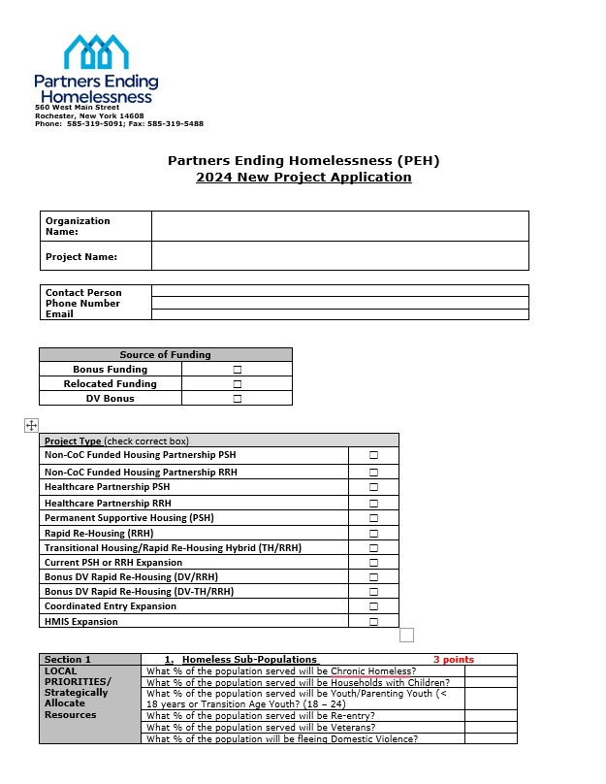
New Project Application
letsendhomelessness.org

Slide 49
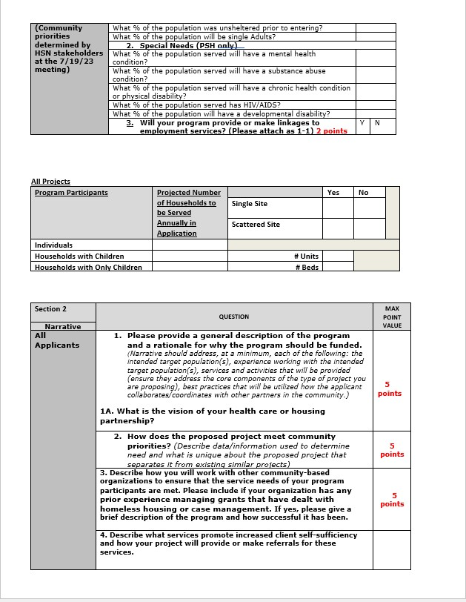
New Project Application
letsendhomelessness.org

Slide 50
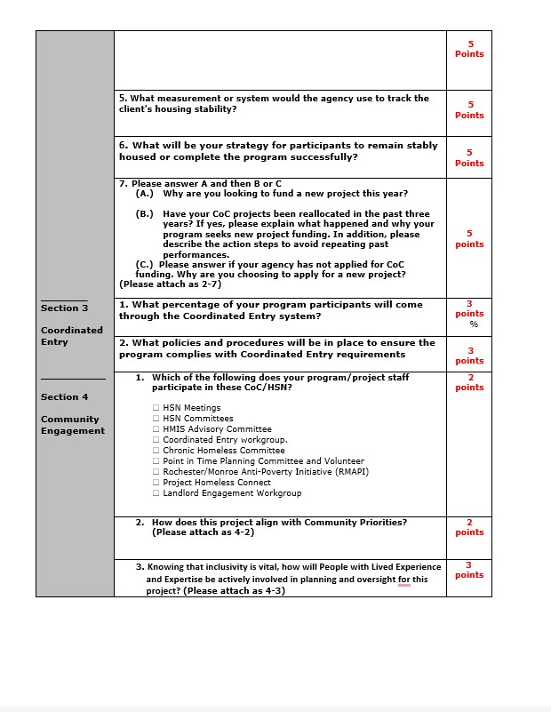
New Project Application
letsendhomelessness.org

Slide 51
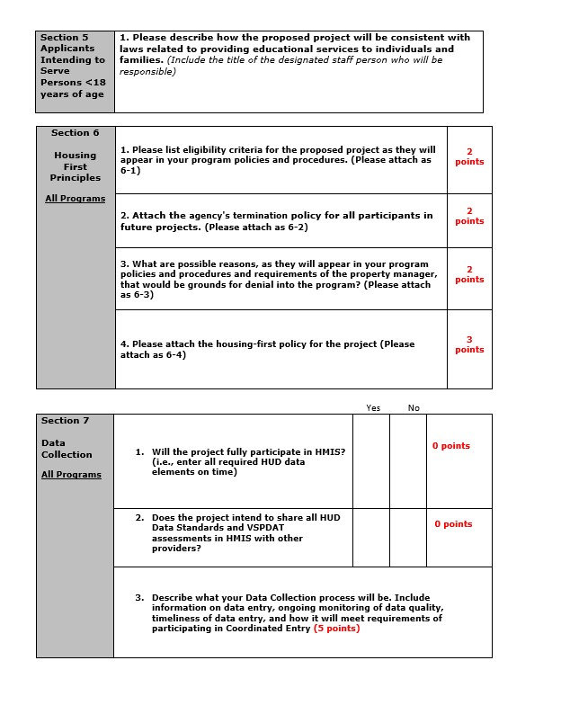
New Project Application
letsendhomelessness.org

Slide 52
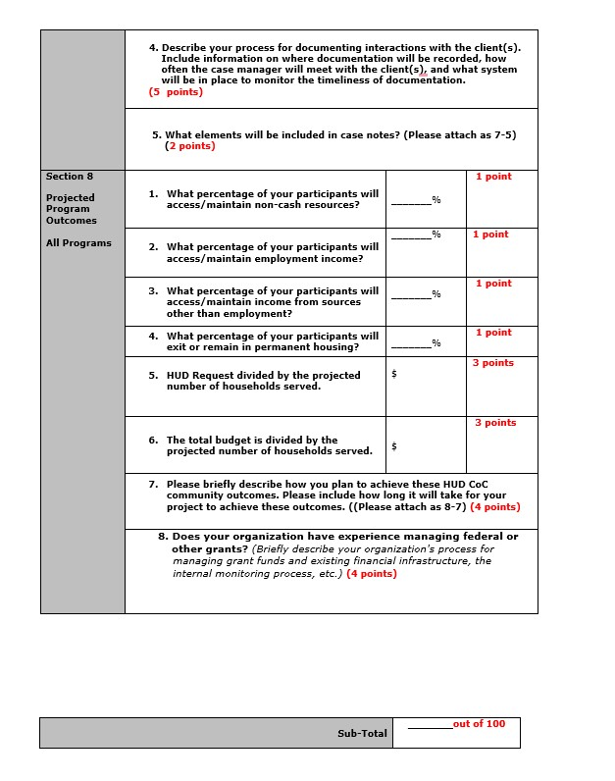
New Project Application
letsendhomelessness.org

Slide 53
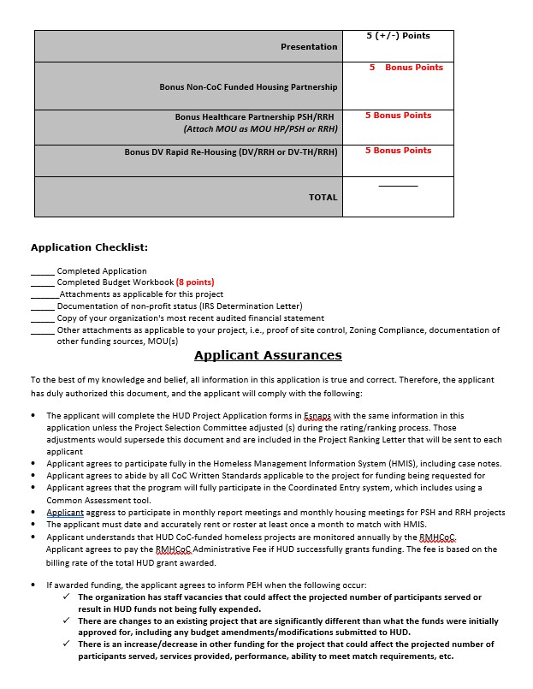
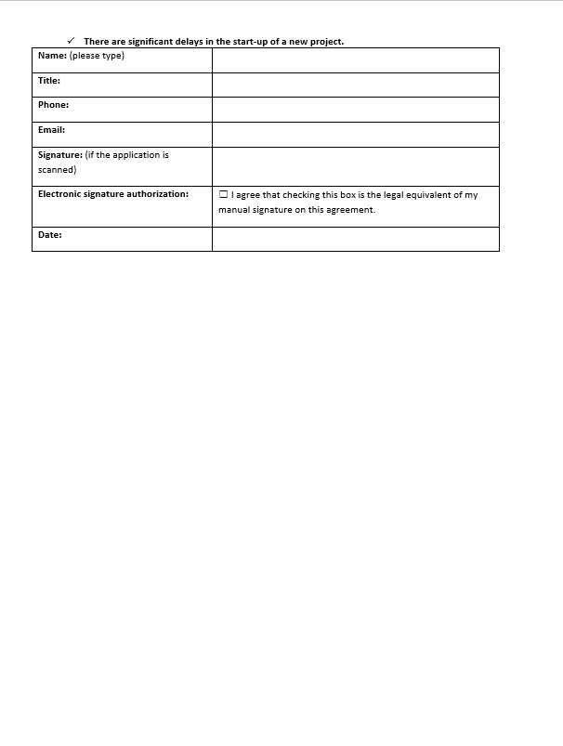
New Project Application
letsendhomelessness.org

Slide 54
Budget
All projects must complete Budget Workbook
Complete the worksheets that are appropriate for your project. Choose N/A box on top of each worksheet that you are not using
Green cells are only places where numbers should be entered
HMIS worksheet is only for dedicated HMIS project
Complete Total Budget Worksheet last – Fill in Project Administration up to 10% only. All other lines will be auto-filled as you complete the other worksheets
New Projects MUST use current FMR rents only.
Please attach documentation of match and include detail on description of the contribution
Budget Points=8
letsendhomelessness.org

Slide 55
Match
Minimum Match requirement is 25%. Applications cannot be reviewed if there is insufficient match.
Match may be cash or in-kind.
The cash match must be cash that comes through your organization’s books and is used for eligible program expenses for the CoC-funded project.
In-kind matches are materials or labor donated to the project. You must include the cash value for the service/goods/labor and how you arrived at the amount.
In-kind match must be documented with an MOU and not a letter.
Funds requested for leasing do not require a 25% match.
letsendhomelessness.org

Slide 56
New Project Attachments
Narrative attachments for the New Project Application should be included in one document and labeled as “Application Attachments for ______________“
The budget workbook is a separate attachment and named “Budget for ___________________”
letsendhomelessness.org

Slide 57
New Project Presentations
Presentations will be scheduled for September 25 or 26.
These presentations will be in person at CCSI.
A presentation to the ranking and review committee will be required for all new projects. This presentation helps the reviewers better understand the new project and their plan for achieving community and HUD goals in the upcoming year.
Reviewers can award plus or negative 5 points based on the presentation. If you want to present materials to the committee, please email them to cbollinger@letsendhomelessness.org no later than Noon on September 20.
The first New Project application submitted can choose their presentation time slot first based on the schedule that is set up
letsendhomelessness.org

Slide 58
HUD References
The 2024 CoC Program Notice of Funding Opportunity (NOFO) New Applicants must also comply with the rules, regulations, and guidance in 2024 HUD NOFO.
https://www.grants.gov/web/grants/view-opportunity.html?oppId=342855
CoC Program Interim Rule (24 CFR part 578) https://www.hudexchange.info/resources/documents/CoCProgramInterimRule_FormattedVersion.pdf
Housing First Information
https://www.hudexchange.info/resources/documents/Housing-First-Permanent-SupportiveHousing-Brief.pdf
Rapid Re-Housing Information
https://www.hudexchange.info/resources/documents/Rapid-Re-Housing-Brief.pdf https://www.hudexchange.info/resource/2889/rapid-rehousing-esg-vs-coc/
letsendhomelessness.org

Slide 59
Timeline of Important Dates
August 20th: Local New Project Application Materials Available
August 29th: Local New Project Application Workshop via Zoom at 2 pm
September 3rd Email your intent to apply to cbollinger@letsendhomelessness.com
September 16th: New Project Applications Due by 12 pm (Noon)
September 25th or 26th : New Project Presentations
October 8th: Applicants Notified of Final Project Rankings and posted to the PEH website
TBA: Esnaps Training via Zoom
letsendhomelessness.org

Slide 60
CoC Builds
CoC Builds is a new HUD funding opportunity with the goal of increasing the supply of permanent supportive housing
Provides capital funding – acquisition, rehabilitation/renovation and construction resources
20% of request can be for services, operating and administrative costs
Applications are submitted through grants.gov
Only one application per CoC can be submitted
Applications are due by 11/21/2024
letsendhomelessness.org

Slide 61
Questions
letsendhomelessness.org

