Slide 1




Pet Program
Kate Rachiele she/her/hers
Pet Program & Operations Coordinator

Slide 2

Overview
Willow Pet Program Services
Shelter facility information
Community Partners
Pet Program Policies
Pet Program Resources
2

Slide 3
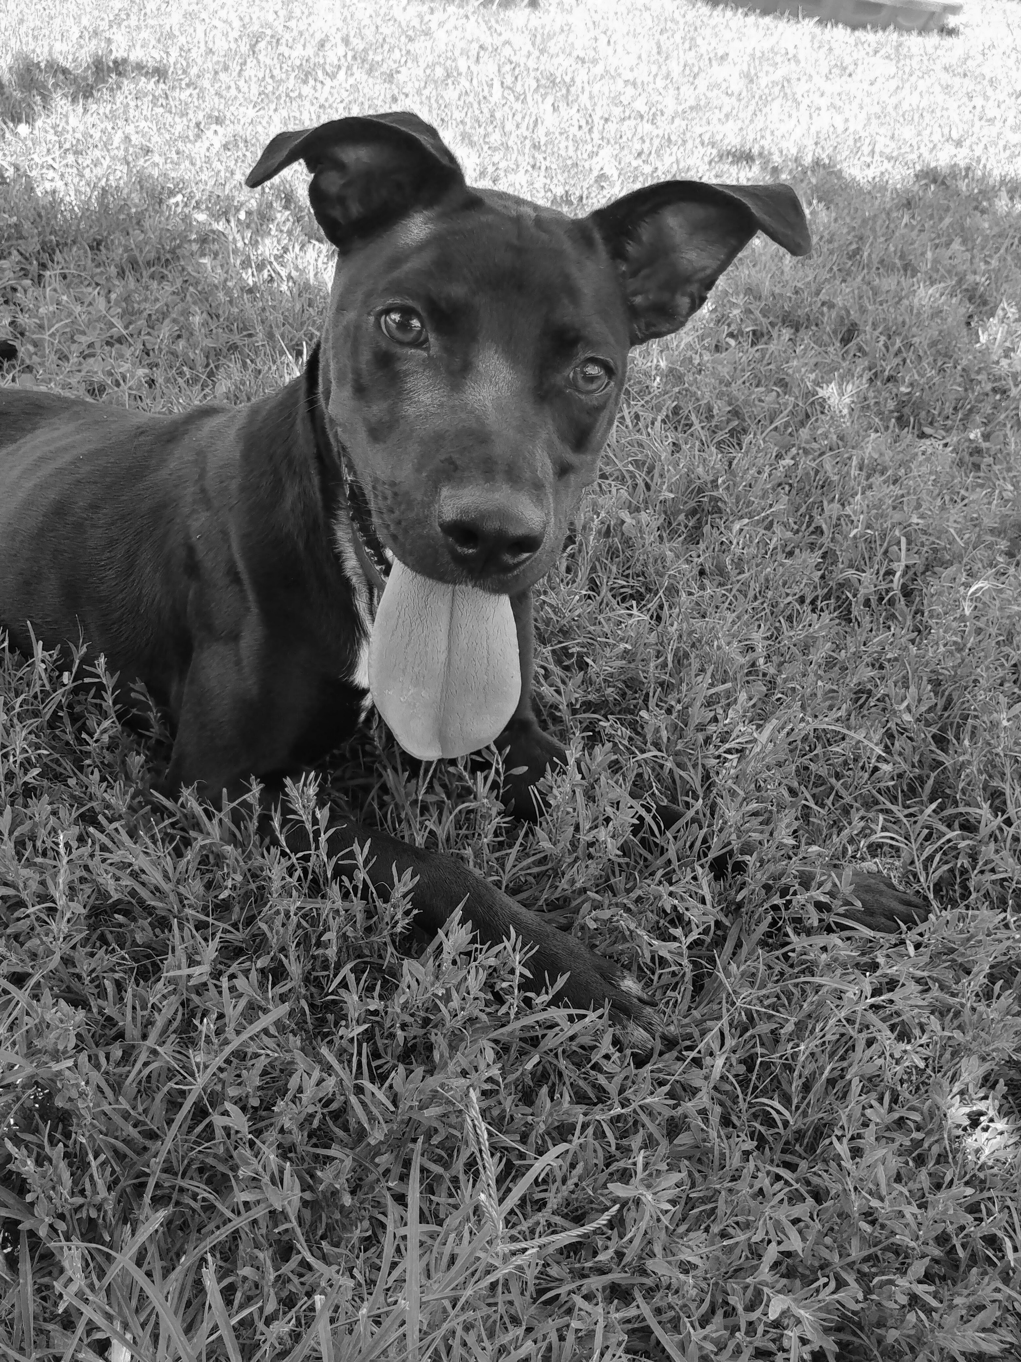

Program Services

Slide 4
On-site Pet Shelter
Placement with
Community Partner
Pet Program
Veterinary Financial Assistance
Safety Planning
Access to Resources

Slide 5
Shelter Capacity
2 dog kennels that can house 2-4 dogs
A cat room that can hold up to 4 cats from the same household, or can be utilized to hold 1-2 dogs from the same household or other species of pet if not otherwise occupied
Other species may be housed in the visiting room or the pet shelter office on a case-by-case basis, dependent upon the current population and the animals’ individual needs
Service animals are permitted in shelter rooms and all common areas

Slide 6
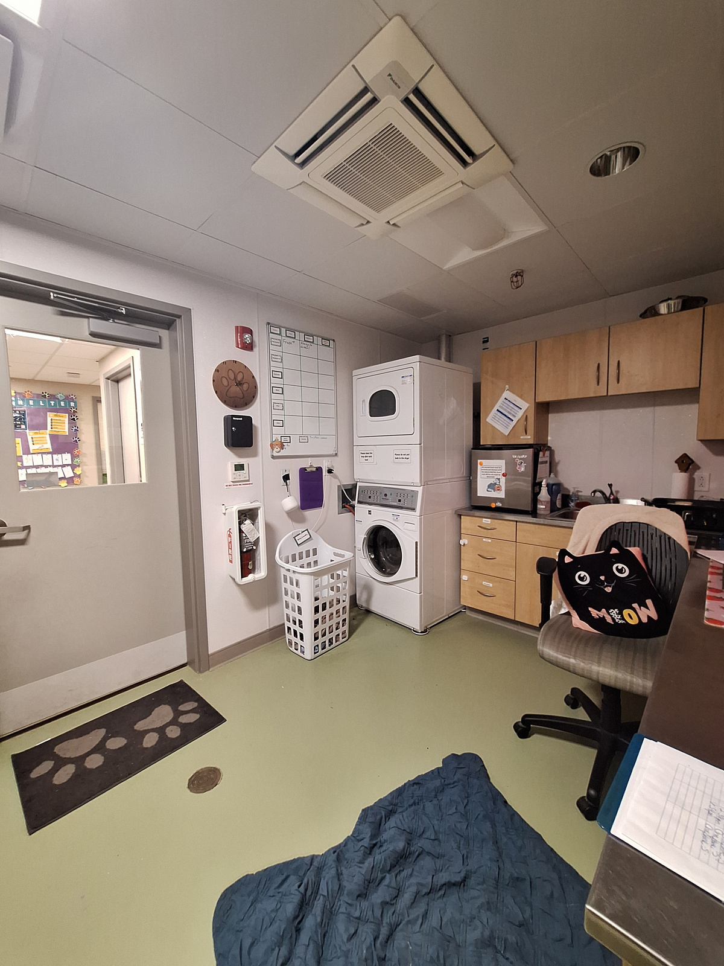
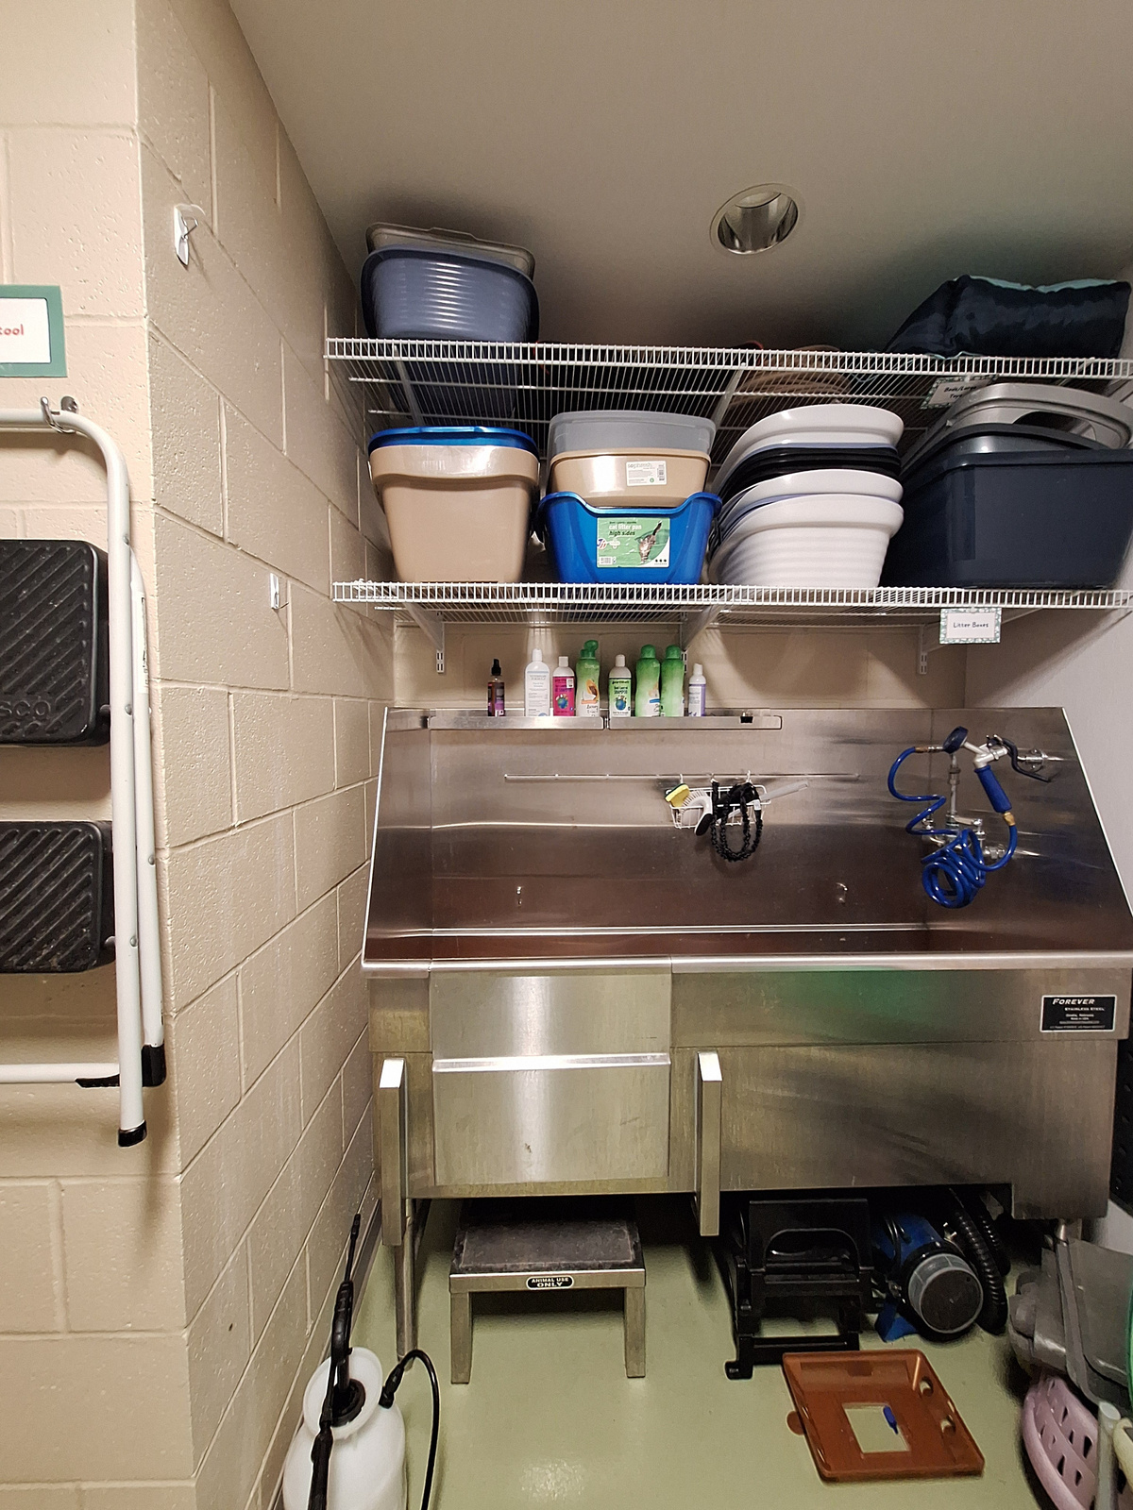
The Pet Shelter Office

Slide 7
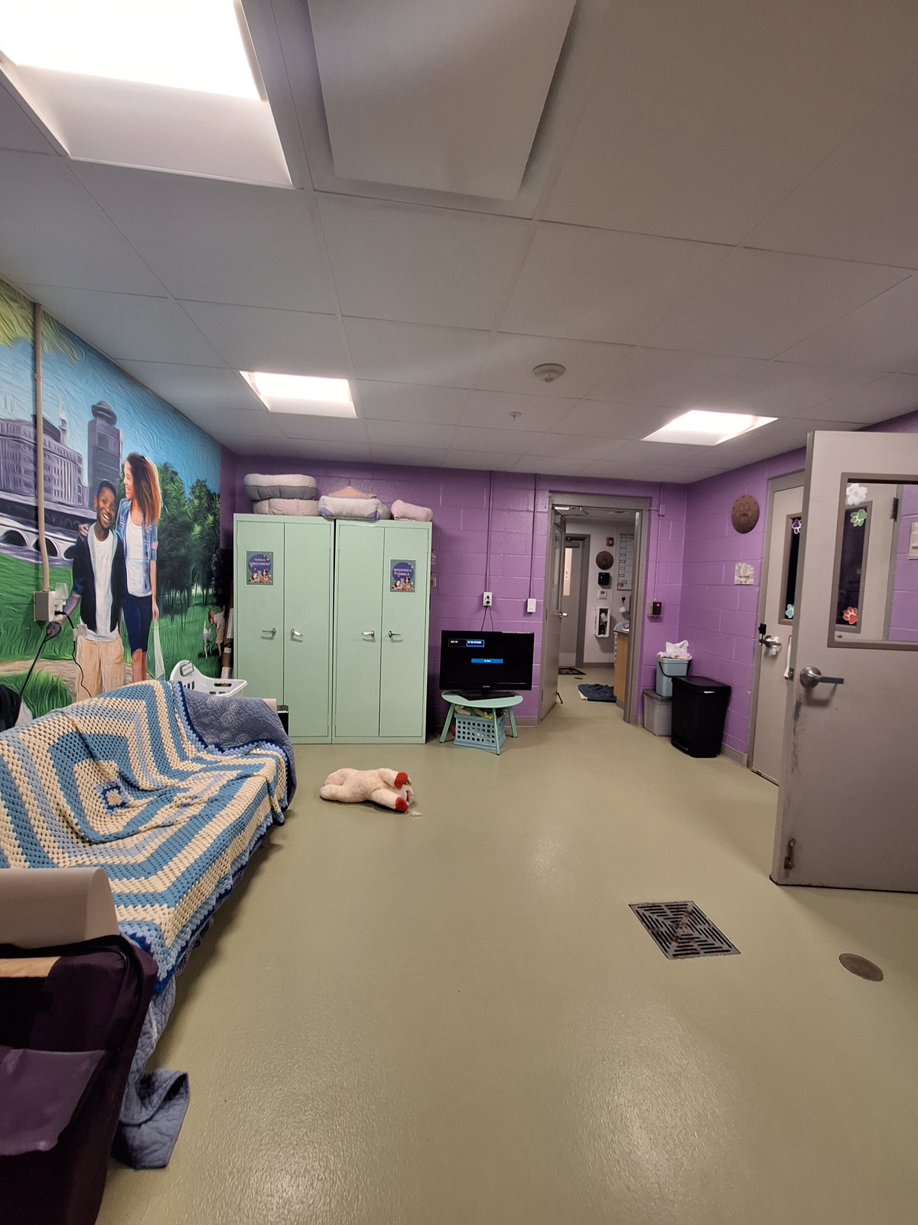
Visiting Room

Slide 8
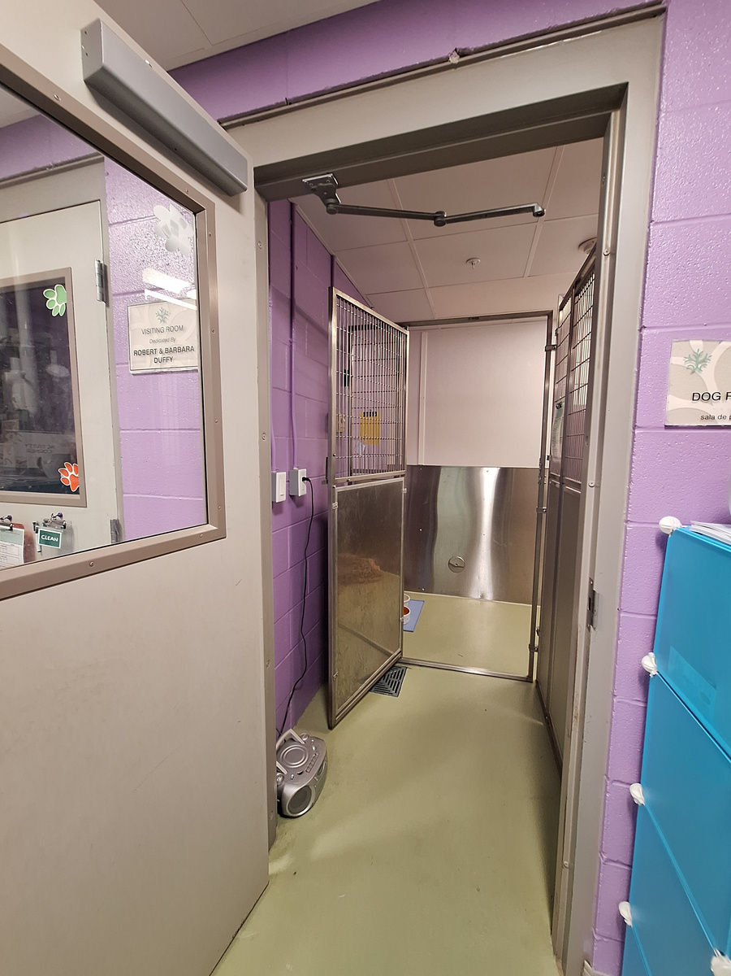
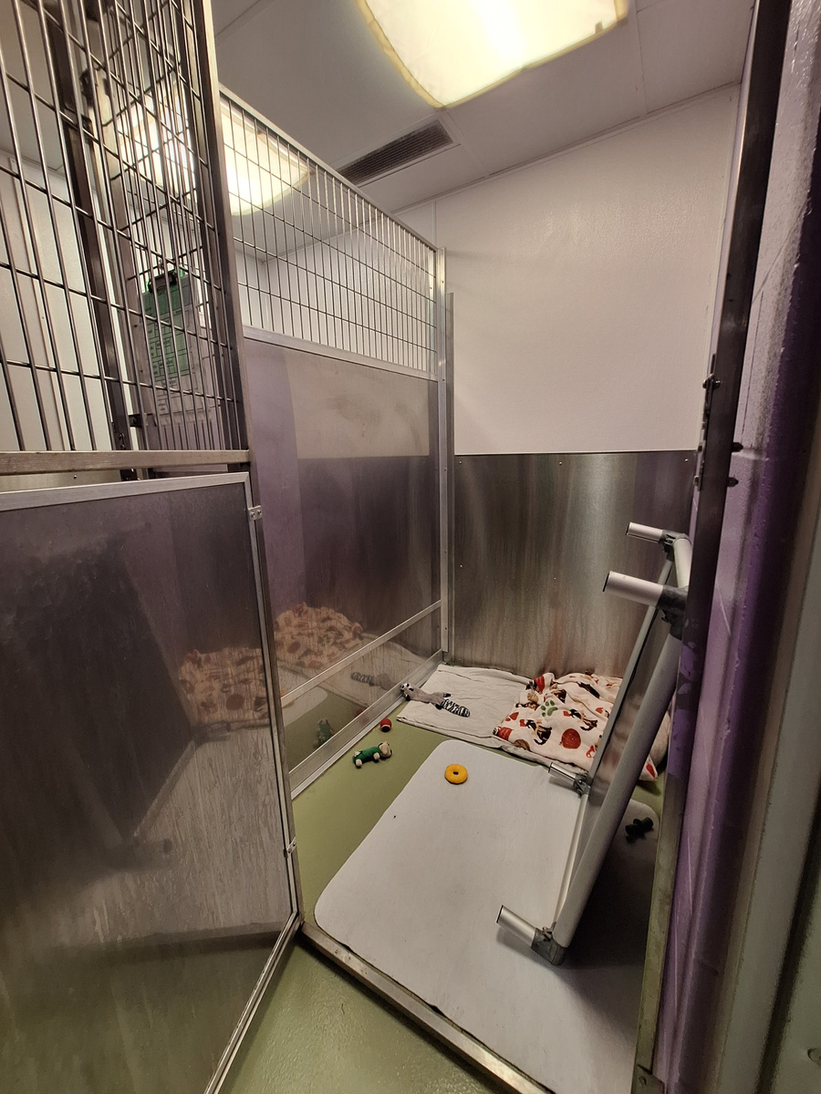
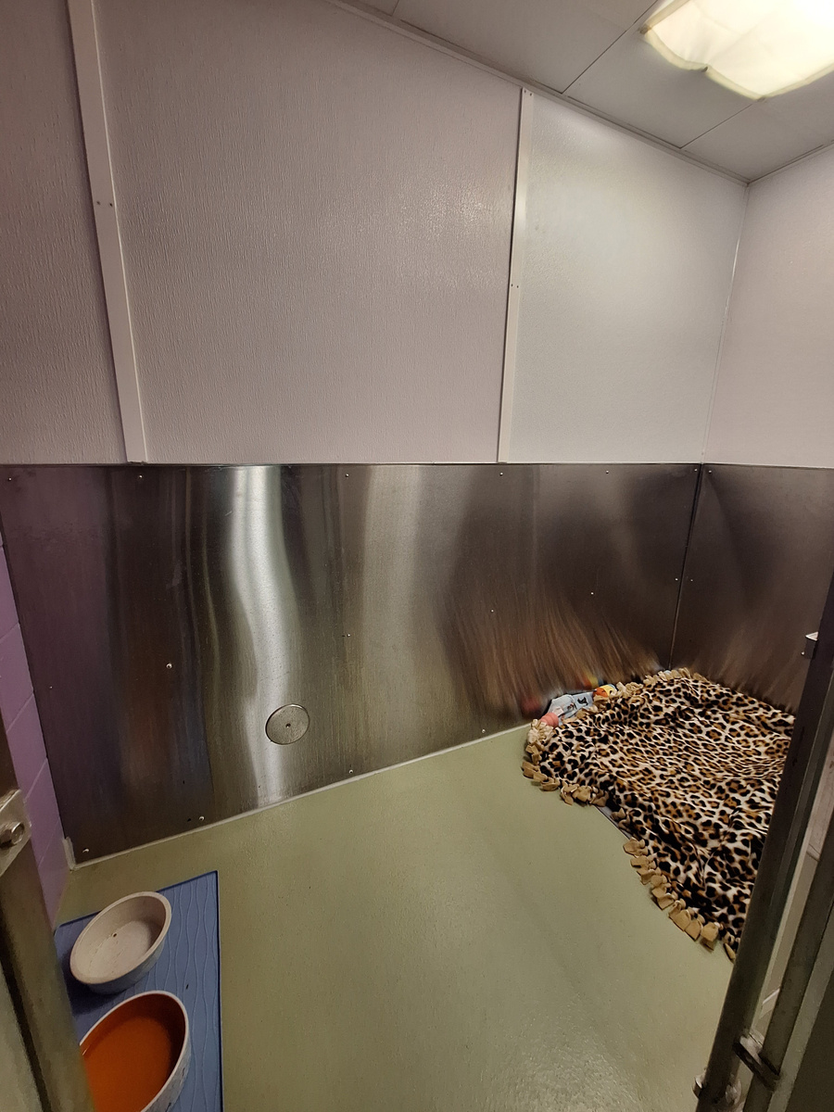
Dog Kennels

Slide 9
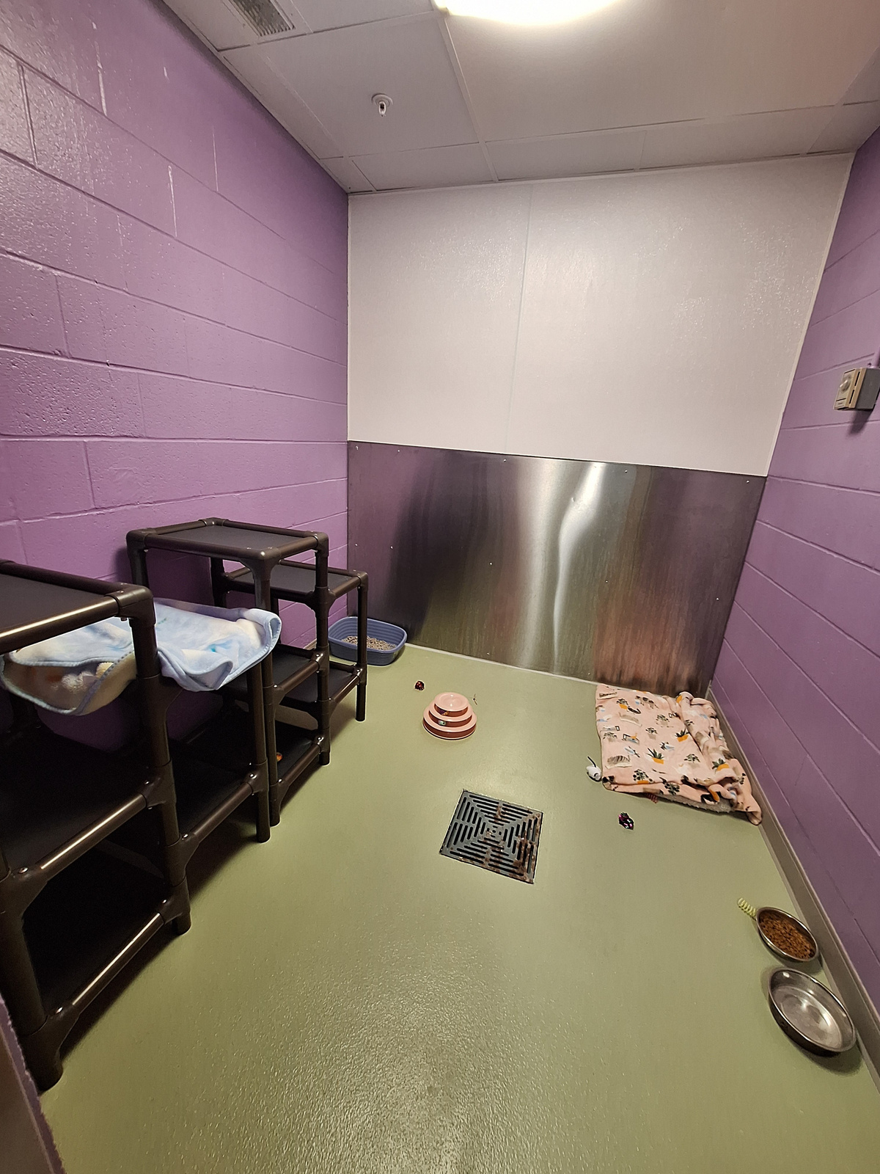
Cat Room

Slide 10



What Animals Can We Accept?
Dogs
Cats
Hamsters
Mice
Rats
Gerbils
Chinchillas
Guinea pigs
Rabbits
Ferrets
Small birds such as finches and cockatoos
Horses
Large farm animals
Wildlife
Reptiles or any animal that requires a heat lamp
Large birds such as parrots
Small “exotics” such as sugar gliders or hedgehogs
Insects and arachnids
Fish
Small farm animals

Slide 11
Intake Considerations & When We Seek Alternate Placement
Capacity: The emergency shelter and pet shelter capacity operate in tandem. Both facilities must have space for an intake. For pets to stay on-site, their guardian must also stay at the shelter.
Medical or behavior concerns: the safety and well-being of the pets and people are the highest priority. Survivors are NOT immediately denied placement for their pets based on medical needs, bite history, or other behavior concerns. Each case is determined individually.
If staff determine placement cannot be offered to an individual, we will create a safety plan with the client. This may involve the pet staying with another family member or friend, being placed in Lollypop Farm’s Mary Ellen Program, or in the future, being placed with a Besty BnB caregiver.

Slide 12
Community Partners
Alternate Placement
Lollypop Farm’s Mary Ellen Program
Besty BnB Caregiver
Veterinary Care
Doorbell Vet
Rochester Community Animal Clinic
General Care
Paws and Claws Grooming
Young Lion Training
** Willow only has an MOU with Lollypop Farm and RCAC

Slide 13
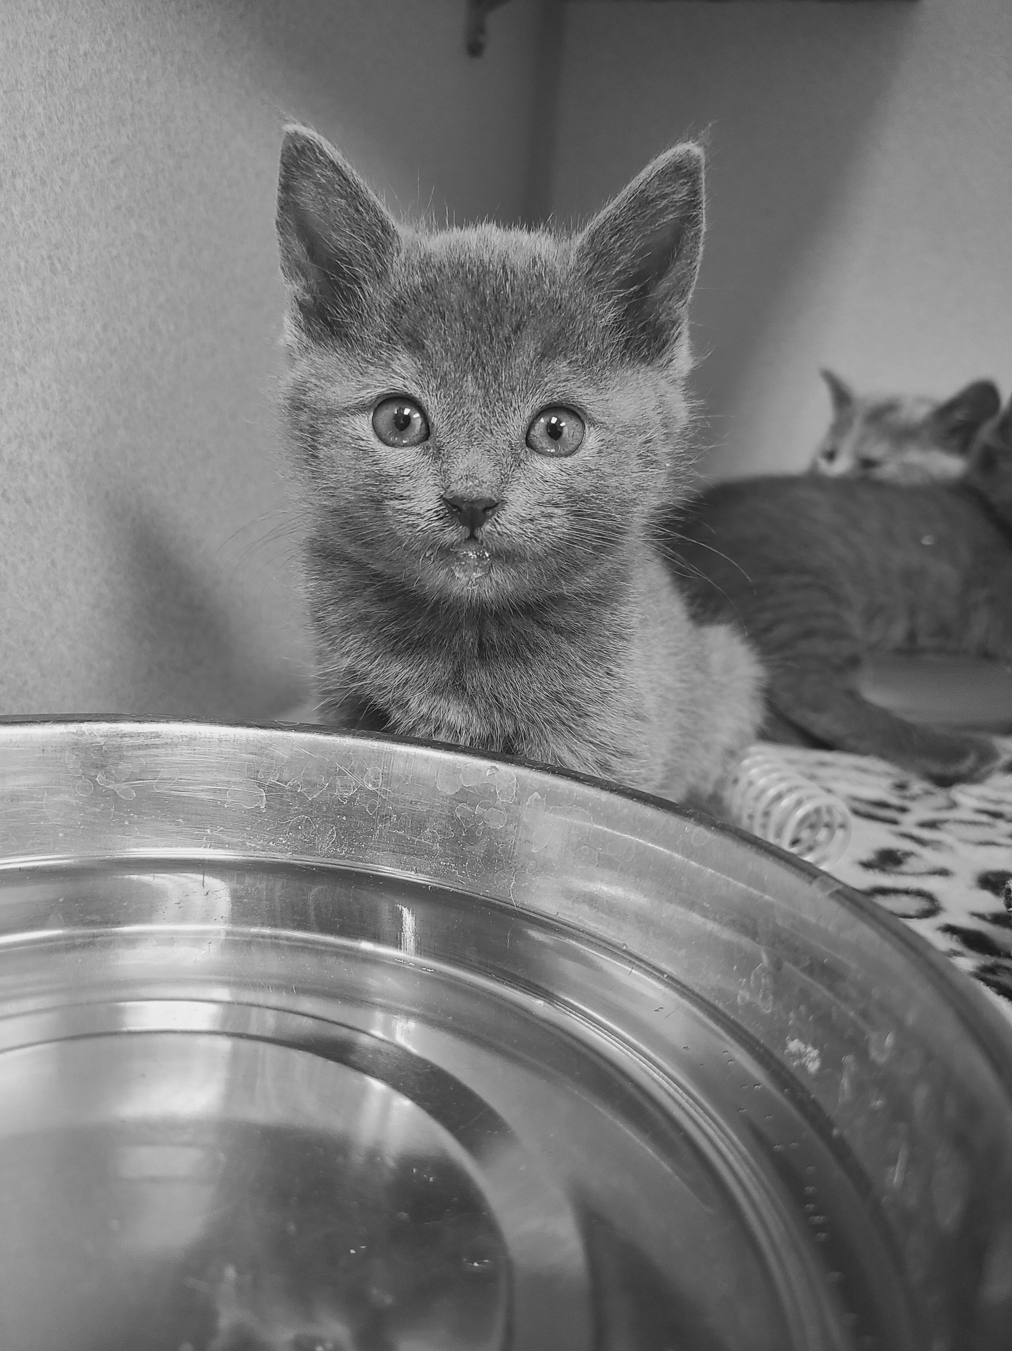

Pet Program Policies

Slide 14





Safety
Trust
Trauma-Informed Care
All program policies are shaped by trauma-informed care.
This means that while there are rules in place for everyone’s safety and well-being, establishing trust and empowering clients to make choices for their pets is a high priority.
What does this look like?
Choice
Collaboration
Empowerment

Slide 15
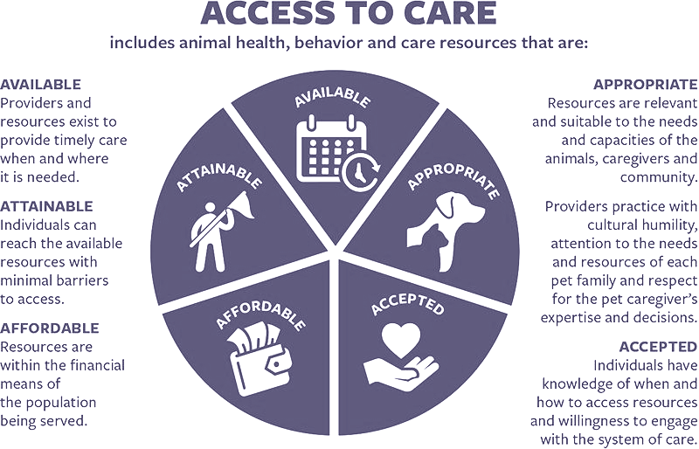

Slide 16
Survivors dictate the care of their pet(s). They are asked if they are comfortable with staff or volunteers handling them, feeding them, etc.
Survivors make the medical decisions for their pet(s), aside from required vaccinations.
Education is offered, not pushed.
The goal is to create a trusting, non-judgmental environment where Survivors feel comfortable asking for help, and where they can feel empowered as a caregiver for their pet(s).

Slide 17
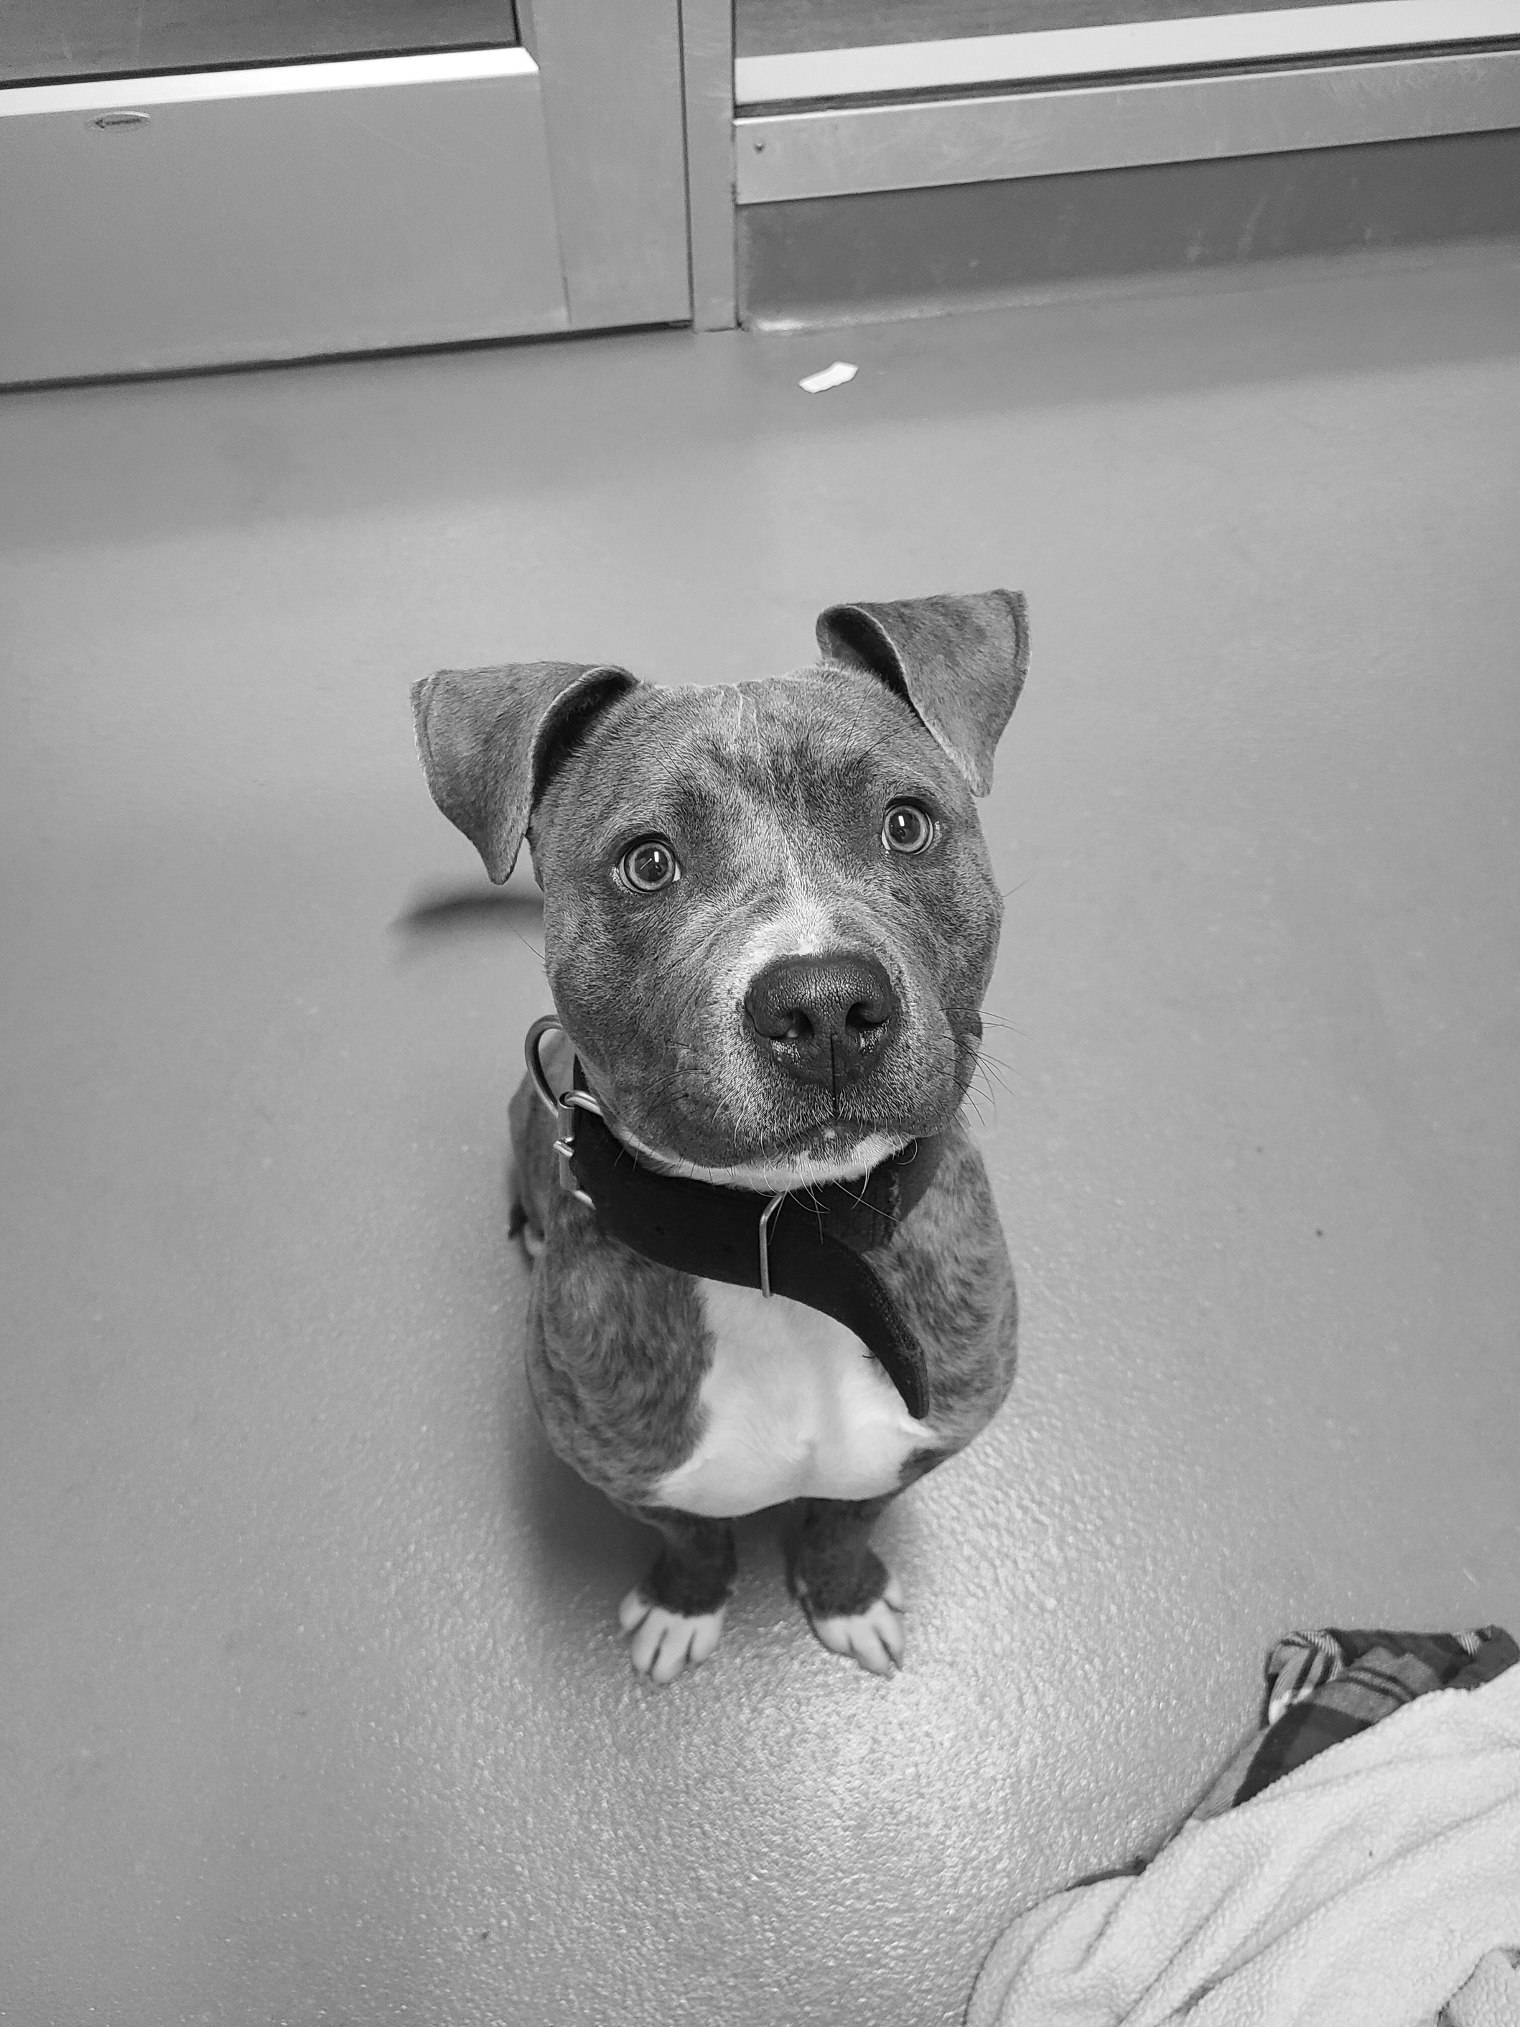
Pet Program Resources

Slide 18
Grants
Red Rover Homeless Shelter Safe Housing Grant
Rescue Rebuild Homeless Housing Renovation
Banfield Community Cares
Greater Good Charities

Slide 19
Educational Resources
Keeping People and Pets Together Toolkit
My Dog is My Home
Co-Sheltering Collaborative
Safe Havens for Pets
Safe-T for Pets
HASS KFT Housing Toolkit

Slide 20

Contact Information:
Kate Rachiele
KateR@WillowCenterNY.org
Work phone: (585) 417-7119
Cell: (901) 486-1007

